Slide 1
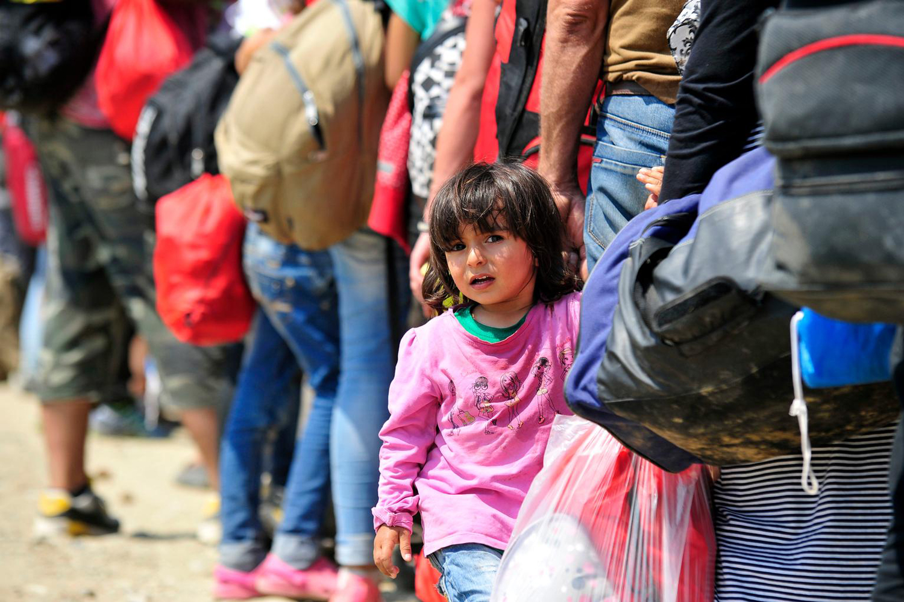
Where in the world?
Notes:
This powerpoint presentation accompanies activity 1 ‘Where in the World’ for primary school children in Unicef UK’s ‘In search of safety: children and the refugee crisis in Europe’ (p. 32 in http://unicef.uk/refugee-resource-pack)
Title slide to the ‘Where in the World?’ primary activity.
The picture: a young girl from Syria waits in a queue of people waiting to board a train to Serbia. See https://blogs.unicef.org.uk/2015/09/04/refugee-crisis-tony-lake-statement/ for details.
(copy and paste the links in your web browser)

Slide 2
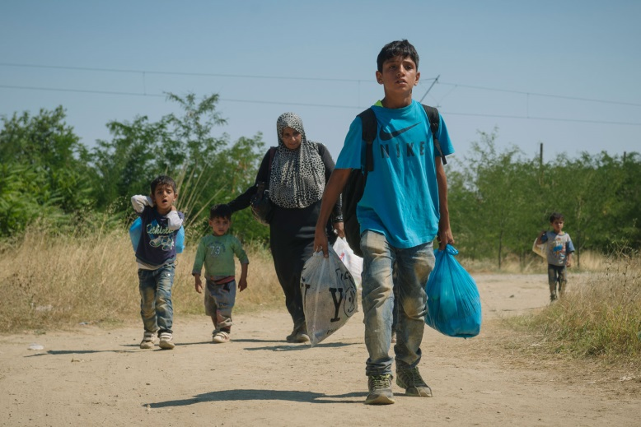
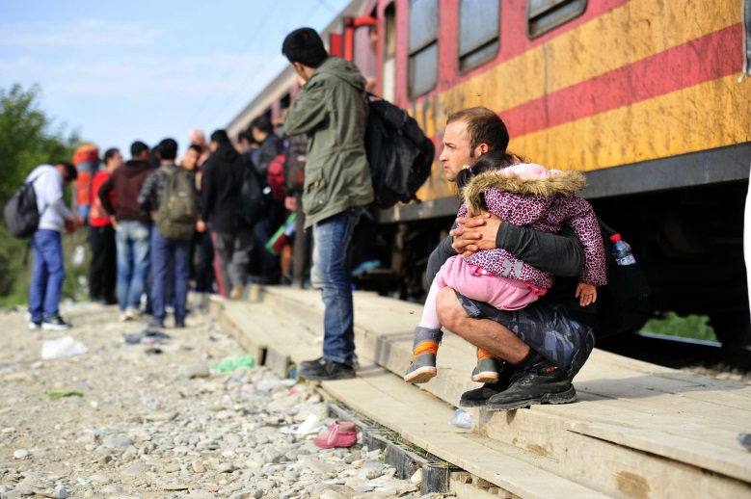
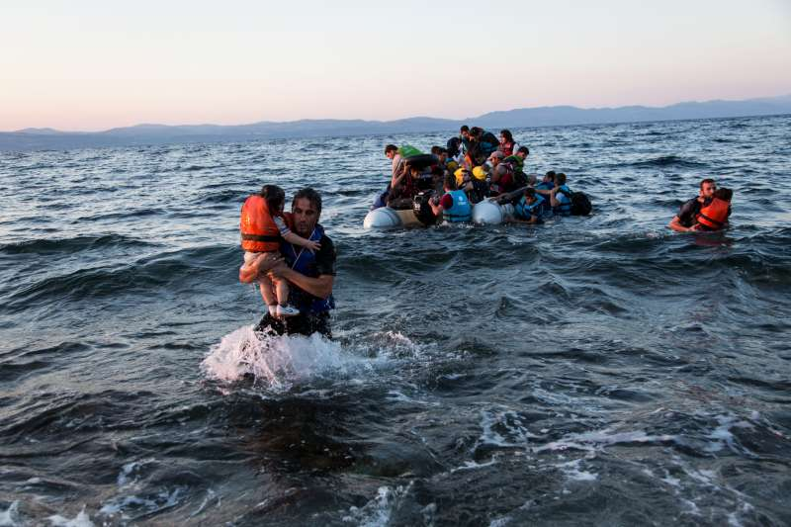
Leaving home
In different parts of the world
people are sometimes
forced to leave their homes.
Notes:
Explain to class that people are sometimes forced to leave their home - there are around 60 million ‘displaced’ people in the world. There are lots of reasons for this including: war or fighting between different groups of people; being treated unfairly (discriminated against); and speaking out against the government which has put the person’s life in danger.
Using the pictures ask about some of the different ways people have travelled when they have left their homes.
By foot: a family walk on dirt road near the town of Gevgelija in the Former Yugoslav Republic of Macedonia, having crossed the border from Greece, now on their way to be registered for a temporary transit visa. Thousands of families like them are escaping conflict and insecurity in their home countries of Afghanistan, Iraq, Pakistan and Syria. Read about it on pages 15-18 and in the Appendix on pages 64-67 in the teaching pack. You can also read this blog (copy and paste the link in your browser): https://blogs.unicef.org.uk/2015/08/29/refugee-migrant-children-conflict-syria-iraq-europe/
By boat: a group of Syrian refugees arrive on the island of Lesbos after traveling in an inflatable raft from Turkey, near Skala Sykaminias, Greece. Read more about this in the teaching pack, including Why refugees are coming to Europe and Countries of Arrival on pages 15-20. See also http://www.unhcr.org/55c4d1fc2.html for more details.
By train: in the former Yugoslav Republic of Macedonia, a man sits on the makeshift platform holding a young child sleeping in his arms as people, primarily from Afghanistan, prepare to board the train at a reception centre for refugees and migrants, in Gevgelija. See https://blogs.unicef.org/blog/what-you-need-to-know-about-children-on-the-move-in-europe/ for details.

Slide 3
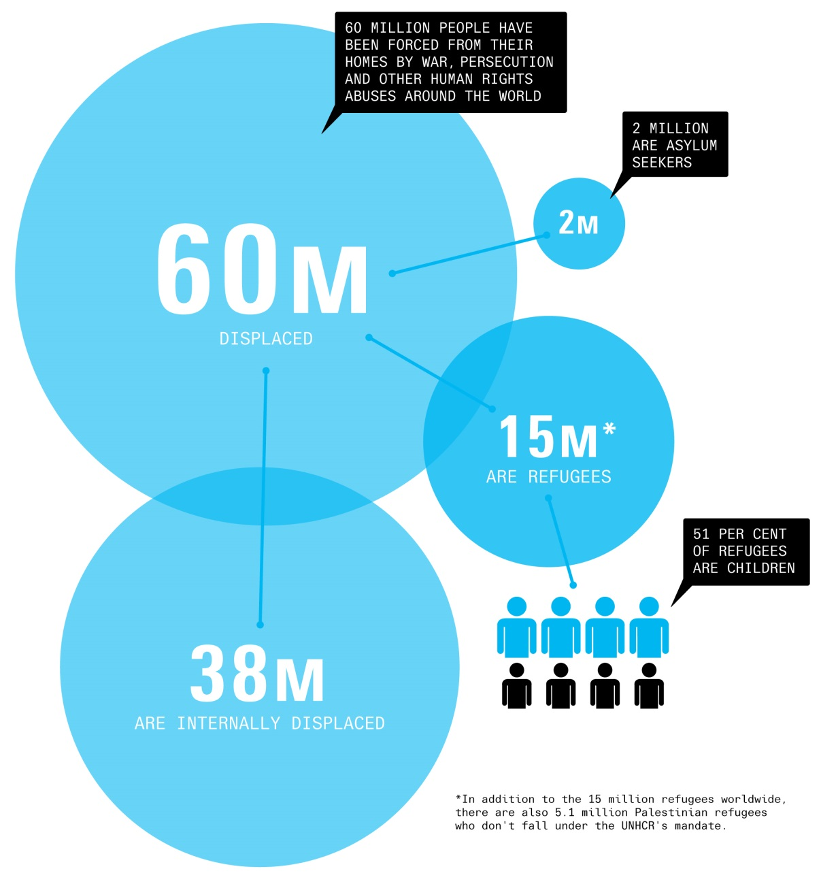
Millions displaced
Notes:
Before exploring the information on this slide it is useful to check that pupils have an understanding of what a ‘million’ means. One way of illustrating that it is such a large number is to ask the class to guess how long it would take to count to a million. The answer will of course vary on the figures used but if you assumed an average of 2.5 seconds for each count and did this for six hours with no breaks each school day it would take around 116 school days i.e more than half the school year.
The population of the UK is just over 65 million.
The slide shows the approximate numbers of people in the world who have been forcibly displaced from their homes. The total is around 60 million (there are over 15 million refugees under the UN Refugee Agency and around another 5.1 million Palestinian refugees registered by another special UN agency). It is important that pupils understand that when someone is forced to leave their home they may either stay in their own country or travel to a different country. For reference (full definitions are available in our glossary of terms pages 57-59 in the teaching pack):
an internally displaced person is someone who is forced to flee their home because of war or persecution but remains within their country’s borders.
a refugee is someone who flees their country because of risk of persecution and terror and has been given refugee status by another country.
an asylum seeker is someone who has left their country and is asking another country to recognise them as a refugee in order to protect them. If the government of that country recognises that it would be dangerous for that person to return to their own country, they would be given refugee status.
a person who moves to another country, but who is not in danger in
their own country, is called a migrant

Slide 4
Long Journeys
Think about a long journey you have made.
YOUR TASK
Draw a picture or write about how you felt during your journey.
You need to think about the different ways you travelled (did you walk or travel by car, boat or aeroplane?).
Were you excited, bored or tired?
Notes:
Task activity:
Using a map in the classroom show where Syria, Iraq and Afghanistan are located. Remember, that many people who have left these countries are now in countries such as Turkey, Jordan and Lebanon. For those who travelled on to Europe most people crossed the Aegean Sea from Turkey to reach Greece whilst some travelled by land to Greece or Bulgaria via Turkey. Once in Europe, some people have remained in that European country whilst others have travelled to other European countries.
In the task activity pupils are asked to draw or write about a long journey they have made in the past. Some prompts are provided on the slide.
The picture and writing can be displayed together and pupils invited to look at each other’s work.

Slide 5
Compare your journeys
How is your journey different from the journeys of children travelling to Europe from Syria, Iraq or Afghanistan?
What rights did you have when you were travelling?
What rights are children and their families trying to protect when they travel to Europe?
Notes:
Following on from the task activity, discuss with the class how their journeys would have differed from those travelling to Europe from countries such as Syria, Iraq and Afghanistan.
The discussion can then be widened to children’s rights. Some of the rights that may have been denied to children making the journey to Europe include:
- non-discrimination (Article 2)
- best interests of the child (Article 3)
- life, survival & development (Article 6)
- birth, registration, name, nationality, care (Article 7)
- separation from parents (Article 9)
- respect for the views of the child (Article 12)
- the right to privacy (Article 16)
- protection from violence, abuse & neglect (Article 19)
- refugee status (Article 22)
- health and access to health services (Article 24)
- the right to an adequate standard of living (Article 27)
- the right to an education (Article 28) & the goals of education (Article 29)
- the right to leisure play and to take part in cultural & artistic activities (Article 31)
- the right to recovery from trauma and reintegration (Article 39)

