Slide 1
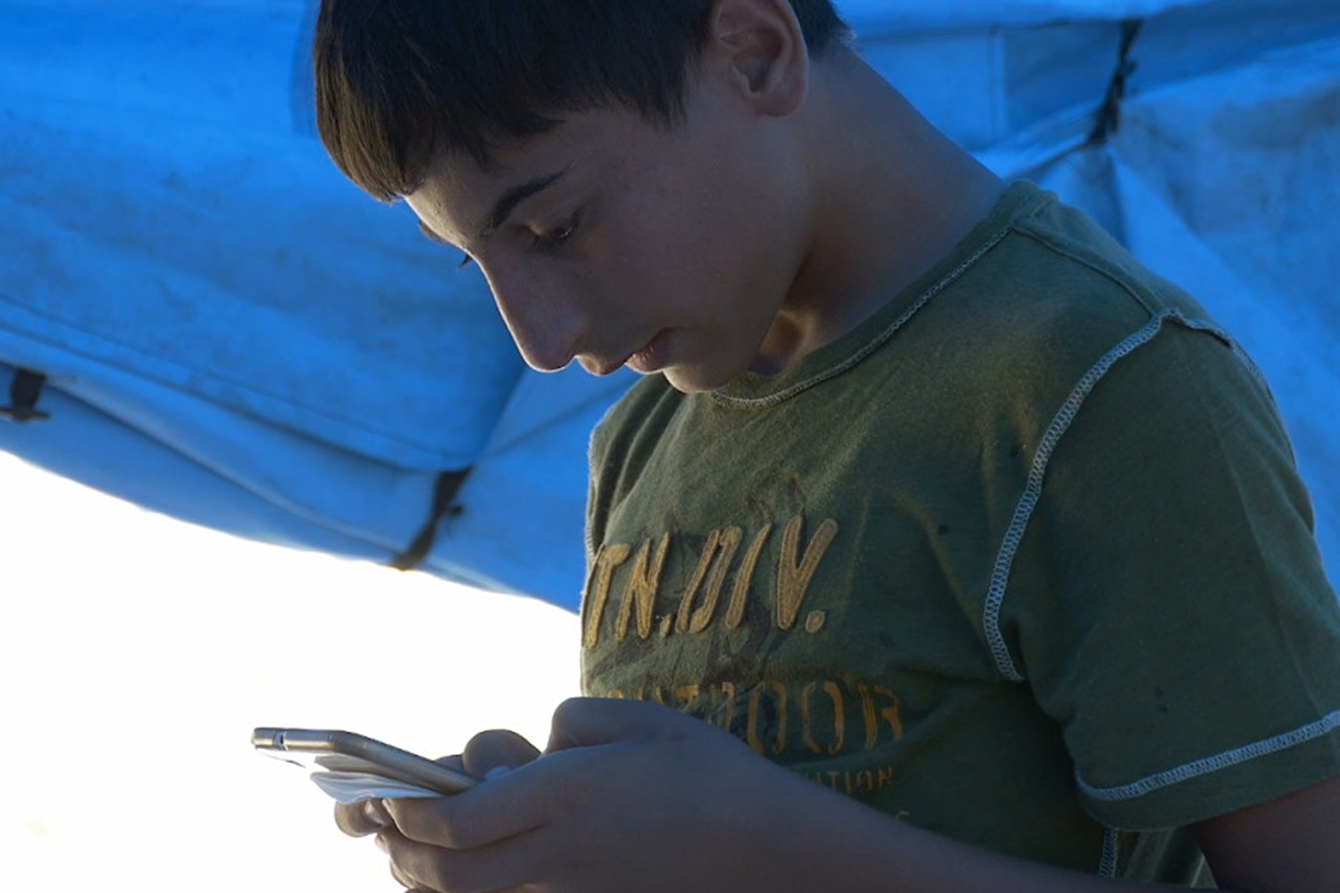
Where in the world?
Notes:
This powerpoint presentation accompanies activity 1 ‘Where in the World’ for secondary school children in Unicef UK’s ‘In search of safety: children and the refugee crisis in Europe’ (p. 33 in our teaching pack: http://unicef.uk/refugee-resource-pack)
Title slide to the ‘Where in the world?’ secondary activity.
The picture: mobile apps are a lifeline for young Syrian refugees. See https://blogs.unicef.org.uk/2015/09/07/refugee-crisis-syria-mobile-apps/ for details
(copy and paste the links in your browser)

Slide 2
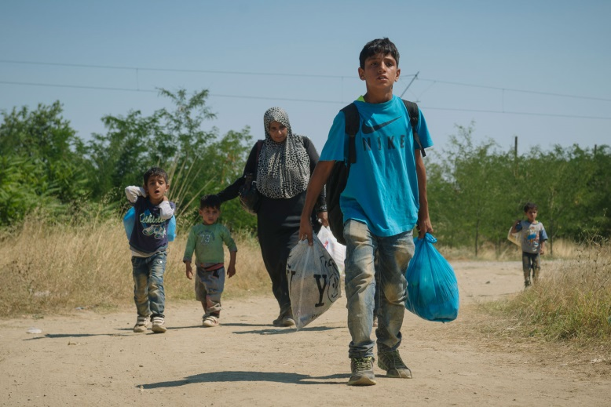
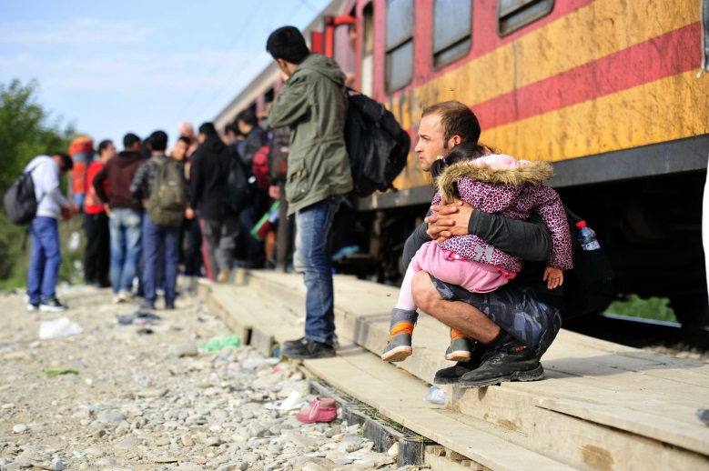
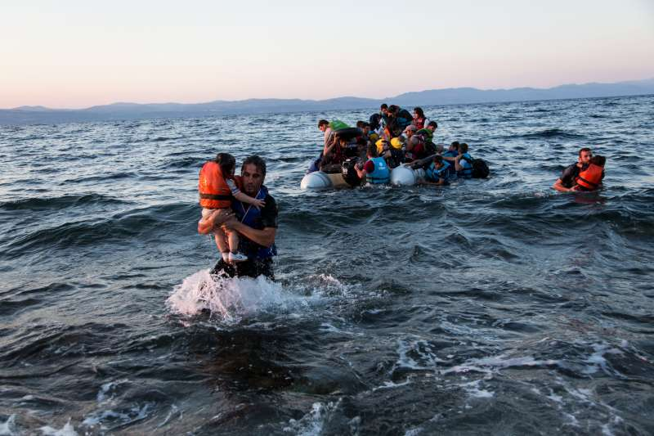
Leaving home
In different parts of the world
people are sometimes
forced to leave their homes.
Notes:
Explain to class that people are sometimes forced to leave their home - there are around 60 million ‘displaced’ people in the world. There are lots of reasons for this including: war or fighting between different groups of people; being treated unfairly (discriminated against); and speaking out against the government which has put the person’s life in danger.
Using the pictures ask about some of the different ways people have travelled when they have left their homes.
By foot: a family walk on dirt road near the town of Gevgelija in the Former Yugoslav Republic of Macedonia, having crossed the border from Greece, now on their way to be registered for a temporary transit visa. Thousands of families like them are escaping conflict and insecurity in their home countries of Afghanistan, Iraq, Pakistan and Syria. Read about it on pages 15-18 and in the Appendix on pages 64-67 in the teaching pack. You can also read this blog (copy and paste the link in your browser): https://blogs.unicef.org.uk/2015/08/29/refugee-migrant-children-conflict-syria-iraq-europe/
By boat: a group of Syrian refugees arrive on the island of Lesbos after traveling in an inflatable raft from Turkey, near Skala Sykaminias, Greece. Read more about this in the teaching pack, including Why refugees are coming to Europe and Countries of Arrival on pages 15-20. See also http://www.unhcr.org/55c4d1fc2.html for more details.
By train: in the former Yugoslav Republic of Macedonia, a man sits on the makeshift platform holding a young child sleeping in his arms as people, primarily from Afghanistan, prepare to board the train at a reception centre for refugees and migrants, in Gevgelija. See https://blogs.unicef.org/blog/what-you-need-to-know-about-children-on-the-move-in-europe/ for details.

Slide 3
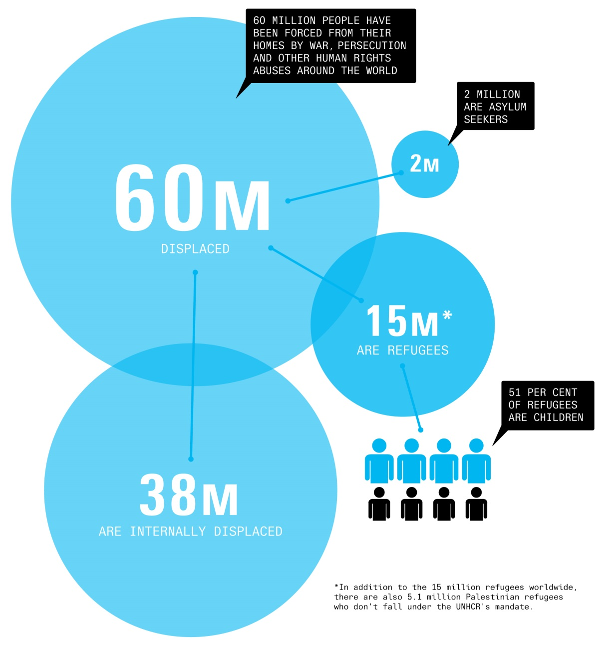
Millions of people have left their homes but not by choice
Notes:
The slide shows the approximate numbers of people in the world who have been forcibly displaced from their homes. The total is around 60 million (there are over 15 million refugees under the UN Refugee Agency and around another 5.1 million Palestinian refugees registered by another special UN agency). It is important that pupils understand that when someone is forced to leave their home they may either stay in their own country or travel to a different country. For reference:
an internally displaced person is someone who is forced to flee their home because of war or persecution but remains within their country’s borders.
a refugee is someone who flees their country because of risk of persecution and terror and has been given refugee status by another country (see slide 4 of ‘Word power’ resource for a full definition).
an asylum seeker is someone who has left their country and is asking another country to recognise them as a refugee in order to protect them. If the government of that country recognises that it would be dangerous for that person to return to their own country, they would be given refugee status.
Our glossary of terms in the teaching pack has longer definitions of all the above terms (pages 57-59)

Slide 4
Fleeing to Europe
In 2015, over a million people arrived in Europe by land or sea; a quarter were children.
Their journeys started from lots of different countries but especially Syria, Afghanistan and Iraq.
78 per cent of those who have claimed asylum in Europe in 2015 come from these three countries.
Notes:
Explain to the class about the number of people who have fled to Europe from different countries.

Slide 5
Why are people coming?
% of all people coming to Europe as refugees from each country
48%
Syria There has been a civil war in Syria since March 2011. More than 250,000 people have been killed and over 11 million people displaced, 5.2 million of whom are children.
Afghanistan Before the war in Syria forced millions of Syrians to become refugees, Afghanistan was considered by the UN Refugee Agency as having ”the world’s largest protracted refugee population”, with 2.6 million refugees living in 92 countries after three decades of conflict.
21%
Iraq United States-led forces removed Saddam Hussein, Iraq’s President, from power in 2003. He was later sentenced to death by an Iraqi court for crimes against humanity. Democratic elections were held in 2004 but violence and repression continues in the country.
9%
Notes:
Use the brief information about Syria, Afghanistan and Iraq to set the context of why so many people have fled these countries. Further information can be found in the teaching resource on pages 15-18 and in the Appendix on pages 64-67.

Slide 6
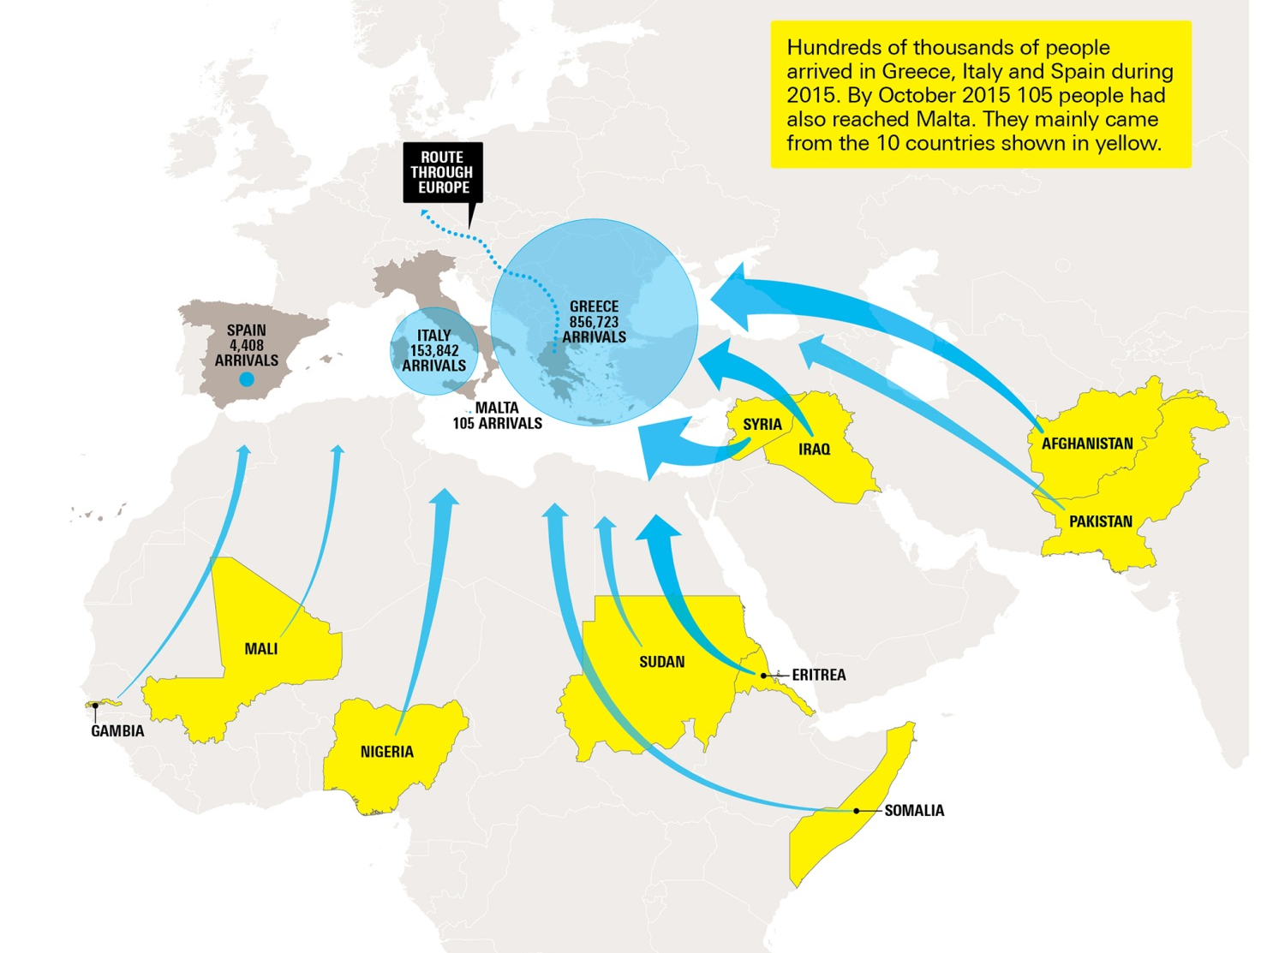
Journeying to Europe
People have journeyed to Europe along different routes depending upon their original starting point.
Notes:
Discuss with the class some of the key routes people are taking to Europe that are shown on the map. In the case of people leaving Syria, Afghanistan and Iraq, remember, that many are now in countries such as Turkey, Jordan and Lebanon. For those who travelled on to Europe most people crossed the Aegean Sea from Turkey to reach Greece whilst some travelled by land to Greece or Bulgaria via Turkey. Once in Europe, some people have remained in that European country whilst others have travelled to other European countries.

Slide 7
the obstacles
What are the obstacles asylum seekers face when they leave their country?
YOUR TASK
In small groups, reflect upon the practical obstacles asylum seekers from Syria, Afghanistan and Iraq face in reaching mainland Europe.
Use the following headings to help you in your discussions:
dangers within their home country;
methods of travel;
food and shelter;
language differences;
weather;
border controls; and
caring for sick and vulnerable family members,
including children.
Notes:
Task activity:
In the task activity pupils are asked to discuss the practical obstacles that asylum seekers from Syria, Afghanistan and Iraq face when travelling to Europe.

Slide 8
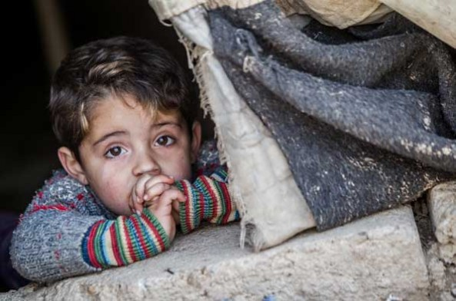
Rights under threat
Which children’s rights are under threat when children and young people flee to another country to seek asylum and refuge?
How can these rights be protected?
Notes:
Ask students to discuss what children’s rights are under threat and how these can be protected when children and young people flee to another country to seek asylum and refuge. Access to summary copies of the Convention on the Rights of the Child would help with this activity. See http://bit.ly/CRC-over11 for a summary of the Convention.
Children’s rights affected include:
- non-discrimination (Article 2)
- best interests of the child (Article 3)
- life, survival & development (Article 6)
- birth, registration, name, nationality, care (Article 7)
- separation from parents (Article 9)
- respect for the views of the child (Article 12)
- the right to privacy (Article 16)
- protection from violence, abuse & neglect (Article 19)
- refugee status (Article 22)
- health and access to health services (Article 24)
- the right to an adequate standard of living (Article 27)
- the right to an education (Article 28) & the goals of education (Article 29)
- the right to leisure play and to take part in cultural & artistic activities (Article 31)
- the right to recovery from trauma and reintegration (Article 39)

