Slide 1
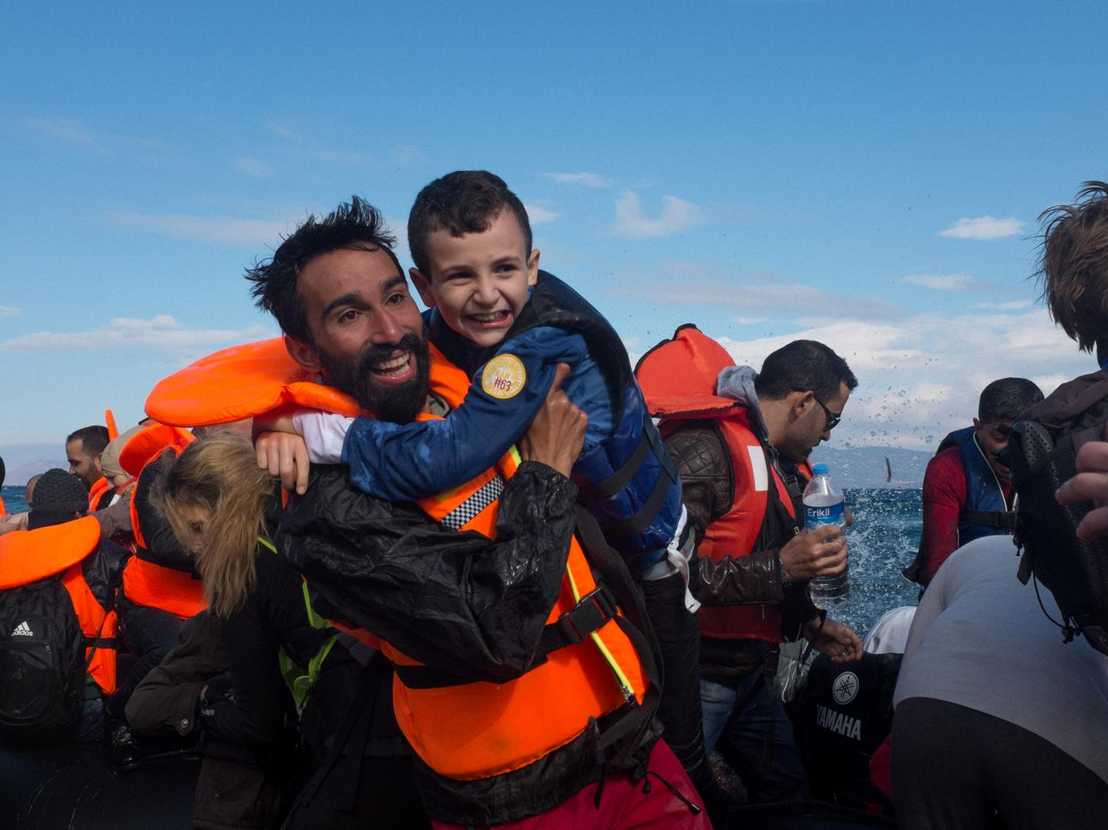
word POWER
Notes:
This powerpoint presentation accompanies activity 2 ‘Word Power’ in Unicef UK’s ‘In search of safety: children and the refugee crisis in Europe’ (p. 34 in our teaching pack: http://unicef.uk/refugee-resource-pack)
Title slide to the ‘Word Power’ activity.
The picture: migrant and refugee crisis in Europe. See http://www.unicef.org/emergencies/index_85510.html
(copy and paste the links in your browser)

Slide 2
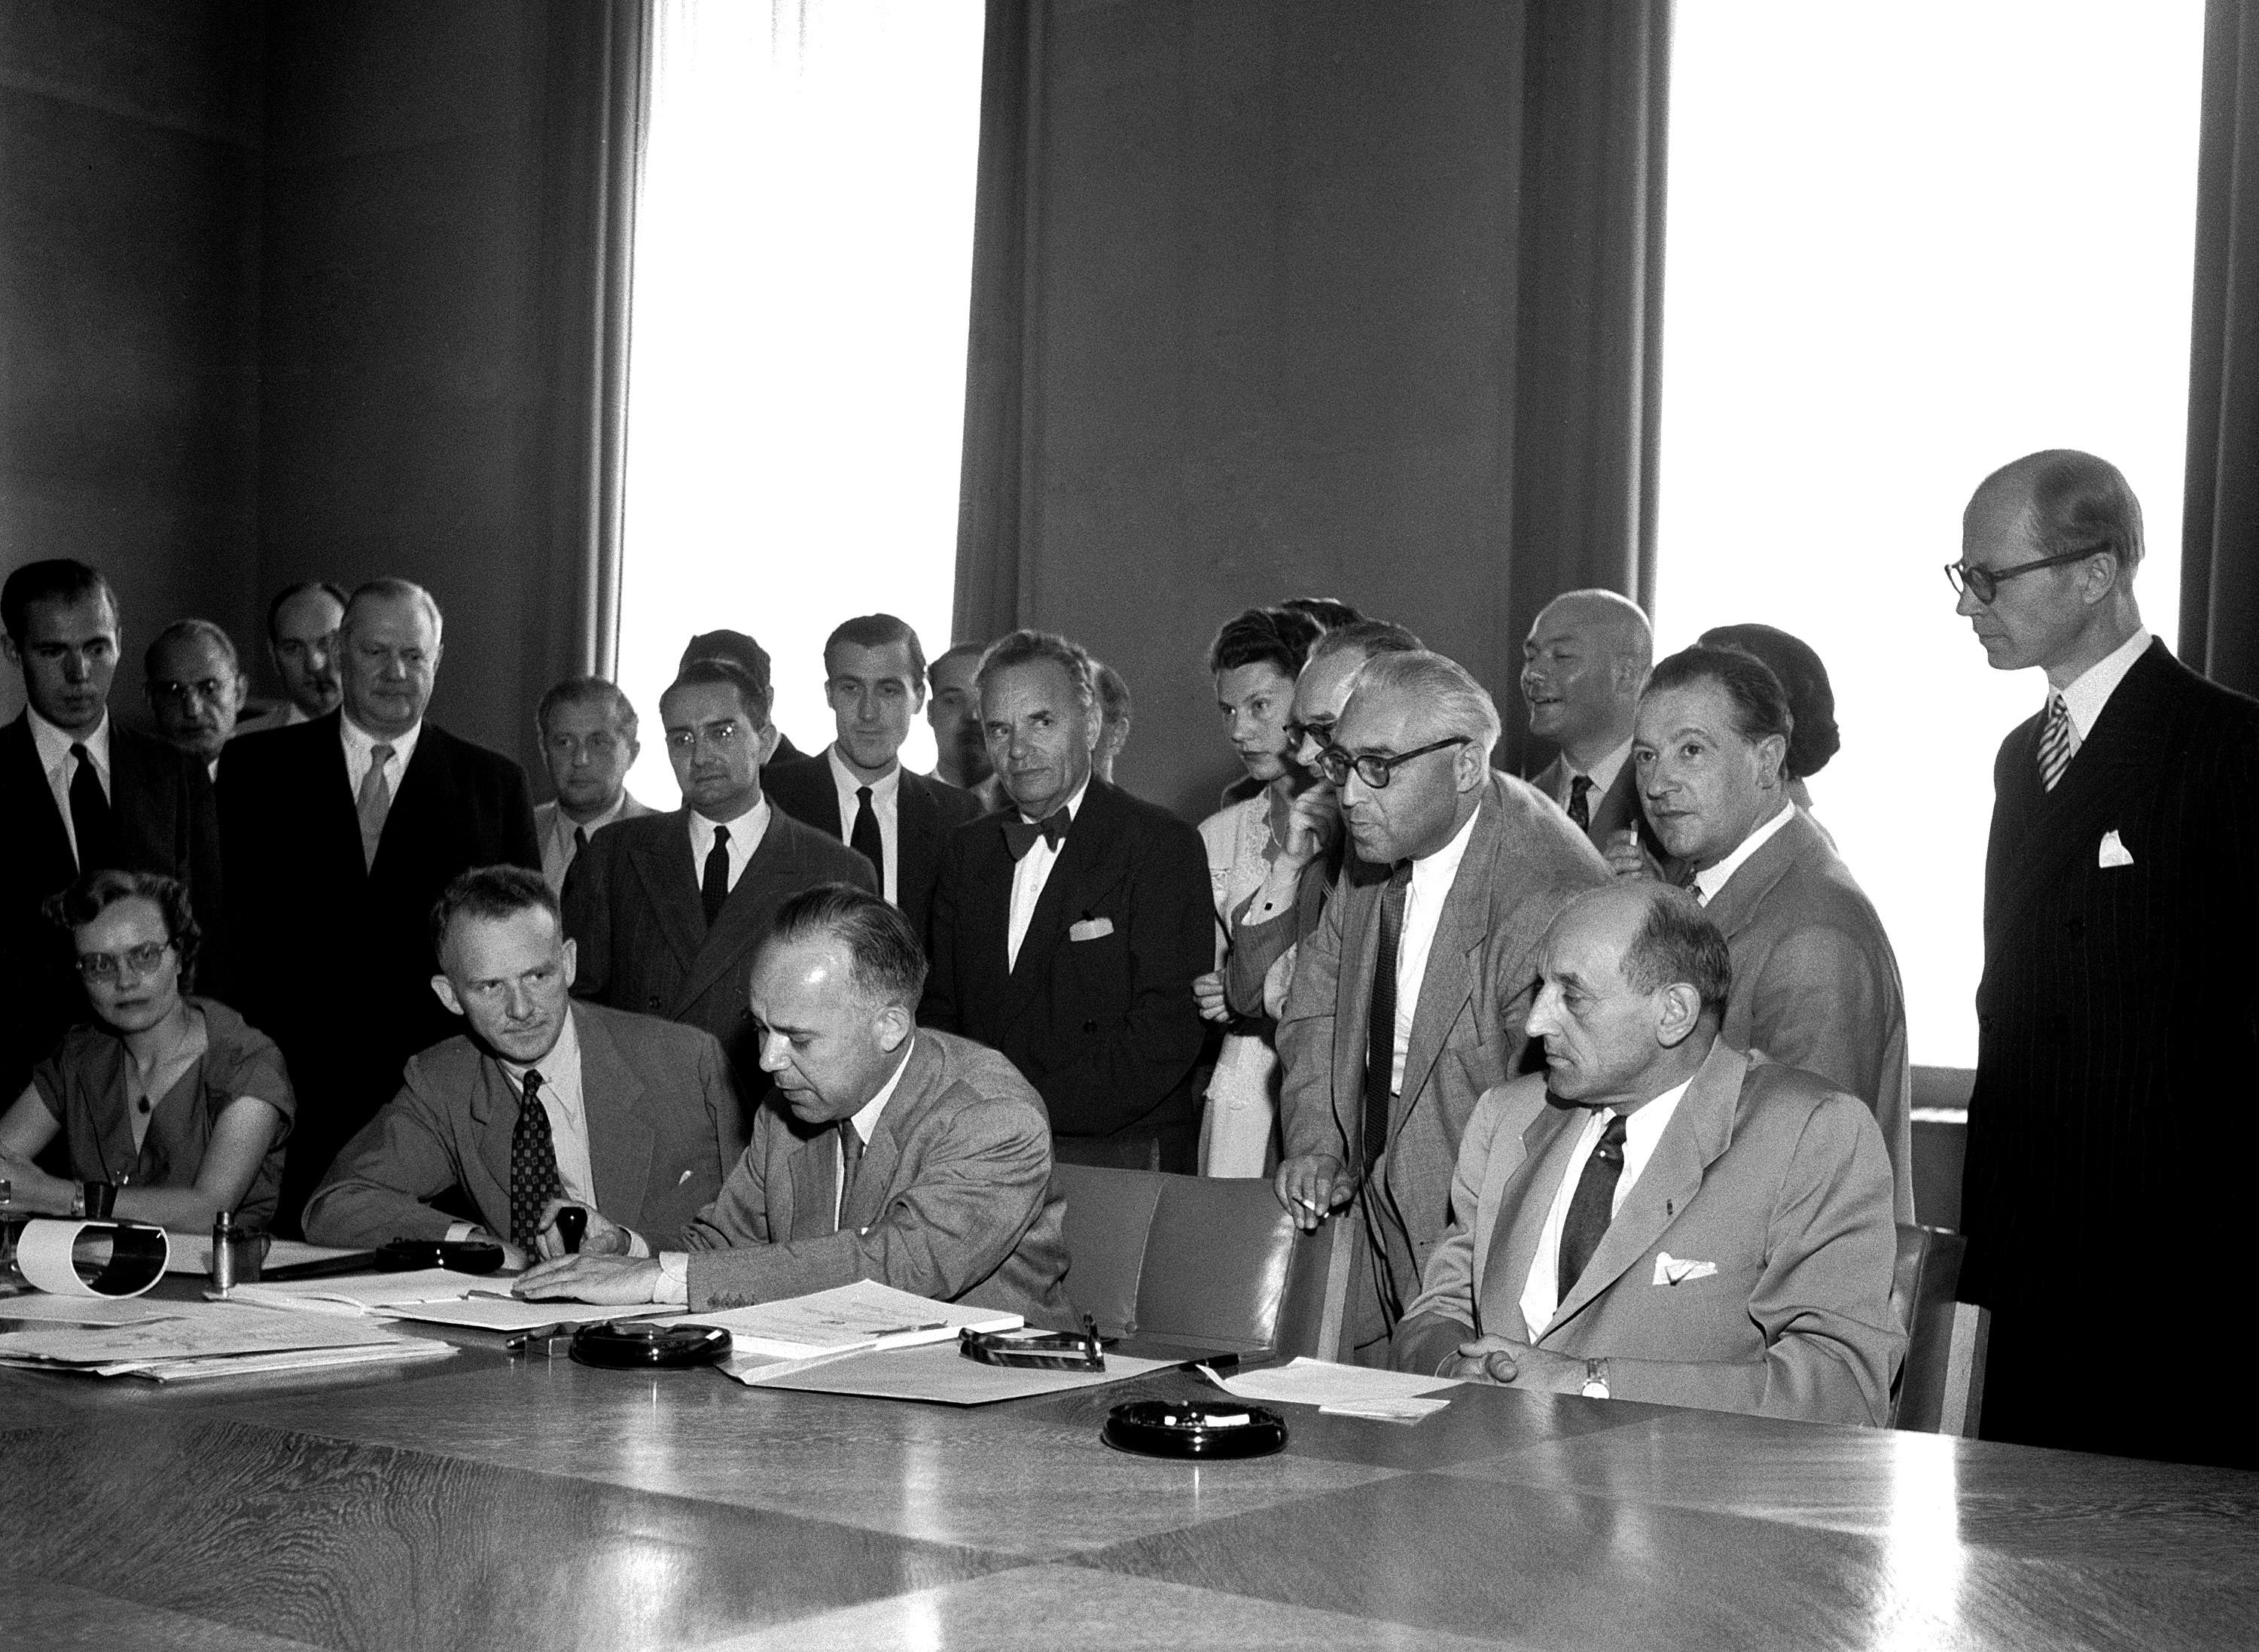
The 1951 refugee Convention
In 1951, the Refugee Convention was adopted by the United Nations.
Denmark was the first country to ratify the Convention in 1952. Since then a total of 145 countries, including the UK, have made a legal promise to protect refugees.
Notes:
Explain to students that in the aftermath of the Second World War, the United Nations adopted The 1951 Convention relating to the Status of Refugees (the 1951 Refugee Convention). Check that they understand that the word ‘Convention’ means in this context an ‘agreement between states’.
It is important to stress that by ratifying the Convention a country has entered into an internationally legally binding agreement to protect refugees.
It follows that defining what is meant by ‘refugee’ is key to understanding the Convention.
Further information about the Convention can be found in our glossary of terms in ‘In search of safety: children and the refugee crisis in Europe’ available at http://unicef.uk/refugee-resource-pack on pp. 57-59 as well as at http://www.unhcr.org/pages/49da0e466.html and http://www.unhcr.org/4ec262df9.html

Slide 3
DEFINE ‘refugee’
Refugees, asylum seekers, migrants? What do the words mean?
YOUR TASK
In pairs, how would you define a refugee using no more than 51 words?
You need to make sure that your definition will protect all those who need assistance in the future. To do this, you will need to think about why someone may need protection and what they will do to seek it.
Notes:
Words and definitions are very important. ‘Refugee’, ‘Asylum Seeker’ and ‘Migrant’ have different meanings and it is important in discussions and the reporting of statistics that these are used accurately. Talk through the short definitions below:
A person who has been accepted as a refugee in a country is allowed to legally stay there. Refugees are people who leave their own country because they are or might be persecuted (persecuted means being treated cruelly or unfairly for reasons linked to your race, religion, nationality, membership of a particular social group or political opinion).
A person who is waiting for a decision by the government as to whether they are a refugee or not is called an asylum seeker.
People who move to other countries, but who are not in danger of being persecuted in their own country, are called migrants.
Task activity:
In the task activity where students are asked to define ‘refugee’, encourage them to think of the many reasons why someone may seek refuge and what ‘seeking refuge’ means.
Students are asked to come up with a definition under 51 words as this is the length of the official international definition of a refugee in the Refugee Convention (see our glossary of terms in the teaching pack on pages 57-59).
As a class, discuss students’ definitions to identify common themes and possibly any key points missing from their definitions.
THEN show the definition on slide 4.

Slide 4
Compare your definition
The 1951 Refugee Convention defines a refugee as a person who owing to a:
well-founded fear of being persecuted
for reasons of race, religion, nationality, membership of a particular social group, or political opinion,
is outside the country of his nationality,
and is unable to or, owing to such fear, is unwilling to avail himself of the protection of that country
Notes:
Once students have come up with their own definitions of ‘refugee’ and discussed their definitions, show the 1951 Refugee Convention definition of a refugee; the definition has been broken down into specific bullet points to emphasise the different reasons why someone might seek refugee and it is important to go through each of these points carefully, checking both students’ understanding of the words being used and providing opportunities for any discussion.
Then go to next slide to show a short film about how important the Refugee Convention is.

Slide 5
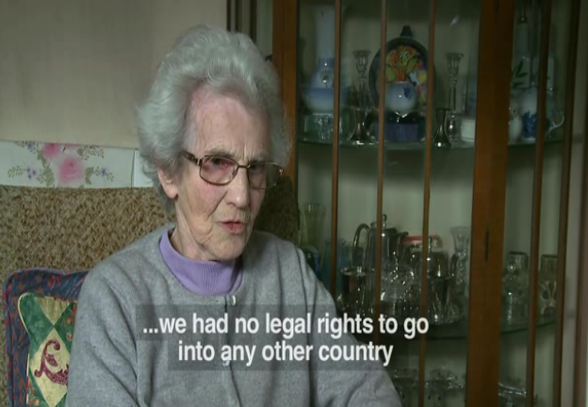
Why is it important?
Notes:
Video: why is the 1951 Refugee Convention so important?
Here is an optional video that you can show pupils (click on the image and it will open the website with the video or just click on this link: https://www.youtube.com/watch?v=LtPXV8a_niI) This video links the personal stories of two refugees over the span of several decades and helps to re-emphasise that the Convention is there to protect people- past, present and future.
(you can also copy and paste the link into your browser)

Slide 6
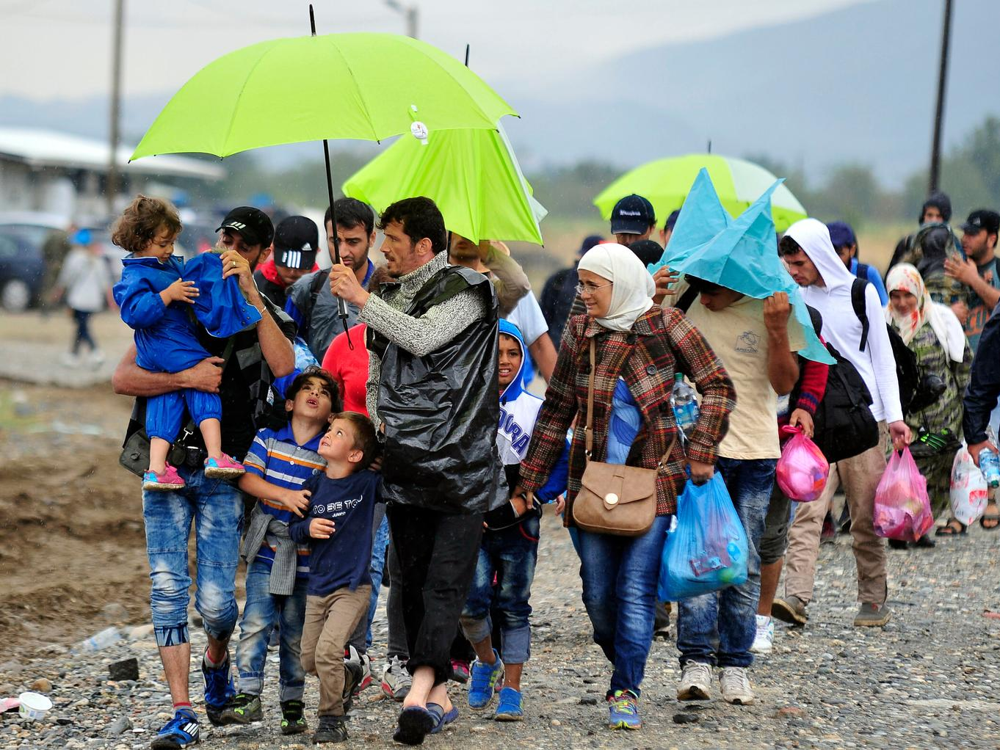
There are about 15 million refugees in the world. More than half are children.
Notes:
This final slide makes the key point that many of the world’s refugees are children and their rights as outlined in the United Nations Convention on the Rights of the Child (CRC or UNCRC) are being denied in so many ways.
Using the picture in the slide, discuss with the class which rights from the Convention (UNCRC) they think are particularly relevant for the children in this picture and/or children seeking refuge in general. Are there any rights they are not enjoying? Are there rights in the Convention that particularly apply to them? Here are some of the rights (or Articles) that may come up:
- non-discrimination (Article 2)
- best interests of the child Article 3)
- life, survival & development (Article 6)
- birth, registration, nationality, care (Article 7)
- separation from parents (Article 9)
- respect for the views of the child (Article 12)
- the right to privacy (Article 16)
- protection from violence, abuse & neglect (Article 19)
- refugee status (Article 22)
- health and access to health services (Article 24)
- the right to an adequate standard of living (Article 27)
- the right to an education (Article 28) & the goals of education (Article 29)
- the right to leisure play and to take part in cultural & artistic activities (Article 31)
- the right to recovery from trauma and reintegration (Article 39)

