Slide 1
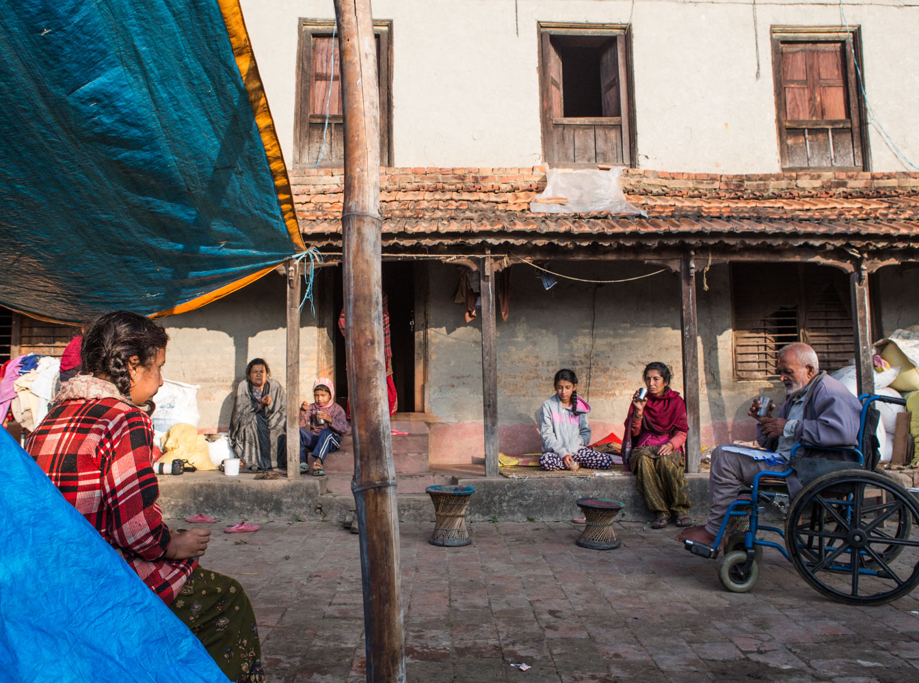

The UN Global Goals - #1
The UN Global Goals - #1
© Unicef/Matas
© UNICEF/UNI173761/Altaf Qadri
© UNICEF/UNI144870/Singh
Notes:
Image: Bansbari, Nepal, 4rd November 2015. Bibhuti (13) and her family drink tea in the in front of the house damaged by the earthquake. Bibhuti's family home was damaged by the massive earthquake that shook Nepal on the 25th April 2015. The house has been deemed unsafe by structural engineers and must be demolished and rebuilt. As a farming family, the Lamichhane have no money to pay for this work. Education is very important to Bibhuti's parents. They want their children to have a good education and to have the opportunity to get good jobs, which will help lift the family out of poverty.

Slide 2
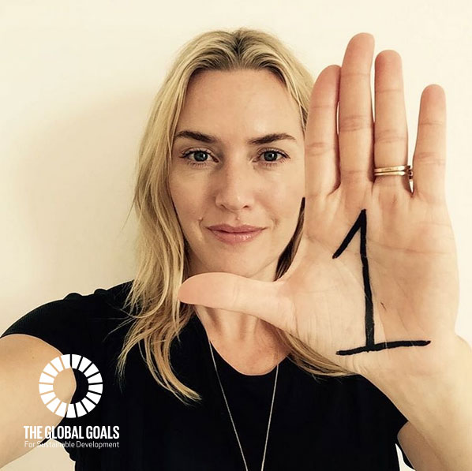

The UN GLOBAL goal #1
Notes:
Presentation: The key point to make here is that the global goal is to eradicate extreme poverty (‘extreme poverty’ is currently measured as people living on less than $1.25 a day) throughout the world by 2030. It is important to link achieving this global goal with the positive impact it will have on children’s rights.

Slide 3
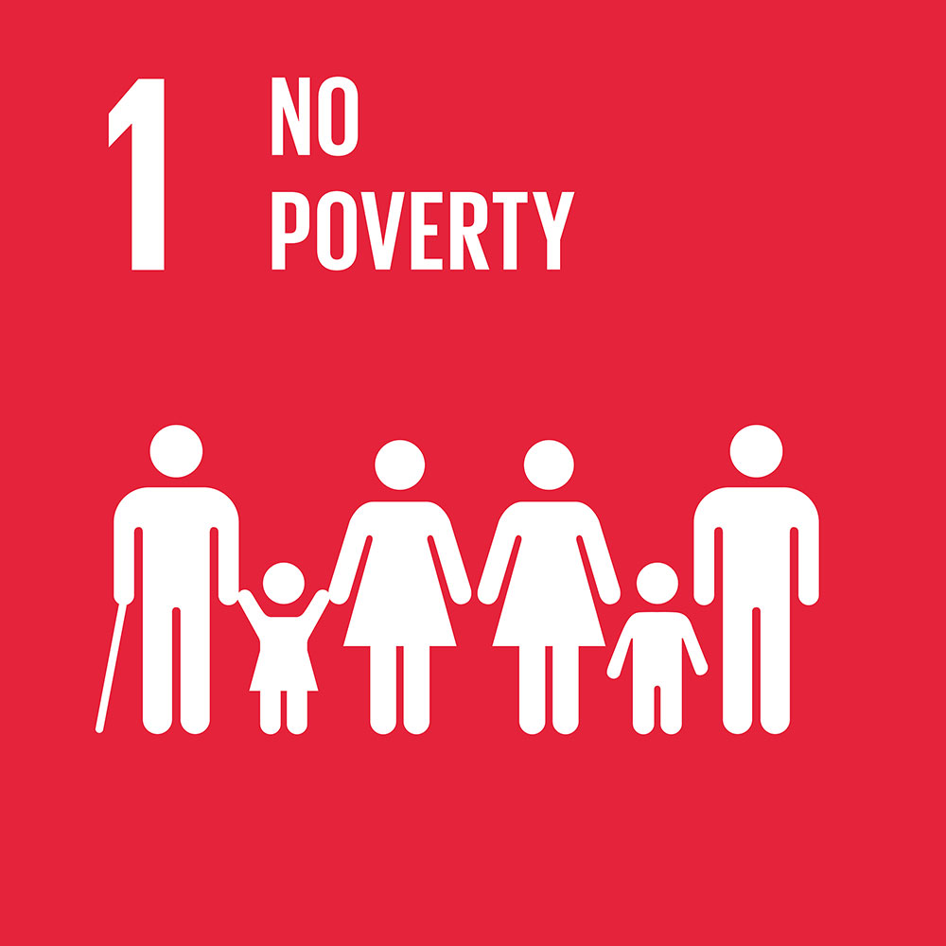
The UN GLOBAL goal #1
Some of the targets of Global Goal #1 are:
By 2030, eradicate extreme poverty for all people everywhere, currently measured as people living on less than $1.25 a day
By 2030, reduce at least by half the proportion of men, women and children of all ages living in poverty in all its dimensions according to national definitions.
Notes:
Presentation: The slide provides details of some of the targets for global goal #1.

Slide 4
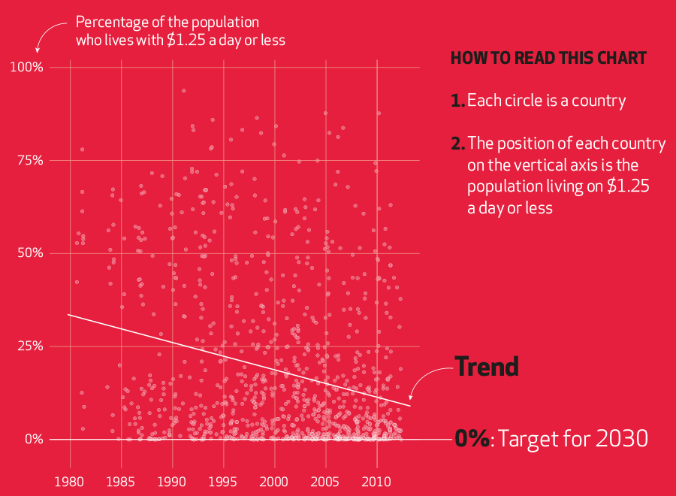
Notes:
Presentation: One of the targets of global goal #1 is to end extreme poverty by 2030 and the graph illustrates the progress that has been made since 1980.

Slide 5
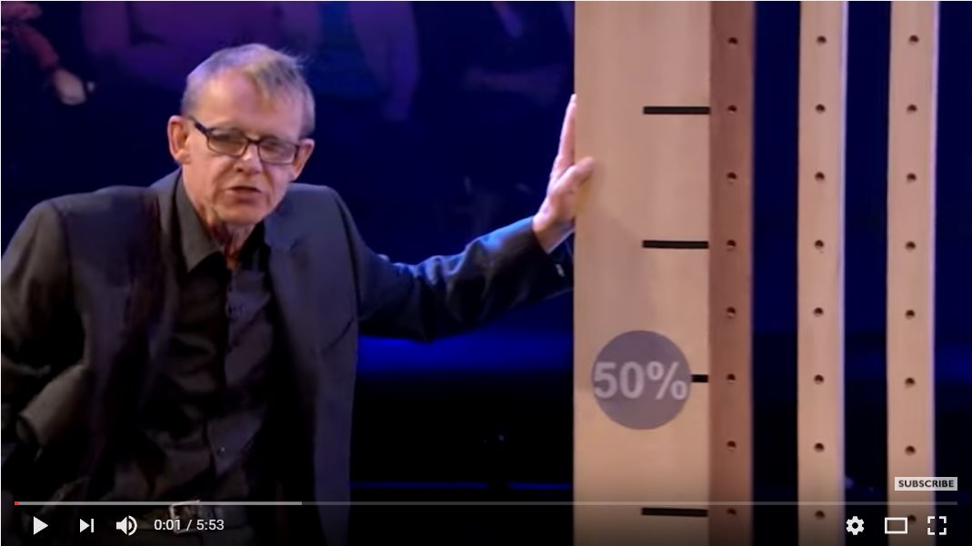
The UN GLOBAL goal #1
You may think that eliminating extreme poverty by 2030 is impossible…………
but is it?
Notes:
Video: If the embedded video will not load then you can view it here: https://www.youtube.com/watch?v=5JiYcV_mg6A
Presentation: Elimination of extreme poverty may seem to be impossible but in the BBC video extract (approximately first three minutes of the video) with Professor Hans Rosling, he explains how this could come about.

Slide 6
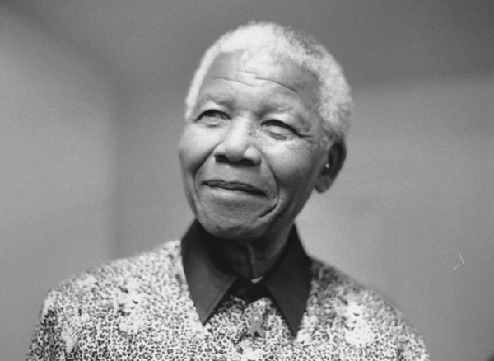
REFLECTION
Nelson Mandela
"In this new century, millions of people in the world's poorest countries remain imprisoned, enslaved, and in chains. They are trapped in the prison of poverty.
“It is time to set them free. Like slavery and apartheid, poverty is not natural.
“It is man-made and it can be overcome and eradicated by the actions of human beings.
“And overcoming poverty is not a gesture of charity. It is an act of justice. It is the protection of a fundamental human right, the right to dignity and a decent life.
“While poverty persists, there is no true freedom."
© wikimediacommons
Notes:
Presentation: An opportunity for students to read the quotation and reflect upon its message.

