Slide 1

Secondary 45

Slide 2


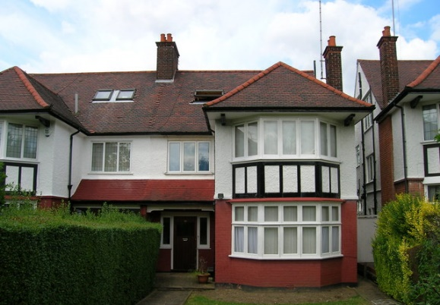
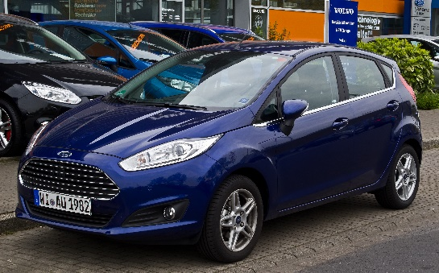
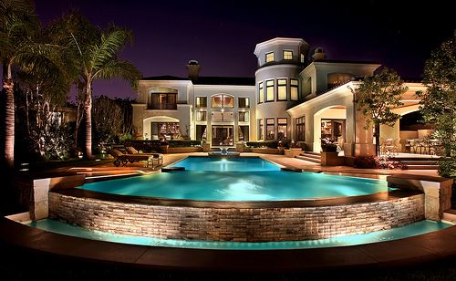




Starter
Imagine you earned enough money to…
Live in a nice house,
drive a nice car,
and go on holiday every year.
If you became a millionaire overnight, would you:
A) Buy a mansion, a fancy car or go on more holidays…
B) Donate all the extra money to a charity.
OR
Could you do both?
©VotesForSchools2018
Notes:
Images:
1- https://en.wikipedia.org/wiki/Cancer_Research_UK
2- https://www.rspca.org.uk/findapet
3- https://www.rspca.org.uk/findapet
4- https://commons.wikimedia.org/wiki/File:Mansion_viewed_from_swimming_pool_in_Sarasota,_Florida.jpg
5- https://pixabay.com/en/lamborghini-car-fast-car-sports-car-2727626/
6- https://pixabay.com/en/holiday-maldives-paradise-colors-3220774/
7-https://en.wikipedia.org/wiki/Ford_Fiesta

Slide 3
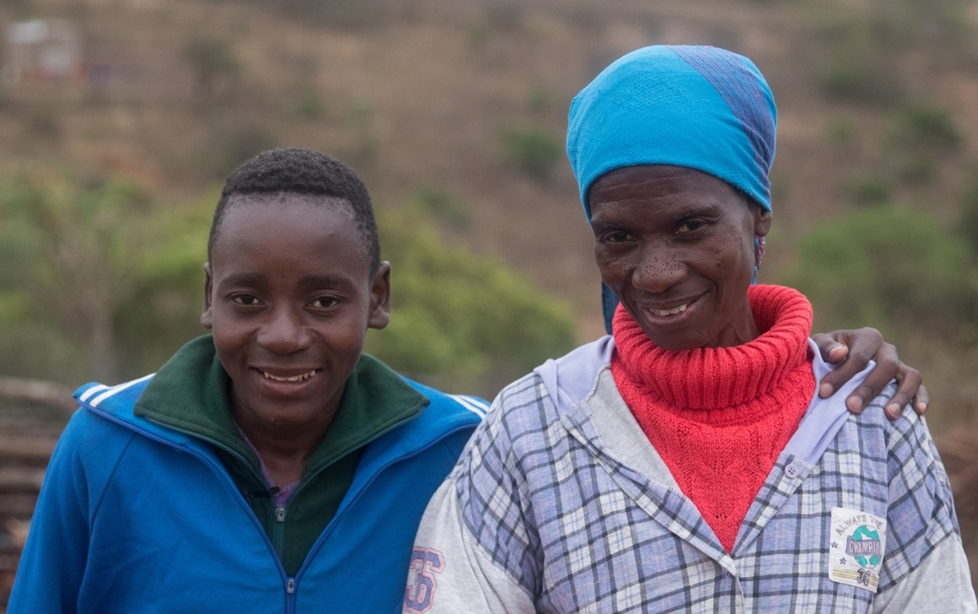

Do rich people give enough money to charity?
This week we are working with UNICEF UK to find out your views on making a difference!
©VotesForSchools2018
Notes:
Images:
1- https://www.istockphoto.com/gb/photo/view-from-rooftop-in-morocco-division-between-rich-and-poor-gm640345778-115954839
Sebenele – Photo: Unicef UK/Matas

Slide 4
Learning objectives for today
To discover what being rich means.
To critically explore what different people can do to make a positive difference to the lives of others.
Keywords
Charitable: giving something for free to those who are in need.
Charity: a system of giving money, food, or help free to those who are in need, or any organisation that has the purpose of providing money or helping in this way.
©VotesForSchools2018
Notes:
References:
1- https://dictionary.cambridge.org/dictionary/english/charitable
2- https://dictionary.cambridge.org/dictionary/english/charity

Slide 5
Issues to consider
If you were rich…
How much do rich people give?
Are you considered rich?
Could rich people end poverty?
Why are we talking about this?
Call to Action
Vote
©VotesForSchools2018
Notes:
Images:
1-http://www.phcs.org.uk/news/sports-relief-2018
References:
1-

Slide 6



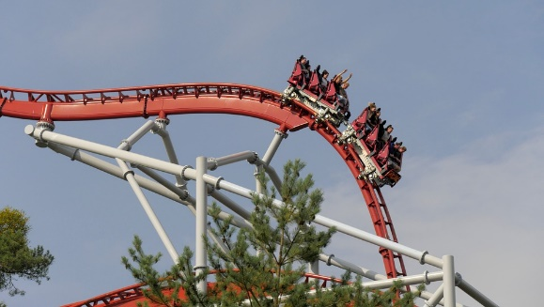
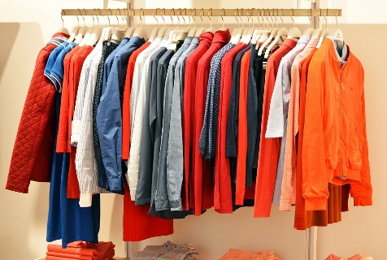



If you were rich…
S&C: What % would you give away?
Holidays / Experiences
Food / Entertainment
Individual Activity (6 mins)
Imagine you earn £10 million a year. You work really hard.
Write down what you would spend your £10 million on. Think about how much you would spend on the things in the pictures. Share your budget with a friend.
Clothes
Family and friends
Example Budget:
£1 million on a house and bills.
£2 million on helping my family and closest friends.
£1 million on awesome holidays!
£1 million to charity.
£5 million in savings.
Charity/ your local community
House
©VotesForSchools2018
Notes:
Images:
1- https://pixabay.com/en/three-children-kids-male-female-2747268/
2- https://pixabay.com/en/vacation-mexico-beach-umbrella-2221347/
3- https://pixabay.com/en/store-clothes-clothing-line-1338629/
4- https://pixabay.com/en/circle-community-hands-holding-159252/
5- https://pixabay.com/en/photos/house/
6- https://commons.wikimedia.org/wiki/File:Skydiving_over_Cushing.jpg
7- https://www.flickr.com/photos/jenumfamily/16947318656
8- https://pixabay.com/en/roller-coaster-amusement-park-3100041/
9-

Slide 7
Issues to consider
If you were rich…
How much do rich people give?
Are you considered rich?
Could rich people end poverty?
Why are we talking about this?
Call to Action
Vote
©VotesForSchools2018
Notes:
Images:
1-http://www.phcs.org.uk/news/sports-relief-2018
References:
1-

Slide 8
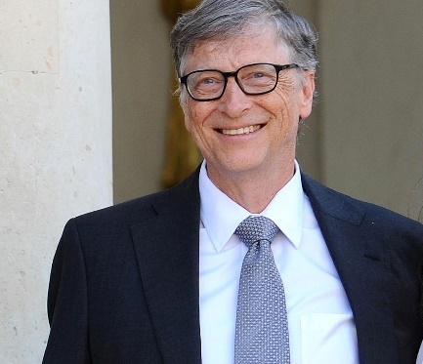
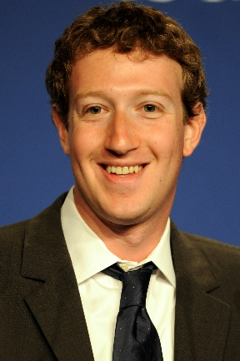
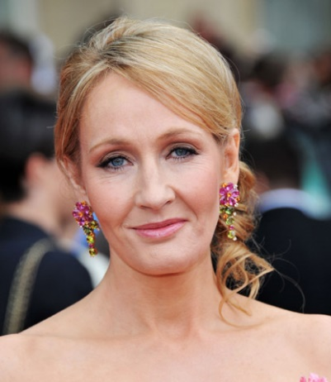



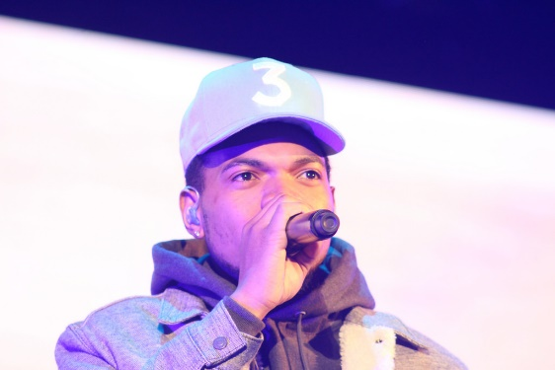
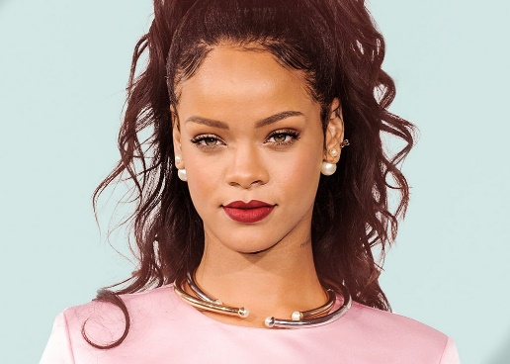
How much do rich people give?
Here’s how much money some of the world’s richest people have given away…
Bill Gates has given
£37 billion⁴ to charity.
J K Rowling gave
£20 million in 2017 alone!
Mark Zuckerberg has promised to give
£33⁶ billion away.
Chance The Rapper has donated £2.2 million³ to schools in Chicago.
Rihanna has helped raise over £1 billion¹ for education and donated
£1.4 million.²
In the UK, the total amount donated to charities last year was £10.3⁵ billion. The top 1000 richest people in the UK made up £3.2 billion⁹ of these donations.
©VotesForSchools2018
Notes:
Images:
1- https://www.cnbc.com/2018/01/18/bill-and-melinda-gates-foundation-is-paying-off-nigerias-polio-debt.html
2- https://commons.wikimedia.org/wiki/File:Mark_Zuckerberg_at_the_37th_G8_Summit_in_Deauville_018_v1.jpg
3- https://www.flickr.com/photos/59632563@N04/5617518534
4- https://www.flickr.com/photos/celebrityabc/27876724745
5- https://www.flickr.com/photos/julioenriquez/33630237573
6- https://www.today.com/video/amazon-ceo-jeff-bezos-fires-back-at-ny-times-over-critique-506613827915
7- https://pixabay.com/en/microsoft-ms-logo-business-windows-80658/
8- https://commons.wikimedia.org/wiki/File:F_icon.svg
References:
1- https://www.wmagazine.com/story/rihanna-helps-raise-2-billion-dollars-global-partnership-for-education
2- http://rihannadaily.com/discover/charity/
3- http://www.nme.com/news/music/chance-the-rapper-2-million-donation-chicago-public-schools-2133677
4- http://time.com/money/4901017/bill-gates-donation-4-6-billion/
5- https://www.cafonline.org/docs/default-source/about-us-publications/caf-uk-giving-2018-report.pdf
6- https://www.forbes.com/sites/katevinton/2015/12/02/what-you-should-know-about-mark-zuckerbergs-big-gift-news/#396c2eae72c9
7- http://time.com/5101089/jeff-bezos-daca-dreamers-scholarship-donation/
8-https://www.cafonline.org/docs/default-source/personal-giving/caf_sunday_times_giving_list.pdf?sfvrsn=1f08240_2
9- https://www.civilsociety.co.uk/news/uk-s-richest-gave-away-over-3-2bn-in-2018-according-to-sunday-times.html

Slide 9


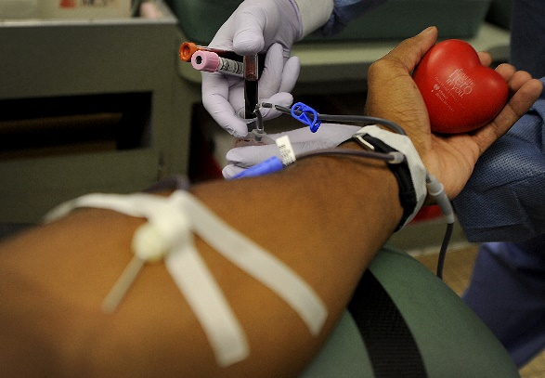


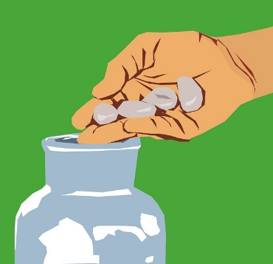
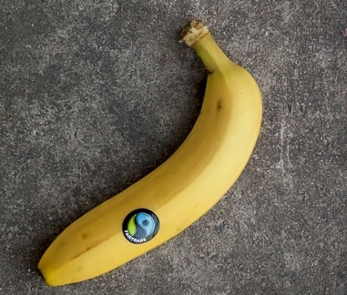
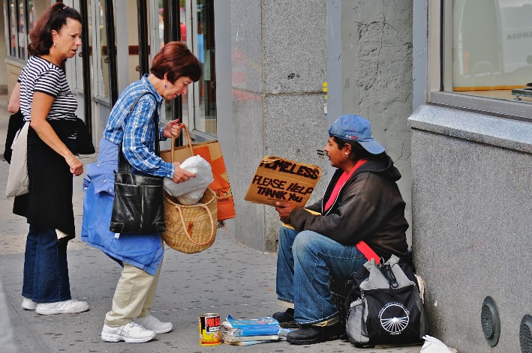
How much do rich people give?
Visit a lonely person
Volunteer
Pair Talk (5 mins)
Can you think of five other ways people can be charitable other than giving money? Use the pictures as clues. Click to reveal.
Raise awareness
Give blood
Donate food
Giving money is not the only way to be charitable.
Buy an ethical product
©VotesForSchools2018
Notes:
Images:
1- http://www.goodfellow.af.mil/Newsroom/Art/igphoto/2000232158/
2- https://pixabay.com/en/banana-requirements-fairtrade-stone-342677/
3- https://commons.wikimedia.org/wiki/File:Helping_the_homeless.jpg
4- https://pixabay.com/en/call-out-advertisement-campaign-2702440/
5- https://www.pexels.com/photo/african-african-american-afro-american-1061582/
6- https://www.flickr.com/photos/roccorossi/4640347206
7- https://pixabay.com/en/sign-protest-blank-strike-placard-2045138/

Slide 10
Issues to consider
If you were rich…
How much do rich people give?
Are you considered rich?
Could rich people end poverty?
Why are we talking about this?
Call to Action
Vote
©VotesForSchools2018
Notes:
Images:
1-http://www.phcs.org.uk/news/sports-relief-2018
References:
1-

Slide 11

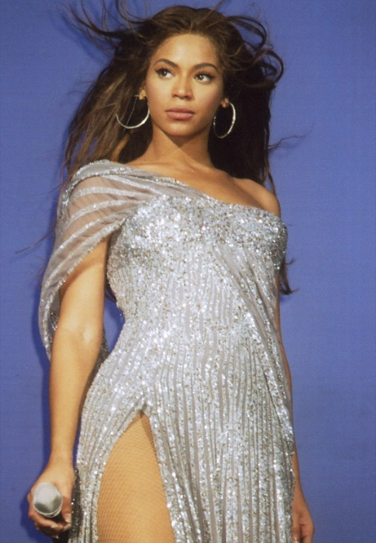


Are you considered rich?
Whole class (5 mins)
Decide who you consider to be rich from the options in the chart. As a class, record your thoughts as a tally in the chart.
 | Yes, they are rich | No, they are not rich
People who own a house
People who drive Lamborghinis
The highest 1% of earners
Billionaires
Nurses
£150,000
©VotesForSchools2018
Notes:
Images:
1- https://pixabay.com/en/truck-lamborghini-realistic-sports-2158284/
2- https://www.flickr.com/photos/pictures-of-money/17121923990
3- https://en.wikipedia.org/wiki/Beyonc%C3%A9
4- https://commons.wikimedia.org/wiki/File:Surgical_Nurse_.jpg
5- iStock

Slide 12
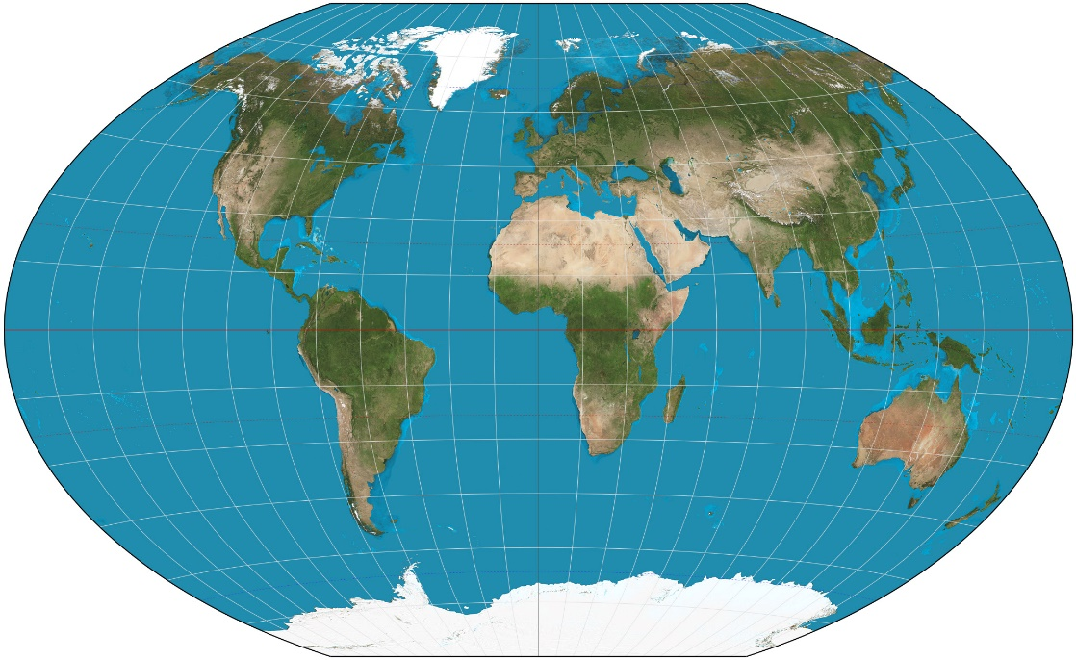

Are you considered rich?
Optional (1 min)
Click the image to hear more about how wealth is spread.
You might think ‘rich’ people are all millionaires and billionaires…
Class Discussion (7 mins)
What do you think about Britain being considered a rich country? Do rich countries have a responsibility to be more charitable than poorer countries?
0:55-
1:59
Salary:
Money that is earned by working.
Click the calculator
to explore how rich a British nurse⁷, on a salary of £23,319, is considered when compared with the rest of the world.
How rich?
but the average British¹ person’s salary, at £27,271, puts them in the top 1% of the world’s earners. This means the average British person is richer than 99% of the world’s people.
http://viewpure.com/uWSxzjyMNpU?start=55&end=119
©VotesForSchools2018
Notes:
Note to teachers: The average Brit is only considered in the top 1% when looking at income. When ranking is done by wealth (assets owned) the top 1% looks different.
Images:
1- https://en.wikipedia.org/wiki/World_map
References:
1- https://www.lsbf.org.uk/blog/news/education-careers/ons-figures-reveal-average-pay-jobs-in-uk/109969
2- https://dictionary.cambridge.org/dictionary/english/income
3- https://www.investopedia.com/articles/personal-finance/050615/are-you-top-one-percent-world.asp
4- http://www.globalrichlist.net/
5- How Rich Am I? : https://www.givingwhatwecan.org/get-involved/how-rich-am-i/
6- http://publications.credit-suisse.com/tasks/render/file/index.cfm?fileid=12DFFD63-07D1-EC63-A3D5F67356880EF3
7- https://www.payscale.com/research/UK/Job=Registered_Nurse_(RN)/Salary

Slide 13
Issues to consider
If you were rich…
How much do rich people give?
Are you considered rich?
Could rich people end poverty?
Why are we talking about this?
Call to Action
Vote
©VotesForSchools2018
Notes:
Images:
1-http://www.phcs.org.uk/news/sports-relief-2018
References:
1-

Slide 14
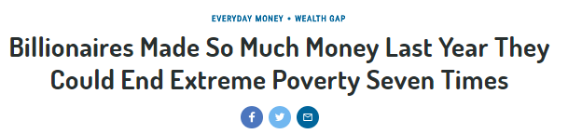
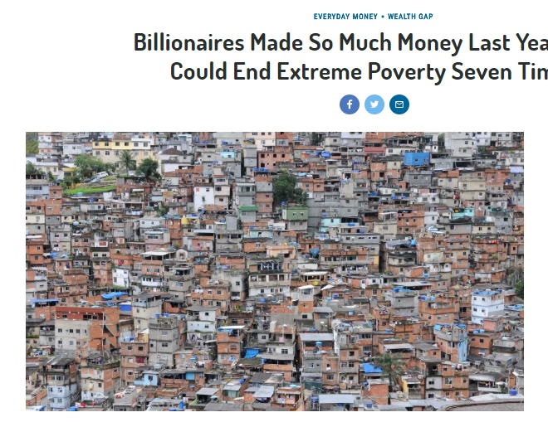
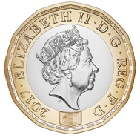
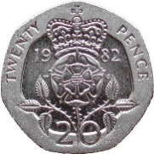
Could rich people end poverty?
You might have seen headlines in the news like this:
Class discussion (5 mins)
Who is responsible for ending extreme poverty in your view?
Info:
The UN Convention on the Rights of the Child² states very clearly that it is the responsibility of the governments in richer countries to help poorer ones.
Extreme Poverty:
a person is considered to be in extreme poverty if they live on less than $1.90 or £1.40 per day.¹
Let’s explore whether rich people could end extreme poverty…
©VotesForSchools2018
Notes:
Images:
1- https://en.wikipedia.org/wiki/One_pound_(British_coin)
References:
1- http://time.com/money/5112462/billionaires-made-so-much-money-last-year-they-could-end-extreme-poverty-seven-times/
2- https://www.unicef.org.uk/what-we-do/un-convention-child-rights/

Slide 15

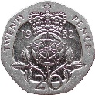
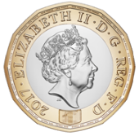
MATHS!
Could rich people end poverty?
The richest¹ 1% of the world have half the world’s money, or £106 trillion. (£106,000,000,000,000)
Important:
For this activity, imagine those in extreme poverty need £2 each a day.
Pair Activity (5 mins)
How much money would the richest 1% of people have to give away each year to get people out of extreme poverty? Do they have enough money to do this? (Teachers: answer is in the notes).
Challenge:
What percentage of their money would the richest 1% have to give away?
Name | Number of Zeros
Million | 6 (000,000)
Billion | 9 (000,000,000)
Trillion | 12 (000,000,000,000)
767 million⁴ people live in extreme poverty, or on less than £1.40 per day.
©VotesForSchools2018
Notes:
*Answer :
Step one: Work out how much people in extreme poverty would need per day: £2 (amount per day) x 767,000,000 (no of people) = £1,534,000,000 (One billion, five-hundred and thirty-four million pounds)
Step two: Work out how much people in extreme poverty would need per year: £1,534,000,000 (daily amount) x 365 (no of days in year) = £559,910,000,000 (Five-hundred and fifty-nine billion, nine-hundred and ten million pounds.)
So the answer is, yes they do have enough money to do this, as this is far less than £106 trillion.
Challenge answer:
Here, students will need to work out £559,910,000,000 (total the richest 1% would need to give away per year) as a % of their total wealth (£106 trillion).
Calculation: £559,910,000,000 ÷ 106,000,000,000,000 = The richest 1% would need to all give away 0.528% of their wealth (rounded to the nearest three decimal places).
Images:
1- https://pixabay.com/en/male-man-stick-figure-symbol-294095/
References:
1-https://www.credit-suisse.com/corporate/en/research/research-institute/global-wealth-report.html
2- http://www.worldbank.org/en/topic/poverty/overview
3- https://www.theguardian.com/inequality/2017/nov/14/worlds-richest-wealth-credit-Suisse
4- http://www.globalincome.org/English/Facts.html

Slide 16
Issues to consider
If you were rich…
How much do rich people give?
Are you considered rich?
Could rich people end poverty?
Why are we talking about this?
Call to Action
Vote
©VotesForSchools2018
Notes:
Images:
1-http://www.phcs.org.uk/news/sports-relief-2018
References:
1-

Slide 17
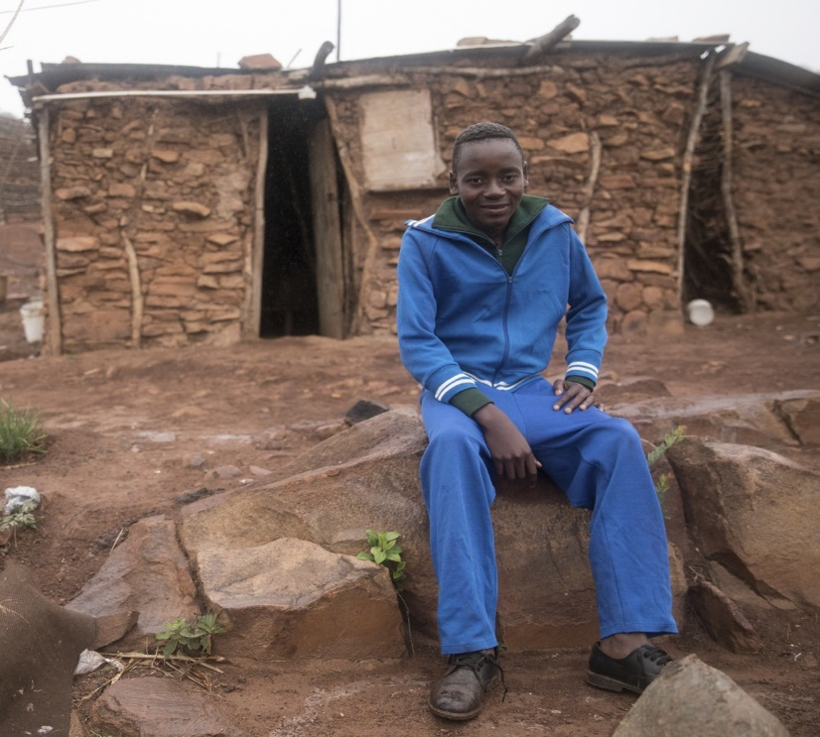
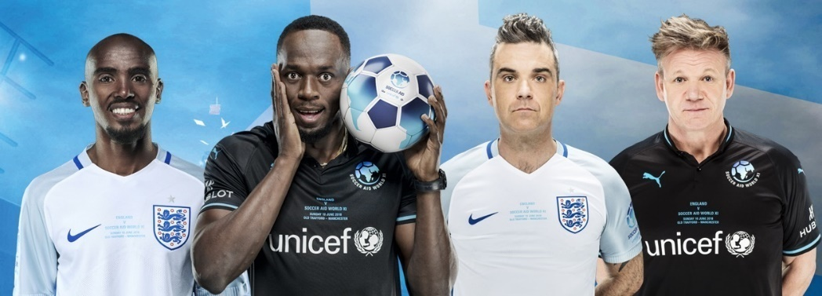
Why are we talking about this?
Class Activity (2 mins)
Click the image to learn more about Soccer Aid.
On 10th June, many rich celebrities and ex-footballers will be competing in Soccer Aid, to help raise money for UNICEF, a children’s charity.
0:00-
1:05
0:00-
1:24
Class Activity (2 mins) Click the image to hear how UNICEF is helping children like Sebenele.
The money raised will make a difference to children like Sebenele, who face many challenges growing up.
Fact!
The last Soccer Aid match raised £6.6¹ million!
©VotesForSchools2018
https://app.aframe.com/links/d47c3476dcf4e38b7b0f4e16773dad5f
http://viewpure.com/wCCcleGg_F8?start=0&end=0
Notes:
Images:
1- Sebenele – Photo: Unicef UK/Matas
Videos:
1- Video: Unicef UK
References:
1-https://www.unicef.org.uk/press-releases/soccer-aid-raises-record-amount-unicefs-work-children/

Slide 18
Issues to consider
If you were rich…
How much do rich people give?
Are you considered rich?
Could rich people end poverty?
Why are we talking about this?
Call to Action
Vote
©VotesForSchools2018
Notes:
Images:
1-http://www.phcs.org.uk/news/sports-relief-2018
References:
1-

Slide 19

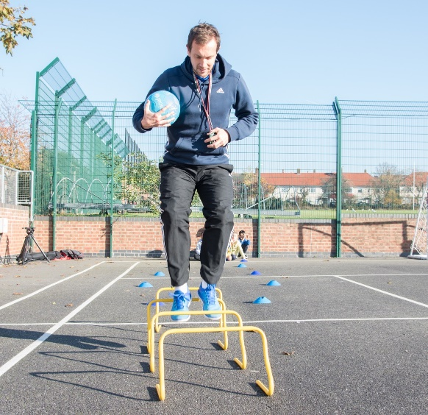
Quick idea
Call to Action
Watch Soccer Aid!
You can watch the fun game live on ITV on Sunday 10th June from 8pm. You could even go to the match yourself! Tickets are on sale here.
Fundraise for Soccer Aid:
Raise money through The Playground Challenge! Design a creative and fun football-themed obstacle course, publicise the event and get people to sponsor you to complete it! Find out more ways to get involved in Soccer Aid 2018 by clicking here.
Big idea
SCHOOL
©VotesForSchools2018
Notes:
Link for Soccer Aid fundraising here:
https://www.socceraid.org.uk/schools/

Slide 20

Do rich people give enough money to charity?
No
NO
Last year, the British public gave more money to charity than the top 1000 richest people in the UK did.¹
Some rich people give a huge amounts of money away, but it can be very small when compared with how much they are worth. ²
It has been claimed that the yearly income of the world’s 100 richest people could end poverty four times over.³
The world’s richest 1% have more than half of the world’s money.⁴
There are 2,208 billionaires in the world who are worth £6.7 trillion altogether.⁵
©VotesForSchools2018
Notes:
1- https://www.civilsociety.co.uk/news/uk-s-richest-gave-away-over-3-2bn-in-2018-according-to-sunday-times.html
2- https://www.thirdsector.co.uk/giving-richest-steady-32bn/fundraising/article/1464614
3- http://www.poverty.ac.uk/report-developing-countries-wealth/super-rich-could-end-poverty-four-times-over
4- https://www.theguardian.com/inequality/2017/nov/14/worlds-richest-wealth-credit-Suisse
5- https://www.forbes.com/billionaires/#75c678d0251c

Slide 21
Do rich people give enough money to charity?
Yes
YES
Last year, rich people in the UK gave £3.2 billion to charity. ¹
The UK⁴ is the 11th most charitable country in the world!
Giving money is just one of many ways that people can help raise money for charities. Many rich people volunteer their time to raise money for charity, like the Soccer Aid players.
There are 175 billionaires like Bill Gates, who have promised to give away almost all of their money to charity.²
A rich British woman, Jamie Cooper, gave £300 million of her £337 million to charity last year, which is almost 90% of her wealth!³
©VotesForSchools2018
Notes:
1- https://www.civilsociety.co.uk/news/uk-s-richest-gave-away-over-3-2bn-in-2018-according-to-sunday-times.html
2- https://givingpledge.org/
3- https://www.thirdsector.co.uk/giving-richest-steady-32bn/fundraising/article/1464614
4- https://www.cafonline.org/about-us/publications/2017-publications/caf-world-giving-index-2017

Slide 22



Vote Now on… www.votesforschools.com
©VotesForSchools2018

Slide 23

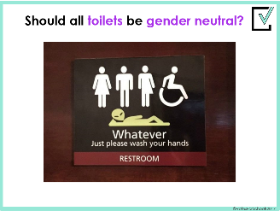
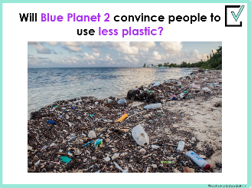
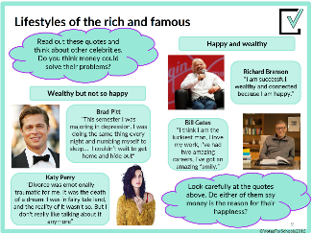
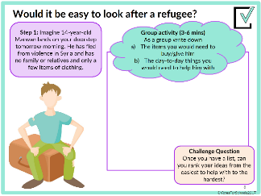
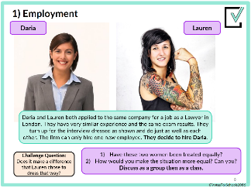
What is VotesforSchools?
VotesforSchools holds weekly debates on issues happening in the news! We aim to give students a balanced view and encourage them to think critically. In this lesson, students were able to think critically about what it means to be ‘rich’ and think about who they think is responsible for ending poverty.
You can find out more about what we do at www.votesforschools.com
(Teachers: You can email matt@votesforschools.com)
©VotesForSchools2018

