Slide 1




Primary KS2
©VotesForSchools2018

Slide 2
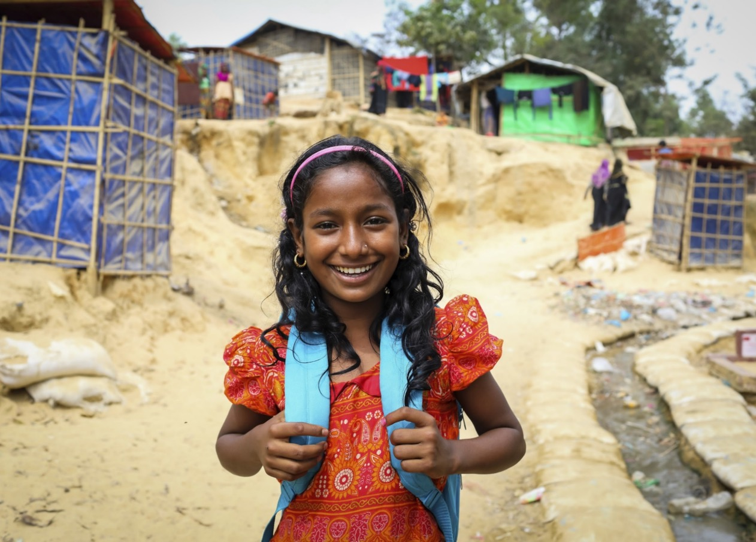

Do rich people give enough
money to charity?
This week we are working with UNICEF UK, a children’s charity, who really want to hear your views!
©VotesForSchools2016
©VotesForSchools2018
Notes:
Images:
1- https://www.istockphoto.com/gb/vector/conceptual-illustration-of-gap-between-rich-and-poor-gm628024370-111361073
Raheema images - Photo: Unicef UK/Akash

Slide 3

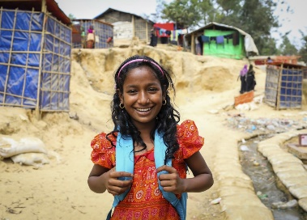


Our learning journey for this week!
It’s not all about money…
Why are we talking about this?
If I were a millionaire…
How can people be more giving?
Call to Action
Vote!
©VotesForSchools2018
Notes:
Image Source:
1-
References:
1-

Slide 4
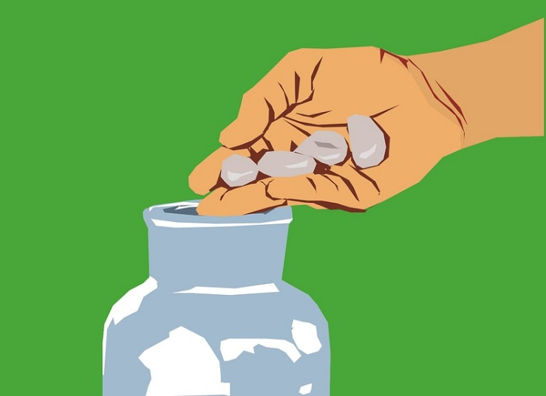



It’s not all about the money…
Pair Activity (6 mins)
There are many different ways to help others. Giving money to a charity is just one way. On a whiteboard, write down all the different ways you can help other people! Use the scenarios on the next three slides to help you think.
©VotesForSchools2016
©VotesForSchools2018
Notes:
Images:
1-https://pixabay.com/en/photos/donation/
2- http://www.magicalmaths.org/why-all-teachers-should-buy-and-use-mini-whiteboards-in-their-classroom-lessons/
References:
1- https://dictionary.cambridge.org/dictionary/english/charitable

Slide 5
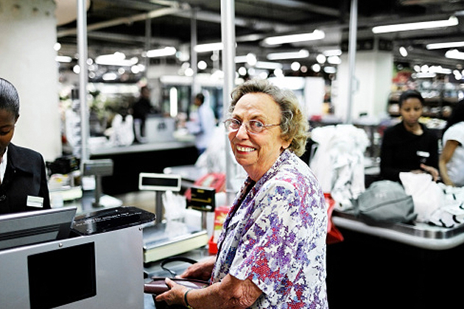
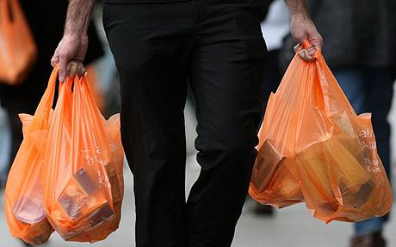
It’s not all about the money…
Sally noticed an old lady in the supermarket who was struggling to pack her bags at the checkout.
Sally helped the old lady pack her bags and then offered to carry them to her car. They were too heavy for the old lady to carry.
©VotesForSchools2016
©VotesForSchools2018
Notes:
Images:
1- https://www.express.co.uk/news/uk/704934/Sainsburys-start-slow-shopping-trials-help-elderly-vulnerable-customers
2- https://www.telegraph.co.uk/news/earth/5114793/Britons-use-160-new-carrier-bags-each-every-year-shows-survey.html

Slide 6
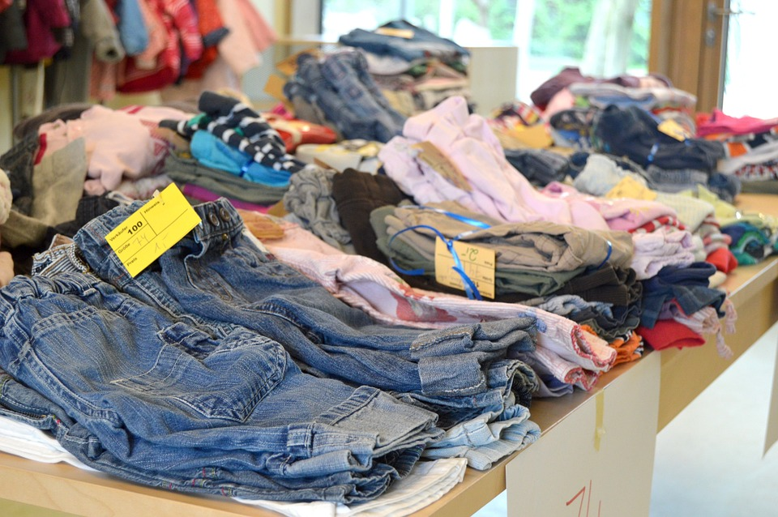
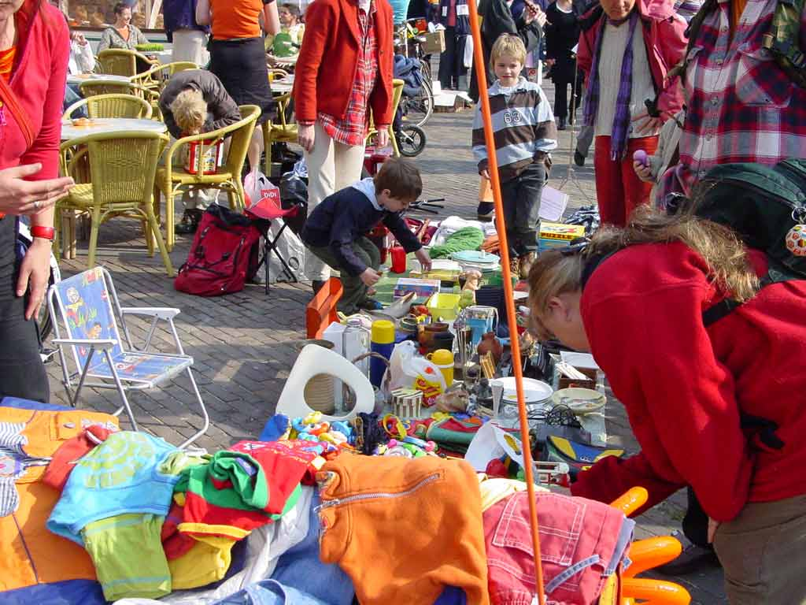
It’s not all about the money…
Dominic’s children are all adults now and they don’t need their old clothes or toys. Dominic decided to take these things to a charity shop so that someone else could have them. Later that day, a lady came in to the shop and bought lots of things her family really needed, including Dominic’s old toys. She was thrilled!
©VotesForSchools2016
©VotesForSchools2018
Notes:
Iamges:
1- https://pixabay.com/en/flea-market-kids-flea-market-804760/

Slide 7
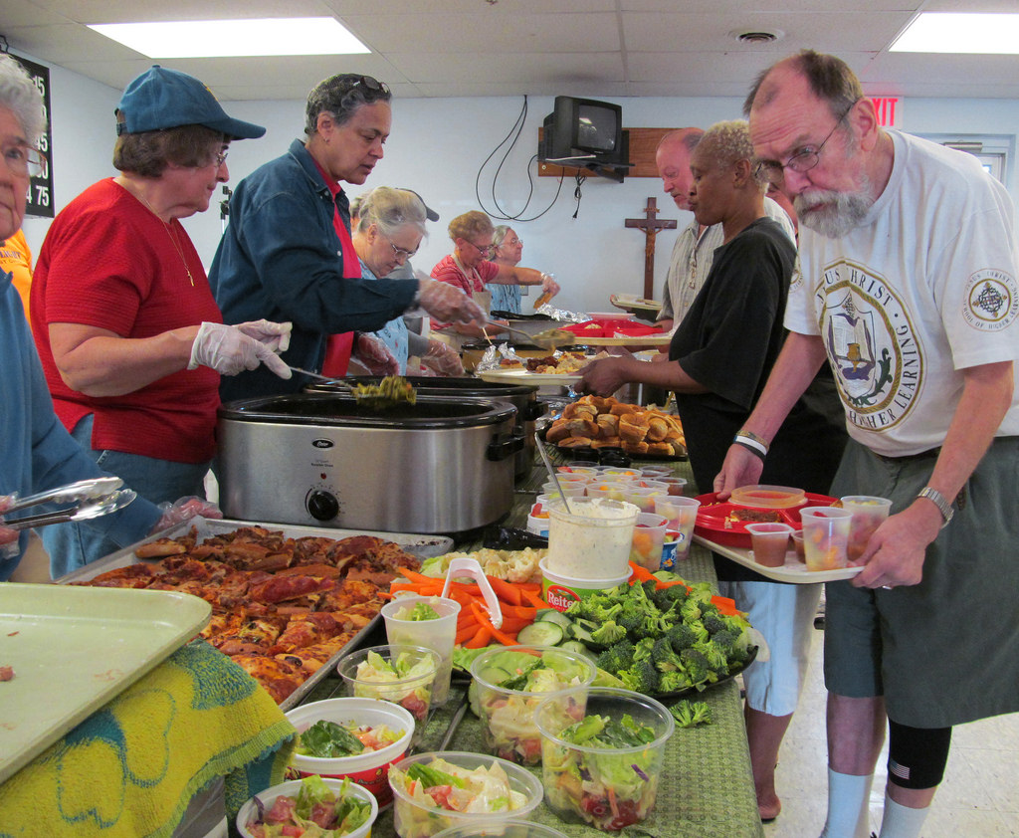
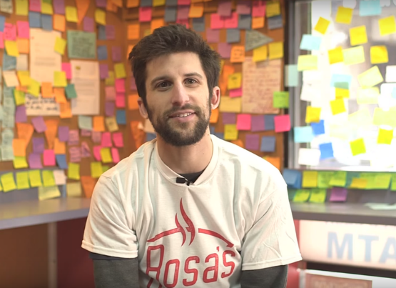
It’s not all about the money…
Class Video (1 mins)
Click the image below to see something charitable happening in America!
0:00-
1:07
Once a week, Jerrell goes to the local community center to help prepare a meal for homeless people with other volunteers. The homeless people get to come in and have a hot meal for free. Before he cooks, Jerrell goes around to his neighbours to ask if they have any spare ingredients to cook with!
©VotesForSchools2016
http://viewpure.com/brzjeICcIt0?start=0&end=67
©VotesForSchools2018
Notes:
Images:
1- https://www.bustle.com/articles/133327-rosas-pizza-pays-it-forward-with-the-cleverest-system-to-help-feed-the-homeless
2- https://www.nlah.org.uk/how-you-can-help/how-to-volunteer/
3- https://www.flickr.com/photos/usdagov/15244531186

Slide 8
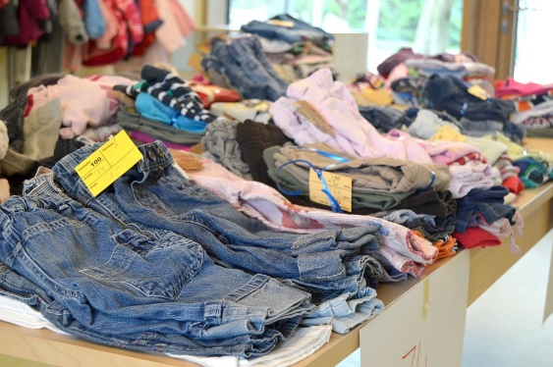
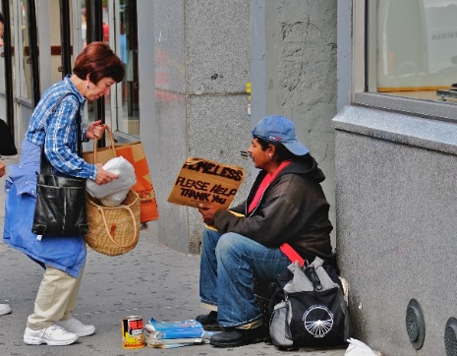
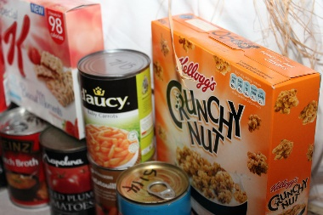




It’s not all about the money…
There are so many ways you can make a difference without giving money. Did you get any of these?
Donate food to people who are hungry.
Help others in your community e.g. visit a lonely old person!
Give second hand clothes and toys to a charity shop.
Raise awareness of an issue.
Volunteer to help a charity!
Charitable:
Giving money, food, or help free to those who are in need because they are ill, poor, or have no home.¹
If you raise awareness, you get people’s attention by telling them about an issue so that they can help you solve it.
©VotesForSchools2016
©VotesForSchools2018
Notes:
Images:
1- https://www.flickr.com/photos/bromfordgroup/8719762063

Slide 9
Our learning journey for this week!
It’s not all about money…
Why are we talking about this?
If I were a millionaire…
How can people be more giving?
Call to Action
Vote!
©VotesForSchools2018
Notes:
Image Source:
1-
References:
1-

Slide 10
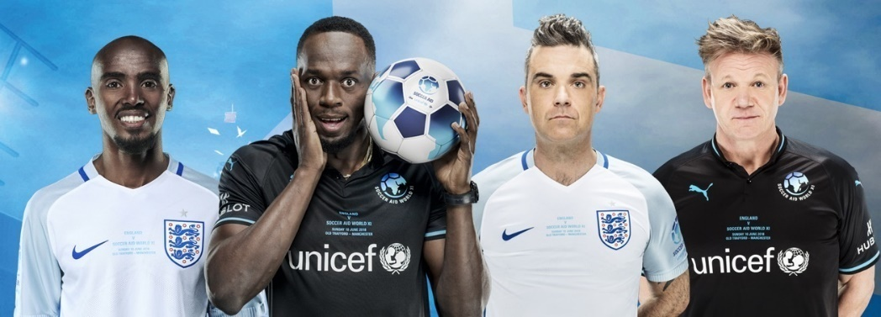


Why are we talking about this?
0:00-
1:05
On 10th June, lots of celebrities are getting together to play a game of football that will help raise money to make a difference to others! It’s called Soccer Aid…
Class Activity (3 mins)
Click the image to learn more about Soccer Aid.
Class Activity (3 mins)
Click the image to hear from Raheema about the challenges she faces.
0:00-
0:56
The money raised from Soccer Aid will go to UNICEF, a children’s charity that helps children in danger all over the world. The match will also raise awareness of the challenges children like Raheema face, all over the world.
How is UNICEF helping Raheema?
©VotesForSchools2016
©VotesForSchools2018
https://app.aframe.com/links/c4d1b81369c2d5651768d3082ebbfc18
http://viewpure.com/wCCcleGg_F8?start=0&end=0
Notes:
Images:
1- Photo: Unicef UK/Akash
2- Unicef UK

Slide 11
Our learning journey for this week!
It’s not all about money…
Why are we talking about this?
If I were a millionaire…
How can people be more giving?
Call to Action
Vote!
©VotesForSchools2018
Notes:
Image Source:
1-
References:
1-

Slide 12


If I were a millionaire…
Individual activity (7 mins)
Imagine you had £100 million.
You can spend your money on whatever you like! How much would you spend on the different things on the next slide? Write down how many million you would spend on each thing. Make sure it adds up to £100 million in total!
EXAMPLE
If I were a millionaire…
£5 million on presents for my family, friends and neighbours.
£1 million on cool holidays.
£3 million on a house with a swimming pool.
£5 million on helping the people in my community e.g. a youth club and new school playground!
£5 million for the homeless from my town to have a home.
£5 million to save.
£76 million to charity.
S&C: Work out each cost as a percentage of £100 million.
©VotesForSchools2016
©VotesForSchools2018
Notes:
Images:
1- https://pixabay.com/en/coins-money-profit-wealth-161724/

Slide 13


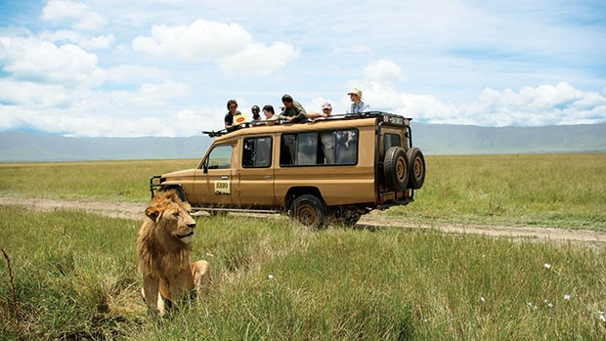

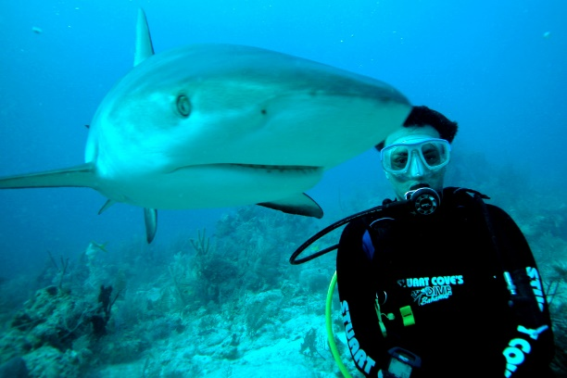

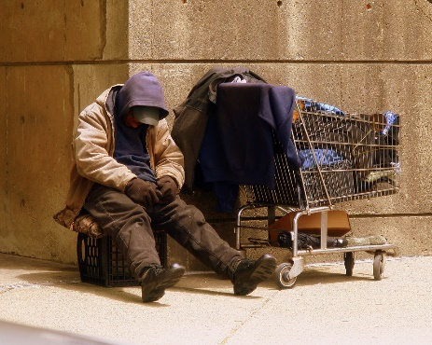


If I were a millionaire…
Would you go on more holidays?
How much would you spend on a house?
Would you buy a pet?
Would you spend money on family and friends?
What would you really want to do?
Would you give away any of your money to help others?
©VotesForSchools2016
©VotesForSchools2018
Notes:
Images:
1- https://pixabay.com/en/photos/house/
2- https://pixabay.com/en/pool-swimming-swimming-pool-690034/
3- https://en.wikipedia.org/wiki/Overseas_Adventure_Travel
4- https://www.flickr.com/photos/mlemos/2863736240
5- https://pixabay.com/en/dog-animal-portrait-baby-animal-3386457/
6- https://pixabay.com/en/disneyland-castle-paris-sky-2652760/
7- https://pixabay.com/en/coins-money-profit-wealth-161724/
8-https://commons.wikimedia.org/wiki/File:Homeless_Man.jpg

Slide 14



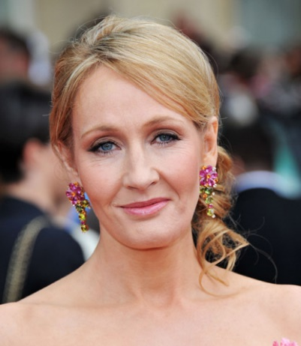

If I were a millionaire…
Lots of rich people are generous. They give money to people in need or they help raise money for charity, like the celebrities in Soccer Aid!
J K Rowling, author of Harry Potter, gave £20 million to charities last year.¹
Pop star Rihanna has helped raise more than
£1 billion³ for schools!
Pop star Akon¹ started his own charity to bring electricity to people in Africa.
Lord Sainsbury², gave more than £224 million to charity last year.
Generous:
giving people a lot of money, presents, or time in a kind way.
©VotesForSchools2016
©VotesForSchools2018
Notes:
Images:
1- https://www.alux.com/networth/akon/
2- https://www.flickr.com/photos/celebrityabc/27876724745
3- http://harrypotter.wikia.com/wiki/File:Jkrowling.jpeg
4- https://commons.wikimedia.org/wiki/File:Harry_Potter_wordmark.svg
References:
1- https://www.bankrate.com/lifestyle/celebrity-money/see-how-rb-singer-akon-built-his-wealth/
2- Sunday Times Giving List 2018: https://www.cafonline.org/docs/default-source/personal-giving/caf_sunday_times_giving_list.pdf?sfvrsn=1f08240_2
3- http://www.rttnews.com/2859144/rihanna-helps-raise-over-2-billion-for-education.aspx

Slide 15
Our learning journey for this week!
It’s not all about money…
Why are we talking about this?
If I were a millionaire…
How can people be more giving?
Call to Action
Vote!
©VotesForSchools2018
Notes:
Image Source:
1-
References:
1-

Slide 16

How can people be more giving?
People all over the world are trying to make a difference to others.
Can you guess which country is the most charitable in the world?
The UK is the 11th most charitable country in the world!
Myanmar, which is a poor country, is the most charitable in the world!
The country that helps the most strangers is Sierre Leone.
Indonesia is the country that volunteers the most.
Share a time when you did something charitable with the class…
©VotesForSchools2016
©VotesForSchools2018
Notes:
Images:
1- https://en.wikipedia.org/wiki/File:World_map_green.png
References:
1- All taken from the Charities Aid Foundation World Giving Index 2017: https://www.cafonline.org/docs/default-source/about-us-publications/cafworldgivingindex2017_2167a_web_210917.pdf?sfvrsn=ed1dac40_10

Slide 17
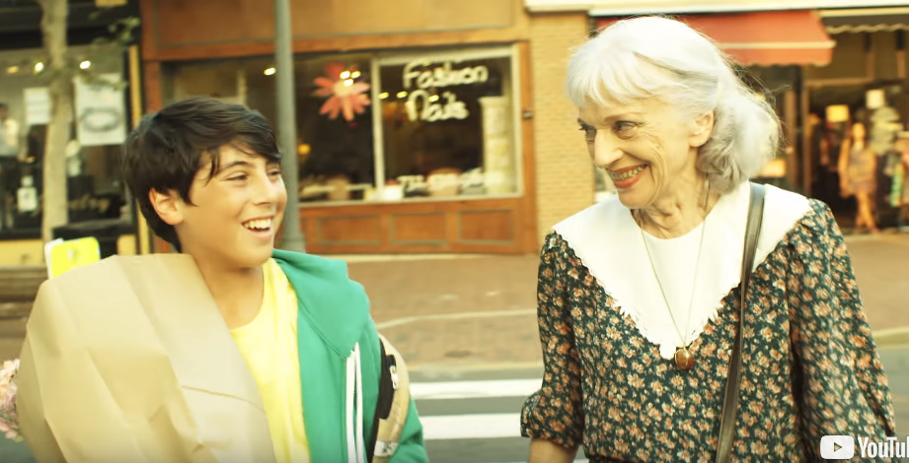
How can people be more giving?
Optional video (5 mins)
Click the image to watch this video about being kind to others to get some inspiration.
You are going to think about how the people in the world could be more giving…
0:06-
4:46
Remember!
Strangers can be dangerous so ask your parents or carers to go with you if you want to help someone.
©VotesForSchools2016
http://viewpure.com/nwAYpLVyeFU?start=16&end=286
©VotesForSchools2018

Slide 18





How can people be more giving?
Group Activity (10 mins)
If you had to write five top tips for how people could be more charitable, what would they be? Have a brainstorm in a group then create either a group or individual poster!
What could your friends do to help others?
What could adults do to help others?
What different ways could you be charitable?
Top tips for being charitable!
1
2
How much money could people give away?
3
4
Tip! It should be for adults and children.
5
©VotesForSchools2016
©VotesForSchools2018
Notes:
Images:
1- https://pixabay.com/en/school-building-education-property-295210/

Slide 19
Our learning journey for this week!
It’s not all about money…
Why are we talking about this?
If I were a millionaire…
How can people be more giving?
Call to Action
Vote!
©VotesForSchools2018
Notes:
Image Source:
1-
References:
1-

Slide 20

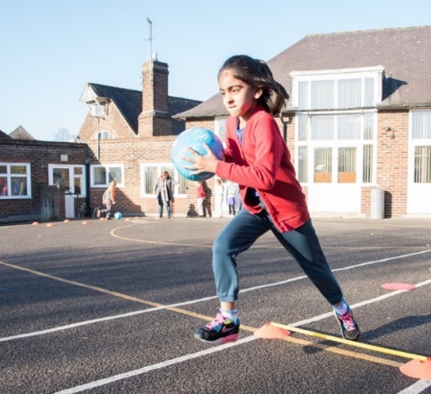

Quick idea
Call to Action!
Watch Soccer Aid!
You can watch the game live on Sunday 10th June from 8pm. You could even go to the match yourself! Tickets are on sale here.
Fundraise for Soccer Aid:
Raise money through The Playground Challenge! Design a creative and fun football-themed obstacle course, publicise the event and get people to sponsor you to complete it! Find out more ways to get involved in Soccer Aid 2018 by clicking here.
Big idea
©VotesForSchools2018
Notes:
Photo: Unicef UK/Fields
Link for Soccer Aid fundraising here:
https://www.socceraid.org.uk/schools/

Slide 21
Our learning journey for this week!
It’s not all about money…
Why are we talking about this?
If I were a millionaire…
How can people be more giving?
Call to Action
Vote!
©VotesForSchools2018
Notes:
Image Source:
1-
References:
1-

Slide 22

Do rich people give enough money to charity?
Yes
Yes
Last year, rich people in the UK gave £3.2 billion to charity.¹
Celebrities like Robbie Williams help to raise money for charity by organising events like Soccer Aid.
Many rich people are very generous and give lots of money to charity, like Rihanna and J K Rowling.
©VotesForSchools2017
Notes:
1- https://www.civilsociety.co.uk/news/uk-s-richest-gave-away-over-3-2bn-in-2018-according-to-sunday-times.html

Slide 23
Do rich people give enough money to charity?
No
No
Last year, the British public gave more money to charity than rich people did.¹
Rich people can afford to give more money to charity.
The UK is the 11th most charitable² country in the world, but it has a lot more rich people in it than Myanmar, which is the 1st most charitable country.
©VotesForSchools2017
Notes:
1- https://www.civilsociety.co.uk/news/uk-s-richest-gave-away-over-3-2bn-in-2018-according-to-sunday-times.html
2- https://www.cafonline.org/docs/default-source/about-us-publications/cafworldgivingindex2017_2167a_web_210917.pdf?sfvrsn=ed1dac40_10

Slide 24


Vote Now on… www.votesforschools.com
©VotesForSchools2017
Notes:
Image Source
1-
Reference
1-

Slide 25
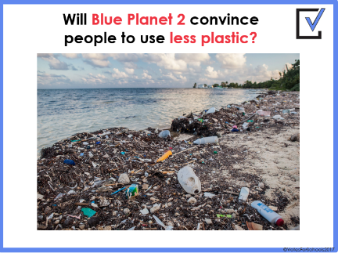
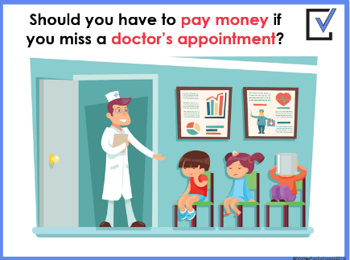

What is VotesforSchools?
VotesforSchools holds weekly debates on issues happening in the news! We aim to give a balanced view and encourage pupils to think critically. In this lesson, we encouraged pupils to think about how they would spend their money and the many different ways that people can make a difference.
If you want to know more about what we do, you can find out more at www.votesforschools.com
(Teachers: You can email matt@votesforschools.com)
©VotesForSchools2018
Notes:
Image Source
1-
Reference
1-

