Slide 1
Outright 2019
© P&Co Ltd./SC 2019

Slide 2
What is outright?
OutRight by Unicef UK will help you to put your rights into practice and speak out in support of all children’s rights in the UK and around the world.
It’s a campaign for children, by children.

Slide 3
the United nations convention on the rights of the child
The most widely ratified (approved) treaty (international agreement) in the world.
It applies to everyone under 18.
© Unicef GB/Herwig

Slide 4
Rights like…
The right to life.
Governments must do all they can to ensure that children survive and develop to their full potential.
© Unicef/Dawe

Slide 5
Rights like…
The right to the best possible health.
Every child should have access to good quality health care, clean water, nutritious food, and a clean environment.
© Unicef/Sutton-Hibbert

Slide 6
Rights like…
The right to have their views respected.
Every child has the right to express their views, feelings and wishes about anything that affects them, and have these taken seriously.
© Unicef/Fields

Slide 7
SO, WHAT’S THE PROBLEM?
This year the UN Convention on the Rights of the Child has its 30th birthday. We think this is worth celebrating!
But despite the UN agreeing to the rights of every child in the Convention 30 years ago, there is still a lot of work to be done for children in the UK and all over the world.
Every year, 5.4 million children die before the age of five. The majority of these deaths are from preventable causes.
Children face many challenges now that didn’t exist before – such as online bullying, childhood obesity and climate change.
More countries are in conflict than at any time since the Convention was written and many children are among the millions of refugees from these conflicts.

Slide 8
WHAT ARE WE GOING TO DO?
We are going to learn about the UN Convention on the Rights of the Child and child rights in the past and present day. We will also imagine the best possible future for children all over the world.
We are going to tell our local decision-makers (like your MP) and the Prime Minister which child rights issues are most important to us and ask them to do something to help.
We will also ask the UK Government to spend more on vaccines for children so that they do not die from preventable causes like measles and polio.
© Unicef/Fields

Slide 9
INTRODUCING PADDINGTON
© P&Co Ltd./SC 2019

Slide 10
PADDINGTONTM AND OUTRIGHT
Paddington’s kindness, tolerance, perseverance in the face of adversity, and willingness to stand up for things he believes in make him the perfect champion for children.
Paddington wants children to use their voice to make the world a better place.
He will be joining us on our journey to learn more about the UN Convention on the Rights of the Child and celebrate its 30th birthday.
Notes:
Adversity means….

Slide 11
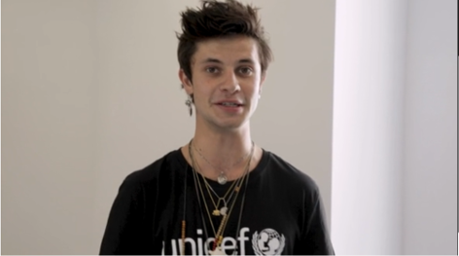
WELCOME FROM CEL SPELLMAN
Cel Spellman, actor and Unicef UK Ambassador
Watch video
Notes:
https://www.youtube.com/watch?v=F_tT8gWG9h4&list=PLLnYeCQ-QQDnmFwcG10e13GKRM8xUBDL9&index=2&t=0s

Slide 12
JOIN PADDINGTON AND CEL MAKE YOUR VOICE HEARD
You can share your views on what matters to you with the Prime Minister.
You can take action by writing to your local decision-maker, e.g. your MP, to tell them what child rights issue is most important to you, and invite them to your school.
You can influence the Secretary of State for International Development to spend more on vaccinating children around the world.
You can get involved in World Children’s Day (20 November) activities or tell your local newspaper or radio station what you’re doing for OutRight.

Slide 13
TAKE ACTION
By getting involved in OutRight this year, you’ll be making yourself heard on what matters to you most.
Together, we can help make sure children in the UK and all over the world live happy, healthy lives.

Slide 14
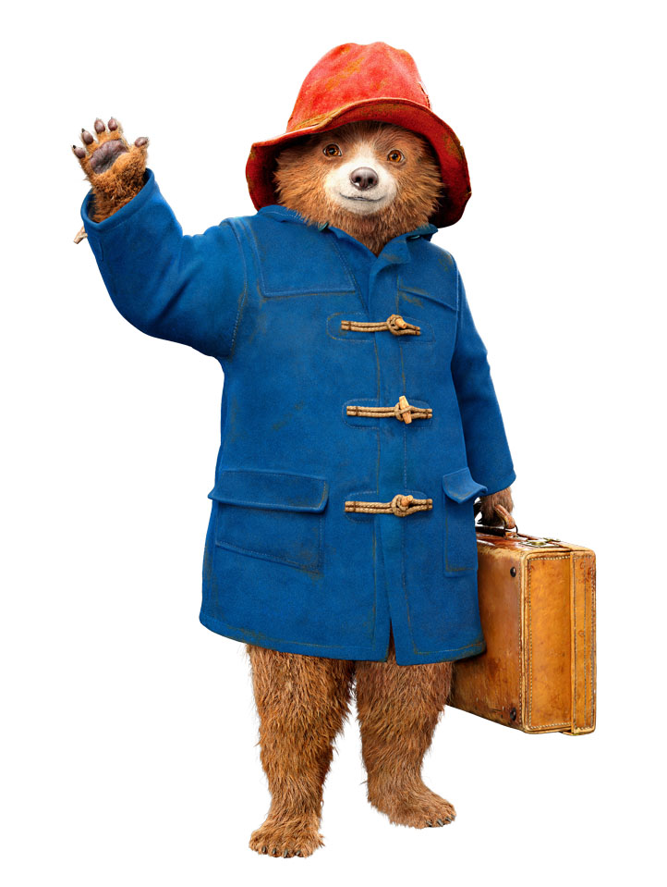
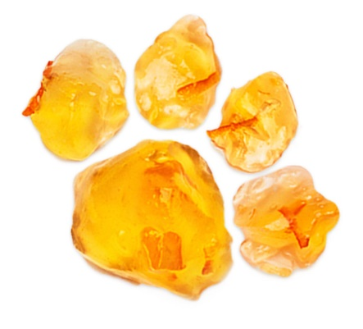
PLEASE LOOK AFTER THIS BEAR
THANK YOU
© P&Co Ltd./SC 2019

