Slide 1
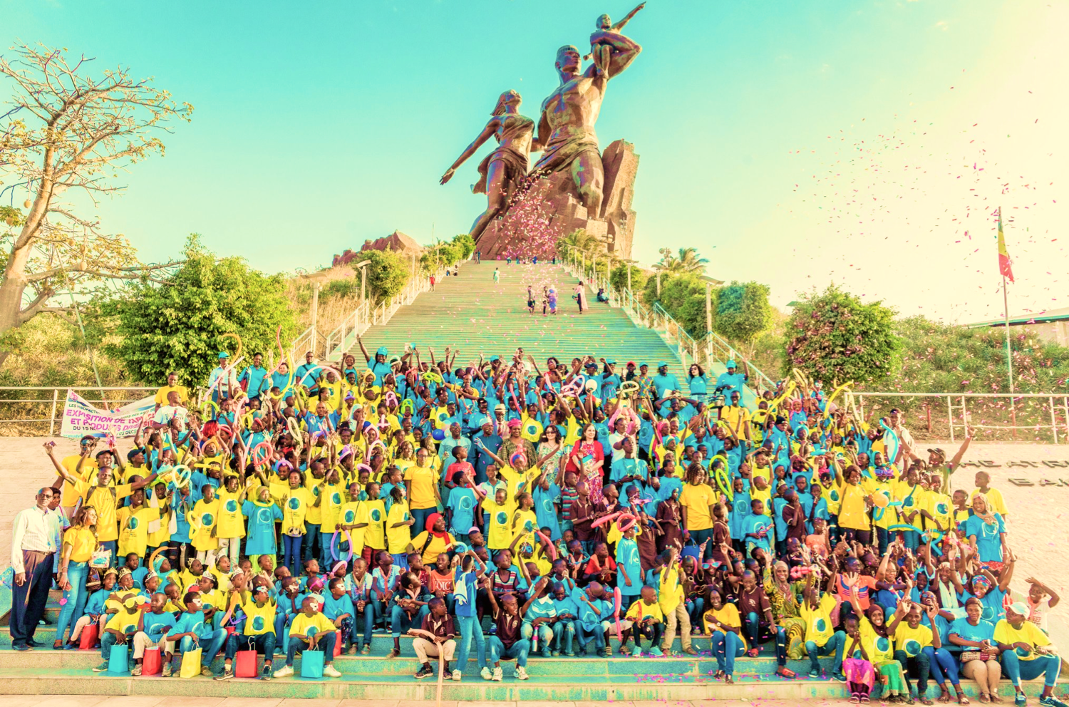
2019
A GLOBAL DAY OF ACTION FOR CHILDREN, BY CHILDREN
Notes:
Background music can be found here:
https://www.unicef.org.uk/rights-respecting-schools/resources/ideas-from-schools/songs-created-schools/

Slide 2
How many children are there in the world?
Your school:
10 million
100 million
A billion
2.5 billion
5 billion
10,000,000
100,000,000
1000,000,000
2500,000,000
5000,000,000

Slide 3
How many children are there in the world?
10 million
100 million
A billion
2.5 billion
5 billion

Slide 4
How many children are there in the world?
10 million
100 million
A billion
2.5 billion
5 billion
That’s about 500,000 times
more than the number of stars you can
see in the night sky!

Slide 5
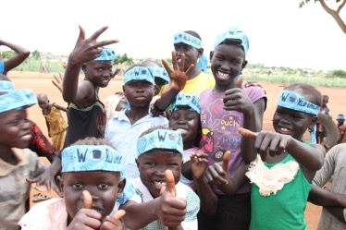
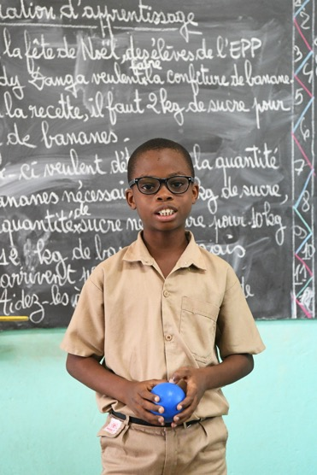
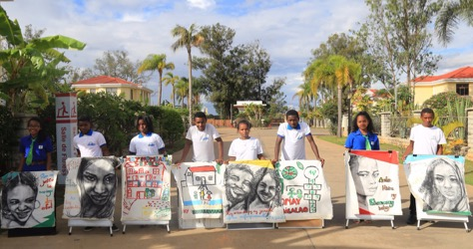
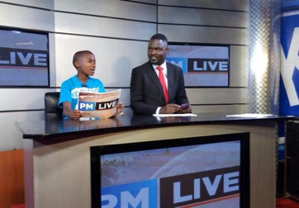
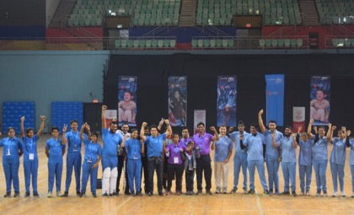
What do all children in the world have in common?
Their Rights!
How many children’s rights can you name?

Slide 6
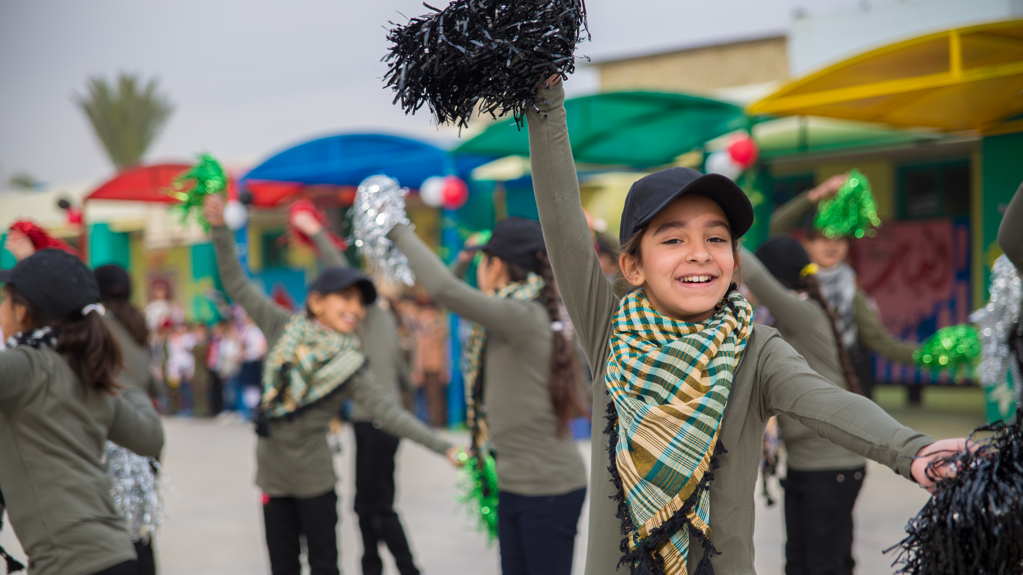
The UN Convention on the Rights of the Child…
… tells us all the rights children have.
If you add them up there are 54 rights in total.
They are for all children, everywhere, all of the time.

Slide 7
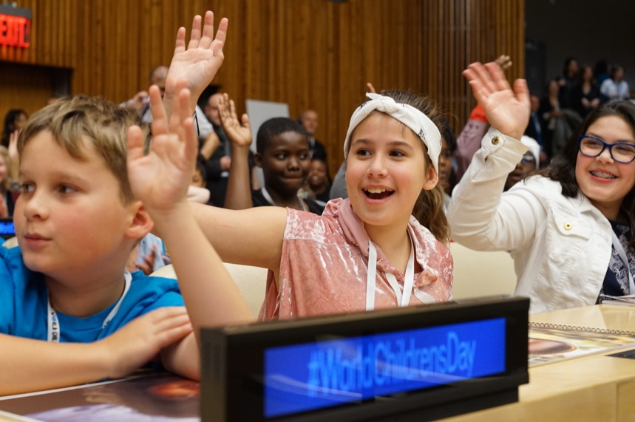
World Children’s Day 2018
World Children’s Day celebrates children’s rights
Help Unicef support and protect children’s rights around the world.

Slide 8
UNICEF SUPPORTs CHILDREN TO CLAIM THEIR RIGHTS
World Children’s Day is an opportunity to imagine a better world for all children.
A world where all children’s rights are respected.
Notes:
Please review video before showing to children.
Talking points can include:
Unicef is a global children’s charity. We work in 190 countries around the world to ensure that children are educated and protected.
We help influence laws and policies to help protect children everywhere and uphold their rights.
Rights are promises that the world has made to children.
These promises are written down in a document called the UN Convention on the Rights of the Child and cover all aspects of a child’s life and set out the civil, political, economic, social and cultural rights that all children everywhere are entitled to.
By having these rights children everywhere can speak out and lead the way to the world they deserve, like the children in this video.

Slide 9
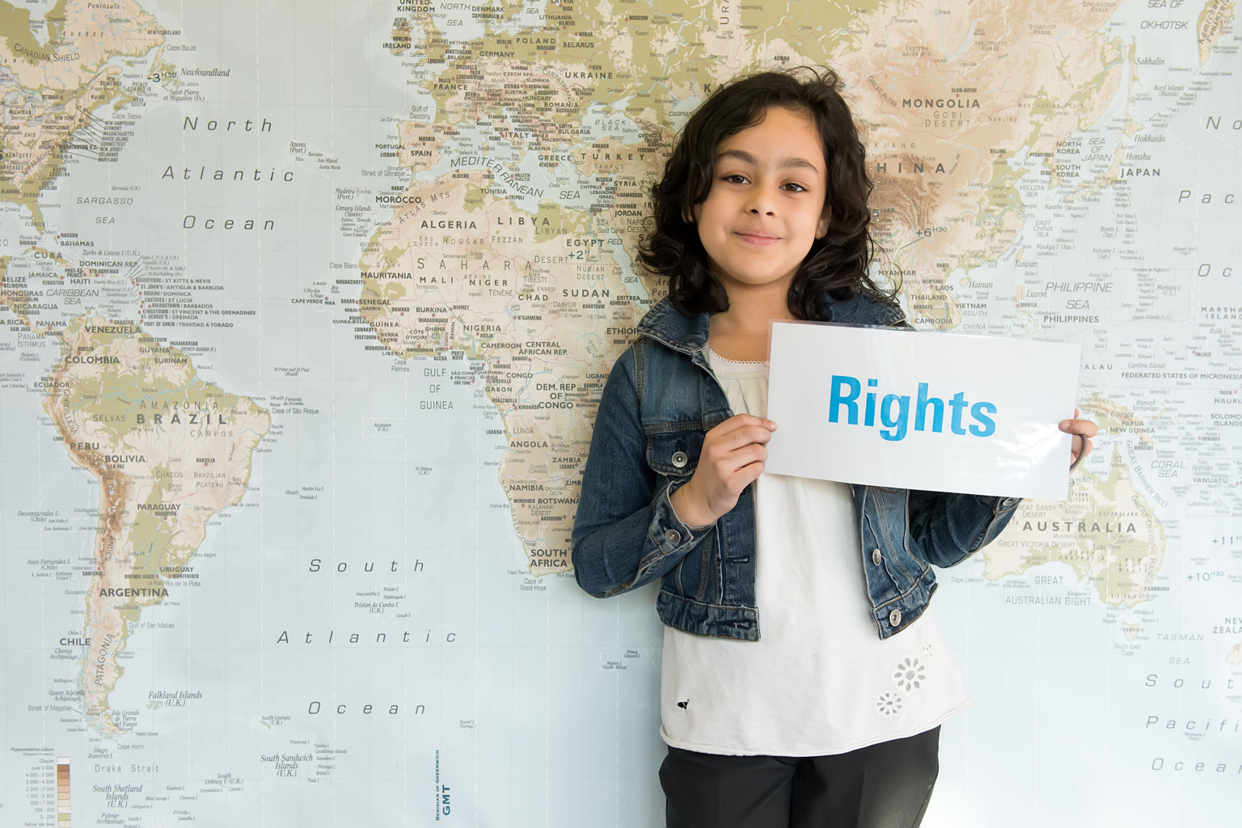
schools can support children’s rights
Sadly, many children in the world (including the UK) are being denied their rights. Here are some ideas for schools which can help you learn more about this and how to help.

Slide 10
Thank You!

