Slide 1
Notes:
Introductory slide.
Photo from https://www.unicef.org/world-childrens-day

Slide 2
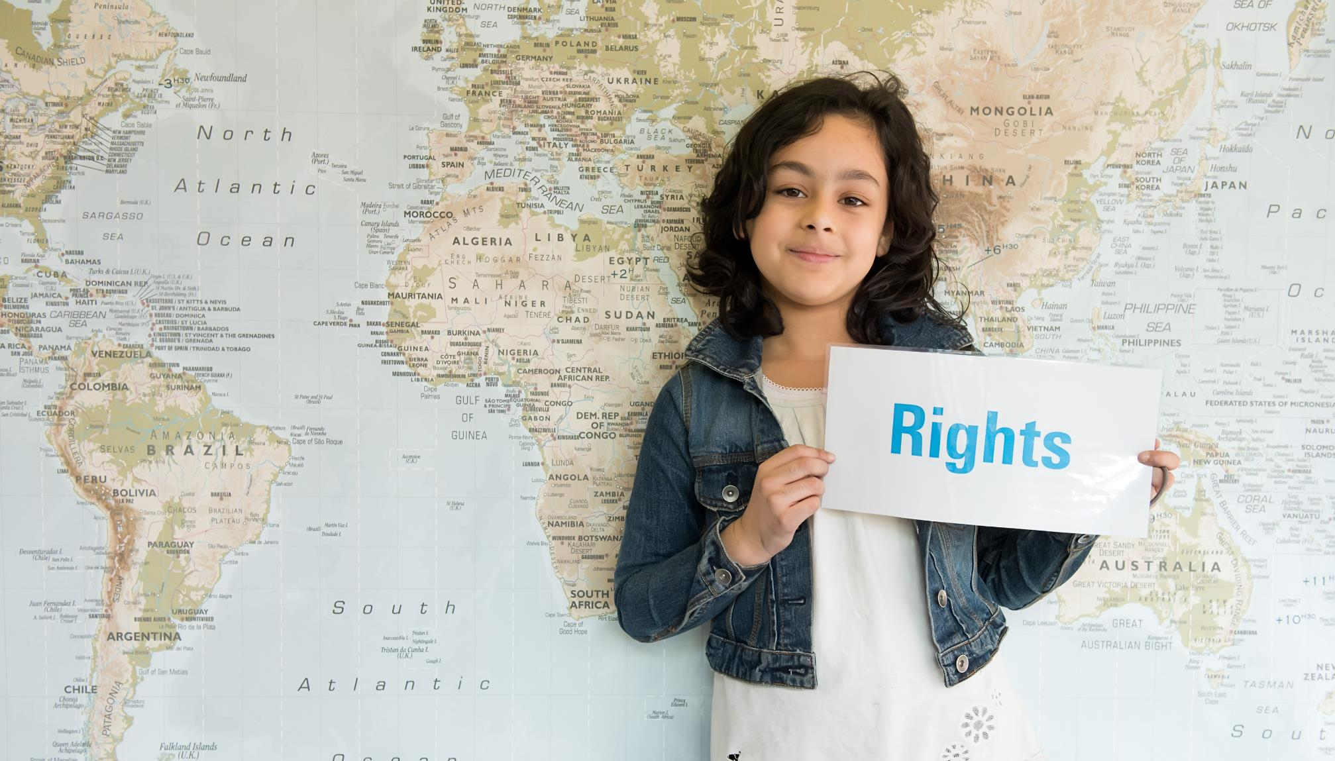
This year we are celebrating the 30th birthday of the
UN Convention on the Rights of the Child.

Slide 3
How many articles are in the Convention?
The Convention highlights the rights children have - these are for all children, everywhere, all the time.
54
Notes:
Talking points:
Ask children to put your hands up if you can tell me how many articles are in the Convention?
If you schools is a Rights Respecting School it is likely they you know, but if not do invite guesses.

Slide 4
ARTICLE 24
Every child has the right to the best possible health.
Governments must provide health care, clean water, good food, and a clean environment so that children can stay healthy.
Richer countries must help poorer countries do this.
What example of supporting children’s health is being shown in the picture?
Notes:
Highlighting Article 24.
Brief discussion with pupils about what aspect of health is being shown in the pictures.
Look for answers like medicine, vaccinations, children’s health, going to the doctors etc.

Slide 5
It’s……… VACCINATIONS!
Notes:
Talking points:
As part of the presentation, ask pupils why one finger is stained in the photo?
Get two or three answers from the children before telling them it is to show that the child has been vaccinated.
Suggested response to children who might say that their parents have not vaccinated them:
Unicef believe that vaccines should be easily accessible and have a really important role to play in preventing the transmission of diseases.
Under the Convention children have a right to the best possible health (article 24). However, we also respect the responsibilities, rights and duties of parents and guardians (articles 5) and the right of parents and guardians to provide direction for their children (article 14).

Slide 6
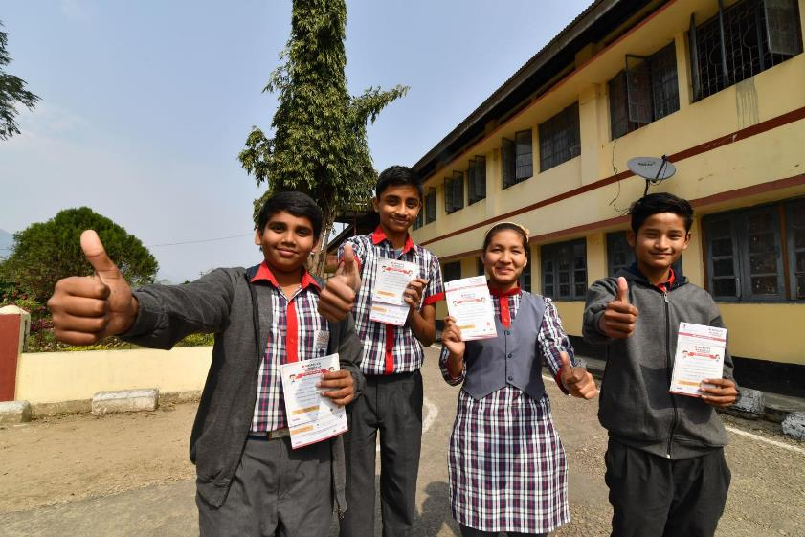
Vaccines help to save lives!
In 2018, UNICEF reached almost half of the world’s children with vaccines.
Vaccinations saves 2-3 million children each year from deadly childhood diseases like measles, polio and pneumonia.
Notes:
Talking points:
You could ask children to thank about what students in photo are celebrating.
They are celebrating because they have been involved in an immunisation programme.
Image taken from: https://www.unicef.org/immunization
Data from https://www.unicef.org/stories/infographic-fast-facts-immunization

Slide 7
It can be easy to take vaccines for granted
Notes:
In some parts of the world getting vaccines to children can be very challenging. Why do you think this is?
UNICEF is working hard to help to try make sure that vaccines can reach these children.

Slide 8
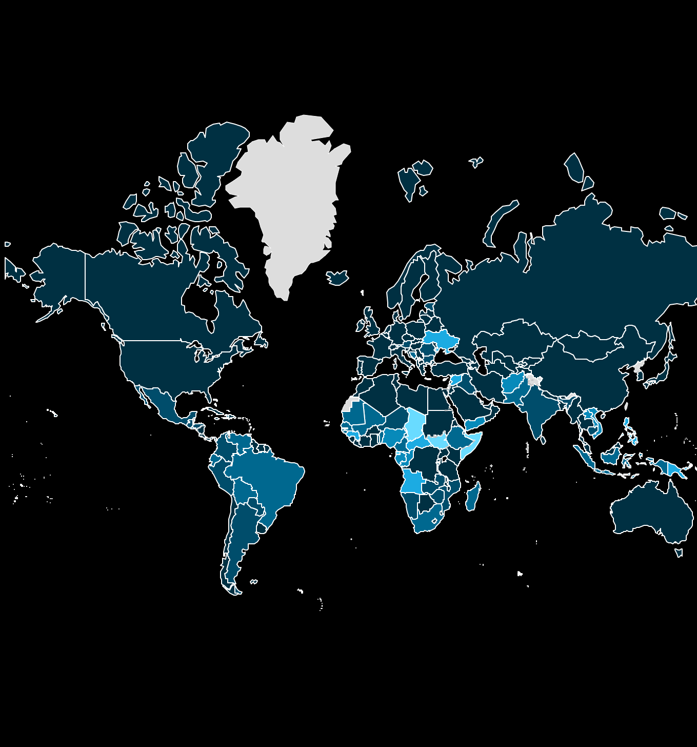
But there is much more to do!
In 2018, 116 million children were vaccinated against diphtheria, tetanus and whooping cough 20 million children worldwide – more than 1 in 10 – missed out on this vaccine.
Interactive
Notes:
Using interactive global map https://data.unicef.org/topic/child-health/immunization/ to highlight challenges re: vaccinations.

Slide 9
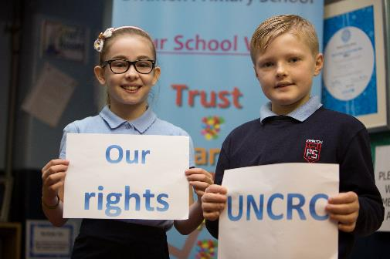
How your school can get involved?
Celebrate World Children’s Day on November 20th!
Sign up to Unicef UK’s OutRight Campaign - speak out on children’s rights and celebrate thirty years of the Convention.
Notes:
Through OutRight this year one of the big project actions is to ask the Secretary of State for International Development why children in the UK care about the health of children around the world.

Slide 10
Thank you!

