Slide 1
UNICEF/Lopez
Notes:
Child monks at Dechen Phodrang Monastic School learning prayers. The monastery sits on top of a steep hill overlooking the Bhutanese capital, Thimphu.
"Many of the children come here because their situation at home is desperate. We try to do the best we can for them," says Kencho Tshering, principal of Dechen Phodrang's monastic school. "Most don't see their families for many months, or even years, as many families can't afford the journey. There is an understanding that once the boys enter the monastery, their lives are now committed to spiritual knowledge.“
"The idea that these children have basic rights – to be protected from harm, to good health, sanitation – is a new concept to many of the monks who have themselves gone through a monastic education, where there is an emphasis on hard discipline and on total integration into spiritual life," says Dorji Wangdi, child protection officer at Unicef Bhutan.

Slide 2
Teacher slide
Contents
Slide 3 Guess the article
Slide 4 Introducing the article
Slide 5 Start thinking about Article 14
Slide 6 Making Article 14 happen
Slide 7 & 8 Primary activities
Slide 9 & 10 Secondary activities
Slide 11 Reflection
Slide 12 Extension
Instructions
This flexible resource is intended to provide you with some easy to use, appropriate rights-related learning to share with your children, their families and your colleagues.
Please edit out non-relevant slides or tasks before sharing with students.
Please check the content works for your learners and feel free to add any content that would make the material more relevant to your setting.

Slide 3
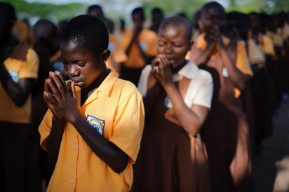
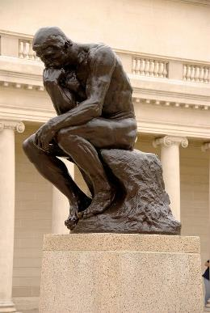
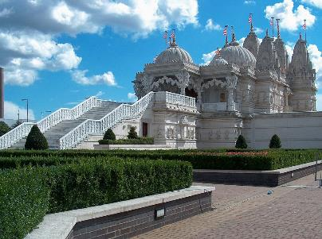
Guess the article
These pictures provide a clue to this week’s article.
How do these pictures help you? Can you guess how they are linked together?
Write down your thoughts or discuss with someone in your house.
UNICEF/Quarmyne
Wikimedia commons
Wikimedia commons

Slide 4
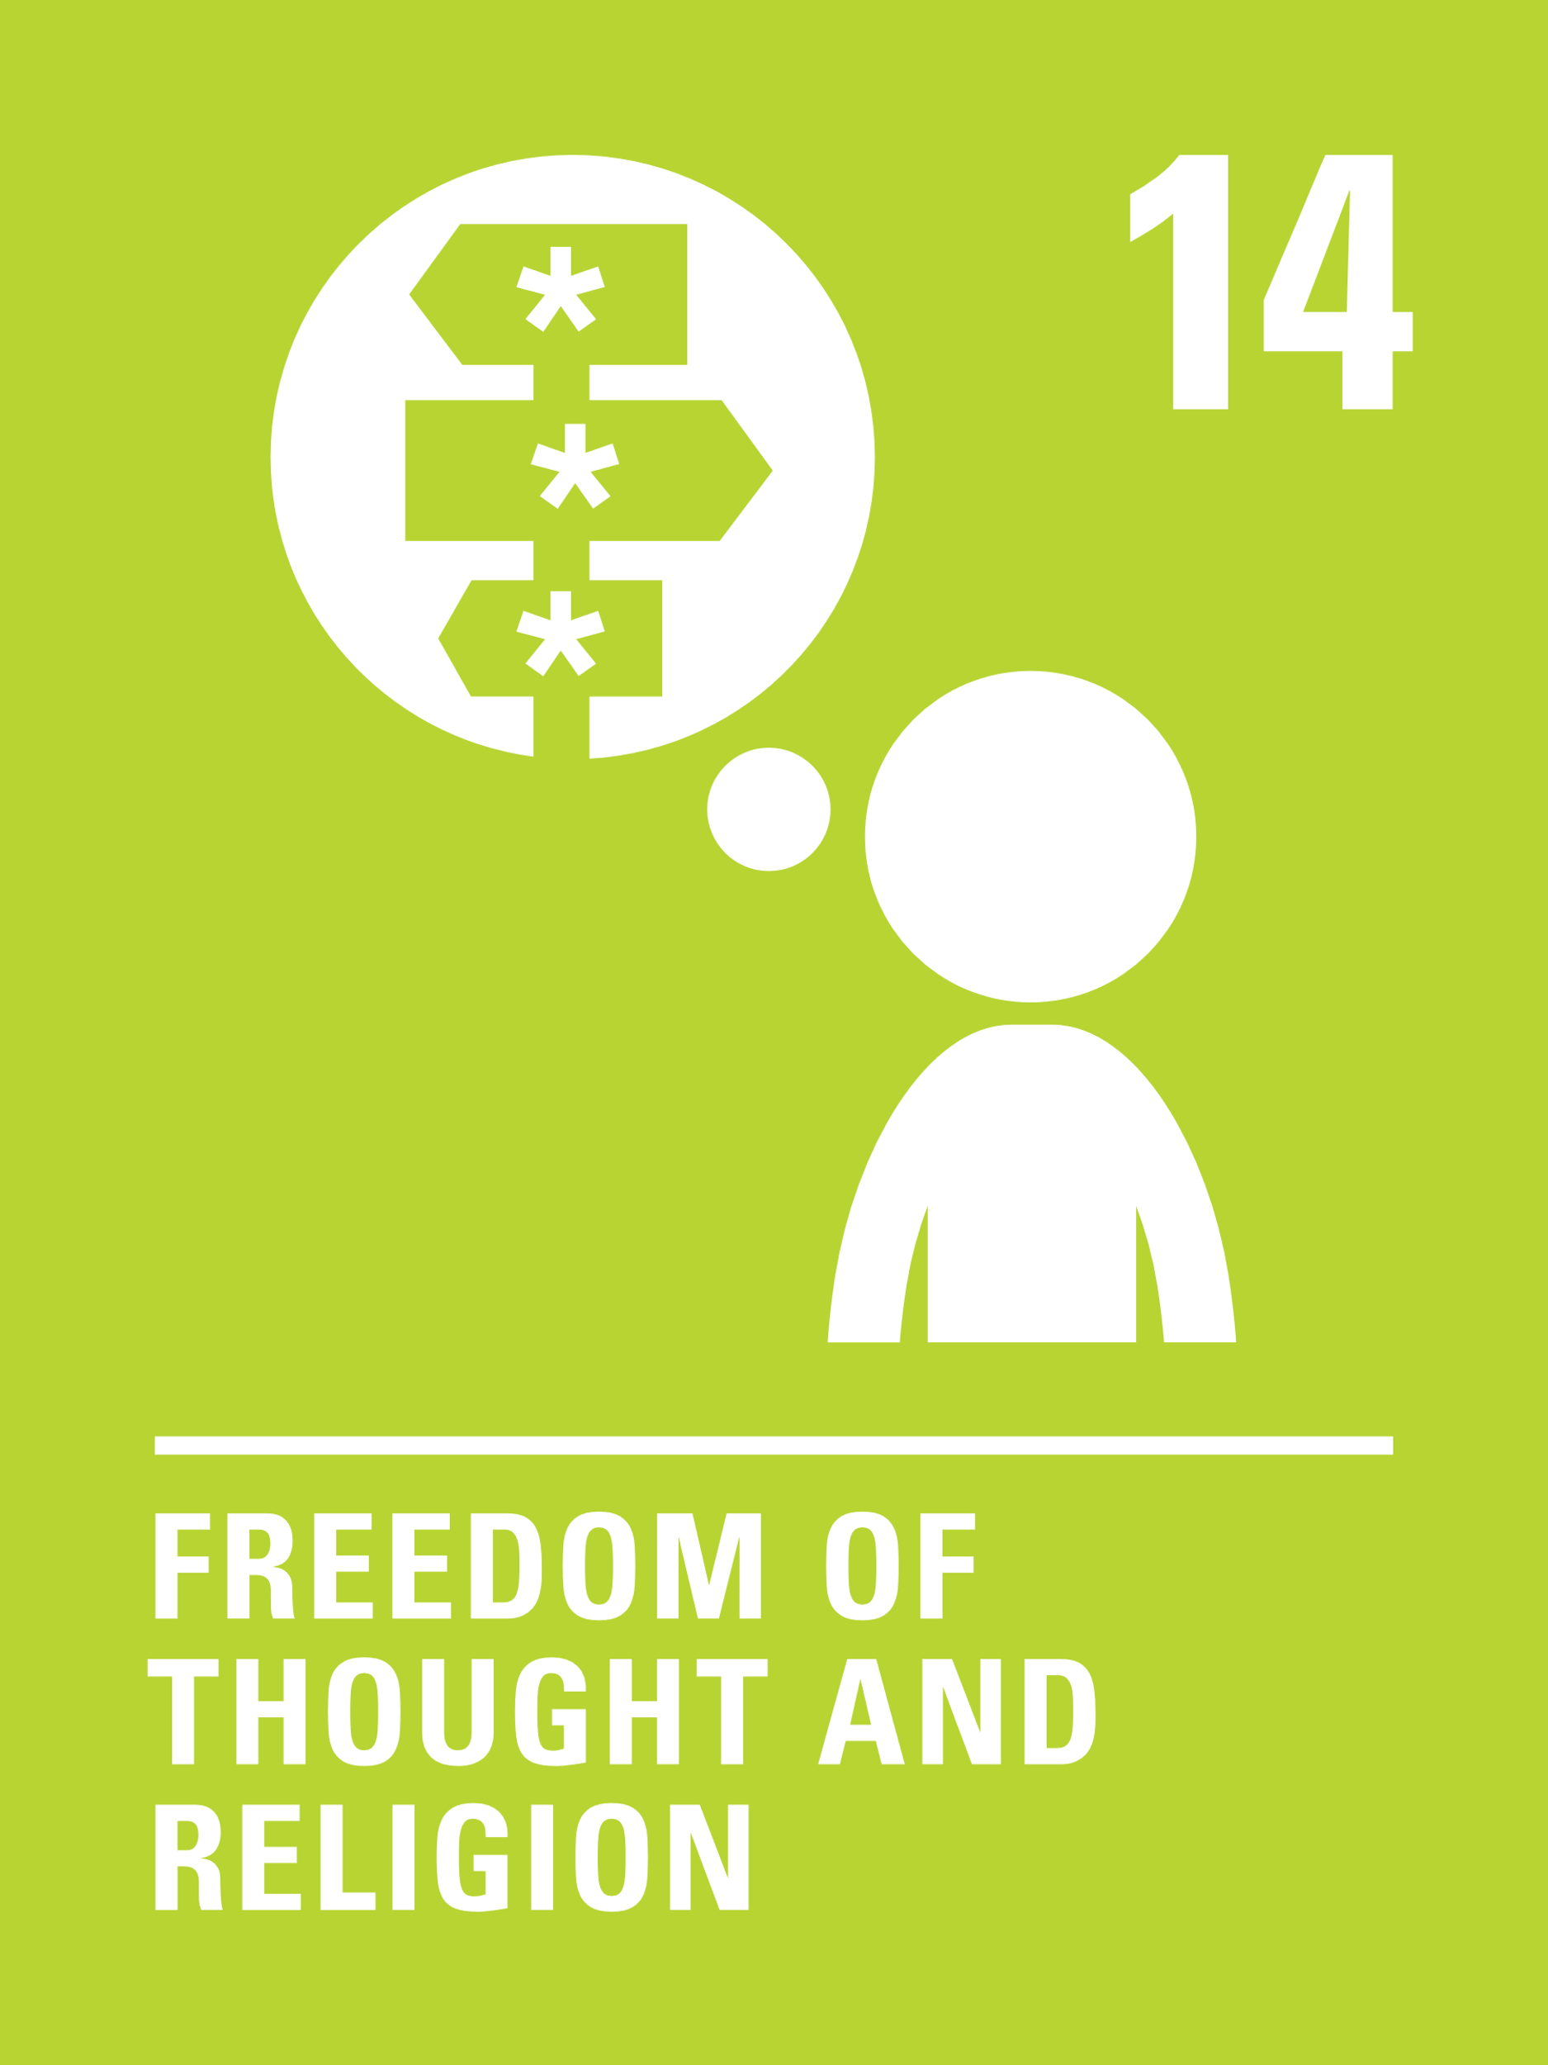
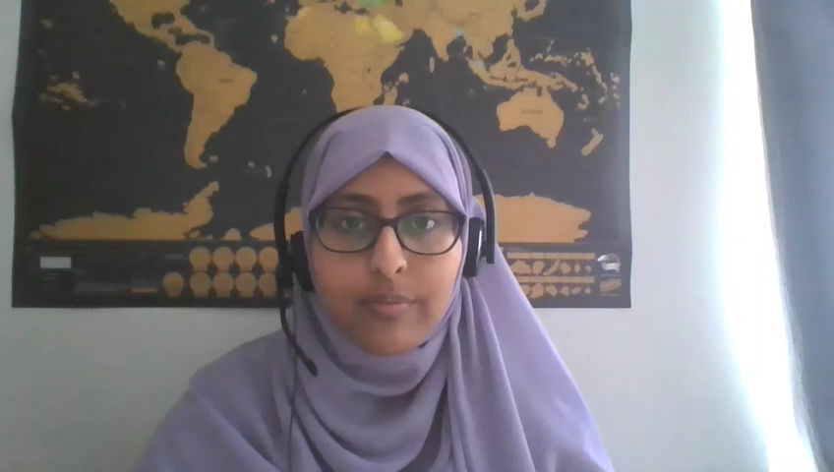
Introducing… Article 14
Samiha introduces Article 14
Article 14 – Freedom of thought, belief and religion.
Every child has the right to think and believe what they choose and also to practise their religion, as long as they are not stopping other people from enjoying their rights. Governments must respect the rights and responsibilities of parents to guide their child as they grow up.
Watch on YouTube

Slide 5
What needs to happen for you to have your thoughts and beliefs respected?
How does your school show they respect everyone’s beliefs?
Write them down and then compare your answers with the next slide.

Slide 6
How many of these did you get?
You have opportunities to have your views listened to and valued
Your food choices are respected
People have the time and space to pray or reflect
There is an opportunity to celebrate special times or festivals
You have a variety of uniform options to reflect beliefs
Everyone is encouraged to respect each other’s viewpoints
It is an inclusive environment where everyone feels welcome
Can you think of any others?

Slide 7
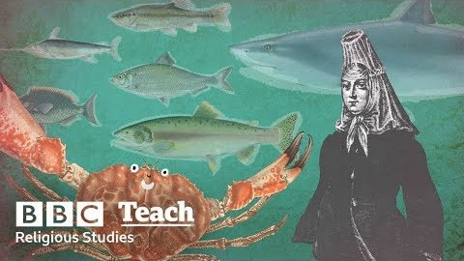



Activity Time
Food choices are really important to some people. Find out about the food rules of veganism or a specific religion. If you have the ingredients at home, why don’t you have a go at making a dish with your family? Watch this video from the BBC and its humorous exploration of food and religion.
All these activities are related to…
Thoughts and beliefs are usually really important to people. Write down some things you believe in strongly. Share these with your family or discuss them with your friends.
Why do you think religious buildings are important? Think of and draw a building that is important to you or make a sculpture of one of these buildings using things you can find around the house (old cereal boxes, empty toilet roll etc.). This could be a religious building like a church or a temple, or even a school or a library. Write a sentence or two about why this building is important to you.
List as many religions as you can think of. Do you know what symbols are linked with these religions? Have a go at drawing them if you can.
You don’t need to do every single activity
but if you have time you can do more than one.
Primary

Slide 8





Activity Time
Imagine you are part of your school council. What ideas do you have to make sure your school listens to the thoughts and respects the beliefs of all children?
People’s beliefs often influence the way they act and behave. Imagine you have discovered a new planet to live on. What ideas do you have about how you would want all the people who live there to treat each other and their planet?
Can you think of some items or religious artefacts that are important in more than one religion? For example, candles, prayer beads and head coverings. Choose one and draw a scene of a child using this item in one of these religions and explain the meaning of this object.
April was an important month this year for many religions. Can you think of some festivals and events that took place in April? Work with your friends and family safely online and see how many you can think of. You could write a sentence, draw a picture or write a story about a child celebrating this festival or special day.
Primary

Slide 9


Activity time
Can you think of an example of when a group of people were stopped from practising their faith? Either in the present day or in history? Research and write a short newspaper article about this event.
These activities will help you
understand how...
…can relate to your life.
You don’t need to do every activity, just do as many as you can.
Religion and beliefs are important in many people’s lives. Why do you think this is? Talk with different generations within your family group or friends to get a range of views.
Write a ‘for and against’ debate for why people should be allowed to wear a religious item of clothing or accessory in public. You can even do a debate with someone you live with and ask a third person to be the impartial judge or have the debate safely online with your friends.
Imagine someone you know has been excluded from a club because of their beliefs. You have been asked to speak on their behalf at the School Council. Write an argument defending them, using Article 14 to help you.
Secondary

Slide 10




Activity time
Every child has the right to think and believe what they choose as long as they are not stopping other people from enjoying their rights. Have you ever heard of views, beliefs and opinions which go against other people’s rights? Discuss this with somebody at home.
When learning about wars in school you might have heard about people refusing to fight because it goes against their beliefs. They are called conscientious objectors. Do some research to find out more about them.
Freedom of thought also means freedom to have no religion. In a poll in 2016, British people under 40 were far more likely to report being “no religion” than anything else. Why do you think this might be? Talk to your family and friends to see what they think. Do you think people of no faith are as respected as people of faith?
Some people choose humanism or another non-religious belief system as a way to live their lives – do some research and create a poster or art piece that captures one of these approaches to life.
Secondary

Slide 11
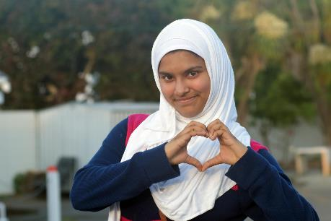
Reflection
Try to spend a few minutes being quiet and still. Think about the beliefs that matter most to you…
Why do you think a child should be allowed to choose their own beliefs? Why is it important that a child is supported by their family to make a decision about their faith and beliefs for themselves?
Are there ways that you can respect and support students in your school that may have different beliefs to you? When you’re back in school you might want to ask about their beliefs to find out more, you could even celebrate a special day with them.
UNICEF/Donnell

Slide 12
Extension
Rights are indivisible and interdependent.
Have a think about other rights that have links with Article 14. You might want to begin with Articles 13 and 17.
You can find a summary of the whole Convention here
UNICEF/Dawe

Slide 13
Thank you

