Slide 1
Unicef/Trillo
Notes:
Sabba [name changed] arrived by sea in Spain in October 2017 from Morocco, photographed on the beach near a city in the south of Spain on 29 November 2019. To escape her parents, at age 14, she married a 27-year-old man. The marriage lasted a month and Sabba returned to the family home, to abuse. "I had to leave Morocco and go to Europe. Only then could I have a future," she says.
Unicef/Trillo

Slide 2
Teacher slide
Contents
Slide 3 Guess the article - images as clues to identify the article
Slide 4 Introducing the article
Slide 5 Exploring Article 19 – the question
Slide 6 Exploring Article 19 – some answers
Slide 7 & 8 Primary activities
Slide 9 & 10 Secondary activities
Slide 11 Reflection
Slide 12 Extension
Instructions
This flexible resource is intended to provide you with some easy to use, appropriate rights-related learning to share with your children, their families and your colleagues.
Please edit out non-relevant slides or tasks before sharing with students.
Please check the content works for your learners and feel free to add any content that would make the material more relevant to your setting.

Slide 3
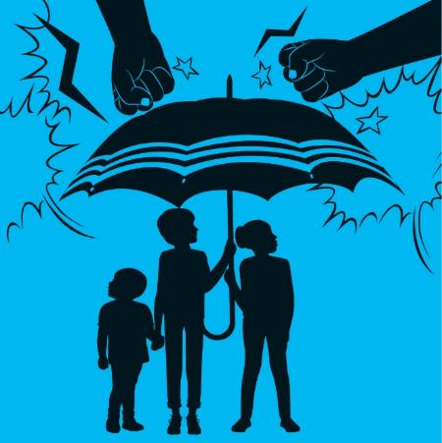
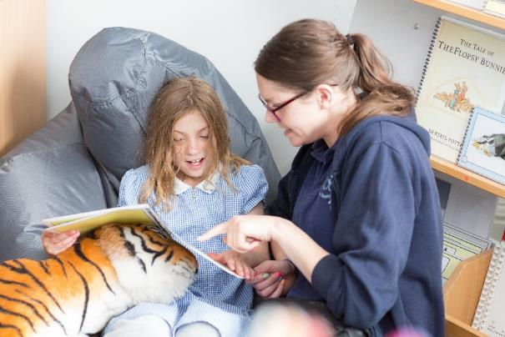


Guess the article
These pictures provide a clue to this week’s article.
What right is being shown in these pictures? Can you guess how they are linked together?
Write down your thoughts or discuss with someone in your home.
Unicef/Dawe

Slide 4

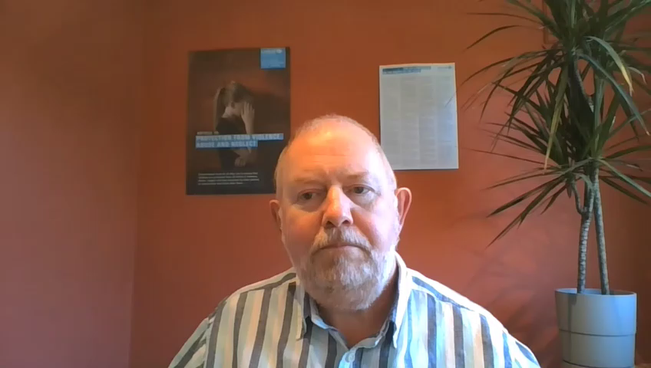
Introducing… Article 19
Martin introduces Article 19
Article 19 – Protection from violence, abuse and neglect
Governments must do all they can to ensure that children are protected from all forms of violence, abuse, neglect and bad treatment by their parents or anyone else who looks after them.
Watch Martin on YouTube

Slide 5
Exploring Article 19
What do people around you have to do to make sure you are safe and protected?
Write them down and then compare your answers with the next slide.

Slide 6
How many of these did you get?
Understanding what it means to be safe and protected
Knowing that people care about you
Being able to talk about your emotions and feelings
Finding out and learning about why some things are not safe
Knowing that there is an adult who will listen to you and take you seriously
Feeling looked after, valued, secure and respected
Having confidence to get help if you need it
Knowing how to be safe on line
What else did you think of?

Slide 7



Activity Time
Can you think of places or situations that have special rules about safety, such as a swimming pool or train station. Choose one and design a safety poster.
All these activities are related to…
Think about the feelings we have when we know we are safe and cared for. Write a poem or song to describe how this feels. Use good metaphors and similes to describe the emotions.
Draw or list some of the people whose job it is to help you stay safe and protected.
Article 19 means that no child should be hurt, hit or treated badly. Find out about the punishments for children in schools in Victorian times. Imagine you lived then and wanted to end physical punishment in school. Write a letter to Queen Victoria explaining why you think things should change.
You don’t need to do every single activity
but if you have time you can do more than one.
Primary

Slide 8




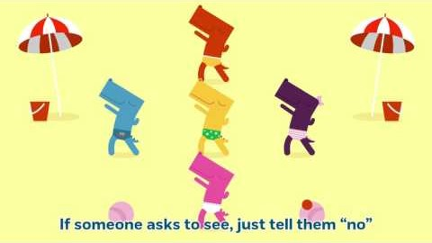
Activity Time
Draw a cartoon or design a logo about the right to be protected from harm. Share this with your family and friends.
When you are in school there are lots of adults to talk to if you are not feeling safe or something is wrong in your life. You have heard of Childline but do you know much about their work? Find out more on their website and share five facts with your friends or family.
What do you know about being safe online? Have a conversation about this with the adults you live with. Talk about safe settings on your router and on all devices in the house. Ask your family to look at this Safer Internet website and let you watch some of the videos in the resources section.
You might have watched this ‘PANTS’ video in school. Watch it with the people you live with and have a look together at the NSPCC information here.
Primary

Slide 9


Activity time
Work with your siblings or with your friends safely online to write and perform a radio advert aimed at children and young people to promote child safety during this lockdown time. Include a message to encourage them to contact ChildLine if necessary.
You probably know lots about being safe on line. Evidence has shown that most young people are glad that parental settings exist. Have a chat with the adults in your home about safe settings on your router and all devices. Imagine you had to prepare a presentation about online safety for younger children – have a go at preparing some slides – you might find these websites helpful: Safer Internet and CEOP
These activities will help you
understand how...
…can relate to your life.
You don’t need to do every activity, just do as many as you can.
Imagine that you had to make sure that every adult properly understood Article 19 and why it is so important, what would you say? How could you persuade them as to why it matters so much. You could write a speech or prepare a PowerPoint presentation.
In Wales, Scotland and Jersey there are now laws in place that protect children from physical punishment from their parents. What arguments or reasons would you put to the Prime Minister to persuade him to make this a UK wide law.
Secondary

Slide 10




Activity time
What if a friend talks to you about not feeling safe at this time? Have you thought about what you would do? Perhaps you and your friends could work together to design a poster reminding young people about how and where to seek help.
Connect with other young people on Unicef Voices of Youth. There is lots here related to being safe especially to do with mental health. You can find Voices of Youth here.
Think about the staff in school who look after Child Protection, Safeguarding and other support such as counselling and emotional support. Think about the skills and qualities those people have to do that work. Write a letter or a poem to sum up what they do for the pupils at your school.
Your school probably reminds you a lot about who to speak with if you are not feeling safe or something is wrong in your life and they probably remind you about organisations that are there to help such a Childline and Young Minds. Take some time to find out a bit more about how these organisations support young people and what they offer. Tell the people you live with, or your friends, what you have found out.
Secondary

Slide 11
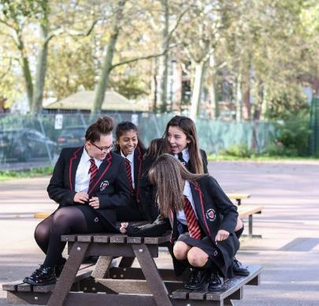
Reflection
Try to find somewhere quiet and spend a few minutes being quiet and still. Then think about these questions:
Who are the people who make you feel really safe and secure? How does it feel to be with them?
In this time when most people are away from school, how can they get help if they are feeling unsafe?
Think of the people you know who make you feel especially safe and secure – think about a way you can thank them for this and let them know how much it matters to you.
UNICEF/Dejongh

Slide 12
Extension
Rights are interdependent – what that means is that there are lots of connections between different articles.
Think about computers, the internet and being online… How many different articles can you link to this?
A clue: some are rights that can be helped by being online and there are other rights about protection and safety.
You can find a summary of the whole Convention here
UNICEF/Dawe

Slide 13
Thank you

