Slide 1
Outright 2018
© P&Co Ltd./SC 2018

Slide 2
What is OutRight?
OutRight by Unicef UK aims to empower you to realise your rights and speak out in support of all children’s rights in the UK and around the world. It’s a campaign for children, by children.

Slide 3
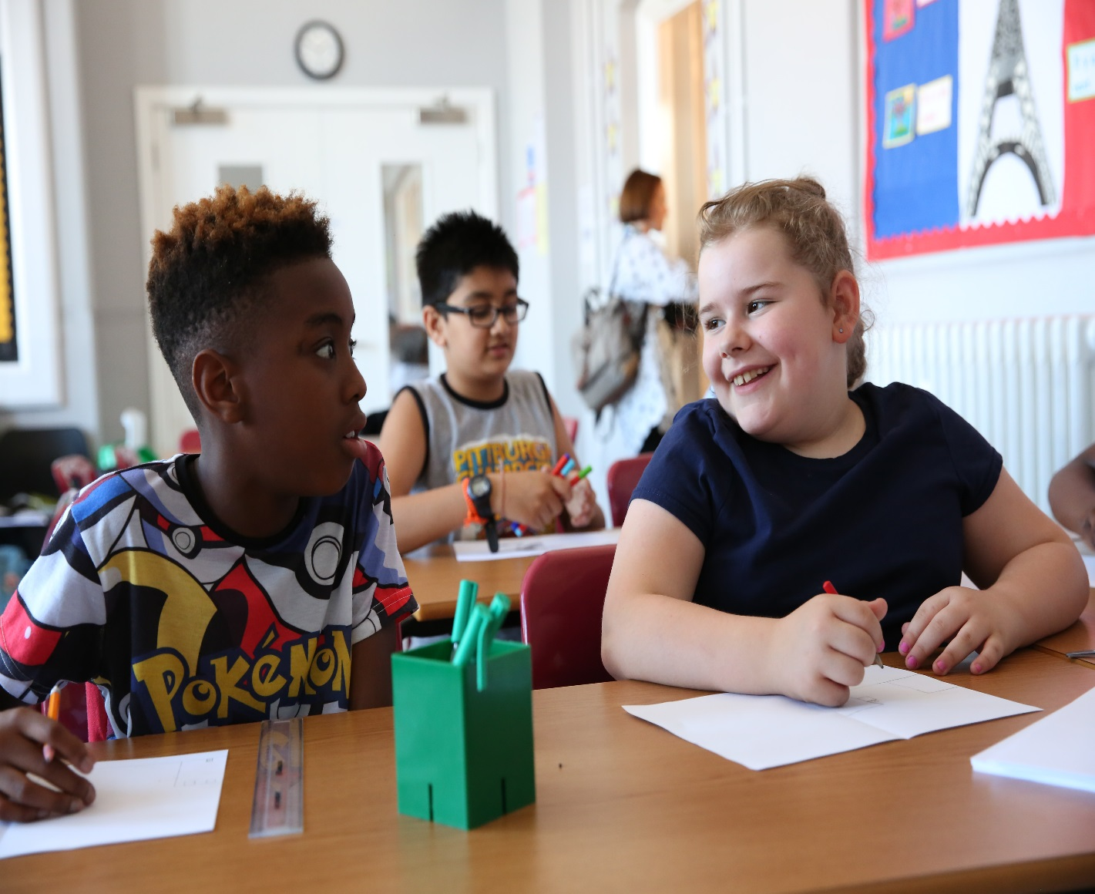
the United nations convention on the rights of the child
The most widely ratified (approved) treaty in the world.
It applies to everyone under 18.

Slide 4
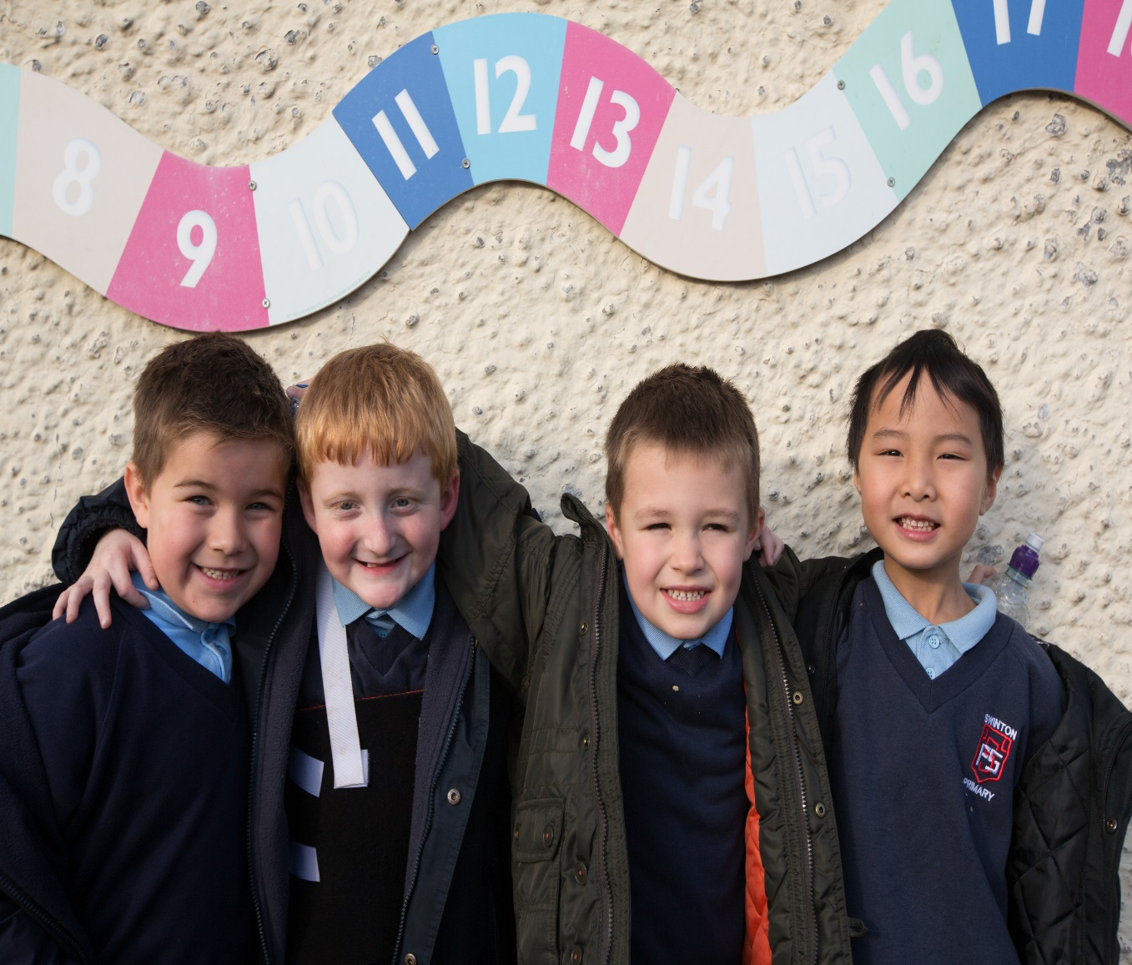
Rights like…
The right to life – governments must do all they can to ensure that children survive and develop to their full potential.

Slide 5
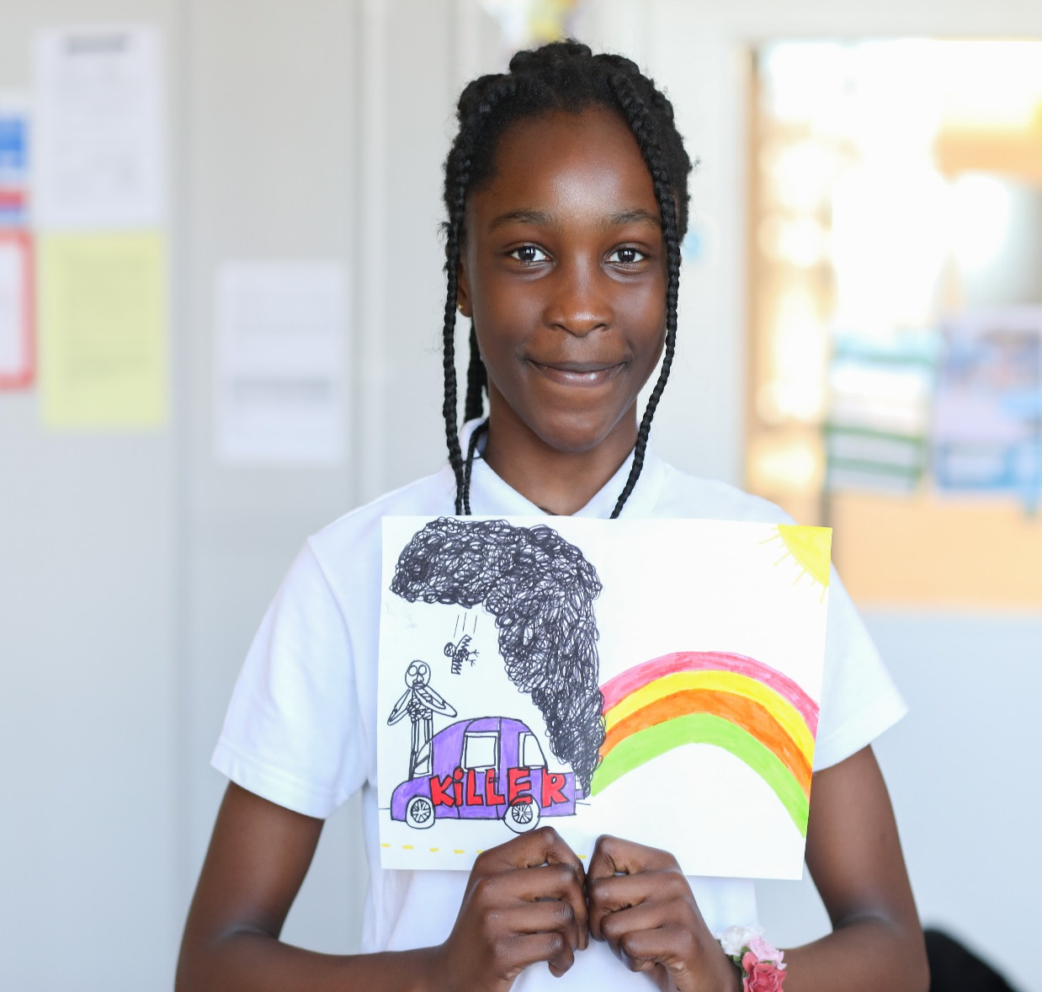
Rights like…
The right to the best possible health.
Every child should have access to good quality health care, clean war, nutritious food, and a clean environment.

Slide 6
So, what’s the problem?
All children have the right to health and to a clean environment wherever they live, learn and play.
Across the UK, around a third of children are living in areas that have unsafe levels of air pollution.
Around the world, almost 17 million babies under the age of one are breathing toxic air.
Air pollution may be invisible, but it’s incredibly dangerous for children.
Breathing toxic air can damage children’s growth and leave them with lasting health problems, increase their risk of conditions like asthma and potentially reduce their brain development.

Slide 7
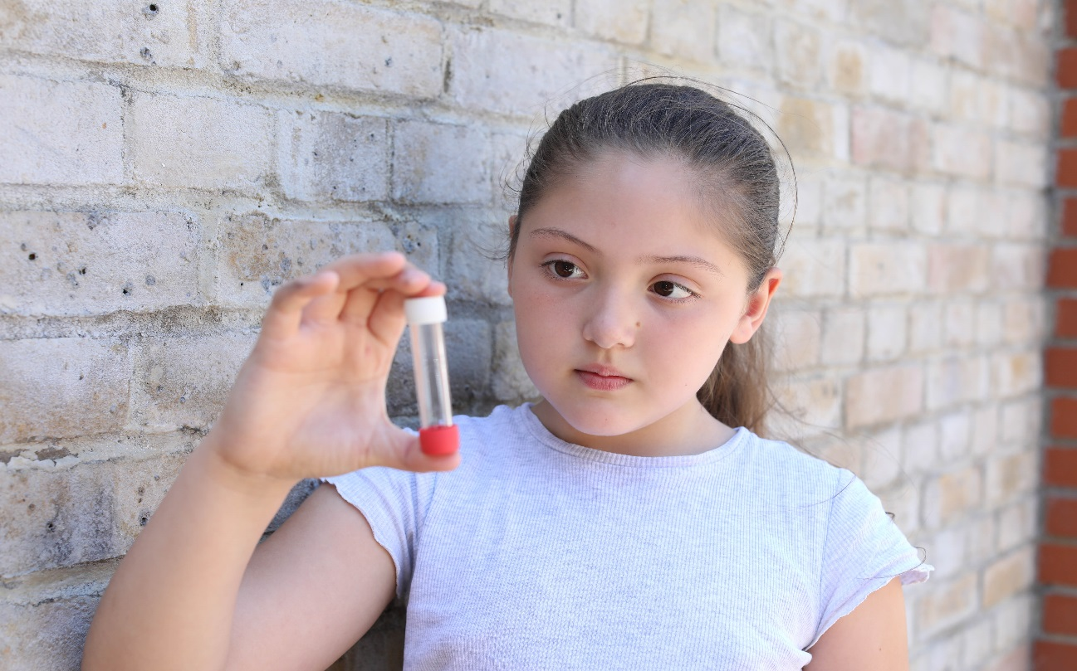
What are we going to do?
We are going to learn about the impact of air pollution on children’s health.
We are going to tell our families, friends, community and our local MP what we learn about air pollution and why every child needs to breathe clean air.

Slide 8
Introducing paddingtonTM
© P&Co Ltd./SC 2018

Slide 9
PaddingtonTM and outright
Did you know that PaddingtonTM originally comes from the forests of Peru? Trees produce oxygen and can also help improve air quality, making it easier to live in a clean and healthy environment.
Paddington will be joining us on our journey through the OutRight campaign.

Slide 10
Join paddington and make your voice heard
Children contribute the least to air pollution, but are the ones suffering most from its effects.
You can share your views with the UK Government to help make sure that children are not forced to breathe toxic air where they live, learn and play.
You can take action by inviting your local MP to your school, participating in World Children’s Day (20 November) activities or telling your local newspaper or radio station what you’re doing for OutRight.

Slide 11
Take action
By getting involved in OutRight this year, you’ll be taking action for clean air in the UK and around the world.
Together, we can help create a healthier and cleaner environment for all children.

Slide 12
Please look after this Bear. Thank you.
© P&Co Ltd./SC 2018

