Slide 1
Unicef/Hajinajaf
Notes:
Mania, 8-year-old second graders, prefers playing with her toys over the computer games. Ahavaz, Iran.
Unicef/Hajinajaf

Slide 2
Teacher slide
Contents
Slide 3 Guess the article - images as clues to identify the article
Slide 4 Introducing the article
Slide 5 Exploring Article 31 – the question
Slide 6 Exploring Article 31 – the answers
Slide 7 Soccer Aid for Unicef
Slide 8 & 9 Primary activities
Slide 10 & 11 Secondary activities
Slide 12 Reflection
Slide 13 Extension
Instructions
This flexible resource is intended to provide you with some easy to use, appropriate rights-related learning to share with your children, their families and your colleagues.
Please edit out non-relevant slides or tasks before sharing with students. Please check the content works for your learners and feel free to add any content that would make the material more relevant to your setting.

Slide 3
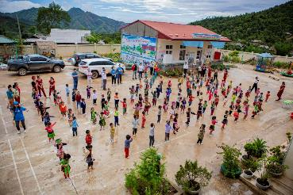
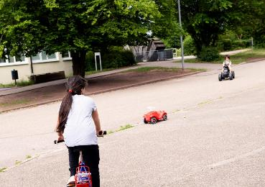
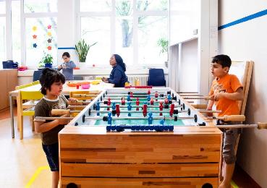
Guess the article
These pictures provide a clue to this week’s article.
Can you guess how they are linked together? Which article of the Convention do these pictures relate to?
Write down your thoughts or discuss with someone in your home.
Unicef/Truong Viet Hung
Unicef/Etges
Unicef/Etges

Slide 4
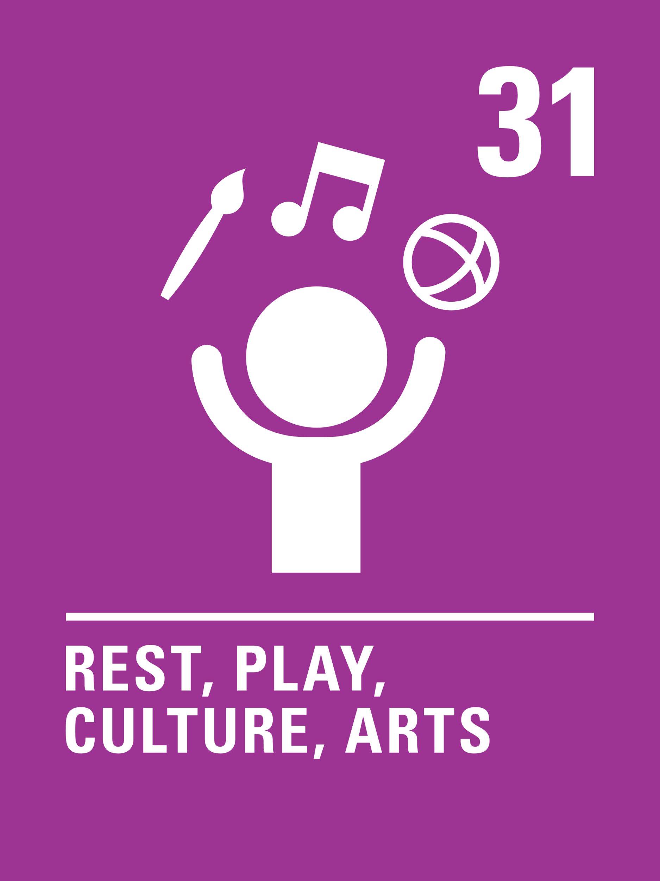
Introducing… Article 31
Martin introduces Article 31 – Rest, play, culture, arts
Article 31 – Rest, play, culture, arts
Every child has the right to relax, play and take part in a wide range of cultural and artistic activities.
Watch Martin on YouTube

Slide 5
Exploring Article 31
What is needed for children to enjoy the right to rest, play, arts and culture?
Write your ideas down and then compare your answers with the next slide.

Slide 6
Did you include these answers?
Children are able to play and make their own choices about play.
Time is needed for play and cultural activities – schools support this and so do families and communities.
It is important to be able to enjoy, play, sport, art, music and theatre without it being too expensive.
Children try new things and are helped to experience things they might not have thought of.
It’s good to have a safe space to, relax, read, draw or listen to music.
Play facilities, spaces and equipment are all safe.
Playing alone and playing with others are both important.
Imaginative play – without toys or equipment – is encouraged.
People enjoy very different things – it is important to respect and celebrate these differences.
What other ideas did you have?

Slide 8
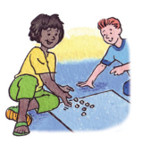
Activity Time
What’s your favourite physical or sporting activity? What artistic or cultural activity do you enjoy most? This could be anything from drawing or singing to going to the cinema. Tell somebody why these are important to you.
Create an ‘Article 31 challenge’ for the summer holidays – Plan out how much time you want to spend doing different things each day – perhaps plan to do something new every week?
All these activities are related to…
Have you heard of the author Michael Rosen? He talks in this video by Norton Road Primary School about the right to play. Do you agree with what the children say? You might like to watch this with adults at home and discuss it with them.
Have you ever been to an art gallery? Here are some great activities for children on the website of the Tate gallery in London.
You don’t need to do every single activity
but if you have time you can do more than one.
Primary

Slide 9
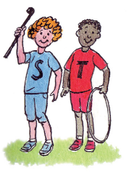
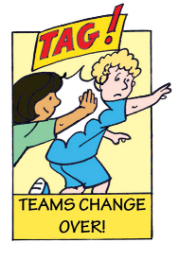
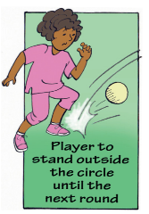
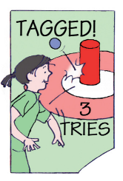
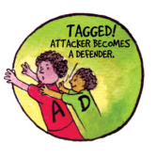
Activity Time
Having time to relax and enjoy our hobbies, interests and favourite pastimes is good for our wellbeing and our emotional health. Try to think of some reasons why this is the case and discuss them with somebody at home? You could design a poster or write a song to encourage others to remember the importance of Article 31.
Design your ideal play area! It can be indoors, outdoors or both! It can be open during the day and even at night. Share your ideas with your friends.
Throughout history and in every part of the world, children have always played. Have a look at some of these Traditional Games from around the world. Choose one and see if you can adapt it to play it your family or friends.
The right to relax and play can include some screen time but everyone knows that too much of this is not healthy. Do a survey among your family and friends to see how much time people spend being active and how long in front of a screen each day.
Primary

Slide 10
Activity time
If you break down the word ‘Recreation’ it means to make again. How do rest, leisure and play help us to renew and restart? How do these affect our mental health and wellbeing? Could you create a piece of art or poetry to express the ideas you think of.
Play is far more important than we think. If you have a much younger sister or brother, spend some time observing them playing - think about what they are learning and how they are developing through play.
These activities will help you
understand how...
…can relate to your life.
You don’t need to do every activity, just do as many as you can.
Imagine that play had never been invented – until you come along! Write a story or drama script about you introducing ‘play’ into the world. How would you do it? What do you think would be the most important place to start? How would people react?
You probably know of the famous children’s writer Michael Rosen – Watch him talking about the power of play. How do some of your teachers use ‘fun’ activities to engage you in learning. Could you feed back to them how helpful this is.
Secondary

Slide 11
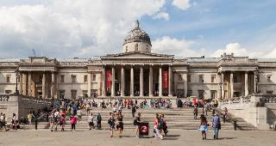
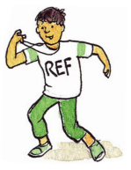
Activity time
Have you ever been to an art gallery? Many galleries and museums now have free virtual tours. Here’s a link to the National Gallery in London if you would like to visit.
Research has shown that break time in secondary schools has reduced significantly in recent years. Do you approve of this move? How would you persuade senior leaders at your school to increase time and invest in play, leisure and culture.
Throughout history and in every part of the world, children have always played. Have a look at some of these Traditional Games from around the world. Choose one and see if you can adapt it to play it your family or friends.
The world ‘culture’ is sometimes off-putting. Look it up to see what it actually means. In this BBC link there is information about a few very different ways to experience culture for free. Why not have a go at making a video like this with your friends to share different cultural ideas and opportunities.
Secondary

Slide 12
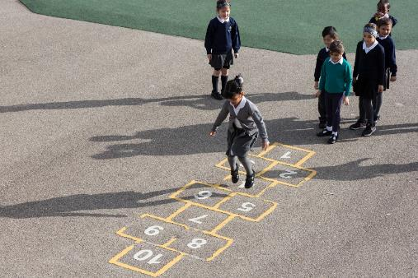
Reflection
Try to find somewhere peaceful and spend a few minutes being quiet and still … then consider these questions:
How do you make time for rest, play, arts and culture in your life? What sort of activity makes you feel most comfortable?
How can we encourage others to find the things that help them relax and express themselves?
How can we show our appreciation to the adults (often volunteers) who support us as coaches, mentors, leaders?
Write down your thoughts and if you want, share this back with your teacher, friends or family.
Uncief/Dawe

Slide 13
Extension
Have a look at this ‘trailer’ for the film Billy Elliot.
Remembering that rights are indivisible and all equally important, what other articles need to be in place for children to fully enjoy article 31
What can prevent some children and young people from fully enjoying the right to rest, play, arts and culture?
You can find a summary of the whole Convention here.
UNICEF/Dawe

Slide 14
Thank you

