Slide 1
Unicef/Ryeng
Notes:
A representative from the National Disarmament and Demobilization Commission is explaining to young people being released from armed forces what will take place. He is supported with representatives from UNICEF, the UN Mission in South Sudan (UNMISS) and the South Sudan People’s Defence forces (SSPDF).
On 26 of May 2020, a total of ten children between 15 and 17 years of age were released from armed forces. The ten were identified in a training facility for the unified South Sudan forces. After they were released, the children were taken to an interim care centre for immediate care and family tracing services.
The release of children from armed forces and armed groups is a collaboration between UNICEF, the UN Mission in South Sudan (UNMISS) and the National Disarmament and Demobilization Commission (NDDRC).
Unicef/Ryeng

Slide 2
Teacher slide
Contents
Slide 3 Guess the article - images as clues to identify the article
Slide 4 Introducing the article
Slide 5 Exploring Article 38 – the question
Slide 6 Exploring Article 38 – the answers
Slide 7 & 8 Primary activities
Slide 9 & 10 Secondary activities
Slide 11 Reflection
Slide 12 Extension
Instructions
This flexible resource is intended to provide you with some easy to use, appropriate rights-related learning to share with your children, their families and your colleagues.
Please edit out non-relevant slides or tasks before sharing with students. Please check the content works for your learners and feel free to add any content that would make the material more relevant to your setting.

Slide 3
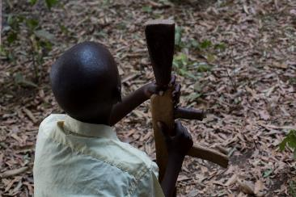
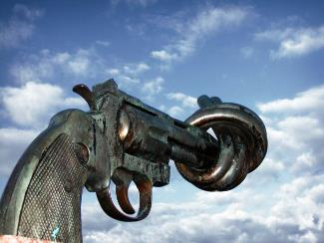
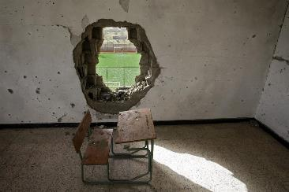
Guess the article
These pictures provide a clue to this week’s article.
Can you guess how they are linked together? Which article of the Convention do these pictures relate to?
Write down your thoughts or discuss with someone in your home.
Unicef/Lomodong
Wikicommons
Unicef/Diffidenti
Notes:
From left to right:
Unicef/Lomodong - Children associated with the Cobra faction wait to be demobilized in Pibor, South Sudan.
Wikicommons - Non-Violence, also known as The Knotted Gun, is a bronze sculpture by Swedish artist Carl Fredrik Reuterswärd of an oversized Colt Python .357 Magnum revolver with its muzzle tied in a knot.
Unicef/Diffidenti – Libya, 2012. A desk, covered with dirt and debris, sits in a classroom damaged during the conflict, in Shohada Yamayer Primary School, in the city of Sirte. An outdoor sporting area is visible through a large rupture in the classroom’s wall. Much of the city, the final stronghold of former Government forces, was destroyed during the weeks-long fighting there.

Slide 4
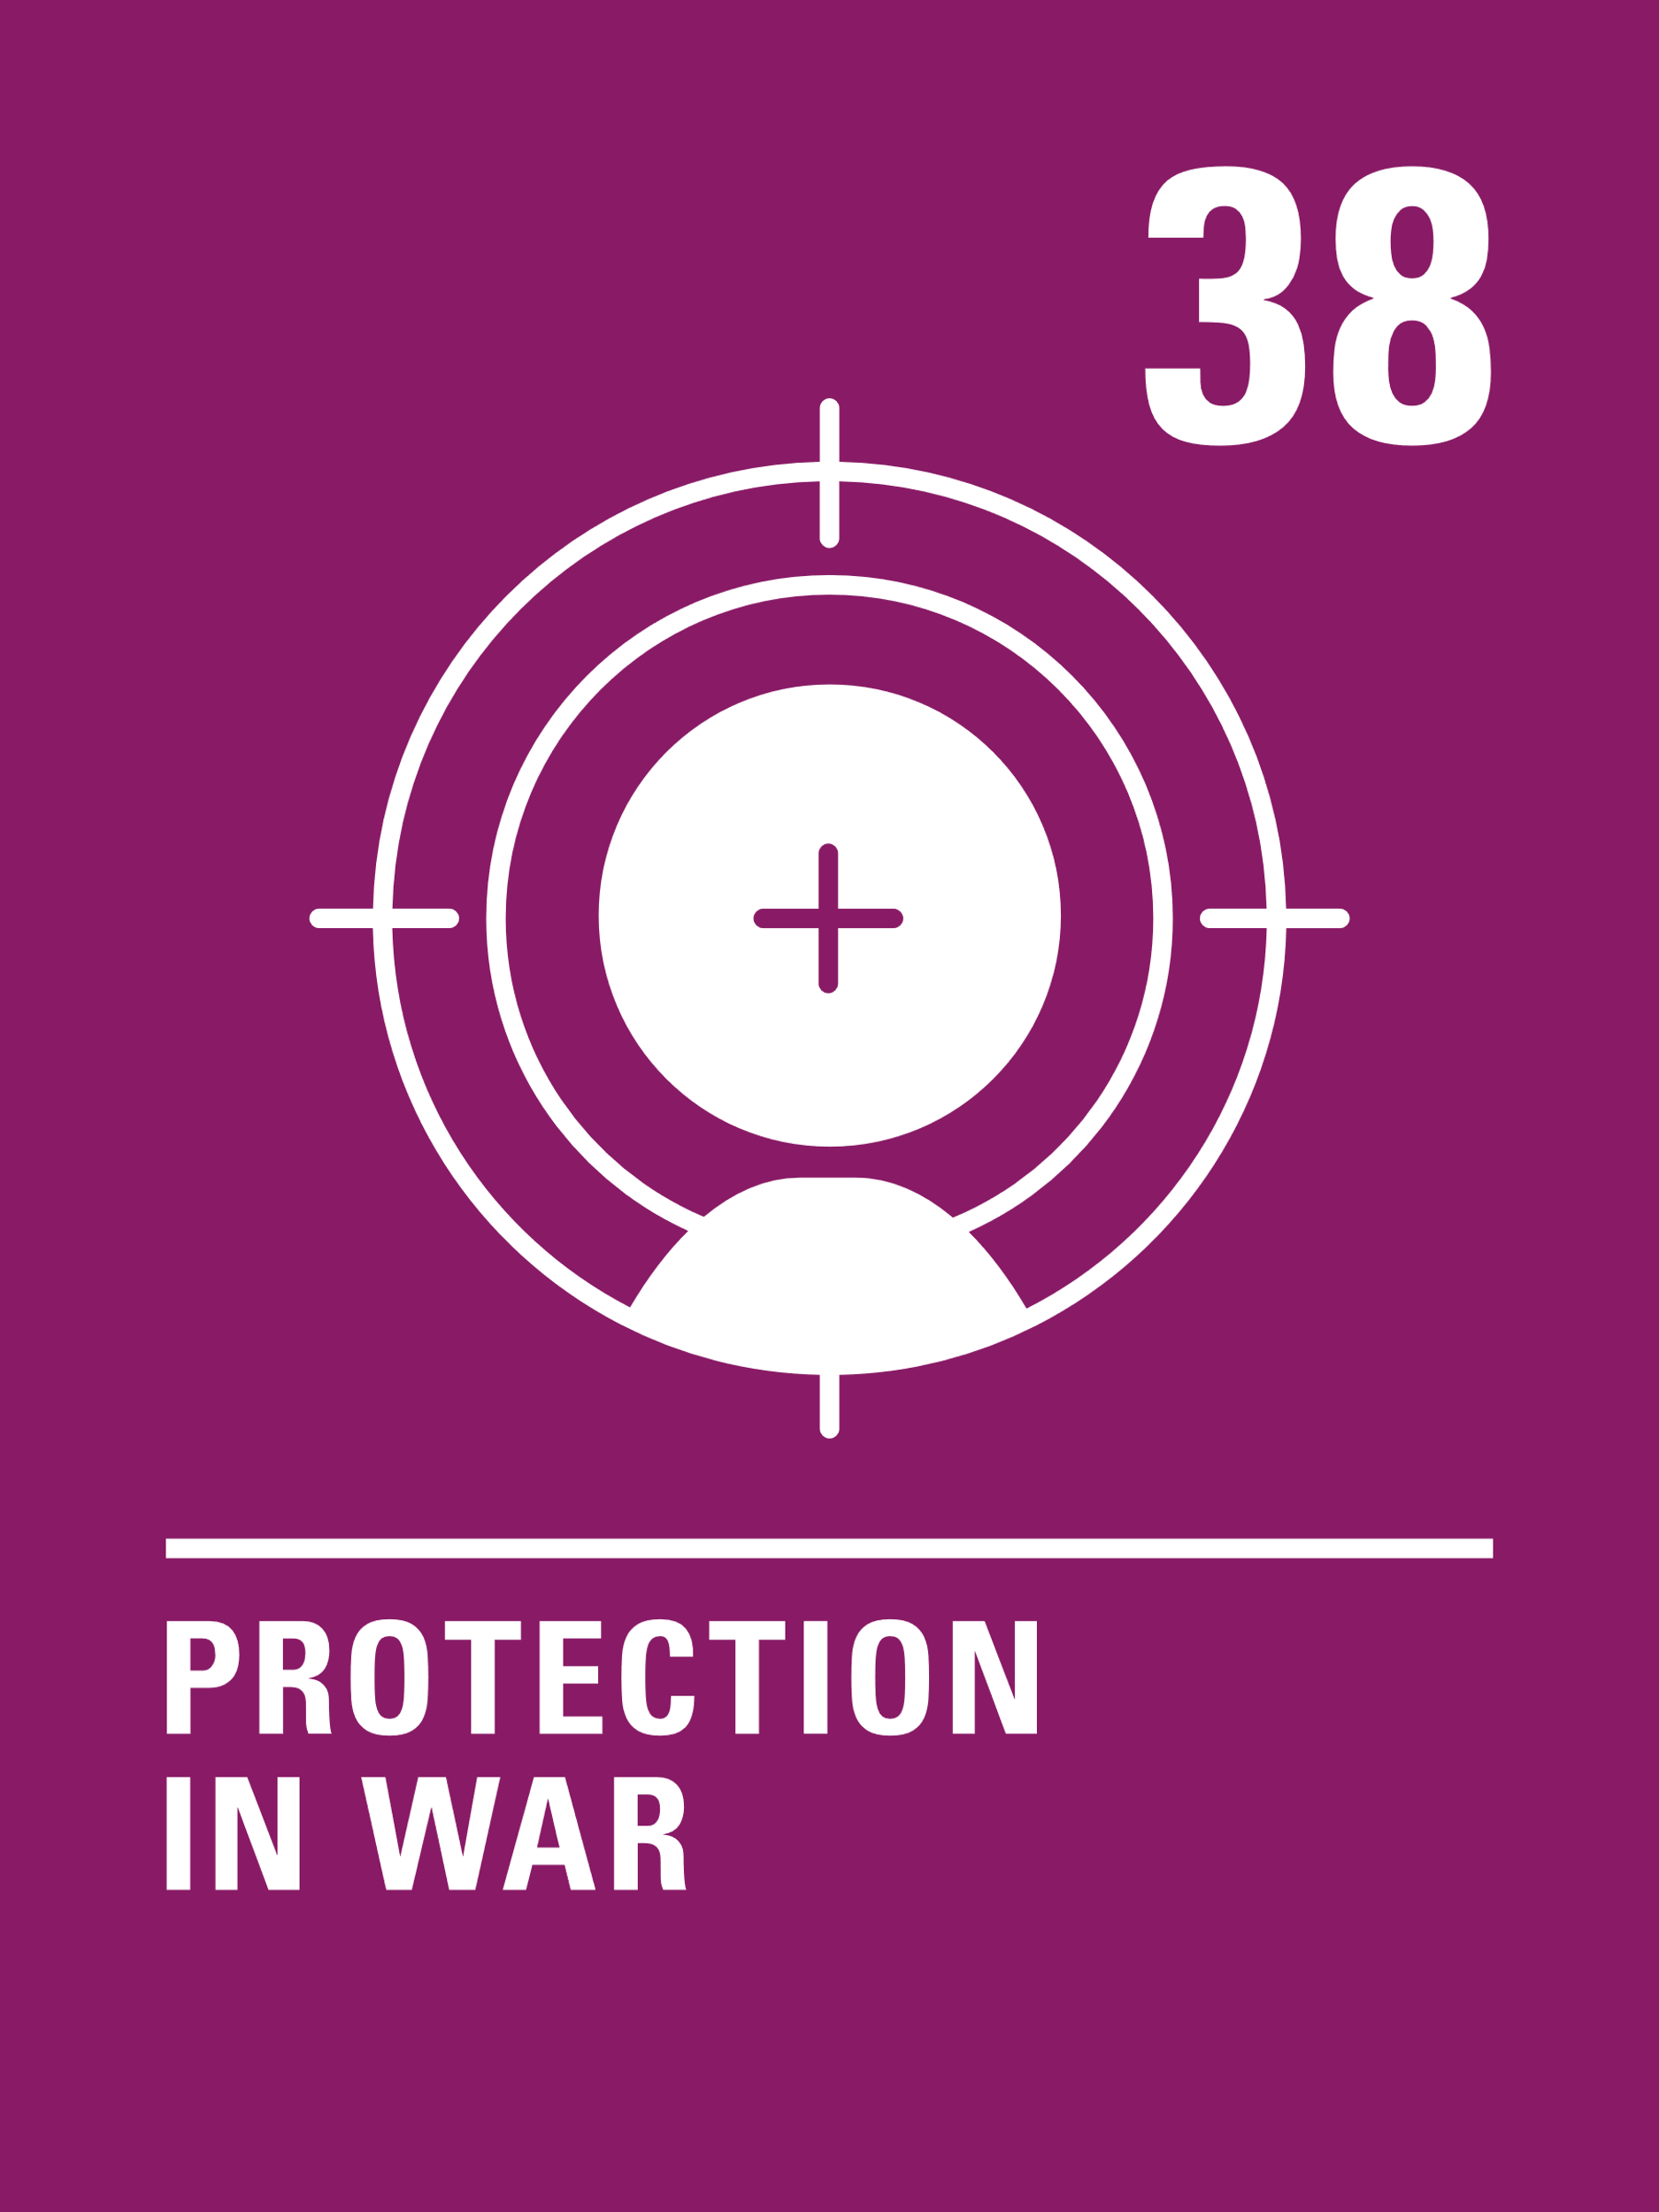
Introducing… Article 38
Martin introduces Article 38 - Governments must not allow children under the age of 15 to take part in war or join the armed forces.
.
Article 38 - Governments must not allow children under the age of 15 to take part in war or join the armed forces.
Governments must do everything they can to protect and care for children affected by war and armed conflicts.
Watch Martin on YouTube

Slide 5
Exploring Article 38
Can you think of some reasons why children should be protected from fighting in wars?
Note your ideas down and then compare your thoughts with the next slide.

Slide 6
How many of these did you get?
They may be too young to understand what the war is about.
War is dangerous. You can be seriously injured or killed and participation in war can have a life-long impact for a person. It’s wrong to make children and young people take part wars, particularly if they are forced to do so.
Adults choose to join the armed forces as a profession and they receive training and support to do their work. Child soldiers are often coerced or forced to take part and receive no training or support.
They are still growing and may not have the physical or emotional maturity to cope.
They should have all their rights in the Convention and war will impact on their ability to enjoy many of these rights.
Governments and adults make wars happen, why should innocent children be affected?
If children see fighting and war as the answer to problems this may affect their whole lives.
What else did you think of?

Slide 7
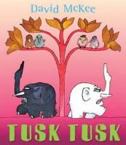
Activity Time
Article 38 is about protecting children from war. Sadly, wars and fighting often affect children and stop them being able to enjoy all their rights. What wars have you heard of or learned about in school? Can you describe the impact on children?
All these activities are related to…
Fighting and wars can be complicated. Read or listen to the story Tusk Tusk by David McKee. Why do you think peace is important? What would you say to the small ear and large ear elephants towards the end of the story?
There are rules about war designed to protect civilians:
Civilians should never be targeted.
Great care must be taken not to harm civilians, or damage things they need to survive – like crops and water supplies.
Places like schools and hospitals must never be targeted.
Are these rules what you expected? Why do you think it’s so important to protect schools?
You don’t need to do every single activity
but if you have time you can do more than one.
Primary
BookTrust

Slide 8
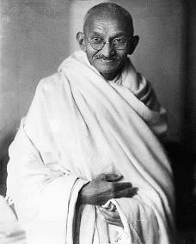
Activity Time
Sadly, through history, children have often been forced to fight in wars, even in recent times. Unicef works hard to rescue children who are forced to fight. Watch this video about the recent war in South Sudan. Perhaps you can discuss with your class why using children to fight in wars is wrong.
October 2nd is the birthday of a famous man called Mohandas K Gandhi. He wanted a fairer world but said instead of using fighting and war to make this happen, you had to find peaceful ways. The United Nations made October 2nd the International Day of Non-Violence. Do some research to find out more about Gandhi’s life and how he made a difference.
If there was peace all over the world, all children would be safe from war. That’s one of the goals of the United Nations. See if you can design a poster to promote peace. You could include why war is so dangerous for children, and emphasise that children have the right to be protected from war.
Primary
Wikicommons

Slide 9
Activity time
Some people are surprised that Article 38 refers to a minimum age of 15 for young people to be involved in direct fighting in war or conflict. This was a compromise to ensure that all countries would agree to the Convention at the United Nations. In the UK the age to join the armed services is 16 but young people can’t fight until they are 18. Some people feel strongly that this is not right. What are your views?
.
Watch this powerful message from a former child soldier. What do you think are the main points Ishmael is making? Do his words challenge or inspire you?
These activities will help you
understand how...
…can relate to your life.
You don’t need to do every activity, just do as many as you can.
A growing number of children and young people joining schools in the UK are refugees fleeing from countries at war. How can schools support such pupils and help them to feel welcome? What role could fellow students play in this?
Find out more about campaigns to stop the use of child soldiers. Start by finding out about Red Hand Day which is marked every year in February.
Secondary

Slide 10
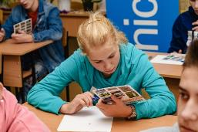
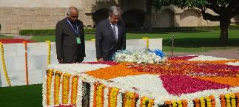
Activity time
Even when a war or conflict is over children can continue to be at risk. Read about Unicef’s work in Ukraine to educate children about the dangers of leftover or hidden weapons and explosive devices. Share what you learn with your peers.
You have probably learned about the two World Wars and lots of other wars in history. Unfortunately there are wars and conflicts happening in the world today. Do some research to find out where these are, what they are about and how organisations like Unicef try to help those affected, especially children.
October 2nd is the United Nations International Day for Non-Violence. Read this article from 2018 in which the head of the UN visited the grave of Gandhi who is famous for the philosophy of non-violence. Could you find out more about Gandhi and his approach and share this with your friends or teachers? Would a non-violent approach to resolving disagreements make the world better for children and young people?
Unicef/Getman
“Children bear no responsibility for war. But they are the first to suffer its consequences.”
Can you explain why Unicef uses this statement. How do you feel about it?
Secondary
Unicef/Clarke

Slide 11
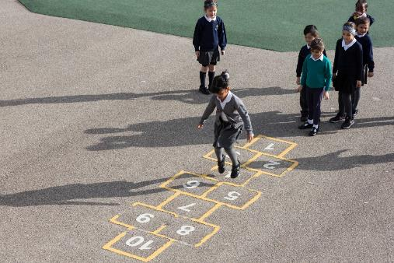
Reflection
Try to find somewhere peaceful and spend a few minutes being quiet and still … then think about these questions…
Each year, in November we remember those who have died in wars.
Take a moment to remember now but think especially of children whose lives have been lost in war.
What would a world without war be like?
What is needed for there to be peace? How can we be ‘peace makers’ in our lives?
Uncief/Dawe

Slide 12
Extension
The rights within the Convention are indivisible – a child should have all of their rights, all the time.
Look at the Convention and try to identify how many other rights might be affected when a child or young person’s life is disrupted by armed conflict or war.
You can find a summary of the whole Convention here.
UNICEF/Dawe

Slide 13
Thank you

