Slide 1
Unicef/choufany
Notes:
On 1 September 2020, Kevin, 8 years old, left, with his mother Nadida Kayyal Bakli and brother at the UNICEF's children friendly space (CFS) at the Karantina public garden in Beirut, Lebanon.
Unicef/Choufany

Slide 2
Teacher slide
Contents
Slide 3 Guess the article - images as clues to identify the article
Slide 4 Introducing the article
Slide 5 Exploring Article 3 – the question
Slide 6 Exploring Article 3 – the answers
Slide 7 & 8 Primary activities
Slide 9 & 10 Secondary activities
Slide 11 Reflection
Slide 12 Extension
Instructions
This flexible resource is intended to provide you with some easy to use, appropriate rights-related learning to share with your children, their families and your colleagues.
Please edit out non-relevant slides or tasks before sharing with students.
Please check the content works for your learners and feel free to add any content that would make the material more relevant to your setting.

Slide 3
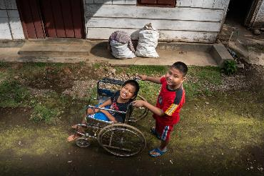
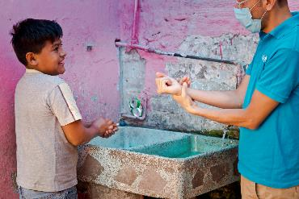
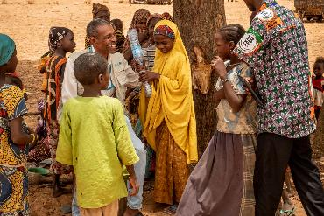
Guess the article
These pictures provide a clue to this week’s article.
Can you guess how they are linked together? Which article of the Convention do these pictures relate to?
Write down your thoughts or discuss with someone in your home.
Unicef/Ijazah
Unicef/Armando
Unicef/Gilbertson
Notes:
From left to right:
Unicef/Ijazah - Syaiful (left), 12, a child with a physical impairment, and his best friend Kevin Saputra (right), 9, a child with a visual impairment, play outside near Syaiful's house in Banyumas, Central Java, Indonesia. Syaiful cannot freely move his lower body or his right hand.
Unicef/Armando - A Unicef member of staff demonstrated good handwashing practice with a child in Mexico.
Unicef/Gilbertson - Ramatou (yellow veil), 12, an unaccompanied minor is returned to her father Bahari Inoussa (not pictured) and brothers and sisters in a tiny village in Niger. Moussa, a child protection officer from UNICEF sits with her, and a social worker is on the right.

Slide 4

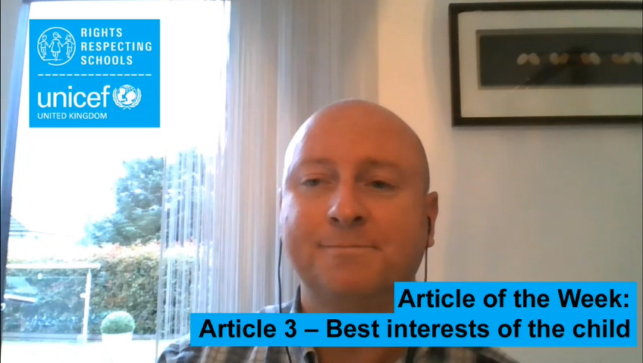
Introducing… Article 3
Gerry introduces Article 3 - Best interests of the child
Article 3 – Best interests of the child
The best interests of the child must be a top priority in all decisions and actions that affect children.
Watch Gerry on YouTube

Slide 5
Exploring Article 3
There are many adults involved in making decisions that affect your life. Give yourself one minute to think of as many types adults as you can.
At the end of one minute share your thoughts.
Then compare with the ideas on the next slide.

Slide 6
How Did you get on?
Did your thoughts include any of these?
Parents or carers
Other family members
Teachers
Healthcare workers
Social workers
Sports coaches
Youth workers
Police officers
Members of the government
Courts officials – judges, lawyers
They should all put your best interests first when they make a decision that affects you, considering every part of your life, including your safety, your education, your views and your relationships with people in your family.

Slide 7

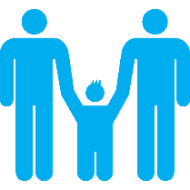
Activity Time
This 9-year-old boy has written to an advice page. Working on your own or with a friend, can you write a reply to him?
“OK, so when I was five, I got scared at the dentist’s and bit her when she was looking at my teeth. She was hurting me, and I don’t want to go again. For ages, my mum hasn’t made me go, but now she says I must because she’s worried my teeth are rotting. I said I’d run away if she made me go. I don’t get why she would make me do it when I don’t want to. What should I do?”
Talk to a friend and try to find three things that might be in your best interest but not theirs.
All these activities are related to…
Don’t forget you should be involved in decisions about your best interest.
Write a letter to your local MP or your headteacher explaining how you would like to be involved in the decisions that affect you.
You don’t need to do every single activity
but if you have time you can do more than one.
Primary

Slide 8


Activity Time
Over the summer lots of things have changed in your school. These decisions were taken in your best interest. Can you list what changes have been made and why they are important.
Create a special badge, certificate or card to give to an adult you know who always think about what is best for you or for other children, to say well done or thank you?
Governments often make decisions that affect many children. Over the summer holidays in July the UK government decided to make vouchers available in the holiday to families whose children usually get free school meals. Do you think this was in the best interests of those children? Can you explain your viewpoint.
Some decisions adults make affect one child, or a few children. Some decisions affect a lot of children. Can you think of any examples of a decision that affects one child, a few children, and many children?
Primary

Slide 9


Activity time
Think about how families involve their children in decisions. “What to have for dinner?” and “Should we move house?” are very different types of decision. Do you think all parents and carers are relaxed about involving young people in decisions? What advice would you give adults to make them better at this?
These activities will help you
understand how...
…can relate to your life.
You don’t need to do every activity, just do as many as you can.
If adults - who might not know you - have to make decisions in your best interest what should they think about?
Over the summer lots of things have changed in your school. These decisions were taken in your best interest. Can you list what changes have been made and why they are important.
Secondary

Slide 10


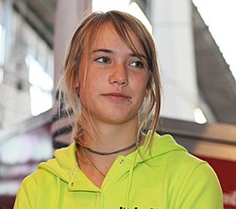
Activity time
Don’t forget you should be involved in decisions about your best interest. Write a letter to your headteacher or your local MP explaining how you would like to be involved in the decisions that affect you.
What is in your best interest may not be the same for all young people in your class or school. Identify three examples where there is a difference between your best interest and those of others.
. Dutch teenager Laura Dekker was given her first yacht at the age of six and she became a very skilled sailor. When she was 14, a court in The Netherlands gave Laura permission to sail around the world alone. She had been stopped from doing this before because there were worries about her welfare. Do you think the court's decision was in Laura's best interests?
Governments often make decisions that affect many children. Over the summer holidays governments decided that secondary school pupils should wear masks in school. Do you think this is a good idea? Can you explain your view-point?
Secondary
wikicommons

Slide 11
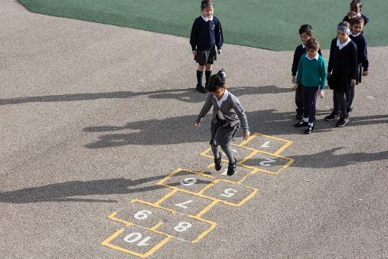
Reflection
Find somewhere quiet and give yourself some space to think:
Who are the adults you trust to make decisions in your best interests?
Think about how they involve you in the decision.
Can you think of decisions made or instructions given to you by adults which you don’t like but you know they are right?
Uncief/Dawe

Slide 12
Extension
Making decisions in the best interest of a child should normally involve listening to the views of the child or young person before making the decision.
Article 12 says that a child or young person should have a say in all matters that affect them.
What other articles could or should be considered for the best interests of the child to be achieved?
You can find a summary of the whole Convention here.
UNICEF/Dawe

Slide 13
Thank you

