Slide 1
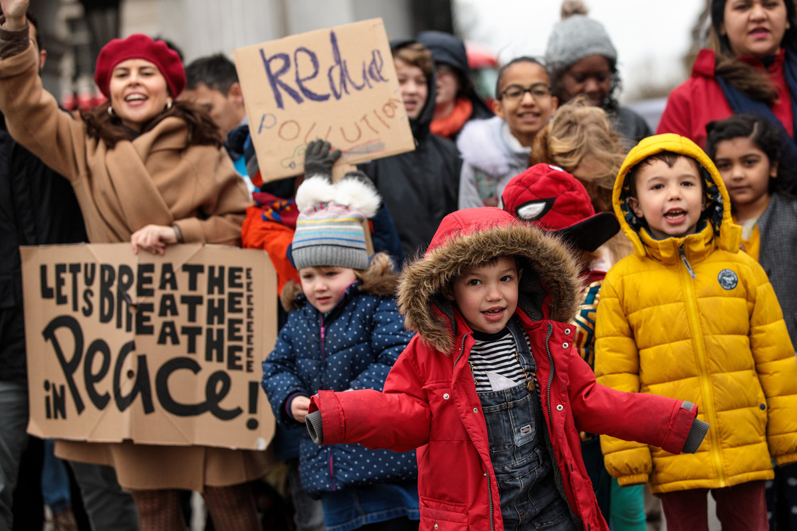
WELCOME TO
OUTRIGHT 2020/21
Children taking part in a Unicef UK Clean Air Action Day. © Unicef

Slide 2
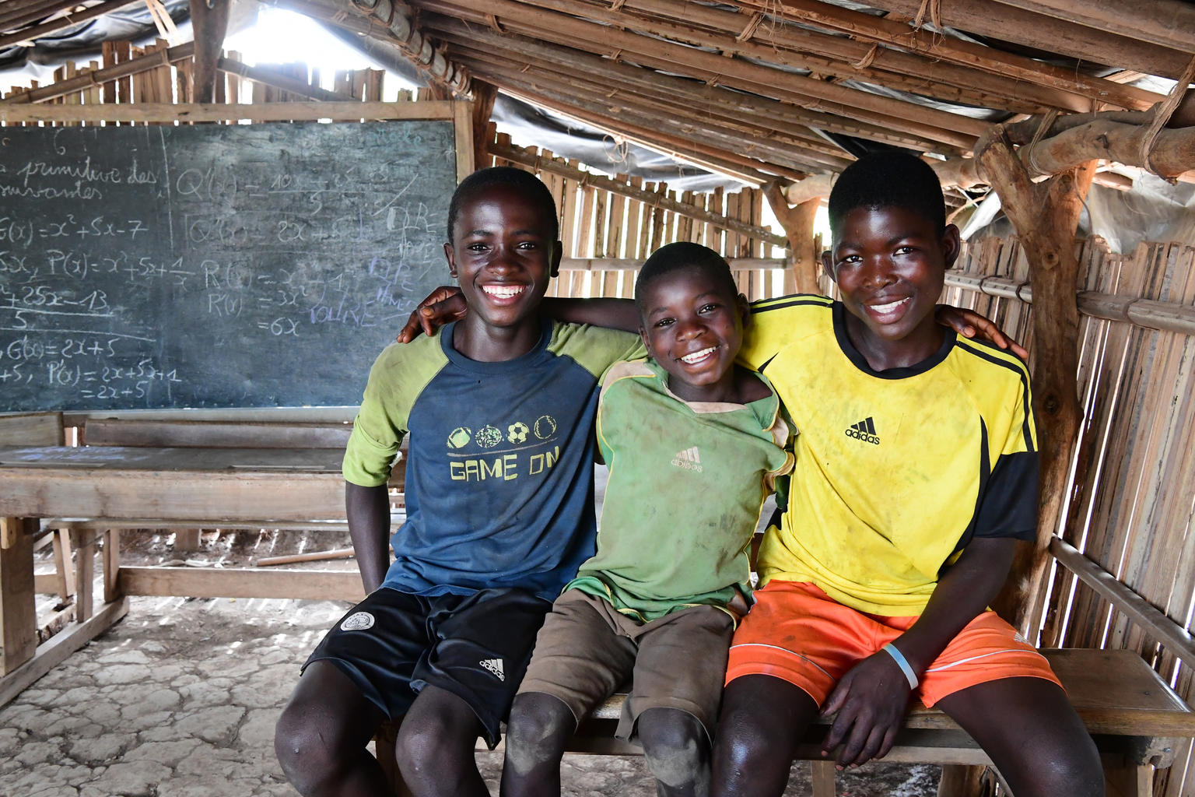
WHAT IS UNICEF?
Three friends in their classroom in Côte d'Ivoire. © Unicef/Dejongh
Unicef UK is a charity that cares about the rights and well-being of every child – wherever they live.
Unicef works in 190 countries around the world.
Notes:
If you are a Rights Respecting School and your group are already familiar with Unicef and its work, you can remove this slide.

Slide 3
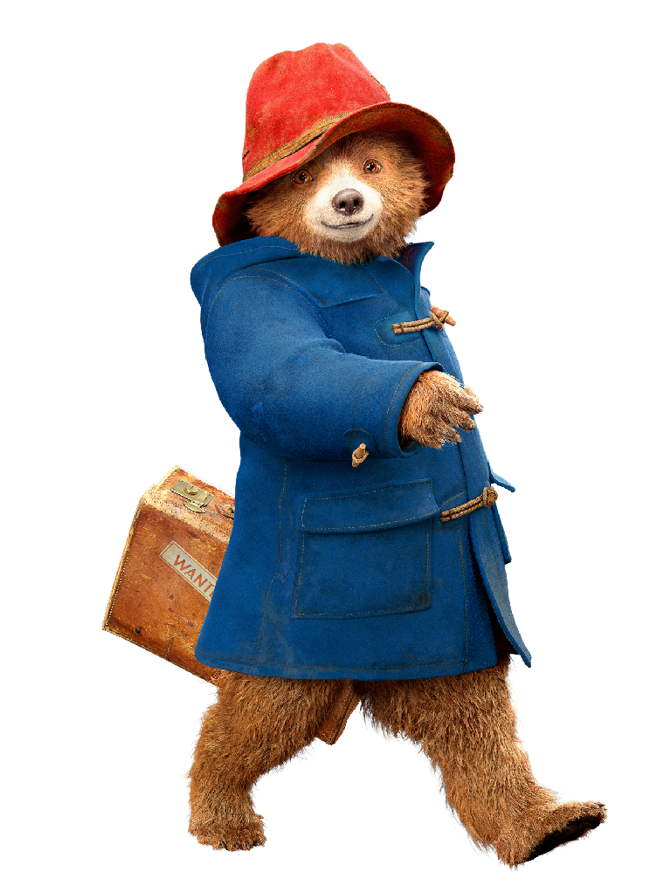
WHAT IS OUTRIGHT?
OutRight is a youth campaign run by Unicef UK that helps children and young people to speak out about children’s rights in the UK and abroad.
It’s a campaign by children, for children.

Slide 4
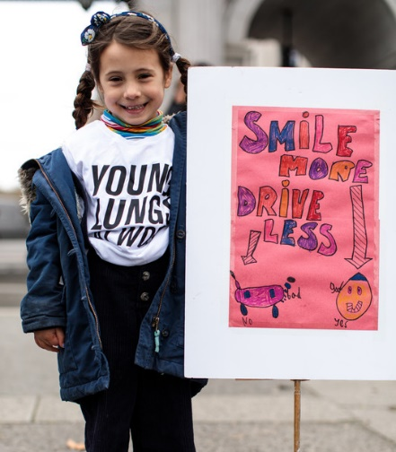
MAKE YOUR VOICE
HEARD!
OutRight will help children like you to stand up for the rights of children in the UK and around the world, with the support of our campaign champions Paddington Bear and actor Cel Spellman.
This year, OutRight is all about climate change and children’s rights.
Speaking out at a Unicef UK Clean Air Action Day. © Unicef

Slide 5
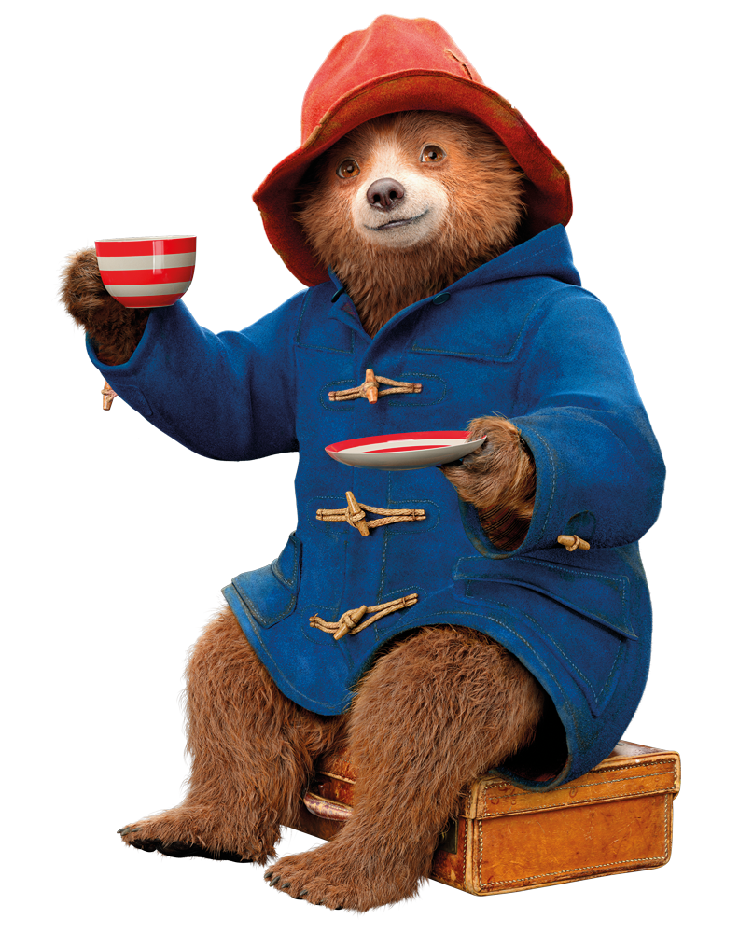

Slide 6
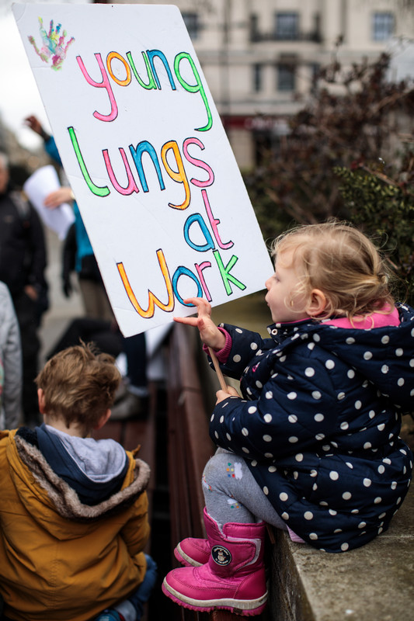
SPEAKING OUT ABOUT
CLIMATE CHANGE
Paddington is a champion for children and, like Unicef UK, wants you to use your voices to make the world a better place.
Through the campaign, you will learn about climate change and children's rights.
Children speak out at an air pollution rally. © Unicef
Notes:
Paddington is not afraid to stand up for things he believes in, and his kindness, tolerance and openness to other cultures make him the perfect champion for children at Unicef.

Slide 7
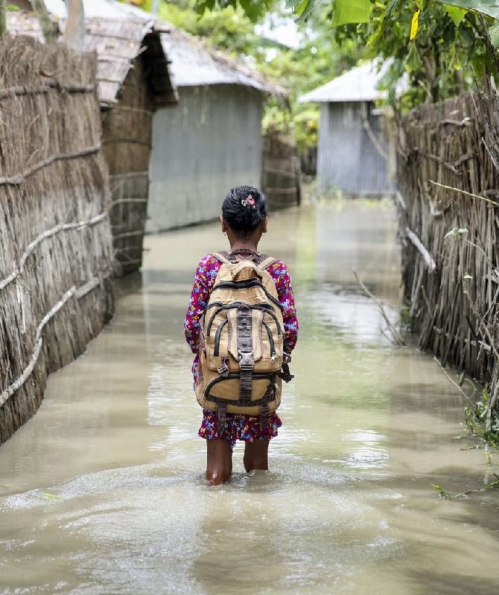
CLIMATE CHANGE AND CHILDREN’S RIGHTS
We will find out how climate change is impacting children’s rights, including:
the right to education
the right to be healthy
the right to have somewhere safe to live
On the way to school during floods in Bangladesh. © Unicef/Akash
Notes:
Climate change affects children’s rights in lots of ways. Firstly, it threatens a child’s ability to survive, grow and to thrive. Extreme weather events threaten lives, undermining access to clean drinking water, which can lead to the spread of diseases.
Extreme weather events like cyclones and floods can also destroy homes, forcing families to leave their villages and destroying schools so that children can no longer get educated.
Increases in temperature and rainfall can threaten people’s crops and lead to food shortages. Air pollution can also have a direct and negative impact on children’s health.

Slide 8
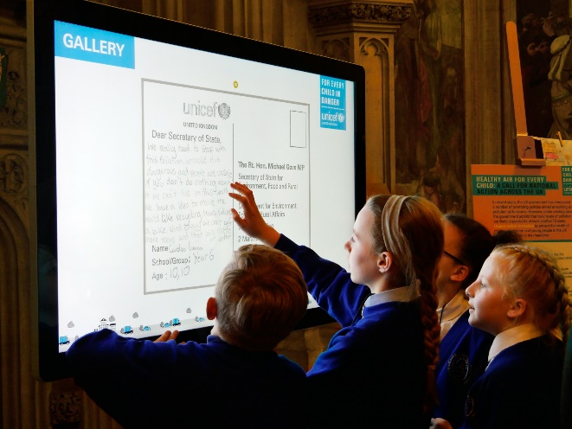
TAKING PART IN OUTRIGHT
By taking part in OutRight, you will have the chance to:
Take part in climate change quizzes
Interview a trusted adult about their experiences of a changing climate
Measure the footprint you are making on our planet
Find out how children and young people around the world are impacted by climate change
Speak out and call on people in power to take actions to protect children’s rights
Children taking part in the OutRight toxic air campaign at the Houses of Parliament. © Unicef

Slide 9
A MESSAGE FROM
Cel Spellman (centre) championing children’s rights. © Unicef/Dawe
Actor and Unicef UK Ambassador Cel Spellman has this message for you about taking part in OutRight…
CEL SPELLMAN
Notes:
The welcome message from Cel Spellman is available here: https://youtu.be/ju_Ms8gSOb8

Slide 10
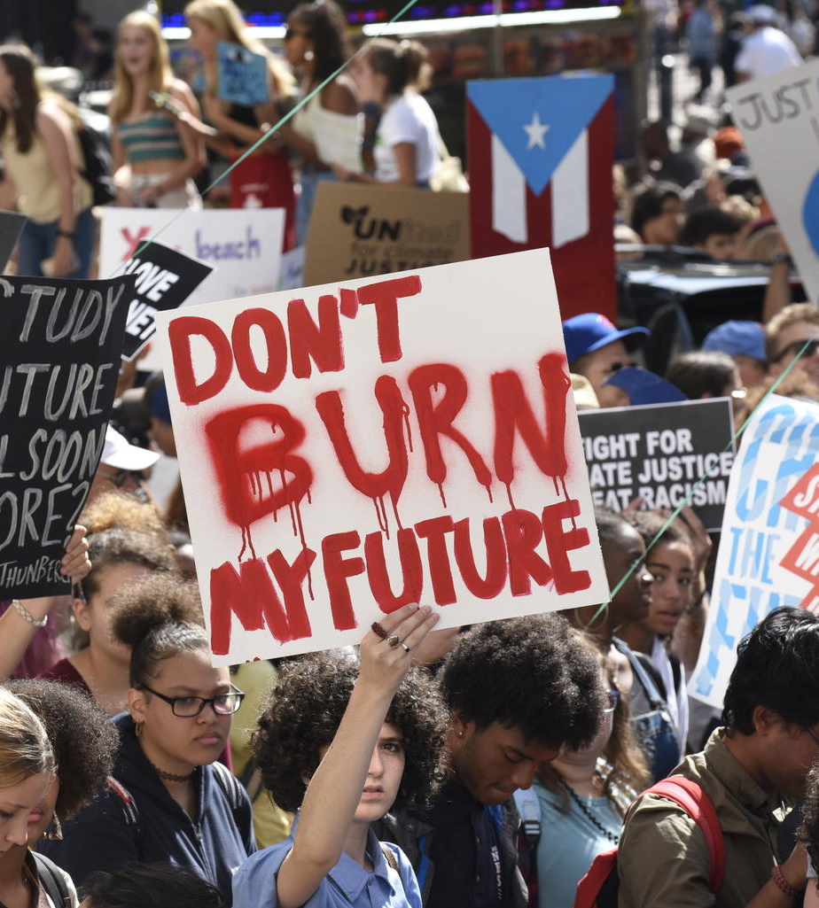
WHY
CAMPAIGN?
Children like you have an important role to play in campaigning to create change.
Your voices matter!
UN Convention on the Rights of the Child: Article 12
Every child has the right to say what they think in all matters affecting them, and to have their views taken seriously.
Youth climate activists join a demonstration in New York calling for global action to combat climate change. © Unicef/Chalasani
Notes:
By signing petitions, making videos, writing blogs, speaking to their local representatives and local media, children can show those in power just how much they care about climate change and its impacts and how they’re affecting children’s rights.

Slide 11
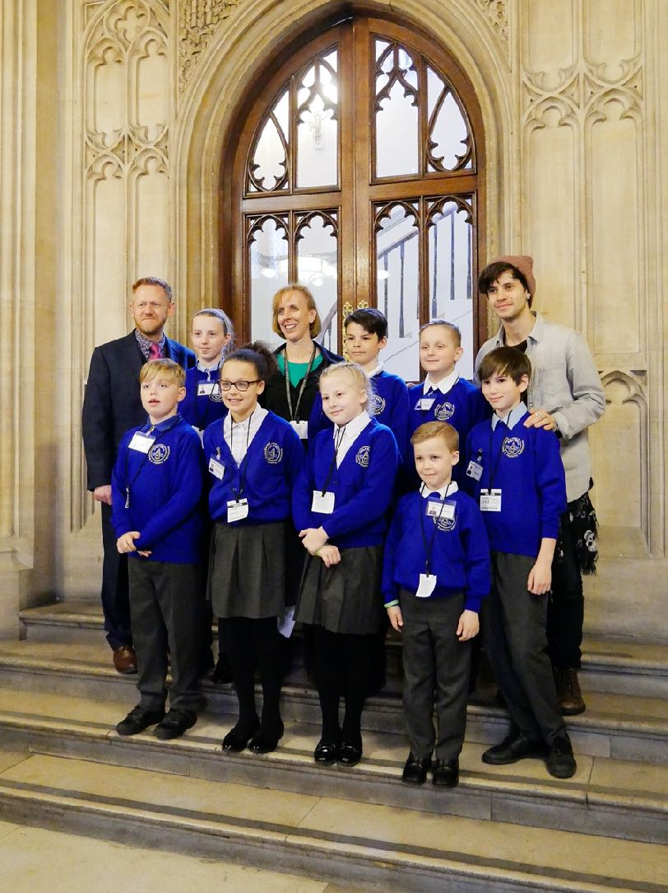
JOIN PADDINGTON AND CEL
MAKE YOUR VOICE HEARD
You can share your views on climate change with the COP26 President
You can take action by writing to your local decision-maker, e.g. your MP, to tell them why you care about climate change, and invite them to meet your group
You can get involved in World Children’s Day (20 November) activities or tell your local newspaper or radio station what you’re doing for OutRight 2020/21
Children taking part in the OutRight toxic air campaign joined Cel Spellman to talk about children’s right to a safe and clean environment in the Houses of Parliament. © Unicef

Slide 12
CELEBRATE
World Children’s Day on 20 November celebrates the United Nations Convention on the Rights of the Child, which protects children’s rights around the world
To protect children’s rights, we must tackle climate change and greenhouse gas emissions urgently
Amia, 11, stands on an ice floe near her home in Alaska, USA. © Unicef/Sokhin

Slide 13
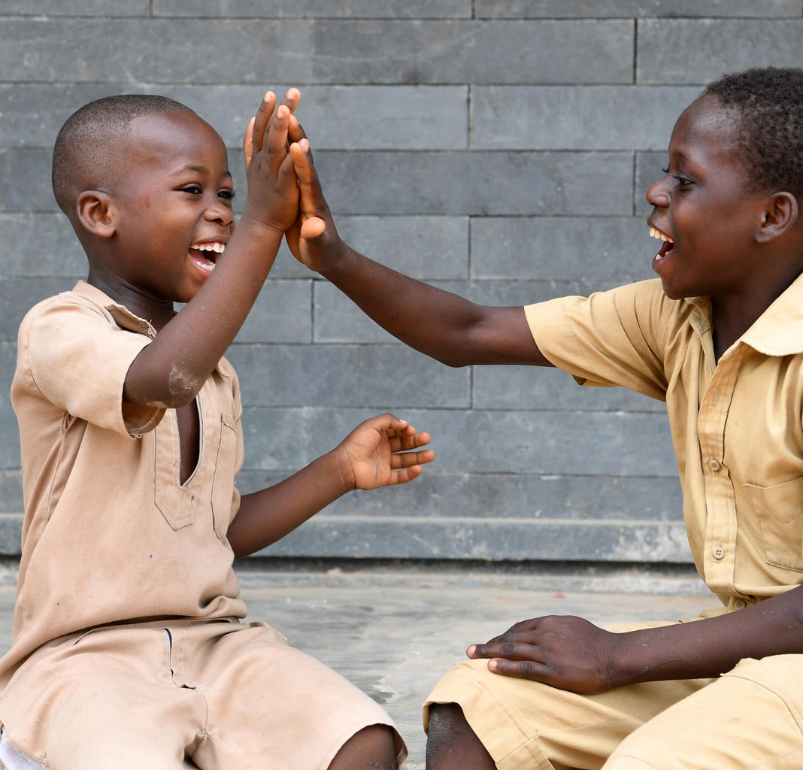
TAKE
Children at the playground of their school, Côte d’Ivoire. © Unicef/Dejongh
ACTION
By getting involved in OutRight this year, you’ll be making your voice heard on one of the most important issues facing our planet – climate change
Together, we can help make sure children in the UK and all over the world live happy, healthy lives
Notes:
The last few months have seen us all experience a global event that has affected every aspect of our daily lives. The pandemic has caused widespread disruption and upheaval, but it has also give us an opportunity to build back better and reimagine a better future for everyone – and for our planet.
Unicef is asking the UK Government to listen to children like you and put children’s rights first – now and in the future. Children and young people like those you are working with can lead this change, making their voices heard and telling decision-makers what they want and need to thrive and survive – to reimagine a happier, healthier future for all children and for our planet after the coronavirus pandemic.

Slide 14
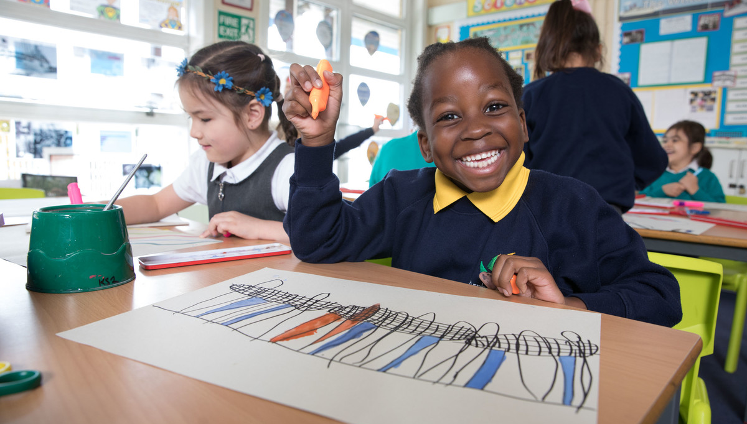
THANK YOU
Thank you so much for taking part in OutRight this year and for making your voice heard.
We look forward to hearing what you get up to!
Enjoying lessons at a Rights Respecting School in London. © Unicef/Dawe

