Slide 1
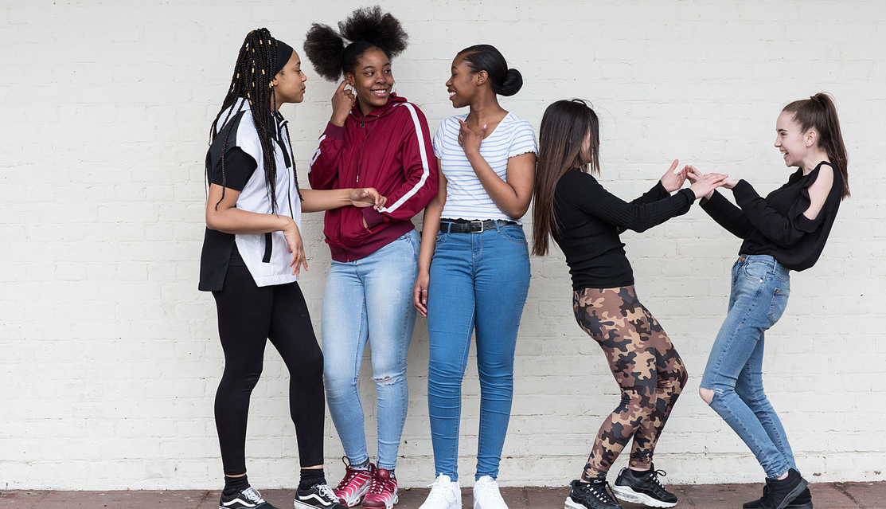
WELCOME TO
OUTRIGHT 2020/21
Young people taking part in Unicef'sChild Friendly Cities programme. © Unicef/Dawe

Slide 2
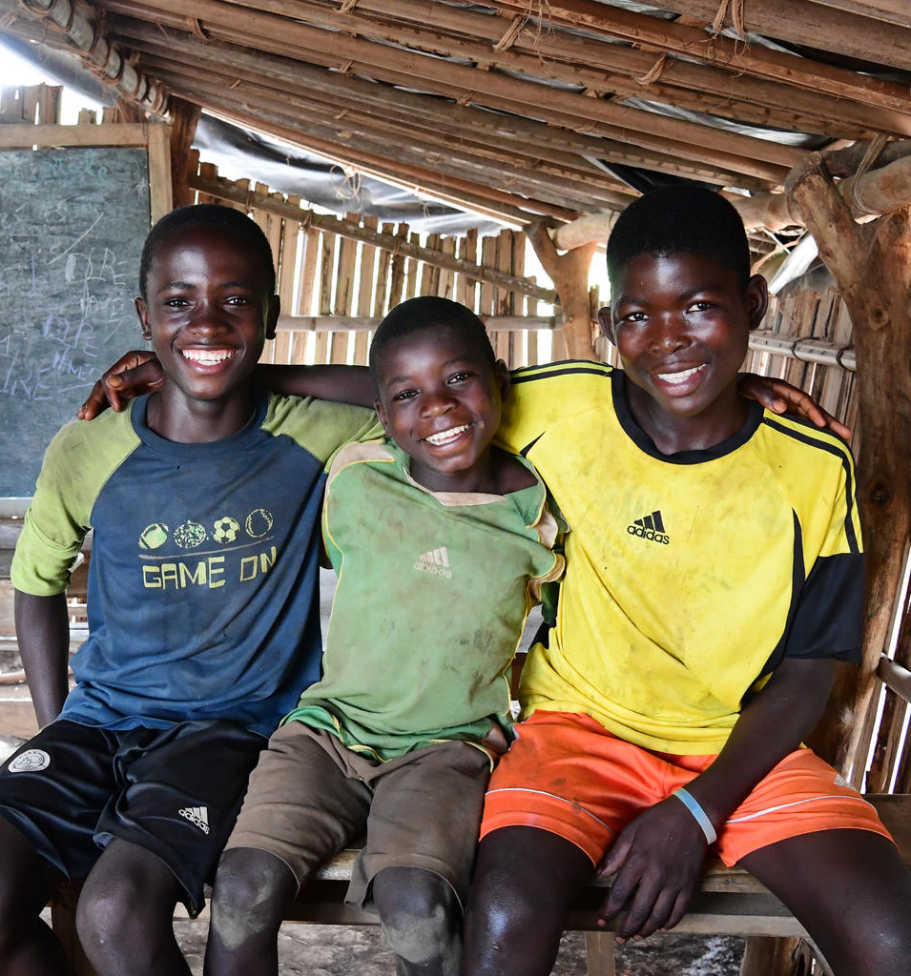
WHAT IS UNICEF?
Three friends in their classroom in Côte d'Ivoire. © Unicef/Dejongh
Unicef UK is a charity that cares about the rights and well-being of every child – wherever they live.
Unicef works in 190 countries around the world.
Notes:
If you are a Rights Respecting School and your group is already familiar with Unicef and its work, you can remove this slide before sharing.

Slide 3
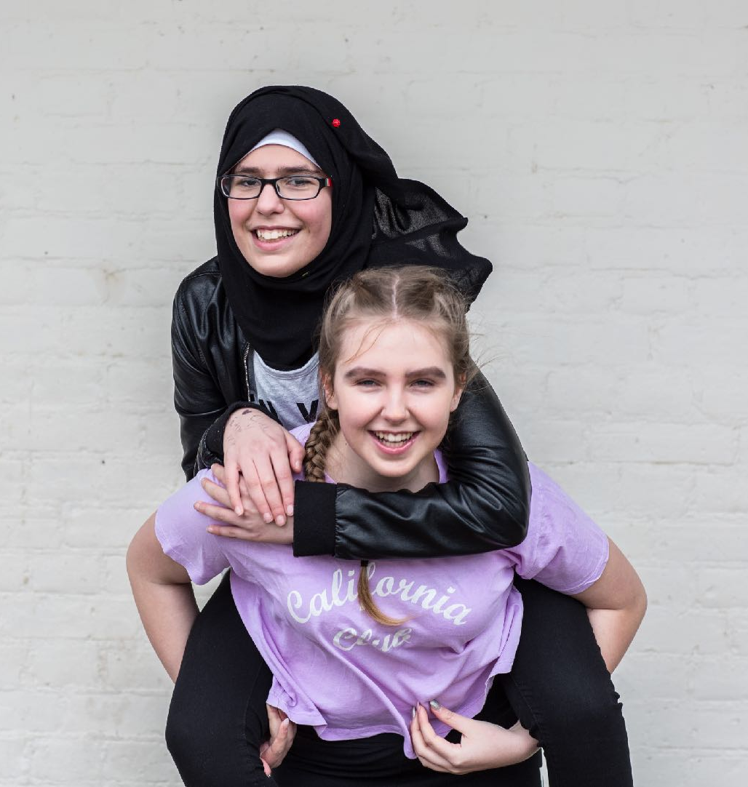
WHAT IS OUTRIGHT?
Two friends in London, taking part in Unicef’s Child Friendly Cities programme. © Unicef/Dawe
OutRight is a youth campaign run by Unicef UK that helps children and young people to speak out about children’s rights in the UK and abroad.
It’s a campaign by young people, for young people.

Slide 4
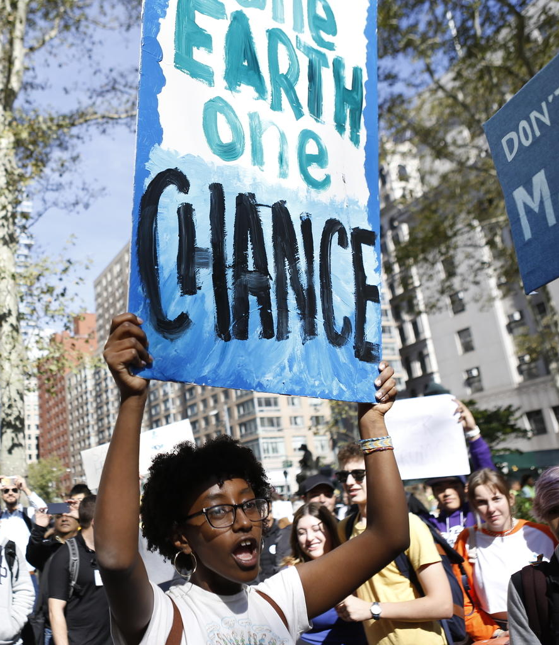
MAKE YOUR VOICE
HEARD!
OutRight will help young people like you to stand up for the rights of children in the UK and around the world, with the support of our campaign champion, actor Cel Spellman.
This year, OutRight is all about climate change and children’s rights.
Youth climate activists at a demonstration in New York. © Unicef/Chalasani

Slide 5
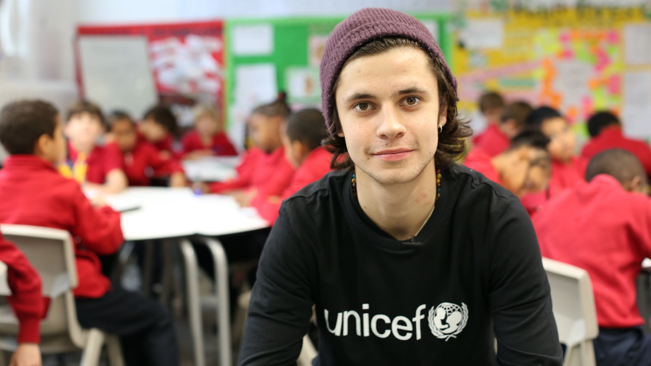
Introducing
CEL
© Unicef/Dawe

Slide 6
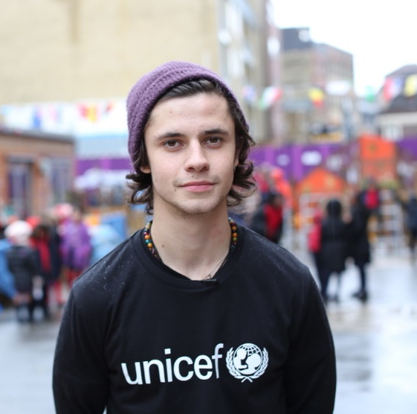
A MESSAGE FROM
Cel Spellman (centre) championing children’s rights. ©Unicef/Dawe
CEL SPELLMAN
Actor and Unicef UK Ambassador
Cel Spellman has this message for
you about taking part in OutRight…
© Unicef/Dawe
Notes:
The welcome message from Cel Spellman is available here: https://youtu.be/ju_Ms8gSOb8

Slide 7
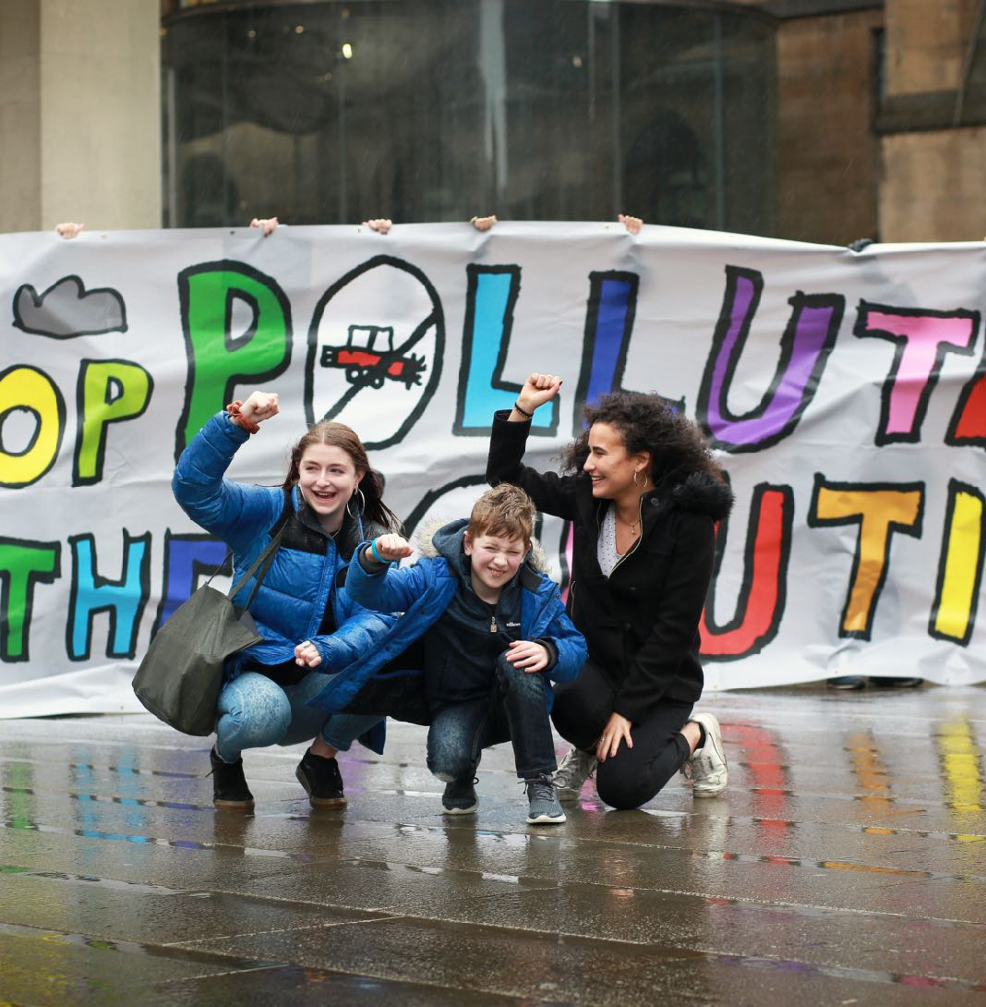
SPEAKING OUT ABOUT CLIMATE CHANGE
This year, OutRight turns the spotlight on climate change and children’s rights.
We want young people like you to use your voices to make the world a better place.
Families taking part in the Unicef UK Action Day. © Unicef
Notes:
Ask young people to suggest what rights they think might be impacted by climate change and for their ideas for making their voices heard, before moving to the next slide.

Slide 8
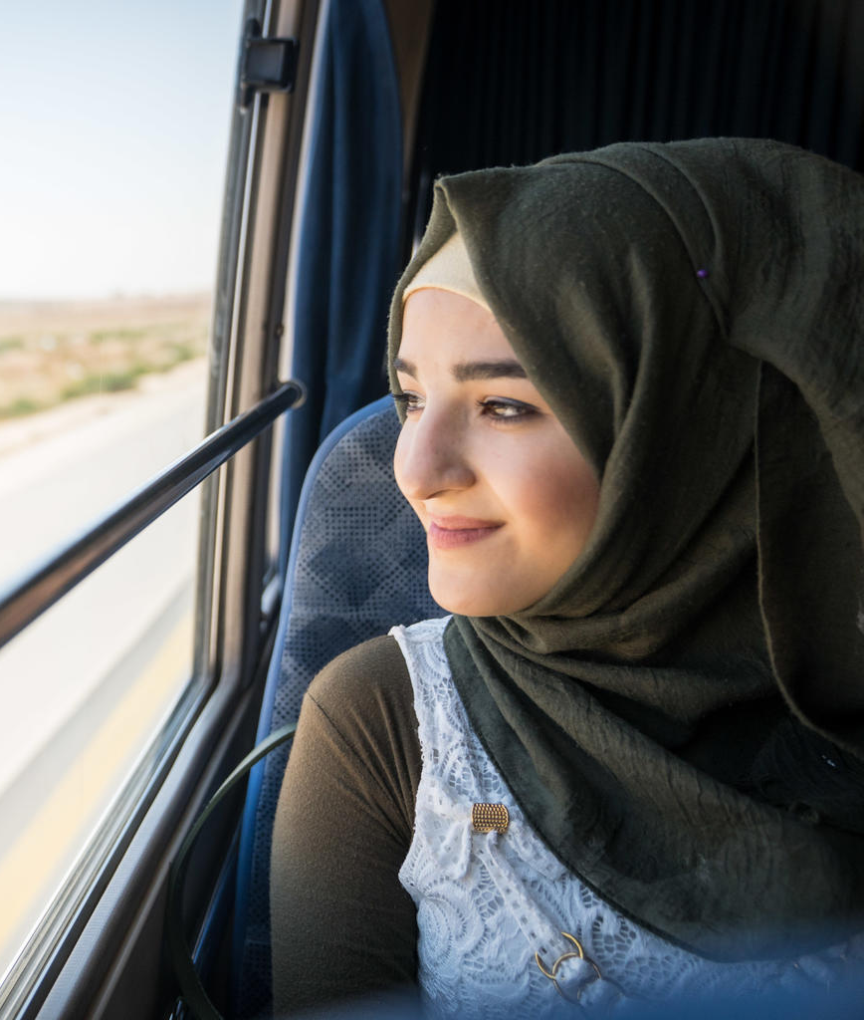
CLIMATE CHANGE AND CHILDREN’S RIGHTS
Through this year’s OutRight campaign, we will find out how climate change is impacting children’s rights, including:
the right to go to school
the right to be healthy
the right to have somewhere safe to live
Siba, 18, on her way from Za’atari Refugee Camp in Jordan to talk about climate change innovations. © Unicef/Herwig
Notes:
Climate change affects the rights of young people in lots of ways. Firstly, it threatens a child’s ability to survive, grow and to thrive. Extreme weather events threaten lives, undermining access to clean drinking water, which can lead to the spread of diseases.
Extreme weather events like cyclones and floods can also destroy homes, forcing families to leave their villages and destroying schools so that children can no longer get educated.
Increases in temperature and rainfall can threaten people’s crops and lead to food shortages. Air pollution can also have a direct and negative impact on children’s health.

Slide 9
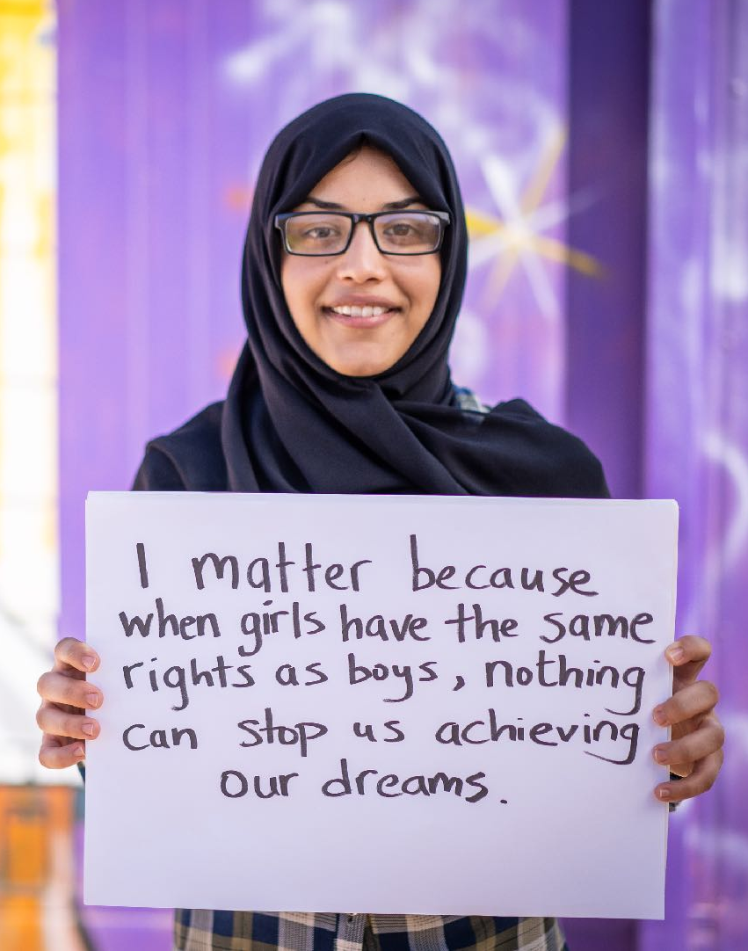
TAKING PART IN OUTRIGHT
By taking part in OutRight, you will have the chance to:
Take part in a climate change quiz
Create a piece of climate change theatre
Find out how young people around the world are impacted by climate change
Speak out and call on people in power to take actions that protect the climate and young people’s rights
A young woman standing up for her rights. © Unicef/Herwig

Slide 10
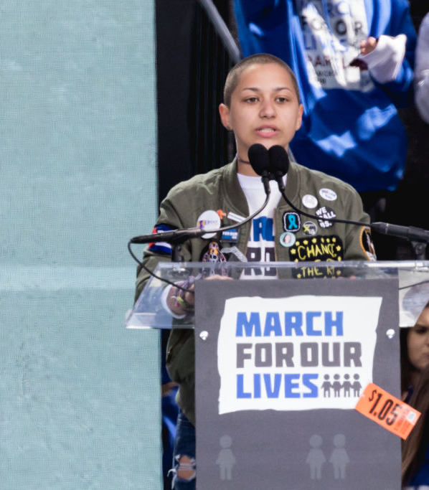
WHY
Youth climate activists join a demonstration in New York calling for global action to combat climate change
© Unicef/Chalasan
CAMPAIGN?
Young people like you have an important role to play in campaigning to create change. Your voices matter!
UN Convention on the Rights of the Child: Article 12
Every child has the right to say what they think in all matters affecting them, and to have their views taken seriously.
Parkland shooting survivor Emma Gonzalez speaks at the March For Our Lives Rally in Washington, D.C.
© Cheriss May/NurPhoto via Getty Images
Notes:
By signing petitions, making videos, writing blogs, speaking to their local representatives and local media, young people can show those in power just how much they care about climate change and its impacts and how they’re affecting children’s rights.

Slide 11
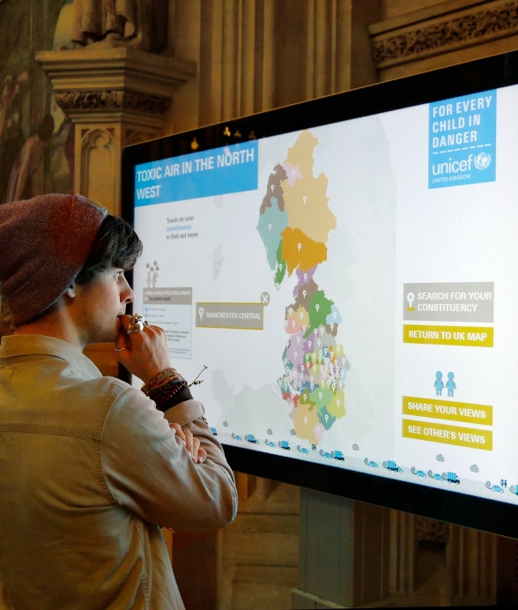
JOIN CEL
MAKE YOUR VOICE HEARD
You can share your views on climate change
You can take action by writing to your local decision-maker, e.g. your MP, to tell them why you care about climate change, and invite them to meet your group
You can get involved in World Children’s Day (20 November) activities or tell your local newspaper or radio station what you’re doing for OutRight 2020/21
Cel Spellman joined children at an event in the Houses of Parliament to talk to Parliamentarians about the OutRight campaign on toxic air. © Unicef

Slide 12
CELEBRATE
World Children’s Day on 20 November celebrates the United Nations Convention on the Rights of the Child, which protects children’s rights around the world
To protect children’s rights, we must tackle climate change and greenhouse gas emissions urgently
Amia, 11, stands on an ice floe near her home in Alaska, USA. © Unicef/Sokhin

Slide 13
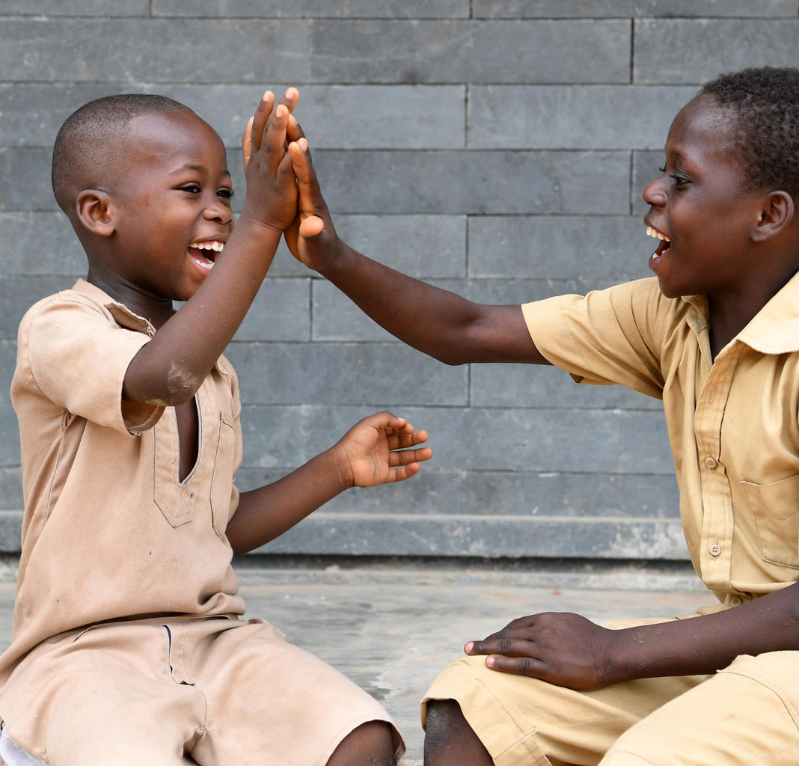
TAKE
Children at the playground of their school, Côte d’Ivoire. © Unicef/Dejongh
ACTION
By getting involved in OutRight this year, you’ll be making your voice heard on one of the most important issues facing our planet – climate change.
Together, we can help make sure children and young people in the UK and all over the world live happy, healthy lives.
Notes:
The last few months have seen us all experience a global event that has affected every aspect of our daily lives. The pandemic has caused widespread disruption and upheaval, but it has also give us an opportunity to build back better and reimagine a better future for everyone – and for our planet.
Unicef is asking the UK Government to listen to young people like you and put the rights of young people first – now and in the future. Young people like those you are working with can lead this change, making their voices heard and telling decision-makers what they want and need to thrive and survive – to reimagine a happier, healthier future for all young people and for our planet after the coronavirus pandemic.

Slide 14
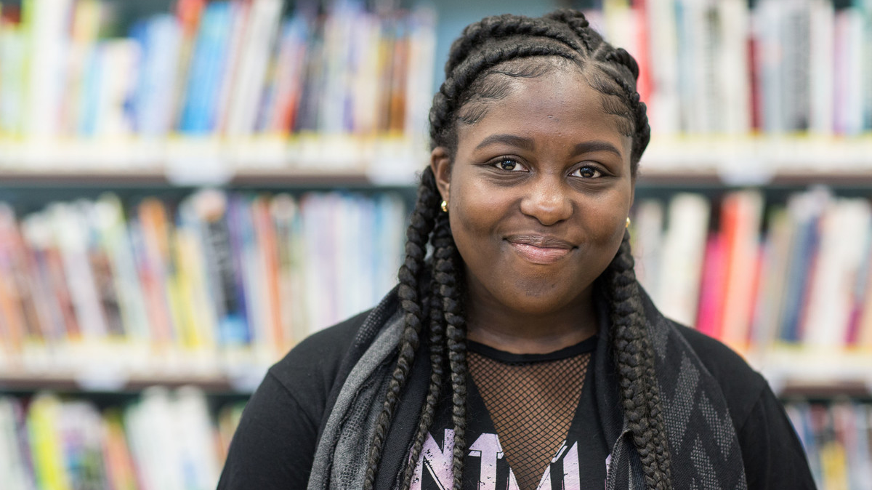
THANK YOU
Thank you so much for taking part in OutRight this year and for making your voices heard. We look forward to hearing what you get up to!
Taking part in Unicef's Child Friendly Cities programme. © Unicef/Dawe

