Slide 1
ACTIVITY 4
Earth explorer
Child enjoying Unicef's Child Friendly Cities & Communities programme. © Unicef/Dawe
Notes:
From the story of Paddington, we know that Paddington had learned about London as a young bear because of an explorer called Montgomery Clyde. Montgomery Clyde had been sent to visit and learn about the jungle of Peru by the Geographer’s Guild of London.
On that trip he met Paddington’s Aunt Lucy. The explorer, Mr. Clyde, wore a red explorer’s hat on his journey and gave this hat as a gift when he left Peru. This red hat is the explorer’s hat that Paddington now wears.
We also know that Paddington is a very curious bear. In this lesson, we are going to be very curious like Paddington to learn more about climate change – what are some things that can cause the climate to change, and what are some of the effects this has on the earth and on people.
To get ready, we must first all put on our hats to remind us that we are curious explorers. Next we will look at different areas on the earth that have unique climates – called ecosystems – to see if we can spot how they are changing.

Slide 2
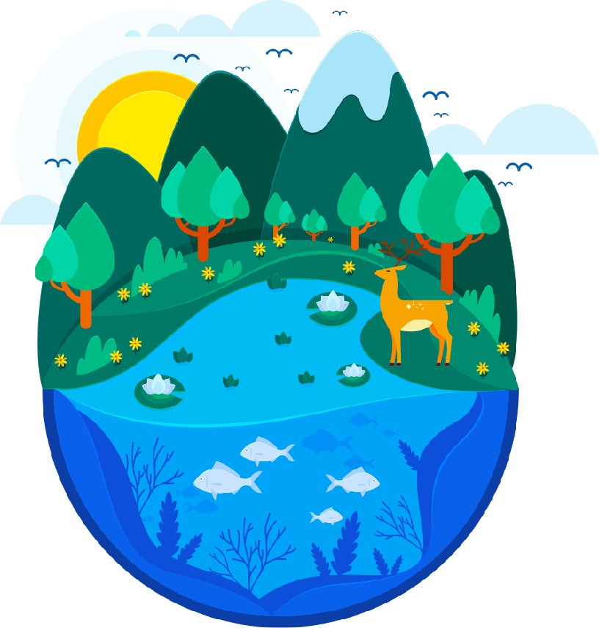

ECOSYSTEM
All of the living and non-living things in an area including plants, animals and other living things that make up the communities of life; plus all of the non-living material like water, rock, soil and sand.
Notes:
Introduce the idea of an ecosystem as a system of living and non-living things in a particular area. This includes all of the plants, animals and other living things that make up the communities of life in an area, plus all of the non-living material like water, rock, soil and sand. Explain that the actions of people increase global heating and that climate change can lead to changes in ecosystems that affect the living things in these systems. All of these systems eventually link to children, and their ability to grow up in a healthy environment.

Slide 3

Spot the difference
Notes:
Share that, as “Earth Explorers”, we are going to play a game called “Spot the Difference”. Explain that in the presentation we will look at four different pictures. Each of these pictures is an ecosystem.
Work through each of the four sets of ‘before’ and ‘after’ ecosystem pictures in the PowerPoint activity. Throughout the process of spotting the differences, prompt the children with questions related to the differences they see. For example, why do you think all the animals are gone from the image? See the Facilitator Notes for more prompts for each of these images.

Slide 4
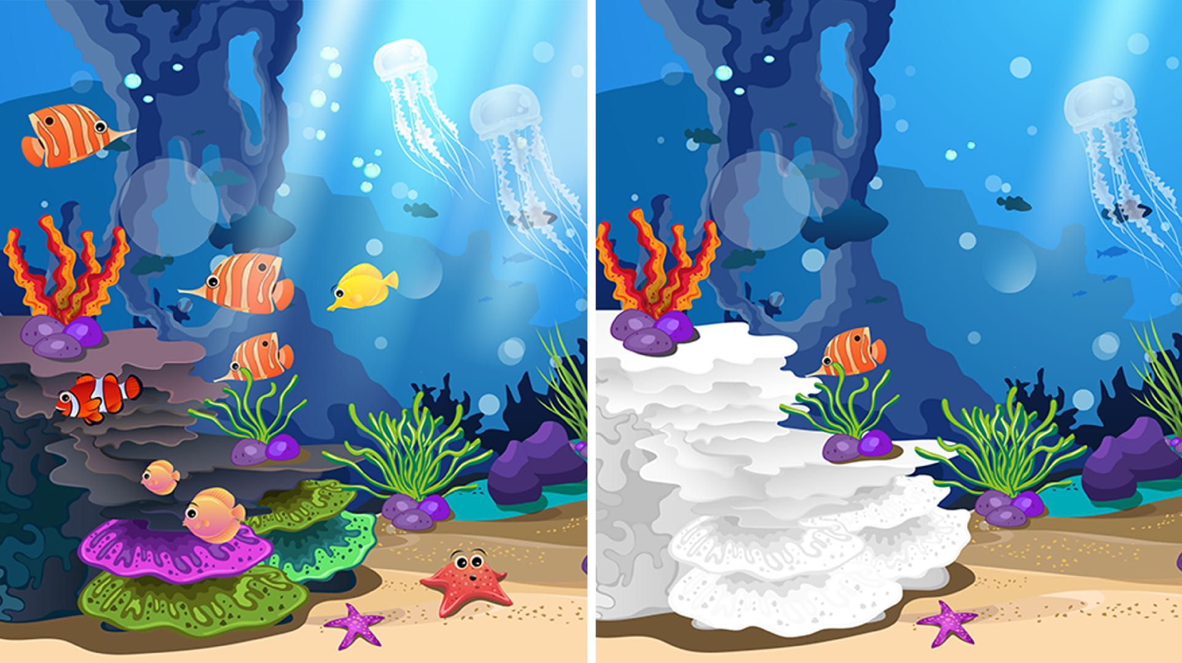
Notes:
Differences:
Higher water level
Plastic and rubbish pollution
Fewer fish
Coral reefs are white (not bright colours anymore)
Fewer sea grasses

Slide 5
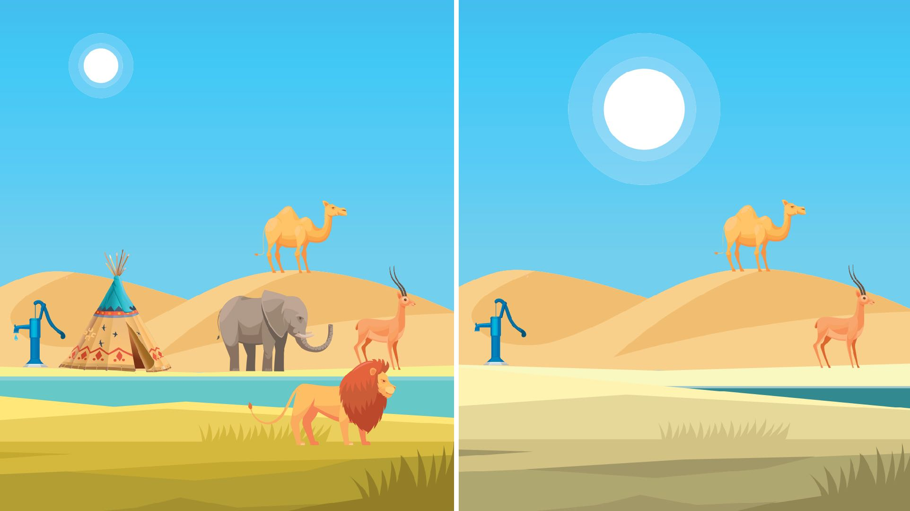
Notes:
Differences:
Sun is bigger/hotter
Fewer animals
Dried up watering hole
Less water underground
Tent gone

Slide 6
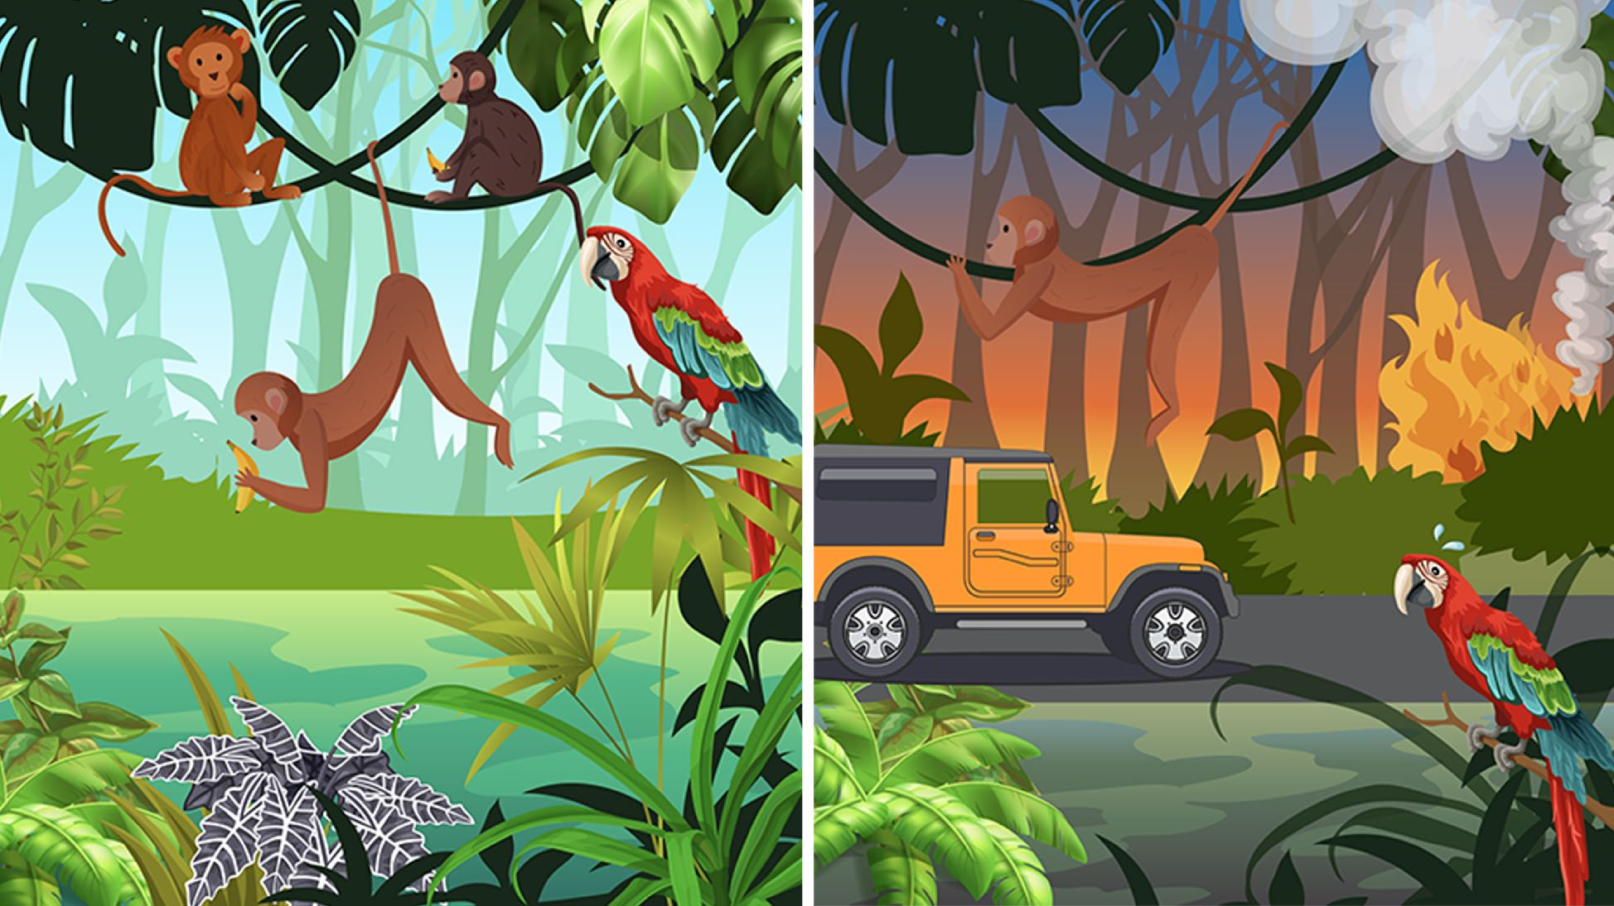
Notes:
Differences:
Many of the trees cut down
Road in the jungle
Polluted water
A wildfire starting

Slide 7
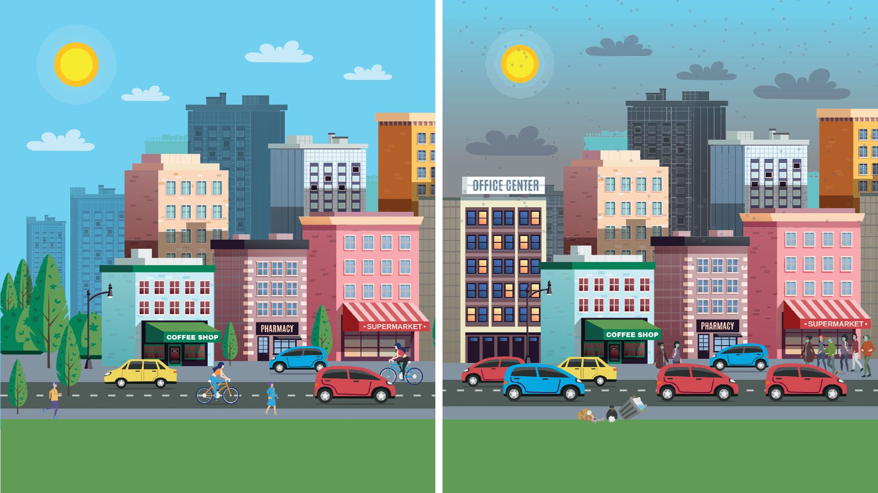
Notes:
Differences:
Rubbish in street
Pollution/smog in skies
More cars/no bicycles
Fewer trees (or a park replaced by a building)
Bigger crowds of people

Slide 8
How does it all link together?
ARTICLE 24
©Unicef/Dawe

