Slide 1
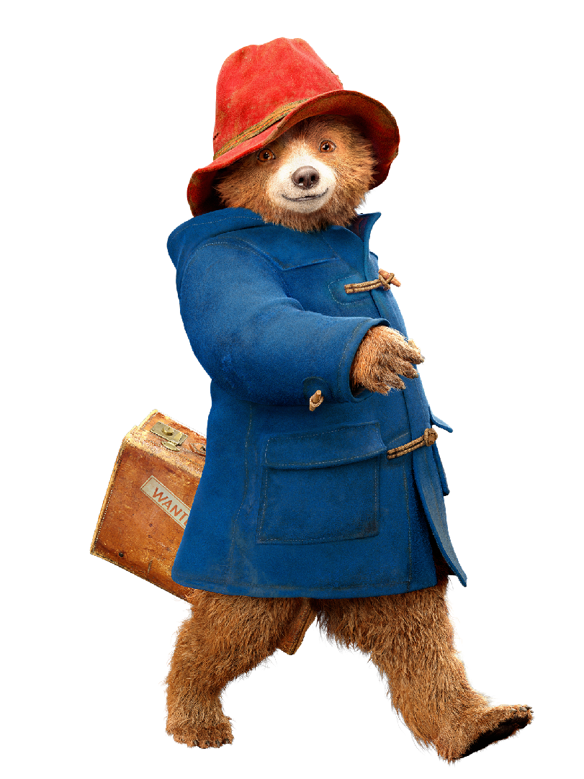
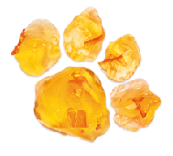
TRACKING YOUR FOOTPRINT
What you can do to help build a healthy planet
Notes:
Tracking your footprint:
What you can do to help build a healthy planet
(Facilitator notes: Part 1, Step 1)
Explain to the children that we are going to spend the next 2-3 days (depending upon how much time there is between sessions) paying attention to the actions we take every day that can either add to or help offset the climate problems we have been learning about.

Slide 2
-
+
EVERYDAY ACTIONS THAT CONTRIBUTE TO CLIMATE CHANGE
POSITIVE ACTIONS TO MITIGATE/REDUCE CLIMATE CHANGE
Notes:
(Facilitator notes: Part 1, Steps 2 & 3)
Using one piece of paper, instruct each child to use a pen or pencil to trace their left foot (shoes on or off is okay); on a second piece of paper have children trace their right foot. (In a classroom, children can complete this in pairs. For virtual leaning, children can do the activity with a sibling or a trusted adult if they need help). If a child has a disability and is not able to trace their foot, they can draw a foot, or draw a Paddington paw print.
Have the children label one footprint page with a plus (+) and one with a (-).
Alternative: Children can draw bear paw prints (as seen in title slide)

Slide 3
EVERYDAY ACTIONS THAT CONTRIBUTE TO CLIMATE CHANGE
-
+
Takeaway dinner
in plastic packaging
Cycling to the shops
Turning off the lights at home
Leaving the TV on when we’re not at home
Recycling newspapers
Taking reusable bags to the shops
Getting a new dress and throwing away the old one
Not turning off the hose
after watering the garden
Reusing plastic containers
Leaving laptop power on all night
Picking up rubbish when
we see it on the ground
Planting a tree
Driving to far away shops
Opening the window while the heating is still on
Walking or using public
transport to get to
the park
Saving rainwater to water the garden
Drinking bottled water
POSITIVE ACTIONS TO MITIGATE/REDUCE CLIMATE CHANGE
Notes:
(Facilitator notes: Part 1, Steps 4 & 5 )
Instruct the children that they will use these two footprints to track the actions that they do every day – like riding their bike, riding in a car, leaving the lights or the television on when they aren’t in use.
On the footprint with the +, children should write a list every day of the actions that they take that help improve the environment.
On the page with the -, children should write actions they take that are not good for the environment and are good for our health.
Remind children that the negative actions aren’t all bad things – but we want to be aware of how much we are doing these things and try to replace these actions with positive alternatives as much as possible because this improves the environment and helps protect the health of children around the world.
After tracking activities for 2-3 days (or completing a brainstorm as a one class activity option), have the children report back on their learnings using the following discussion questions:
Which list was bigger: your + footprint or your - footprint? What are some of the actions that were recorded on each one of the footprints?
What actions could you take to move items from your - footprint to your + footprint?
How do the actions you listed in your + footprint improve your health and the environment?
How are/were your actions on this list different during the time you’ve spent at home during the coronavirus pandemic? (did you ride your bicycle more and drive your car less?)

Slide 4
TRACKING my
Climate footprint
Report Back and Discussion

Slide 5
A healthy
Future home
Today
Climate change global heating
Notes:
(Facilitator notes: Part 2, Step 1)
Building on the discussion from Part 1, explain that the actions that we can each take to help keep our environment healthy are very important, but small actions are not enough alone. Explain that there is a spectrum of solutions required to combat climate change and ensure future generations have a healthy planet.

Slide 6
A healthy
Future home
Today
Climate change global heating
Big ideas + government action
Notes:
(Facilitator notes: Part 2, Step 1)
Demonstrate (using the footprint analogy on the spectrum) that positive personal actions help to ensure that we don’t contribute to making the climate situation worse. However, we also need big innovative ideas for alternative ways of living, and we need governments to take serious action to reduce global heating and ensure the rights of children in the longer term.

Slide 7
1
Take personal action to keep our environment healthy
A healthy
Future home
Today
Climate change global heating
2
Call on our government + businesses to tackle climate change and put children’s rights first
Big ideas + government action
Notes:
(Facilitator notes: Part 2, Step 2)
Children can contribute to these solutions in two ways: 1) by continuing to take action to keep our environment healthy and improve it as much as possible; and 2) by using your voice and your right to have your opinion taken seriously by government (Article 12) to call on governments and businesses to tackle climate change and put children’s rights first.

