Slide 1
Activity 3
What do people think about climate change?
– The State of Our Planet News Report
Families take part in the Unicef UK Action Day. © Unicef

Slide 2
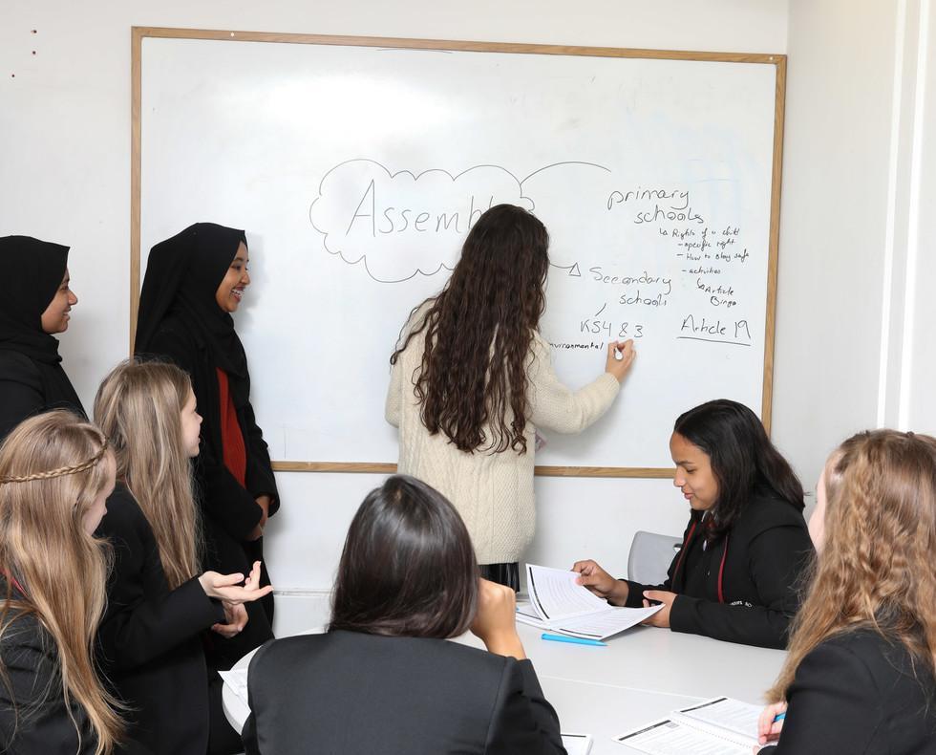
Young people learning about their rights. © Unicef/Dawe
In this activity, we will explore why acting on climate change is important: through climate conversations with community members with expertise around different areas of rights or climate.

Slide 3
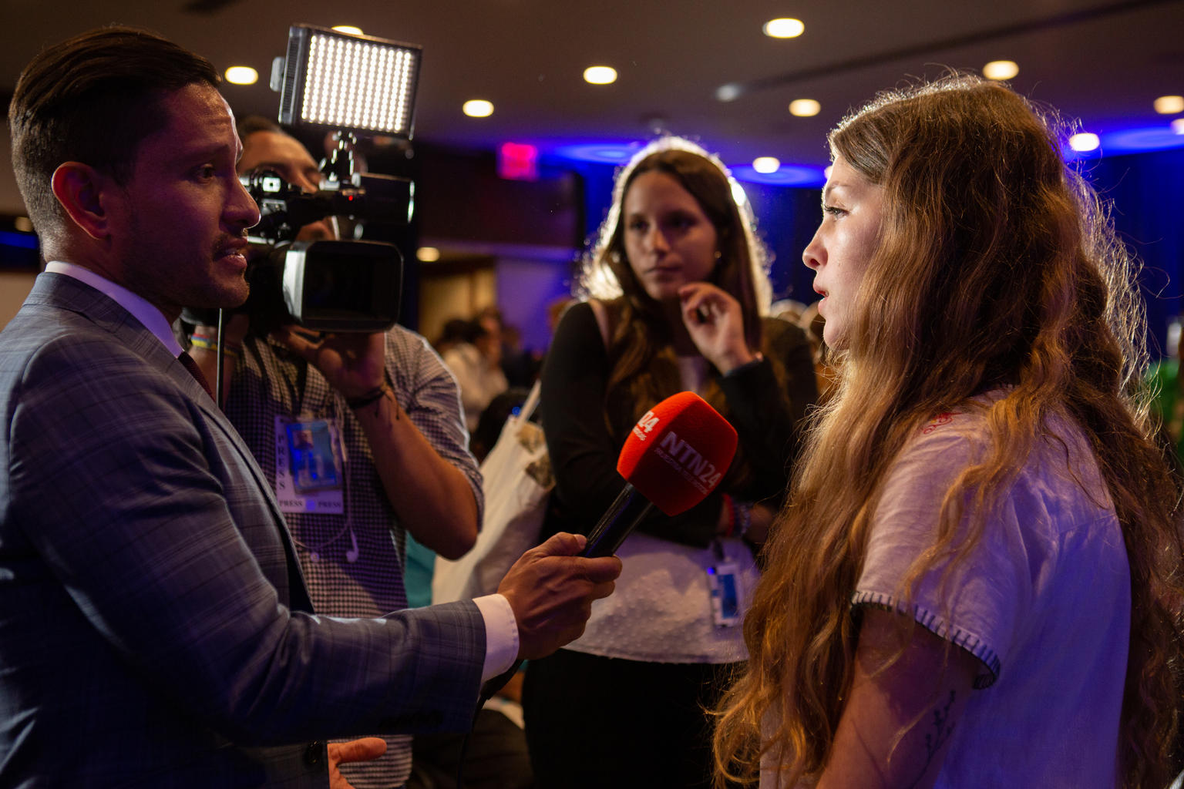
At Unicef House in New York, Chiarra, 17, from Argentina, gives an interview about climate change. © Unicef/Chalasani
Information gathered from interviews can be presented as a piece of journalism – as a podcast, video interview or a written feature based on access to tech and interest of participants.

Slide 4
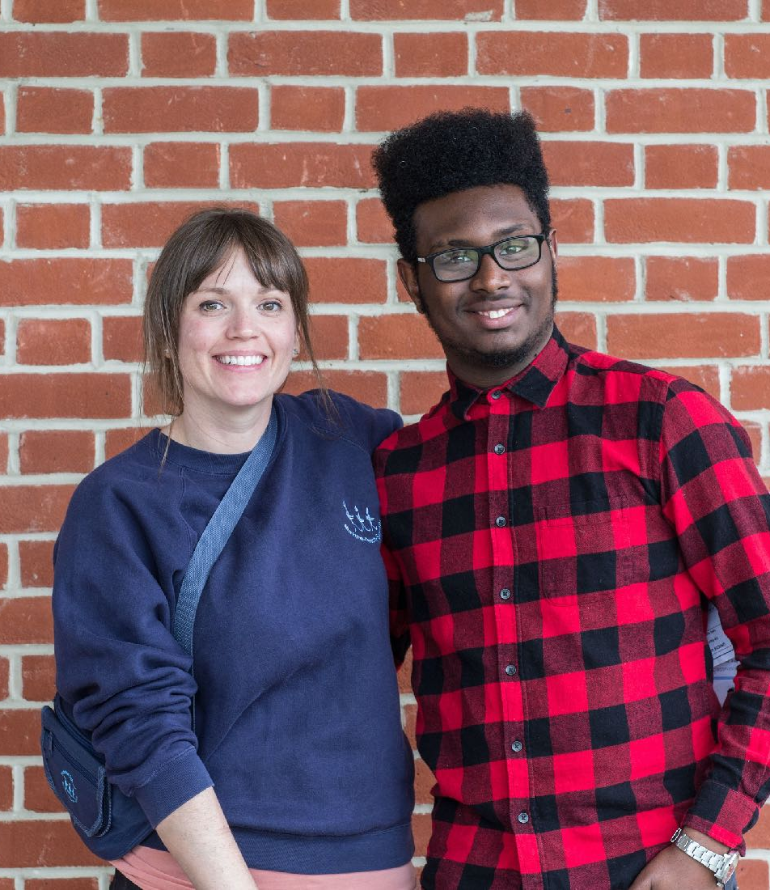
INTERVIEW TIPS
Young people at a Rights Respecting School in England. © Unicef/Dawe
Practise and prepare your questions in advance.
Let the interviewee know how long the interview is going to take.
Let the interviewee know what you are going to do with the information that they share (will you publish it or just share it in your class or youth group?).
Always ask permission if you will be recording the interview with audio or video (even if the recording is only for your own notes).
Be clear. Use language that anyone will be able to understand.

Slide 5
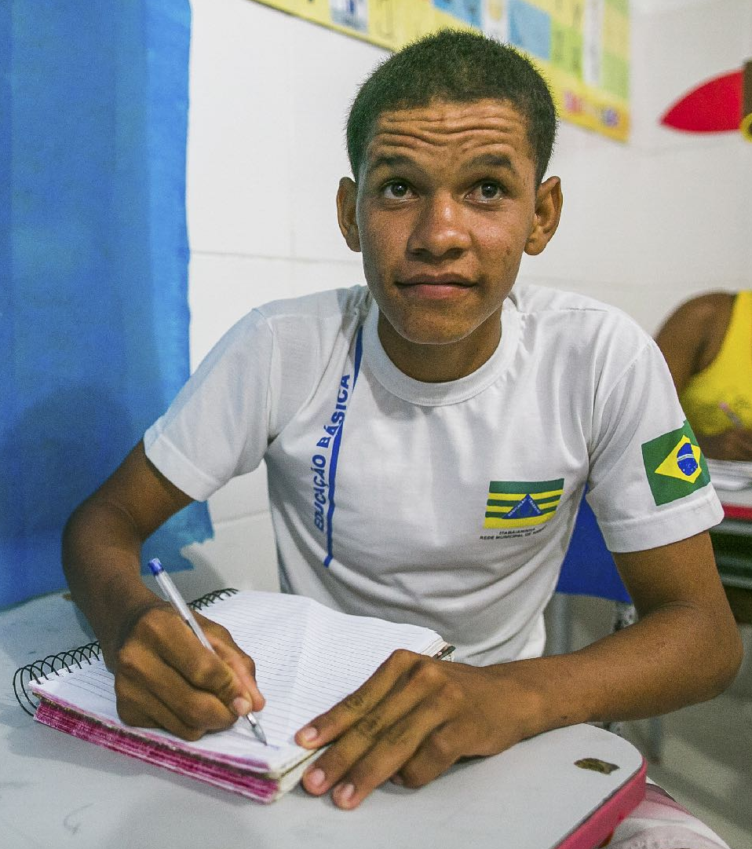
INTERVIEW TIPS
A young man enjoying his right to education.© Unicef/Liborio19
Be sensitive to other opinions and experiences and remember that you are interviewing someone to get their perspective. Climate change can be a topic that some people have different opinions about. If someone’s perspective is different from yours, follow up with a question like “why” to gain more understanding. If an interviewee seems to become angry or upset, stay calm and ask the question in another way.
Try to relax and enjoy the experience!
After the interview, remember to thank your interviewee for their time.

