Slide 1
ACTIVITY 4
Healthy earth, healthy lives
Two friends in London, taking part in Unicef’s Child Friendly Cities programme. © Unicef/Dawe

Slide 2
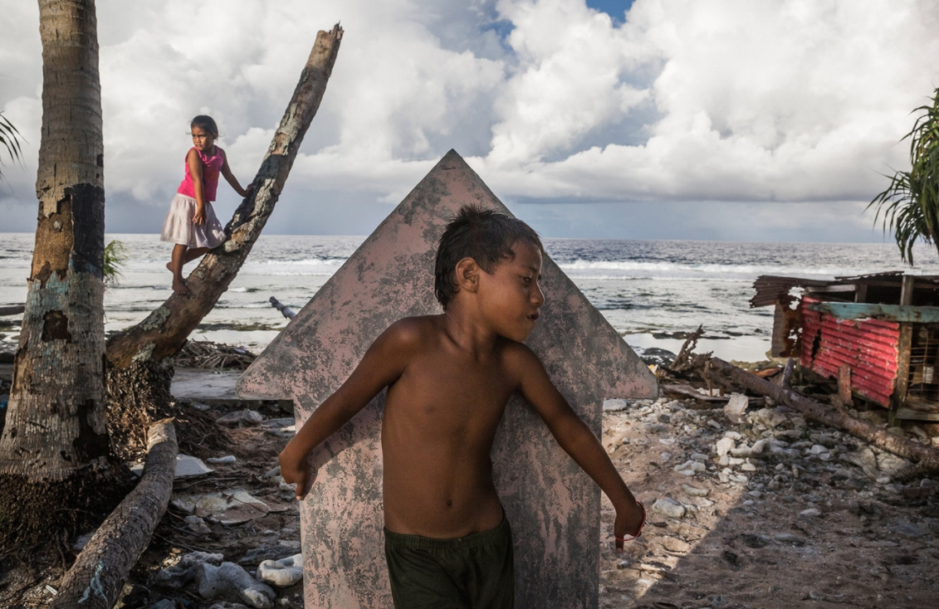
Young people playing on a beach in Tuvalu. © Unicef/Sokhin
Notes:
Using the Tuvalu image as a discussion, help young people to make the linkages that global warming (caused by some of the actions we just considered in the climate calculator) is causing ocean rise on the Pacific island nation of Tuvalu.
As the ocean level gets higher, sea water is contaminating the water table, meaning that children in Tuvalu are lacking access to clean water that is essential for their health and well-being. This is not only a problem in Tuvalu. Because of the effects of climate change, it is expected that 600 million children – one in four worldwide – will be living in areas with extremely limited water resources by 2040 (source).
Guide the young people to conclude that, because human action is part of the problem, human action can also be part of the solution.

Slide 3
WRITE DOWN
3 new things you learned
2 actions you can take
1 question this has raised
The ocean is rising in the Pacific island nation of Tuvalu. © Unicef/Sokhin
Notes:
Wrap up the activity with a reflection exercise, asking the young people to write down three new things they learned, two actions they could take and one question that this activity made them want to know more about.

