Slide 1
Unicef/Georgiev
Notes:
On 28 April, children dance as UNICEF Goodwill Ambassador Orlando Bloom visits the centre for children's creativity in Svitlodarsk, eastern Ukraine. The centre specialises in informal education - like art classes and drama.
Unicef/Georgiev

Slide 2
Teacher slide
Contents
Slide 3 Guess the article - images as clues to identify the article
Slide 4 Introducing the article
Slide 5 Exploring Article 13 – the question
Slide 6 Exploring Article 13 – the answers
Slide 7 & 8 Primary activities
Slide 9 & 10 Secondary activities
Slide 11 Reflection
Slide 12 Extension
Instructions
This flexible resource is intended to provide you with some easy to use, appropriate rights-related learning to share with your children, their families and your colleagues.
Please edit out non-relevant slides or tasks before sharing with students.
Please check the content works for your learners and feel free to add any content that would make the material more relevant to your setting.

Slide 3
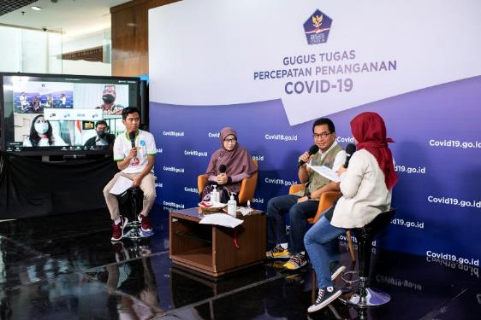
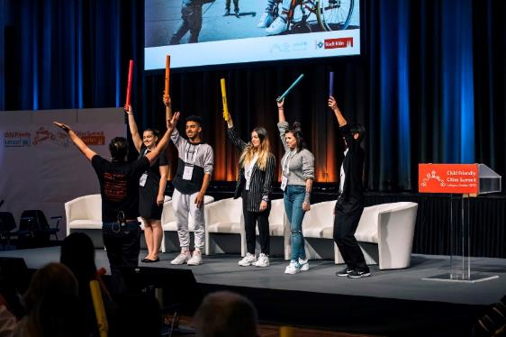
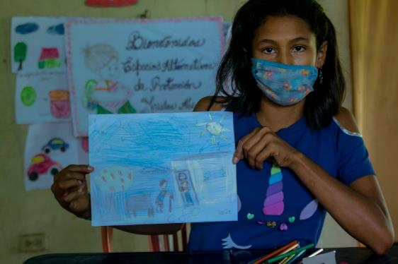
Guess the article
These pictures provide a clue to this week’s article.
Can you guess how they are linked together? Which article of the Convention do these pictures relate to?
Write down your thoughts or discuss with someone in your home.
Unicef/Wilander
Unicef/U4A2612
Unicef/Urdaneta
Notes:
From left to right:
Unicef/Wilander – Andika, 16 and Sephia, 13, engage in a talkshow on health knowledge during the COVID-19 pandemic in the media centre of the National Agency for Disaster Management in Indonesia, July 2020.
Unicef/U4A2612 – October, 2019 UNICEF and the City of Cologne hosted the first international Child Friendly Cities Summit in Cologne, Germany. The last day of the event saw children and young people present Mayors a manifesto on child friendly cities.
Unicef/Urdaneta – Marelys, 15, draws a self-portrait helping an old man during an art therapy activity in one of the protection centres supported by UNICEF in Bolívar state, July 2020.

Slide 4

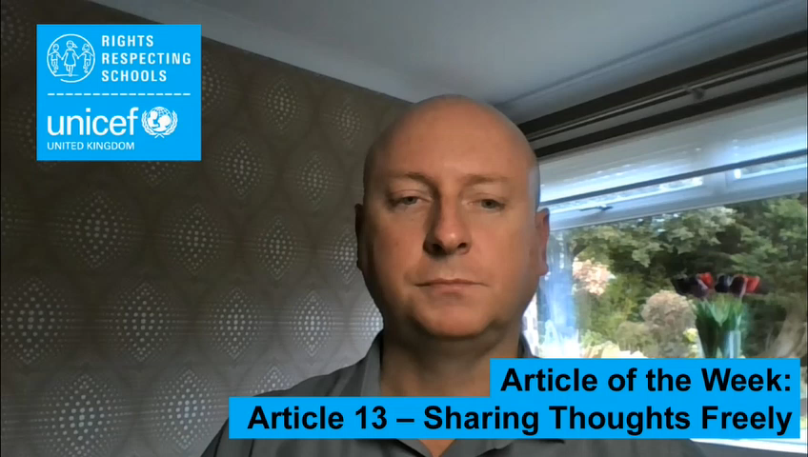
Introducing… Article 13
Gerry introduces Article 13 – Sharing Thoughts Freely
Article 13 - Every child must be free to express their thoughts and opinions and to access all kinds of information, if it is within the law.
Watch Gerry on YouTube

Slide 5
Exploring Article 13
Article 13 says you have the right to express your thoughts and opinions.
What does this mean?
What do you need to do this?
Note your ideas down and then compare your thoughts with the next slide.

Slide 6
How many of these did you get?
You can tell people what you think and how you feel. This includes sharing your own views, opinions and ideas on anything at all.
You can do this by speaking up, writing down your thoughts or drawing how you feel.
It is important that you do not harm other people with the things you say, or stop them enjoying their rights.
In school you can join pupil voice groups such as the Rights Group and the School or Pupil Council.
You can talk to your parents/carers, teachers, friends or other adults. They should all provide ways to support you to share your opinions.
You can look up information to help you find out something important to you, and to help you make your own decisions or decide on your own views.
What else did you think of?

Slide 7
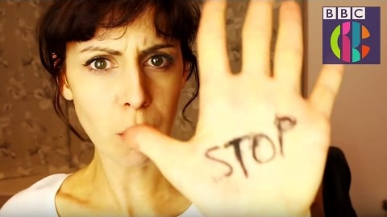
Activity Time
You have the right to express yourself. Can you find out about groups in school or your community that you can join to help you express yourself?
Do you remember looking at Article 12 about children’s views being taken as seriously as adults? Can you explain to your
friends or teachers how Articles 12 and 13 support each other?
All these activities are related to…
How do you like to express yourself? Create some art, write a story, poetry or make up a song or dance, or draw a poster to show what it’s like to be you!
You have the right to access information as long as it is within the law. Why are there age limits on things, like films or social media, which you can access? Watch this video and talk to your class about how you stay safe online.
You don’t need to do every single activity
but if you have time you can do more than one.
Primary

Slide 8
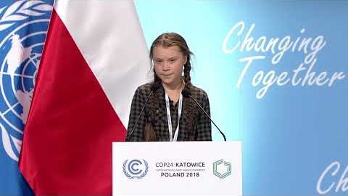
Activity Time
We are all special. What makes you special? Talk about a favourite song, movie, game or sport that interests you. Share your story with a friend.
During lockdown, if you weren’t able to go into school or go to clubs and attend activities that interest you, what did you do to express yourself? Did you draw, write a story, or make up a game? How did you keep in touch with your friends and family? Talk about it in your class.
Can you think of a someone famous who uses their freedom of expression to be heard? Watch this video of Greta Thunberg addressing adults at COP24 for inspiration. Is there anything that you feel very strongly about? How do you express your thoughts about this issue. How could you share your views in school.
Imagine you had a 5 minute radio interview to talk about something that is important to you. What would you say? Pair up with a friend and interview one another.
Can you think of a time when someone sharing their opinions could be harmful or upsetting to others? What would you do about this?
Primary

Slide 9
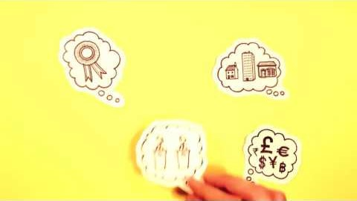
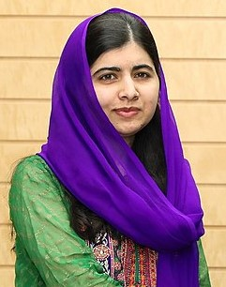
Activity time
Do you remember looking at Article 12 about children’s views being taken seriously adults? Can you explain to your
friends or teachers how Articles 12 and 13 support each other?
These activities will help you
understand how...
…can relate to your life.
You don’t need to do every activity, just do as many as you can.
Watch this video from Amnesty International and talk about how it makes you feel.
You have the right to express yourself and look for information to help you share your opinions. How do you do this in your life?
Do you know the story of Malala Yousafzai? Malala continues to use her right to share her thoughts freely to change the world, even though people tried to stop her doing so. How might people like Malala and Greta Thunberg inspire other young people to express their opinions? Are their qualities they show, that you would like to develop? Explore these questions in a piece of writing or by discussing in groups.
.
Secondary
WikiCommons

Slide 10
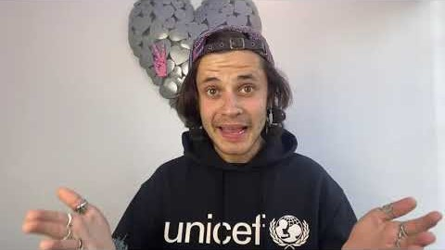
Activity time
People express themselves in many different ways like though the way they dress or the clubs and activities they get involved in. How do you express yourself? Why don’t you try expressing yourself in a way you haven’t tried before.
You may not always agree with what other people say. Why is it important that we show respect towards one another? Discuss in small groups.
Voices of Youth is Unicef’s digital community for young people by young people. Find out more about it and consider how you could express your views to other young people.
It is a crime to harass someone because of their race, gender, sexuality, disability or religious beliefs. Article 13 is also a human right. It is important that while expressing yourself, you do not stop others from enjoying their rights. Talk about why this is important, or research the impact of hate speech on the rights of others.
One way to express your opinions is to campaign for change. Unicef UK’’s Outright supports young people to learn about issues and how to use their freedom of expression to campaign and make a difference. This year the campaign explores climate change. Is your school getting involved? Watch this video.
Secondary

Slide 11
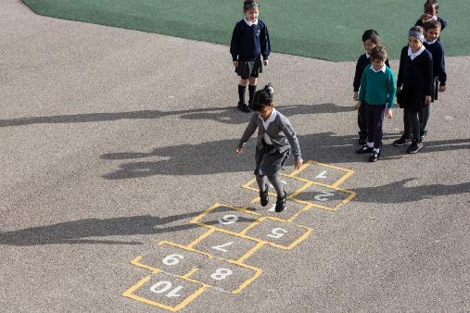
Reflection
Try to find somewhere peaceful and spend a few minutes being quiet and still … then think about these questions…
Think about all the amazing ways you can share your thoughts and opinions. How would you feel if you couldn’t do this?
Think about times when people say hurtful things. They are sharing their opinions. Why is it important to show respect to each other even when we disagree?
Accessing information can be done in lots of ways. How can you make sure what you find out is accurate? How can you make sure you keep safe?
Uncief/Dawe

Slide 12
Extension
Your thoughts and opinions can make a big difference and you can campaign for change.
Can you think about a time when children in your school have made a difference?
What can you do to be heard and to feel included?
You can find a summary of the whole Convention here.
UNICEF/Dawe

Slide 13
Thank you

