Slide 1
Unicef/Wilander
Notes:
4 October 2018 in Indonesia, Ainun, age 7, smiles as a UNICEF-supported psychosocial support team plays with children affected by the recent earthquake and resulting tsunami at the Secretariat for child protection.
Unicef/Wilander

Slide 2
Teacher slide
Contents
Slide 3 Guess the article - images as clues to identify the article
Slide 4 Introducing the article
Slide 5 What do you need to be healthy – the question
Slide 6 What do you need to be healthy – the answers
Slide 7, 8 & 9 Primary activities
Slide 10 & 11 Secondary activities
Slide 12 Reflection
Slide 13 Extension
Instructions
This flexible resource is intended to provide you with some easy to use, appropriate rights-related learning to share with your children, their families and your colleagues.
Please edit out non-relevant slides or tasks before sharing with students. Please check the content works for your learners and feel free to add any content that would make the material more relevant to your setting.

Slide 3
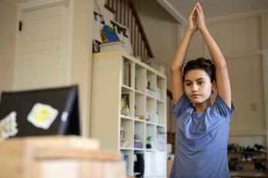
Guess the article
These pictures provide a clue to this week’s article.
Can you guess how they are linked together? Which article of the Convention do these pictures relate to?
Write down your thoughts or discuss with someone in your home.
Unicef/Schverdfinger
Unicef/Babajanyan
Notes:
From left to right:
Unicef/Schverdfinger – April 2020, Mila, 11, does an online yoga class at home in Gamboa, Colon Province, Panama.
Unicef/Babajanyan – Psychologist Rodica Moraru speaks with a 12-year-old girl at a UNICEF supported shelter in Moldova.
Place2Be and YoungMinds logos

Slide 4
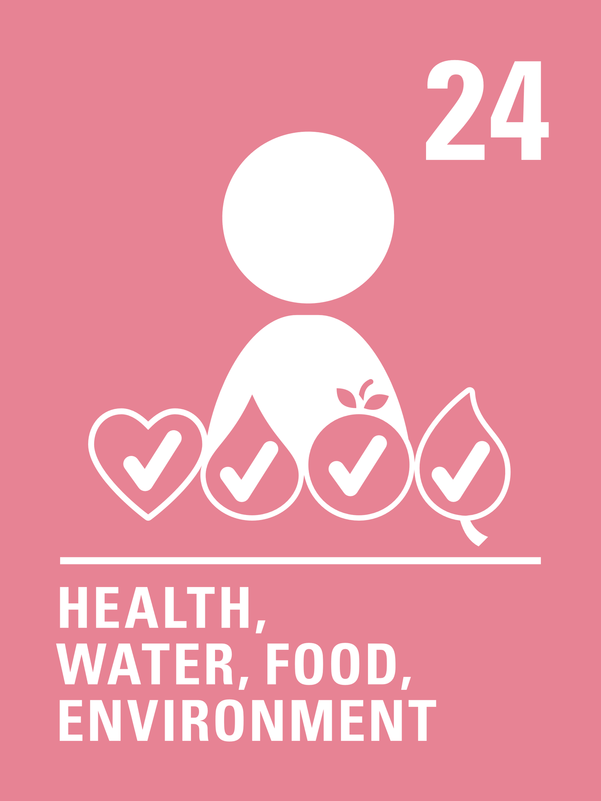
Introducing… Article 24
Stuart introduces Article 24 – Health Care
Article 24 – Health Care - ensures that every child has the right to the best possible health.
Governments must provide good quality health care, clean water, nutritious food, and a clean environment and education on health and well-being so that children can stay healthy.
Richer countries must help poorer countries achieve this.
Watch Stuart on YouTube

Slide 5
Exploring Article 24
Your mental health is just as important as your physical health. Can you think of ways to keep yourself mentally healthy?
Note your ideas down and then compare your thoughts with the next slide.

Slide 6
How many of these did you get?
Understanding the different types of emotions you have.
Knowing that everyone has emotions, both positive and negative.
Knowing who to talk to if you are feeling unhappy or unsafe.
Making sure you exercise regularly.
Making sure you have a healthy diet.
Limiting time on social media or other online platforms.
Feeling safe, secure and respected.
Health care – being able to see a doctor, nurse or counsellor if you need to.

Slide 7
Activity Time
Take 5 post-it notes and draw a face on each one showing a different emotion. Write the name of the emotion below it. How many different emotions can you generate? Can you group these in any different ways? Discuss how we all have different emotions and that all emotions are valid. Discuss different ways in which our body language can change depending on how we feel.
All these activities are related to…
Think about a place that makes you happy and then draw it or write about that place.
What makes this place special?
Who is with you at your happy place?
What do you have with you at your happy place?
Keep this drawing somewhere safe and look at it next time that you are not feeling happy.
Design a poster or create a PowerPoint presentation to promote World Mental Health Day within your school community. Don’t forget to link it to Article 24.
You don’t need to do every single activity
but if you have time you can do more than one.
Primary

Slide 8
Activity Time
For older pupils Watch this video explaining mental health then have some group or class discussion time about the ideas raised.
Anxiety and stress can make your body feel different things. Draw around one member of your group onto big paper. Think about a time you felt stressed or anxious and draw or write into the outline the different ways this made you feel or the physical things that can happen to your body.
For younger pupils
Watch one or more of these videos about emotions :
Story Bots
The Colour Monster
Ruby's Worry
Use circle time to explore the meaning behind these.
Have you read The Huge Bag of Worries? (watch and listen here). Draw a picture of a bag then draw or write all of the things that worry you or make you sad inside. Once you have finished, decide what you want to do with your bag. You can talk about it with an adult you trust, you might want to keep it somewhere safe or simply throw it away. Talk about what we can do about things that make us sad or worried.
.
Primary

Slide 9
Activity Time
Watch this video of children explaining what mindfulness is. Discuss with your class how mindfulness can help to support good mental health. Find out about some mindful challenges your class could try over the week. Some ideas here to get you started.
Some schools have a worry box in the classrooms and when children are worried about something, they write the worry on a piece of paper and place it in the box for the teacher to read. Could you create a worry box for your classroom? Think about how people should use the box. Decide with your teacher how your worry box will work in your classroom. Maybe you feel that all classes in your school should have worry boxes? Write a letter to your headteacher or governors telling them why you feel it would be a good idea to introduce worry boxes to your school.
Create a list or poster detailing all the people who you can talk to if you are worried about something. They are the duty bearers for all your rights. How many people can you think of? Display this around your school to remind the other pupils of who they can talk to if they are feeling worried, sad or anxious.
Primary

Slide 10
Activity time
Design a questionnaire that could be completed with your class or with other classes to check-in each day about how you are feeling. Think about what types of questions you want to include. You could use this simple questionnaire each morning to see how everyone is feeling about the day ahead, or perhaps at the end of each school day.
.
These activities will help you
understand how...
…can relate to your life.
You don’t need to do every activity, just do as many as you can.
Think about how diet, exercise, hydration and sleep contribute to a person’s mental and emotional wellbeing. Create a presentation to share this.
Watch this video explaining World Mental Health Day share the main messages with your form/tutor group. Don’t forget to link to Article 24.
Research online the different organisations you can reach out to if you are feeling stressed or anxious. Create a poster or information sheet to distribute to other pupils signposting them to who can help.
Secondary

Slide 11
Activity time
Sometimes things happen that we cannot control. We often react to these in a negative way. By making a list of positive ways to react, we build resilience. Make a list of ways that you can react positively. Can you make a display or poster to remind you about these in your classroom. Some ideas might include: Deep breaths and counting to ten - Thinking of all of the positive things that have happened today etc. .
Anxiety and stress can make your body feel different things. Draw around one member of your group onto big paper. Think about a time you felt stressed or anxious and draw or write into the outline the different ways this made you make you feel or the physical things that can happen to your body. Discuss.
On a sheet of paper write the letters of the alphabet in the margin. Next to each letter write a word starting with that letter detailing what you would lack if you were to live without Article 24. For example, A – ambition B - breakfast C – confidence etc. Alternatively, work in pairs to create the A-Z of what contributes to good mental health.
Think about what things have had to change at home and at school because of the current Covid-19 restrictions. Can you sort these into positives and negatives? Discuss how they may have affected people’s mental health and wellbeing.
Secondary

Slide 12
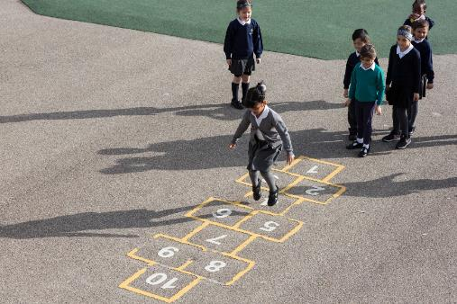
Reflection
Try to find somewhere peaceful and spend a few minutes being quiet and still … then think about these questions…
Why does good mental health matter to us?
Think of one thing you could do to support and strengthen your mental health this week
Is there one thing you could do to help the mental health of one of your friends or family members?
Think about your ‘go to’ adult who you trust to support your mental health. Have you thanked them lately?
Uncief/Dawe

Slide 13
Extension
Article 24 speaks about health, including mental health – which other articles would you say are linked to our emotions and mental wellbeing?
You can find a summary of the whole Convention here.
UNICEF/Dawe

Slide 14
Thank you

