Slide 1
Unicef/Babajanyan
Notes:
May 2019, Sugarmaa, 1, walks with her mother outside of their home in Khövsgöl province, Mongolia where they live.
Unicef/Babajanyan

Slide 2
Teacher slide
Contents
Slide 3 Guess the article - images as clues to identify the article
Slide 4 Introducing the article
Slide 5 What do you need for an Adequate Standard of Living – the question
Slide 6 What do you need for an Adequate Standard of Living – the answers
Slide 7 & 8 Primary activities
Slide 9 & 10 Secondary activities
Slide 11 Reflection
Slide 12 Extension
Instructions
This flexible resource is intended to provide you with some easy to use, appropriate rights-related learning to share with your children, their families and your colleagues.
Please edit out non-relevant slides or tasks before sharing with students. Please check the content works for your learners and feel free to add any content that would make the material more relevant to your setting.

Slide 3
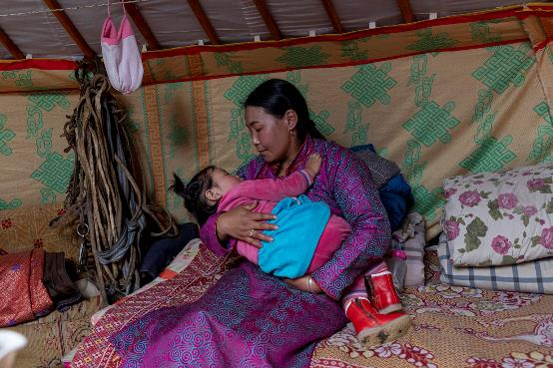
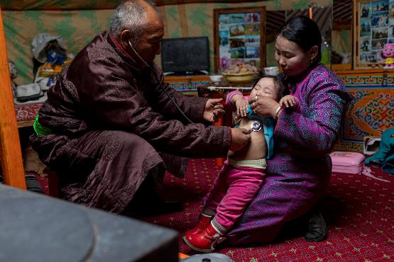
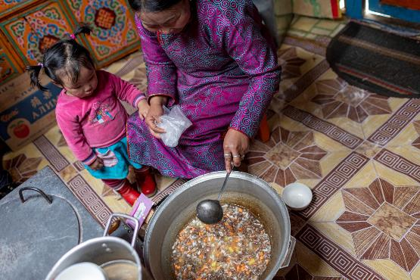
Guess the article
These pictures provide a clue to this week’s article.
Can you guess how they are linked together? Which article of the Convention do these pictures relate to?
Write down your thoughts or discuss with someone in your home.
Unicef/Babajanyan
Unicef/Babajanyan
Unicef/Babajanyan
Notes:
From left to right:
Unicef/Babajanyan – Sugarmaa, 1, falls asleep in the arms of her mother in the family’s nomadic tent in Mongolia.
Unicef/Babajanyan - Dr Ganbold examines Sugarmaa as she is held by her mother.
Unicef/Babajanyan – Sugarmaa looks on as her mother stirs a pot of soup.

Slide 4
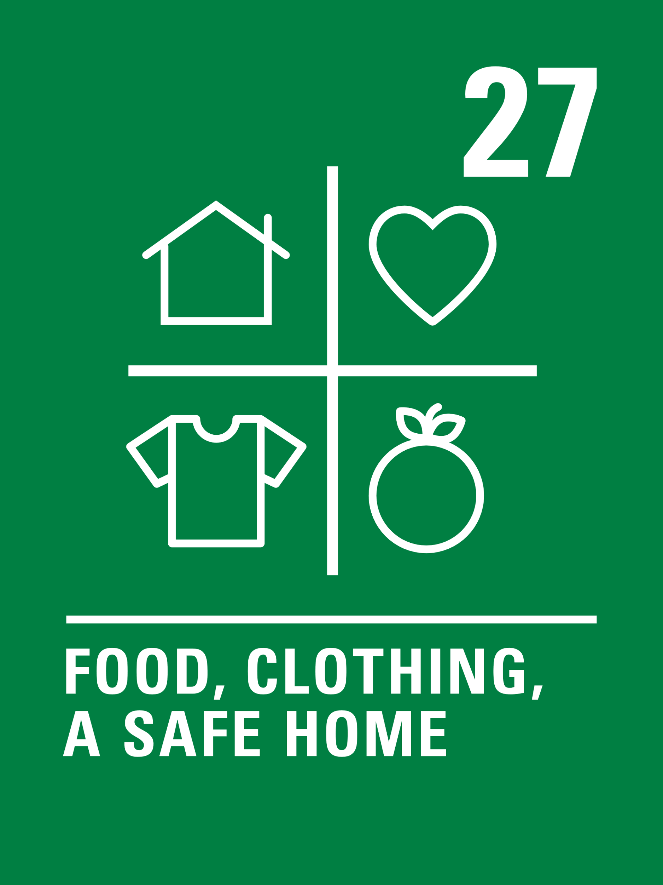
Introducing… Article 27
Helen introduces Article 27 – Adequate Standard of Living
Article 27 – Adequate Standard of Living
Every child has the right to a standard of living that is good enough to meet their physical and social needs and support their development. Governments must help families who cannot afford to provide this.
Watch Helen on YouTube

Slide 5
Exploring Article 27
What does every child need to survive and develop in body and mind?
Note your ideas down and then compare your thoughts with the next slide.

Slide 6
How many of these did you get?
A place to live in which is safe, warm and dry.
Healthy food and clean water.
Clothes to keep you warm and dry.
The opportunity to take part in play, rest and leisure time.
Friends and family.
Medical care and treatment.
A society that supports children and families.
Education and the chance to learn.
What else did you think of?

Slide 7
Activity Time
Send a messenger bird to support the campaign to ‘End Child Poverty’
All these activities are related to…
Watch this animation about the Sustainable Development Goal – No Poverty. Note down what the causes of poverty worldwide are.
Read ‘It’s a No Money Day‘ by Kate Milner and discuss the issues raised. Find out if there is a local food bank in your community. How could you encourage members of your school to donate to the food bank? Could you organise something as a school?
You don’t need to do every single activity
but if you have time you can do more than one.
Primary

Slide 8
Activity Time
Watch this clip to find out about teenager Christina, who successfully campaigned for the government to provide access to food vouchers over the summer holidays for children who receive free school meals. Have a circle time discussion about why it is important that the government provides free school meals to children. Why was it important for them to extend this support to the summer holidays this year? How else do the government support Article 27 for children in the UK?
Do you know the story of Jack and the Beanstalk? Jack and his Mum did not have much money. He swapped his cow for some magic beans because he thought that would make their life better. Imagine what would happen if Jack did not need magic beans to make his life better and instead, the people in charge of his country followed Article 27. They gave help to Jack’s mother, and now Jack has what he needs to grow and develop. Draw a picture of Jack with all the things he needs for a great life. Include his cow in the picture if you like! Or, you could act out or create a puppet show of Jack’s new story.
Watch this animation about the life of two sisters, Chantelle and Keona. Is their house good enough to support their needs? What could the government do to support their family?
Primary

Slide 9
Activity time
Watch this animation explaining Sustainable Development Goal – No Poverty. List some of the causes of poverty globally. How can it be addressed?
These activities will help you
understand how...
…can relate to your life.
You don’t need to do every activity, just do as many as you can.
View some of the animations here. They are designed to show what it is like to live in poverty in the UK – which one do you find most powerful? Create your own animation or write your own story to show the impact of living in poverty.
Read this article about child poverty in the UK from the Children’s Society and take a look at this map to find out about the levels of child poverty where you live. Using these resources as a starting point, research and present the facts about child poverty in the UK to your class.
Secondary

Slide 10
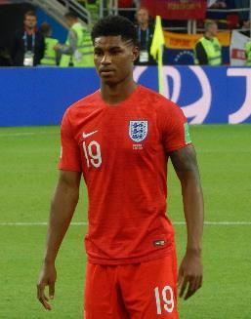
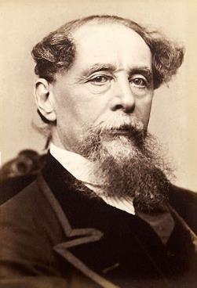
Activity time
What does an adequate standard of living actually look like across the world? Spend some time exploring how people across the world actually live using the Dollar Street tool from Gap Minder.
Research people who have made a difference to tackling poverty. You could choose someone like Charles Dickens, Marcus Rashford, Joseph Rowntree, William Beveridge, Wangari Maathai or Abisoye Ajayi-Akinfolarin. Pick one and create a poster for display with the persons picture and a summary of their achievements in tackling poverty.
Look at the Global Goals. In pairs, decide which of these goals you think link with ensuring children around the world have their rights in Article 27 respected? Can you explain your answers? Choose a global goal and find out more about the work that is being done to achieve this goal.
Secondary
All WikiCommons

Slide 11
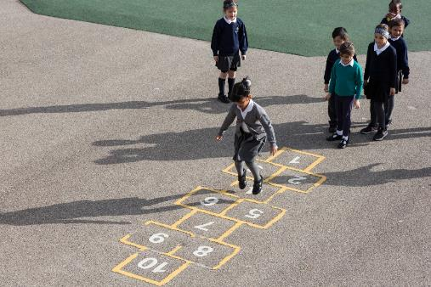
Reflection
Try to find somewhere peaceful and spend a few minutes being quiet and still … then think about these questions…
Children living in poverty are often denied their right to the basic items they need to survive and develop under Article 27. Reflect on the following:
How could the government help children living in poverty?
How could your school help children living in poverty?
Write down your thoughts and if you want share this back with your teacher, friends or family.
Uncief/Dawe

Slide 12
Extension
Use the UNICEF UK Advocacy Toolkit to research and plan a campaign to tackle child poverty where you live and remember to make links to Article 27.
You can find a summary of the whole Convention here.
UNICEF/Dawe

Slide 13
Thank you

