Slide 1
Unicef/Dejonghe
Notes:
Djeneba Doumouya, a 19 year old girl, at the development action centre of Guingreni, in the North of Côte d’Ivoire. The young girl is mother of a 1 year and 2 months old boy. Her life didn’t start easy. Djeneba says: “I was married very young but I was beaten a lot by my husband for no reason. When my baby was 3 months old I couldn’t stand it anymore and I went back to my parents. It was not easy but I had no choice. And because I stopped school very young I couldn’t find a job to take care of me and my baby. My father was informed about this centre and the opportunity to learn a profession for free during a 3 months training in this centre. I did not hesitate for one second. You can choose between different disciplines. My choice was to learn to become a pastry chef because it was my dream since I was a child. I was told I could bring my baby with me to the centre but I left him with my mother. I miss him very much but it’s only for 3 months and after I can become independent and I don’t need to depend on a men to take care of myself and my child. I’m here now for 1 and 1/2 month and I learned already a lot. Not only to cook but also respect. I feel very happy now after all and I am very proud of myself. This changed my life already. “ The centre is supported by UNICEF and provides civic and professional training for vulnerable adolescent girls, to offer them opportunities for professional integration.
Unicef/Dejongh

Slide 2
Teacher slide
Contents
Slide 3 Guess the article - images as clues to identify the article
Slide 4 Introducing the article
Slide 5 What do you need for life, survival and development– the question
Slide 6 What do you need for life, survival and development – the answer
Slide 7 & 8 Primary activities
Slide 9 & 10 Secondary activities
Slide 11 Reflection
Slide 12 Extension
Instructions
This flexible resource is intended to provide you with some easy to use, appropriate rights-related learning to share with your children, their families and your colleagues.
Please edit out non-relevant slides or tasks before sharing with students. Please check the content works for your learners and feel free to add any content that would make the material more relevant to your setting.

Slide 3
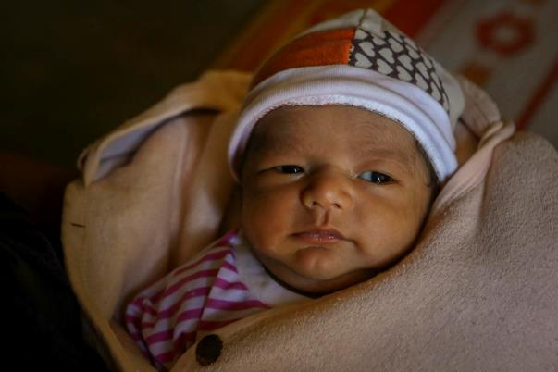
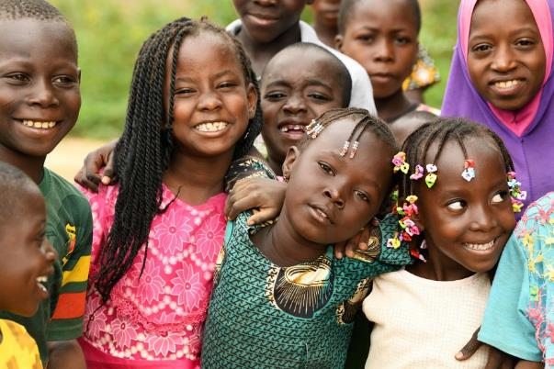
Guess the article
These pictures provide a clue to this week’s article.
Can you guess how they are linked together? Which article of the Convention do these pictures relate to?
Write down your thoughts or discuss with someone in your home.
Unicef/Viet Hung
Unicef/Dejonghe
Unicef/Pinheiro
Notes:
From left to right:
Unicef/Viet Hung - “Thanh is our third child. The two previous children were girls. I am very happy to give birth to this baby boy. Thanh means ‘success’. I hope that when he grows up, he will be a successful man,” Thanh's mother, Ms Y Duch happily shared.
Unicef/Dejongh - Children playing and learning at a child friendly space of Fada, in the East of Burkina Faso.
Unicef/Pinheiro - On 31 October 2018, (right) Letícia Gomes speaks with a group of teenagers as part of her peer-to-peer education work.

Slide 4
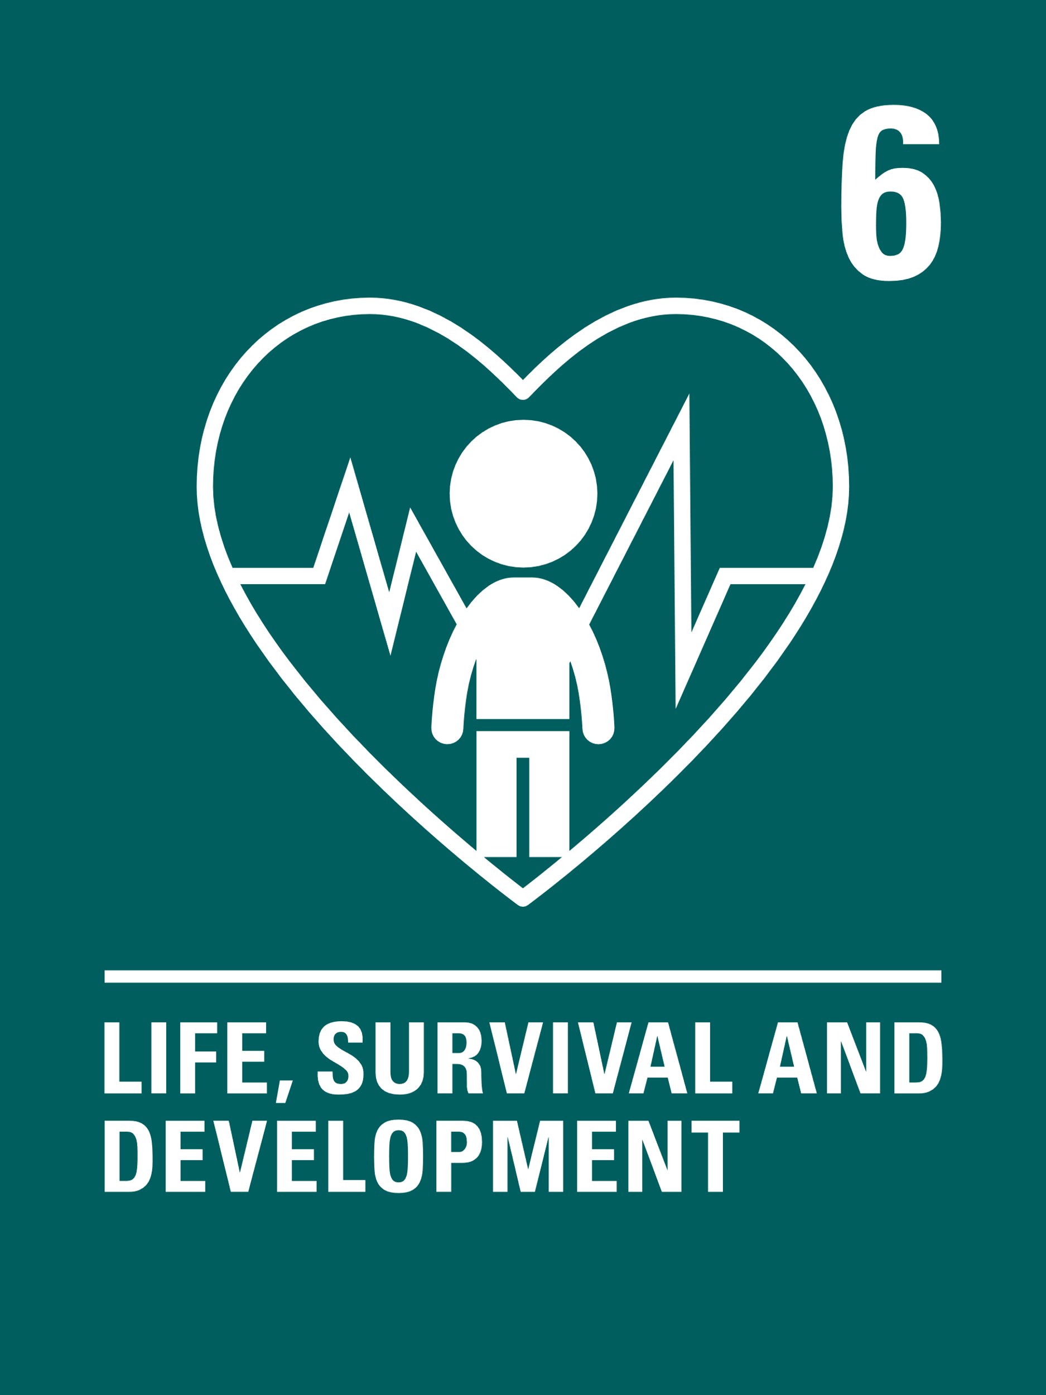
Introducing… Article 6
Kathy introduces Article 6 – Life, survival and development
Article 6 – life, survival and development
Every child has the right to life.
Governments must do all they can to ensure that children survive and develop to their full potential.
Watch Kathy on YouTube

Slide 5
What does a child need for their life, survival and development?
How many different ideas can you think of to support this right?
Write them down and then compare your answers with the next slide.

Slide 6
How many of these did you get?
Care, protection and nurture from adults
Nutritious food and clean water
The chance to become more independent as you get older
Exercise and sleep
A clean, safe environment
Quality education and a chance to play
Feeling safe, secure and respected
Health care - to see a doctor or a nurse when you need to and to be vaccinated against diseases
All your rights!!

Slide 7
Activity Time
Your education helps you to develop in school. How do the things you do out of school also support your life, survival and development? Write a short newspaper report or design a poster to show this information.
All these activities are related to…
Draw a duty bearer (or adult) and label your picture with everything they do to help you survive and develop.
How do these things change over time?
Article 6 is often summed up as the ‘right to life’. Why is life important or special? Write a poem or song with your friends to celebrate the right to life.
You don’t need to do every single activity
but if you have time you can do more than one.
Primary

Slide 8
Activity Time
Think about a new born baby. What do they need to live, survive and develop. Compare this list with what you need. Discuss the differences with each other in class. Will your list be different when you are 14?
Design a logo or write a poem to help other people to understand the meaning of Article 6.
Read the book or watch the video of ‘Here we are’ by Oliver Jeffers. Share your questions about the world and think about how we can look after the world around us so that we can all survive and thrive.
Think about where you live. Are there any barriers to realising Article 6? What can we do about this?
Primary

Slide 9
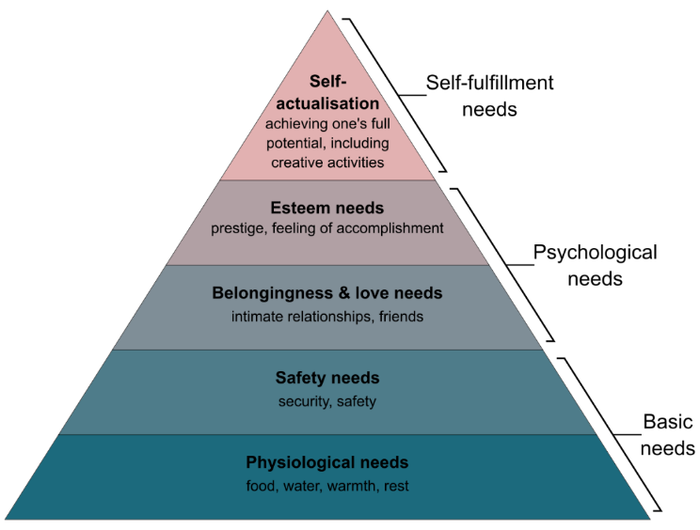
Activity time
Have you ever watched TV programmes about survival? Discuss a highlight that sticks in your mind with your friends. Identify the top priorities for the people involved in extreme survival situations. Compare your priorities with a friend. Are they the same?
These activities will help you
understand how...
…can relate to your life.
You don’t need to do every activity, just do as many as you can.
Draw a timeline of your life to create a visual image of events and people who have helped you develop and become the person you are today.
Explore Maslow's hierarchy of needs. Discuss how this model relates to the right to life, survival and development?
Secondary
WikiCommons

Slide 10
Activity time
Unicef and other organisations have made a massive difference around the world to reduce the number of children dying before the age of 5. Do some research to look at the differences in the data on this between a range of countries. Here’s one website to get you started.
How do you show through the choices you make and the actions you take that you respect your own life? With your friends, make a video to encourage young people to show respect for their own lives.
Have a look at this video made by Unicef about the lives of different children in the world. How could you relate what you see to the right to life, survival and development.
Many religions believe that life is so special that it should always be protected and respected and that nobody should ever take a life away. Discuss your thoughts and beliefs about this.
Think about where you live. Are there any barriers to realising Article 6? What can we do about this?
Secondary

Slide 11
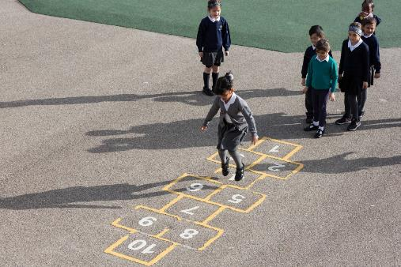
Reflection
Try to find somewhere peaceful and spend a few minutes being quiet and still … then think about these questions…
We often hear a lot about life on other planets. How do we respect and value our life on planet Earth?
How can we show our appreciation to those people who have been important in our lives? Why is this important?
In school how are you supported to develop to your full potential?
Uncief/Dawe

Slide 12
Extension
Thinking about the whole Convention, which other articles are most connected to realising the right to life, survival and development?
You can find a summary of the whole Convention here.
UNICEF/Dawe

Slide 13
Thank you

