Slide 1
Unicef/Mukherjee
Notes:
A girl combs her hair using the mirror placed on eye level of the children in Raipur, India.
Unicef/Mukherjee

Slide 2
Teacher slide
Contents
Slide 3 Guess the article - images as clues to identify the article
Slide 4 Introducing the article
Slide 5 What do you need for your identity to be protected – the question
Slide 6 What do you need for your identity to be protected – the answers
Slide 7 & 8 Primary activities
Slide 9 & 10 Secondary activities
Slide 11 Reflection
Slide 12 Extension
Instructions
This flexible resource is intended to provide you with some easy to use, appropriate rights-related learning to share with your children, their families and your colleagues.
Please edit out non-relevant slides or tasks before sharing with students. Please check the content works for your learners and feel free to add any content that would make the material more relevant to your setting.

Slide 3
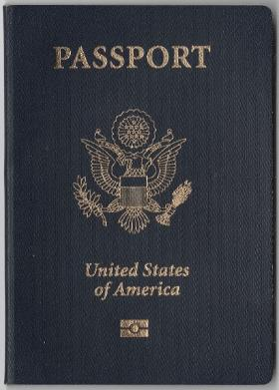
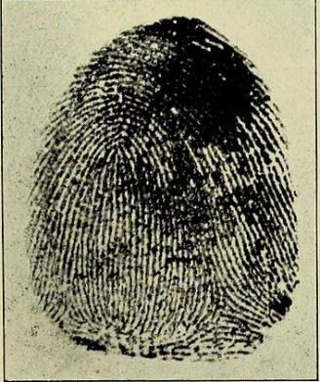
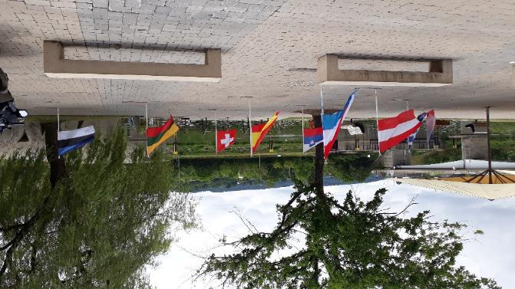
Guess the article
These pictures provide a clue to this week’s article.
Can you guess how they are linked together? Which article of the Convention do these pictures relate to?
Write down your thoughts or discuss with someone in your home.
All WikiCommons
Notes:
From left to right:
All images WikiCommons
A passport
A finger print
Flags from several nations

Slide 4
Introducing… Article 8
Martin introduces Article 8 – Identity
Article – Protection and Preservation of Identity
Every child has the right to an identity. Governments must respect and protect that right, and prevent the child’s name, nationality or family relationships from being changed unlawfully.
Watch Martin on YouTube

Slide 5
Exploring article 8
Why is your personal identity important?
Note your ideas down and then compare your thoughts with the next slide.

Slide 6
How many of these did you get?
We need our identity to access other things like education, health, banking
Having our identity protected helps to keep us safe.
Identity makes you who you are and each person is a unique individual.
Identity belongs to the individual and must not be taken away.
In order to access your rights under Article 27, like to extra help from the government.
We need our identity to access other things like education, health, banking.
The government needs to know who each person is.
Identity make us different from other people.
What others did you think of?

Slide 7
Activity Time
There are lots of things that help to make up our identity such as date of birth, name, nationality, gender, faith, our appearance, personal talents and abilities. If you had to highlight only ONE part of your identity that is most special to you, what would it be? Can you explain why.
All these activities are related to…
How would you describe your identity to somebody who does not know you? Try using a mixture of words and pictures.
Government must protect the legal identity of children. That means that your name, nationality and the family you are part of can only change if a court agrees to this. Are your name, nationality and family special to you? Can you explain why this matters?
You don’t need to do every single activity
but if you have time you can do more than one.
Primary

Slide 8
Activity Time
During October your school has probably talked about Black History Month. Why is it important to celebrate racial and ethnic diversity. What links can you see with the idea of identity?
Imagine a world where everyone had a number instead of a name. Write a story or poem to show your thoughts about what this would be like.
You might have learnt about protecting your identity as part of online safety? Why is it important not to share information about your name, date of birth, location or other details that might identify you?
Watch this short video from BBC Newsround about Black History Month. Could you find out all things that happened in your school during the month? Perhaps you could write a report for your school newsletter or website or create a display for visitors to see.
Primary

Slide 9
Activity time
Our identity can be complicated and has many factors. How would you describe the most important aspects of your identity?
Have a conversation with a person who has known you well for much of your life. Explore together how much you have changed and what has remained constant. Which aspects of you feel them most permanent to you?
These activities will help you
understand how...
…can relate to your life.
You don’t need to do every activity, just do as many as you can.
Watch this Black History Month video from the organisation Young Scot. One of the participants challenged the idea of one month to focus on Black History. What are your thoughts about this? Discuss the issues with your class.
During October your school has probably talked about Black History Month. What were the reactions to this in school? Could you do a survey to find out people’s opinions? What could be done better in future?
Secondary

Slide 10
Activity time
There are lots of things that help to make up our identity such as date of birth, name, nationality, gender, faith, our appearance, personal talents and abilities. If you had to highlight only ONE part of your identity that is most special to you, what would it be? Can you explain why.
Do you consider it important to celebrate people’s racial and ethnic identity and to promote diversity? What more could be done in our society, in your school, or by you to protect these aspects of people’s identify?
Watch the first few minutes of this Ted Talk about identity. Discuss with your friends or in class, some of the reasons why we should value our legal identity and not take it for granted.
Article 8 links identity particularly to ‘name, nationality or family relationships’. Why do you think these were seen as so important by the people who put the Convention together?
The government has lots of information about us. Why do you think that’s important? Think of 5 ways in which they use our data.
Secondary
All WikiCommons

Slide 11
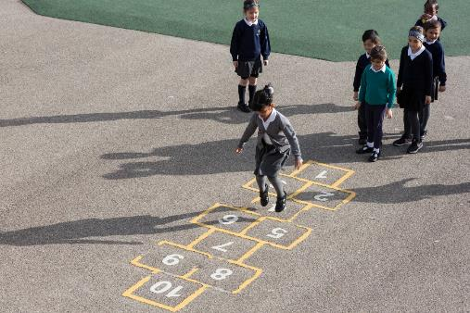
Reflection
Try to find somewhere peaceful and spend a few minutes being quiet and still … then think about these questions…
Who are you and what makes you the person you are?
Which aspect of your identity makes you feel happy or proud?
How can we show respect and appreciation for other people’s identity?
What lessons have you learnt from the events in Black History Month this year or in the information you have seen about the Black Lives Matter movement?
Uncief/Dawe

Slide 12
Extension
Rights are indivisible and all equally important. There are links and connections between the Articles.
Look at the Convention to find other rights that are related to Article 8.
You can find a summary of the whole Convention here.
UNICEF/Dawe

Slide 13
Thank you

