Slide 2
Thought of the Week…
Who’s your #BlackBritishHero?
Notes:
Images:
iStock

Slide 3
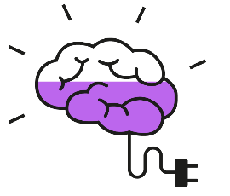
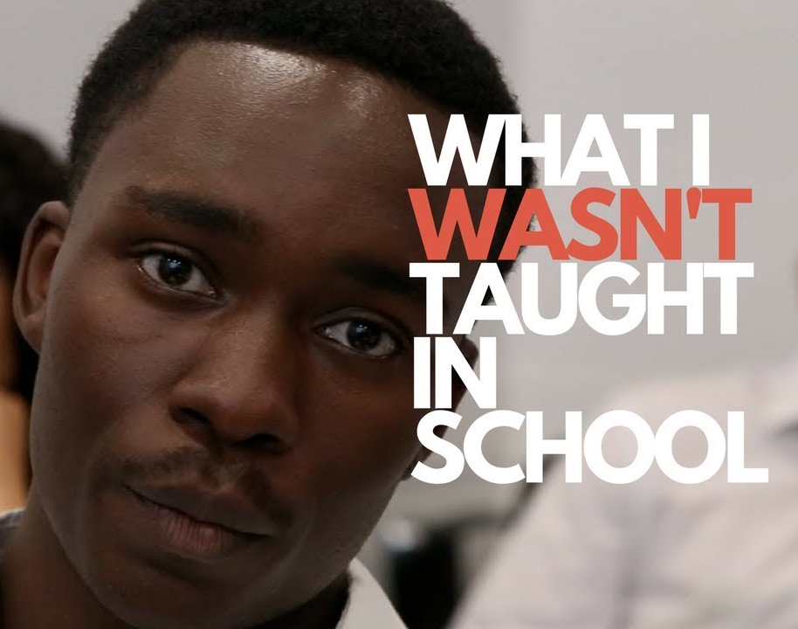
Be informed: What’s going on?
It’s Black History Month here in the UK – a month to learn about and celebrate the achievements of Black people in Britain.
This year, the conversation feels more important than ever, as there have been many events, protests and discussions about racism, both here in the UK and across the world.
One of the discussions that has been amplified this year is whether the school curriculum teaches young people enough about Black British History, and whether it provides enough Black British role models for young people today.
0:00-1:35
Watch (2mins)
Click to hear part of a poem by Samuel King. Do you agree with him?
https://safeshare.tv/x/ss5f75b38d50368
Notes:
Alternative video link: https://www.youtube.com/watch?v=TNfH41-LI4w (0:39-2:14)
Images:
iStock
https://www.blackhistorymonth.org.uk/
From video

Slide 4
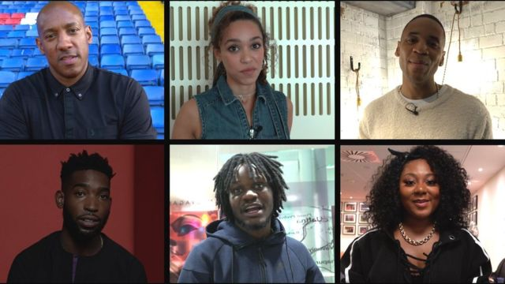
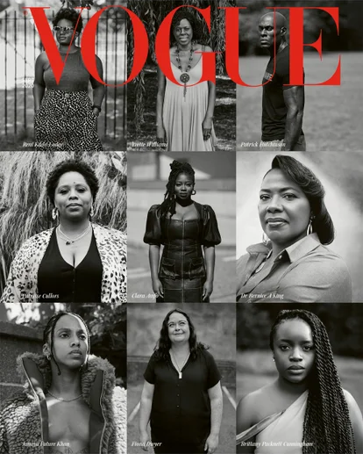
Be curious: Introducing…
If you took part in our assembly last year, you might remember hearing about #BlackBritishHeroes…
0:00-3:52
Watch (4 mins)
Click to hear from six celebrities on who their #BlackBritishHero is!
Well, this year, we’re back with even more #BlackBritishHeroes – and this time around they’re all people who are working hard to make a difference to the lives of Black people all around the world.
https://safeshare.tv/x/bRNQA5Z81N4
Notes:
Alternative video link: https://www.youtube.com/watch?v=bRNQA5Z81N4
Images:
https://www.vogue.co.uk/news/article/activists-british-vogue-september-2020
From video

Slide 5
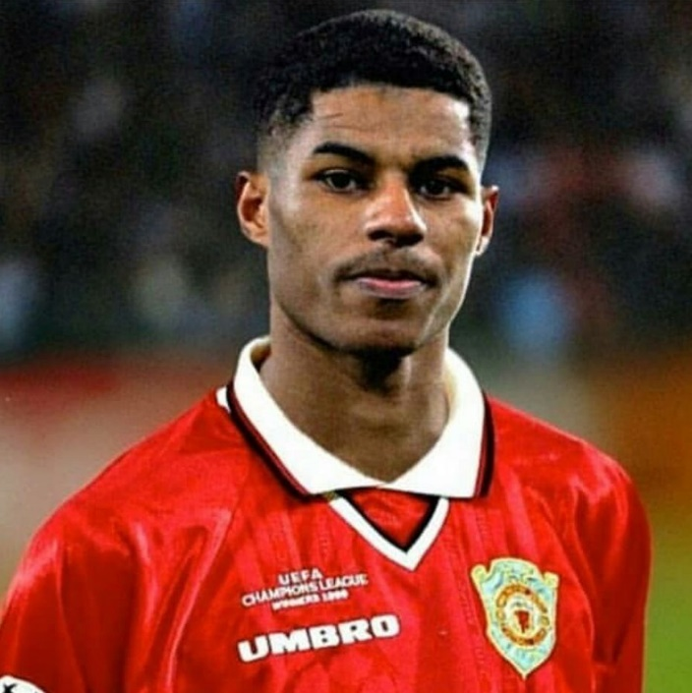
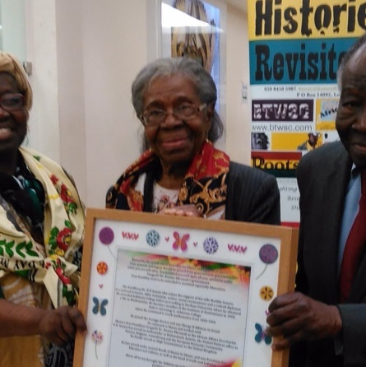
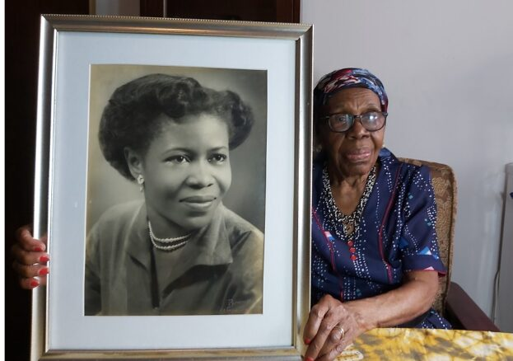
Be curious: Our #BlackBritishHeroes
1
You probably know Marcus Rashford for his skills on the football pitch, but that’s not why he’s our #BlackBritishHero this year.
Think (1min)
Do you know why Marcus Rashford is our #BlackBritishHero?
During lockdown, Marcus started a campaign to ask the Government to provide free school meals for children from low-income families over the summer holidays.
After writing an emotional letter and demanding change, Prime Minister Boris Johnson personally called Marcus to tell him that he would be giving food vouchers to families over the holidays.
2
Dzagbele Matilda Asante is nearly 93 years old, yet came to England to train as a nurse when she was just 20.
Not only did she dedicate her entire life to looking after others, she also spoke up against racism, got involved in politics and went on to become Ghana’s High Commissioner to the UK and Ireland!
Notes:
Images:
https://thebusbybabe.sbnation.com/2020/5/14/21258131/manchester-united-players-at-home-quarantine-continues-and-marcus-rashford-has-a-beautiful-soul
References:
1) https://www.bbc.co.uk/sport/football/53042684

Slide 6
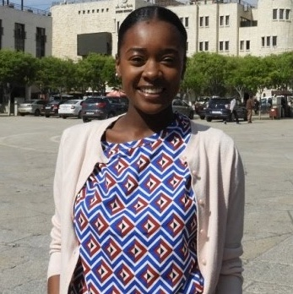
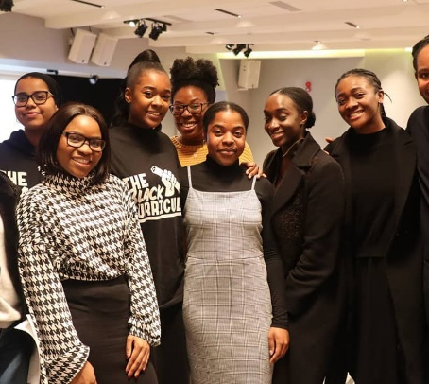
Be curious: Our #BlackBritishHeroes
3
Lavinya Stennett is the founder is a new organisation called The Black Curriculum.
At just 23 years old, she started the organisation because she’s passionate about every young person learning about Black British history, and has even spoken to the Government about her plans.
0:00-0:49
Watch (1min)
Click the image to hear from Lavinya on what inspired her to start the Black Curriculum.
4
Tony Warner is the founder of Black History Walks – a way to discover the hidden African heritage around the city of London and across the UK.
He is also the director of education at 100 Black Men of London - a charity that mentors and empowers young Black people to achieve their potential in their education and their health and wellbeing.
https://safeshare.tv/x/6fhvZomsTRw
Notes:
Alternative video link: https://www.youtube.com/watch?v=0fx8hN5JyZM
References:
http://100bml.org/what-we-do/
http://www.majoritynotminority.co.uk/current-positive-black-role-models.html

Slide 7
Be heard: Be your own hero
As you’ve seen today, it’s not just the rich and famous that are heroes- anyone can be a hero, including you! As it’s Black History Month, why not complete one of these tasks to become a hero yourself…
Learn what racism looks like¹:
Racism is not always immediately obvious or easy to see. So, why not find
out more about how to spot it?
Listen to a range of voices:
Whether it’s through the books
you read, films you watch or music you listen to, diversify whose stories you hear.
Show your support:
This can be by attending a protest, sharing educational articles on social media, or helping to set up a campaign in your community.
Use your words³:
Write to your MP about the issues you face or see day-to-day and include some suggestions about action they
could take.
Be an “ally”²:
Doing all of the above is a great way to show allyship, but knowing why is also necessary. Search for “The Guide
to Allyship” to find out more.
Share what you know:
The classroom is a great place
to discuss the key issues affecting you, as well as any new discoveries you make. Tell others about them!
©VotesforSchools2020
Notes:
Images
iStock
https://socialbuddy.com/report-instagram-account/
https://www.commonsensemedia.org/blog/how-to-block-and-report-cyberbullies-on-tiktok

Slide 8
How do I make sure my voice is heard?
Voice your opinions during your VotesforSchools lessons!
Cast your vote at the end of each lesson!
Send your thoughts and comments on the VoteTopic to us.
Let us know any future VoteTopics you would like to see!
This week’s question is:
“Does your curriculum represent you?”
Make sure you vote and have your voice heard!
Notes:
Images:
Icons8
iStock

Slide 9
Be heard!
This week, you will be discussing:
There is always more that can be done to represent everyone.
Our school celebrates everyone!
Does the curriculum represent you?
We spend lots of time learning about each other and what makes us special.
I don’t feel like we learn about my history and culture at school.
At the end of the lesson, vote to share your opinion with the rest of the VotesforSchools community.

