Slide 1
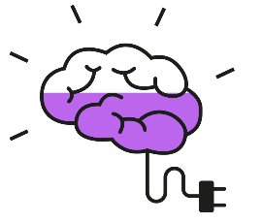


Coming up this week…
This assembly will cover:
Feedback from previous topic
Recent headlines
Thought of the Week: Do you know the signs of bullying?
Be informed: What is Anti-Bullying Week?
Be curious: What does bullying look like?
Be heard: What can I do if I’m worried?
Introduce the VoteTopic
Please Note:
This assembly is designed to be used in conjunction with either the 15 or 45 minute lesson in this VotePack.
Videos:
Unite Against Bullying (Slide 11)
Notes:
Videos:
Safeshare: https://safeshare.tv/x/ss5fabd06f60331
YouTube: https://www.youtube.com/watch?v=DOeRmP3XRHg&t=38s
Images
iStock

Slide 3
Feedback: “Would you want to be a
politician right now?”
“I love the idea that by using my voice I am making a positive impact on people's lives. However, I do feel that being part of a BAME group, and also being female, would have an impact on my experience greatly as I feel that we are very underrepresented. Whilst this would present to be an issue, I would love the opportunity to add diversity to parliament whilst helping the country.”
Christ’s Hospital School
“I would not be able to handle the stress of being a politician. Being in the public eye all the time would terrify me. I know I wouldn’t be able all the hate and ridicule that Politicians get every day.”
St Mary’s School for Girls
“there will always be people who will disagree, even if it’s the best decision on for the country, you will also be constantly getting hate.”
St Wilfrid’s Church of England Academy
Yes
No
17.8%
82.2%
“As much as I want to have my voice heard, being a politician takes a lot of time and effort and I think Boris Johnson and the Government are doing a great job.”
Sutton Coldfield Grammar School for Girls

Slide 4





Feedback: “Would you want to be a
politician right now?”
Well done to all the young people who cast their votes in VotesforSchools as part of UK Parliament Week. It’s great to see young people getting involved and expressing their views – that’s exactly what UK Parliament Week is all about. Voting is such an important way to have your say and get your voice heard – keep it up! We wish these future voters and future politicians all the very best on their democratic journeys!
Comment on behalf of the team at UK Parliament Week!
The VoteTopic results were also shared with…
Youth Politics UK
British Youth Council
Leader of the House of Commons
UK Parliament Week
The Children’s Commissioner
Notes:
Images
https://youthpolitics.org.uk/
https://www.byc.org.uk/uk/uk-youth-parliament
https://twitter.com/commonsleader
https://www.ukparliamentweek.org/en/?s=UK+Parliament+week+funding
https://www.childrenscommissioner.gov.uk/

Slide 5

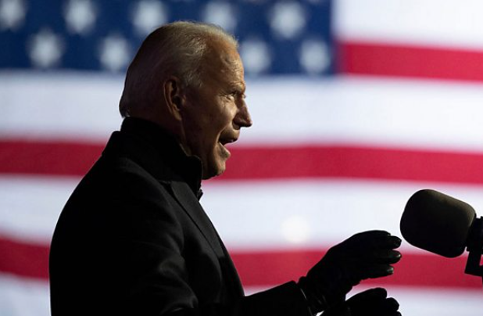



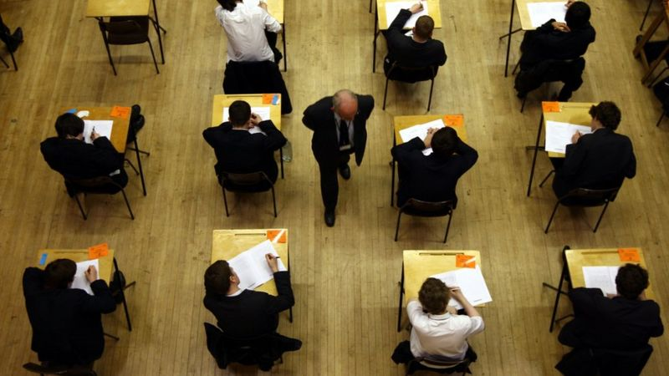
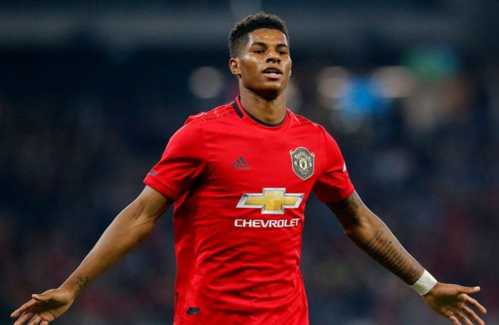
Be informed!
Here’s what’s been in the news this week...
Coronavirus vaccine progress?
The results are in…
Based on early results from the company Pfizer, it is thought their Coronavirus vaccine could be up to 90% effective. But, it still needs further checks.
After a long vote count, Joe Biden will be the next President of the USA. The number of Americans who voted in this election was the highest for 100 years!
Due to the pandemic, next year’s GCSEs & A-Levels in Wales have been cancelled. They will be replaced with grades based on classroom assessments.
On 7th November, Marcus Rashford received a call from the PM to say that there will be £170 million of funding for free school meals over Christmas.
No GCSEs & A-Levels for Wales
Rashford convinces the PM (again)
Notes:
References & Images
Vaccine: https://www.bbc.co.uk/newsround/54873843
Biden: https://www.bbc.co.uk/newsround/54855171
Rashford: https://www.bbc.co.uk/newsround/54862230 and https://www.itv.com/news/2020-11-07/rashford-proud-after-government-u-turn-on-free-school-meals-at-christmas
Wales: https://www.bbc.co.uk/newsround/54891773

Slide 6





Thought of the Week…
Do you know the signs of bullying?
Notes:
Images
iStock

Slide 7


Be informed: What is Anti-Bullying Week?
It’s Anti-Bullying Week! A week where all schools come together to unite against bullying.
But do you know what bullying is, and what to do if you see or experience it? That’s what you’ll be thinking about in this assembly.
A quick poll…
Put your hand up if you have ever witnessed or experienced bullying.
Notes:
Images
iStock
https://www.anti-bullyingalliance.org.uk/anti-bullying-week/anti-bullying-week-2020-united-against-bullying

Slide 8
Be curious: What does bullying look like?
Bullying is a serious thing, so it’s important to know the difference between rude and unkind behaviour and bullying behaviour. Need a reminder?
Is it bullying?
Take a look at these behaviours. Can you sort them into the correct groups? Then, your teacher will click and show you if you’re right.
It was hurtful
It happened many times
It only happened once
It was a mistake
It was on purpose
Rude/unkind behaviour | Bullying behaviour
It was a mistake
It was hurtful
It happened many times
It only happened once
It was on purpose

Slide 9









Be curious: What does bullying look like?
Bullying is unkind behaviour that happens more than once. It might look like:
Stealing
Being mean
Being hit or pushed
Name calling
Being made fun of
Unkind comments on social media
Spreading rumours
Sending unkind messages
Being threatened
If you’re being bullied, it’s important to remember that it is not your fault. However, there are some things that you can do to stop the bullying from happening.

Slide 10

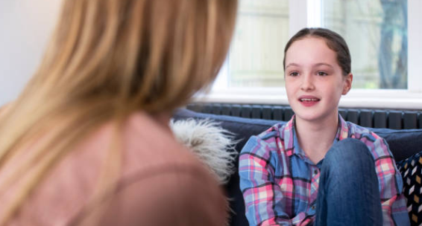


Be heard: What can I do if I’m worried?
If you’re worried about yourself or someone that you know, there are lots of things that you can do.
1
Tell someone that you trust
Find a trusted adult and tell them what has happened. They will be able to help you make the bullying stop.
Write it down
2
If talking about it is hard, try to write down what is happening and how you are feeling, and then share this with an adult.
3
Call the National Bullying Helpline
If you’re finding it hard to talk to someone that you know, you can call the National Bullying Helpline for advice on 0300 323 0169 for free.
Notes:
Images
iStock
https://www.nationalbullyinghelpline.co.uk/
References
https://www.nationalbullyinghelpline.co.uk/

Slide 11


Be heard: What can I do if I’m worried?
0:00-1:57
Watch!
Click the image to watch this year’s Anti Bullying Week video. While watching, think about what you can do to unite against bullying.
https://safeshare.tv/x/ss5fabd06f60331
Notes:
Alternative video link: https://www.youtube.com/watch?v=DOeRmP3XRHg&t=38s
Images:
1. https://www.anti-bullyingalliance.org.uk/anti-bullying-week/anti-bullying-week-2020-united-against-bullying

Slide 12


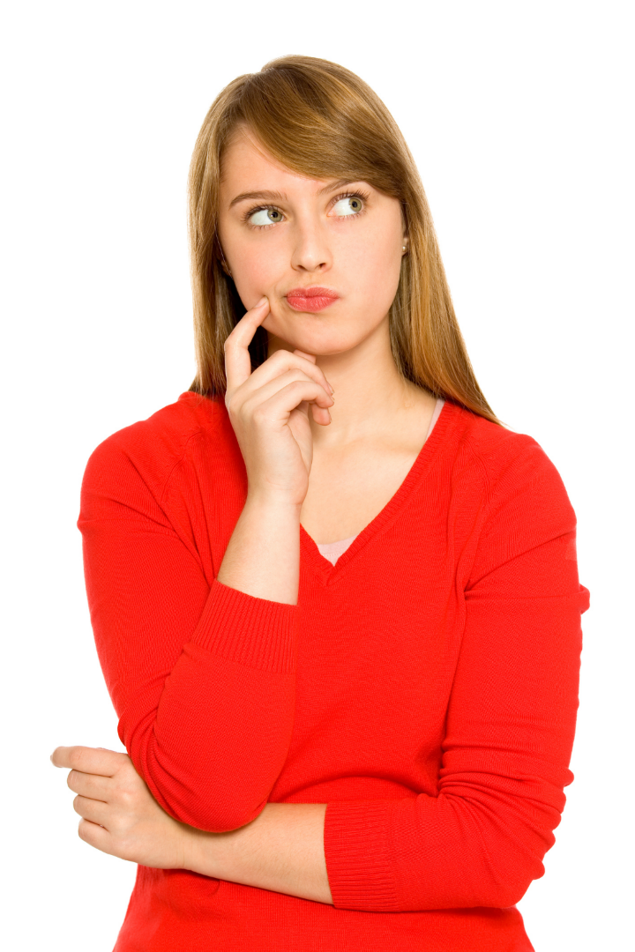



How do I make sure my voice is heard?
Voice your opinions during your VotesforSchools lessons!
Cast your vote at the end of each lesson!
Send your thoughts and comments on the VoteTopic to us.
Let us know any future VoteTopics you would like to see!
Head over to the next slide to find out what you will be discussing this week.
Make sure you vote and have your voice heard!
Notes:
Images:
Icons8
iStock

Slide 13
Be heard!
This week, you will be discussing:
Being yourself is the most important thing.
It’s easy to fit in and to avoid being bullied.
Is it important to fit in at school?
Even without bullying, I just want to fit in.
We should end bullying, not fit in to avoid it.
At the end of the lesson, vote to share your opinion with the rest of the VotesforSchools community.

