Slide 1
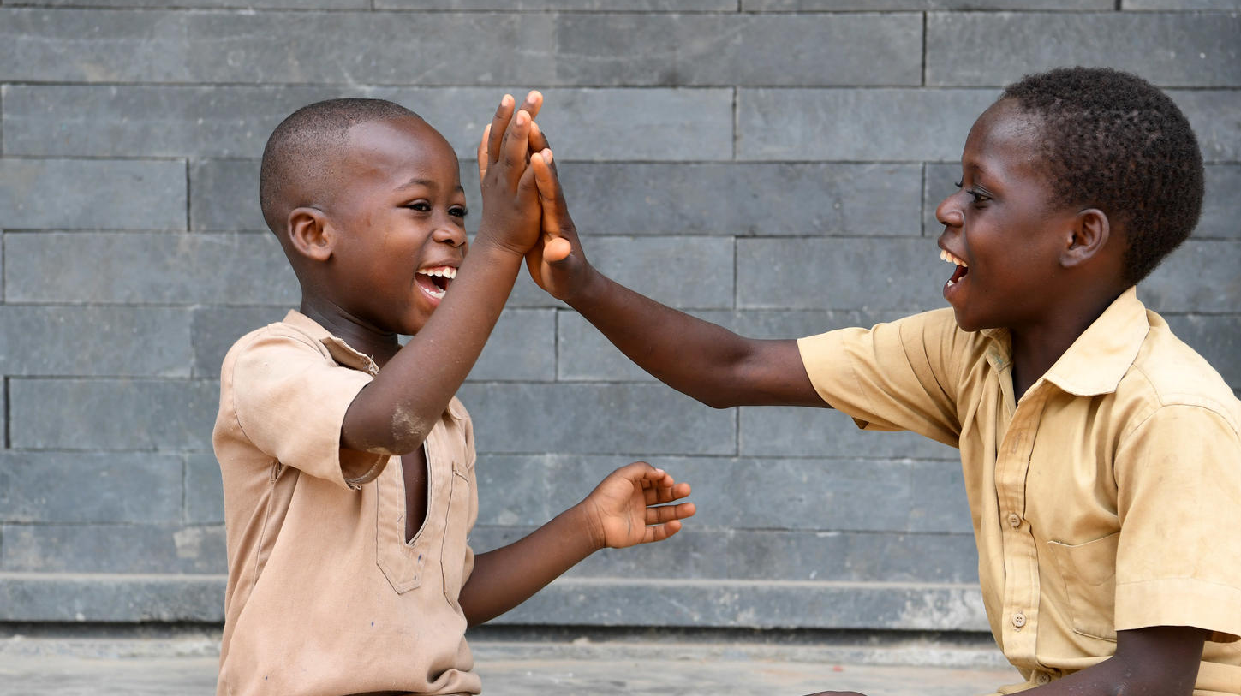
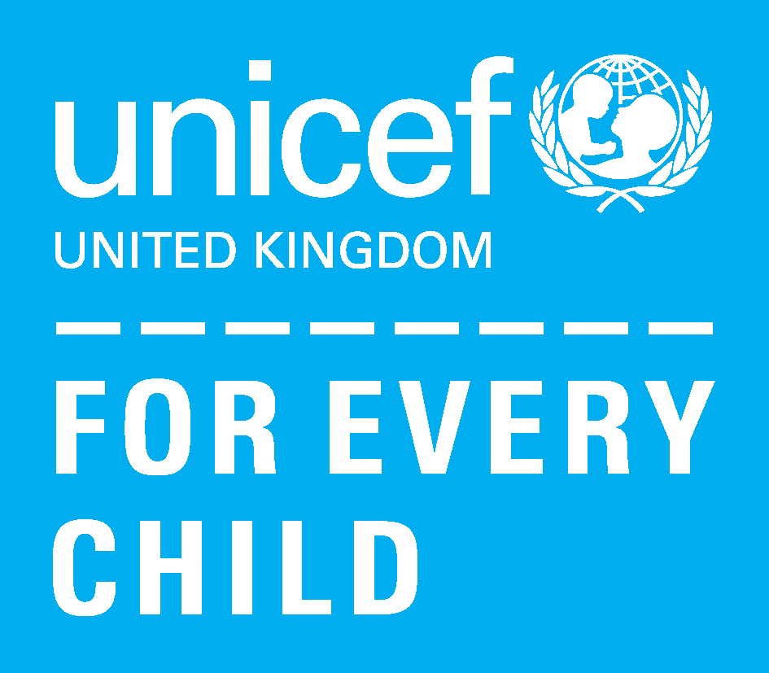
Boys playing in their school in Côte d'Ivoire © Unicef/Dejongh
ACTIVITY 6
Protecting our planet and home

Slide 2
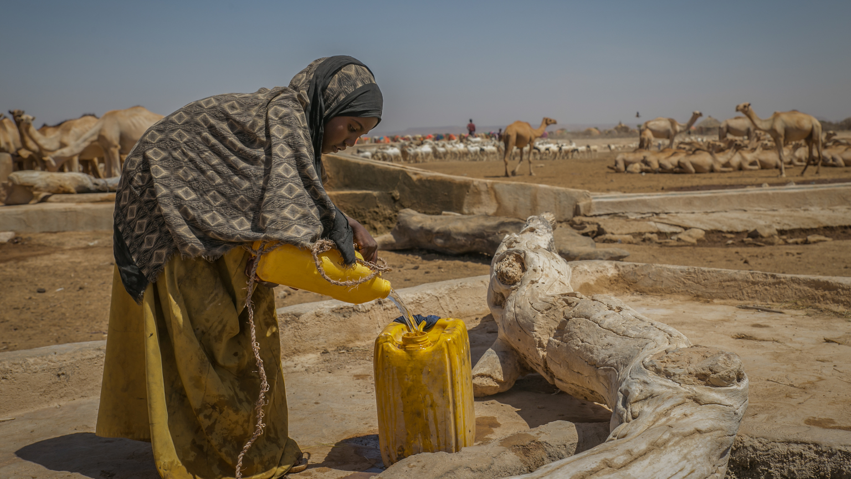
Nine-year-old Sulem fills up a jerry can, helping her family to gather water in her village in Ethiopia. © Unicef/Ayene
Notes:
Droughts in Ethiopia mean that many people will need food aid to have adequate nutrition to stay healthy. Many millions of people will struggle to access drinking water, and many people are likely to get diseases because of a lack of water.
When droughts happen, environments often became unsuitable for growing food. Warmer temperatures also increase water demand and evaporation, and water supplies are usually threatened, eventually causing migration.
Without action against climate change, Unicef predicts that 600 million children will be living in areas with extremely limited water resources by 2040. How do you think this will affect children’s right to health?

Slide 3
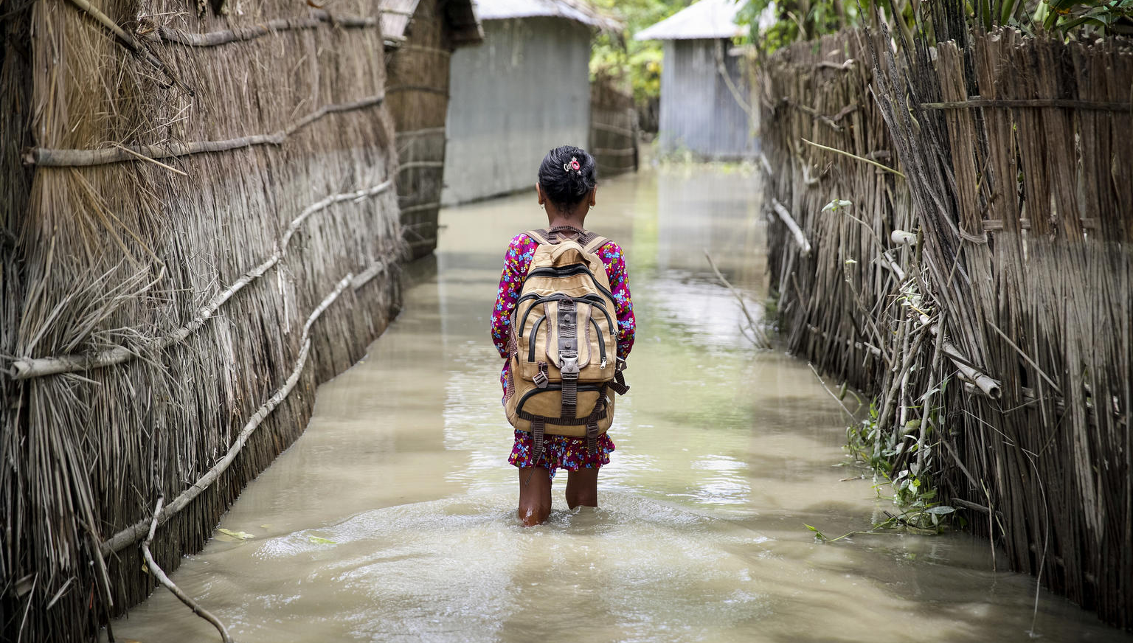
Source: Gathering Storm Report
A child walks to school through the flooded streets of her village in Bangladesh. © Unicef/Akash
Notes:
In Bangladesh, more than 12 million children live in and around river systems that are at increased risk of flooding.
This is as more people than live in all of London! Can you imagine if the Thames River in London flooded and everyone’s homes were destroyed? Where would all of the people go? How would the children get an education?

Slide 4
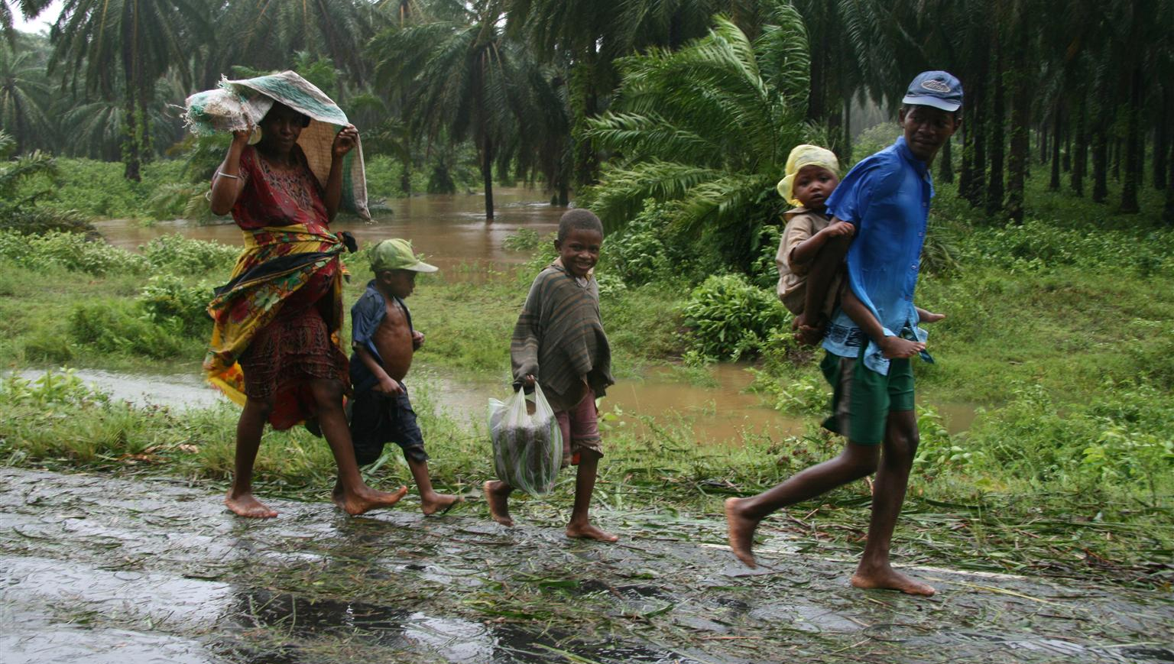
A family in Madagascar, forced from their home by a cyclone, walk to a temporary shelter Source: Children and the Changing Climate Taking action to save lives
Notes:
A family in Madagascar, forced from their home by a cyclone, walk to a temporary shelter
Madagascar is one of the countries that is most vulnerable to the hazardous impacts of climate change. Sixteen of the country’s 22 regions are at risk of tropical cyclones, extended droughts, variability of rainfall patterns, and serious flooding.
1,200 classrooms are damaged or destroyed each year in Madagascar as a result of extreme weather
Natural disasters in Madagascar are becoming more intense and more frequent. After disaster strikes, many families struggle to pick up the pieces and rebuild their lives before another disaster strikes again.

Slide 5
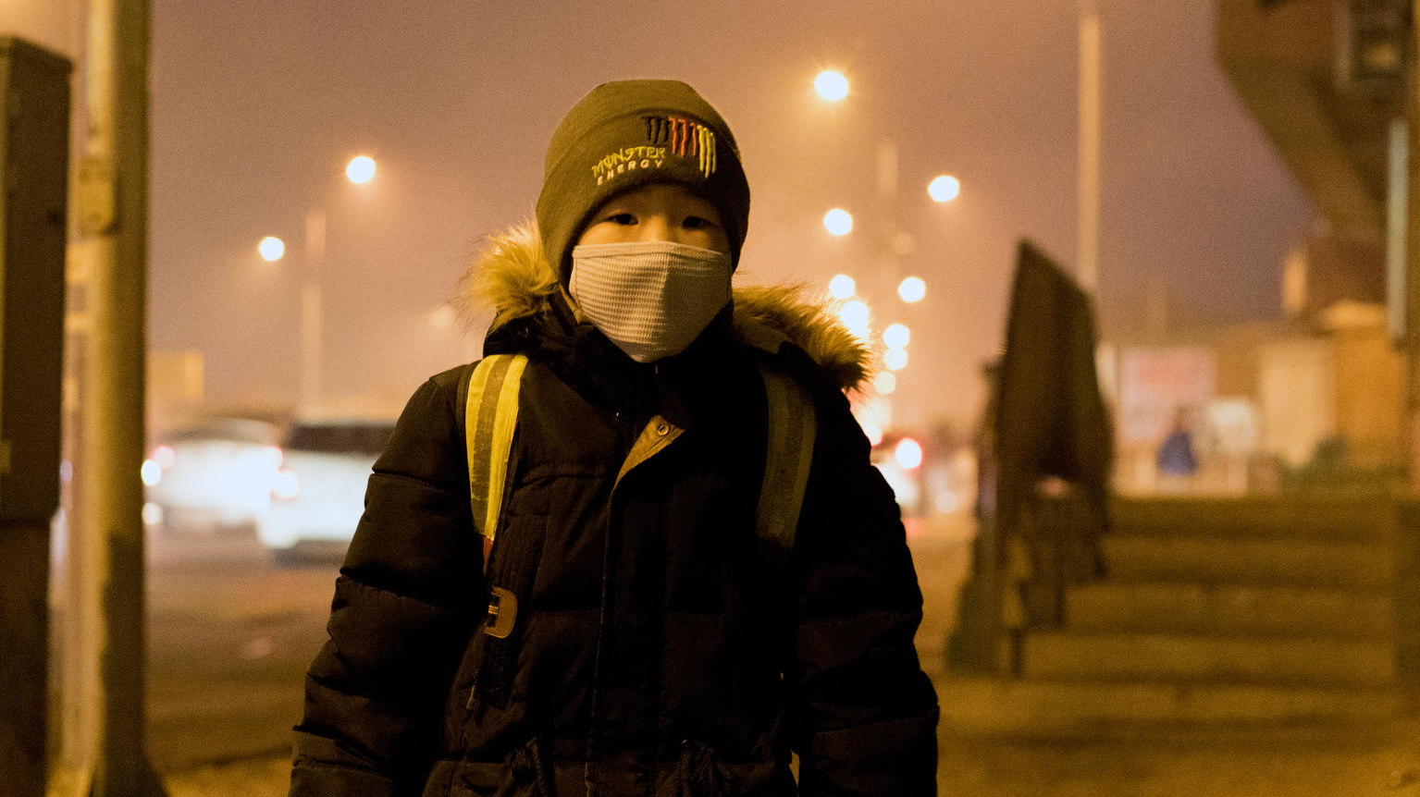
Air pollution levels are dangerously high in Mongolia's capital. © Unicef/Batbaatar
Notes:
In Ulaanbaatar, the capital of Mongolia, air pollution levels are dangerously high. A young boy waits for his bus to school.
Approximately two billion children live in areas where air pollution levels exceed standards set by the World Health Organization. When pollution gets bad, some families are forced to migrate to different locations in order to have access to a healthy home.

Slide 6
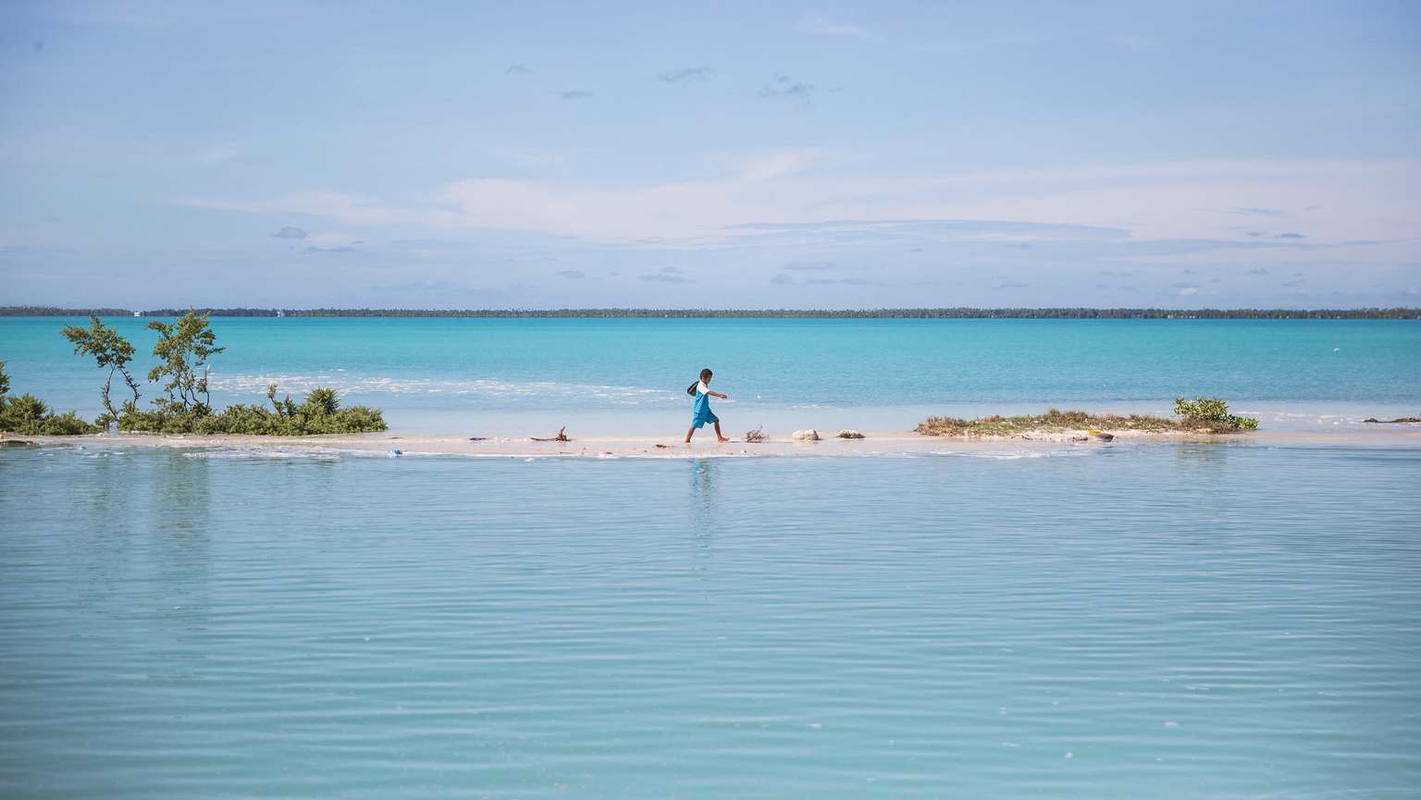
A boy walks from school to his house in a village in South Tarawa, Kiribati. © Unicef/Sokhin
Notes:
Kiribati is an island nation in the Pacific Ocean and is one of the countries most affected by rising sea levels.
Around the world sea levels have risen due to the melting of glaciers and ice sheets. Warmer seas are also making coastal storms more damaging – putting children who live in these island nations at risk.

Slide 7
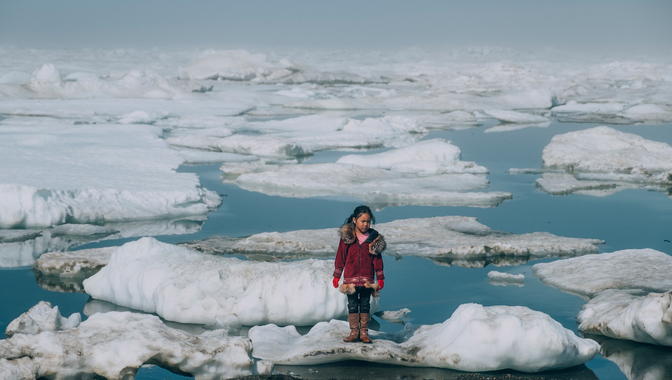
Amia, 11, stands near her home on an ice floe on a shore of the Arctic Ocean in Alaska. © Unicef/Sokhin
Notes:
Amia is an 11-year-old Iñupiat girl standing near her home on an ice floe on a shore of the Arctic Ocean in Barrow, Alaska in the United States of America.
The melting of Arctic ice is one of the many effects of global warming that has a serious impact on the life of humans and the wildlife.
When temperatures become warmer due to climate change, glaciers and sea ice melt. With less ice in the sea, fewer bright surfaces are
available to reflect sunlight back into the atmosphere from the earth’s surface causing ocean temperatures rise.

Slide 8
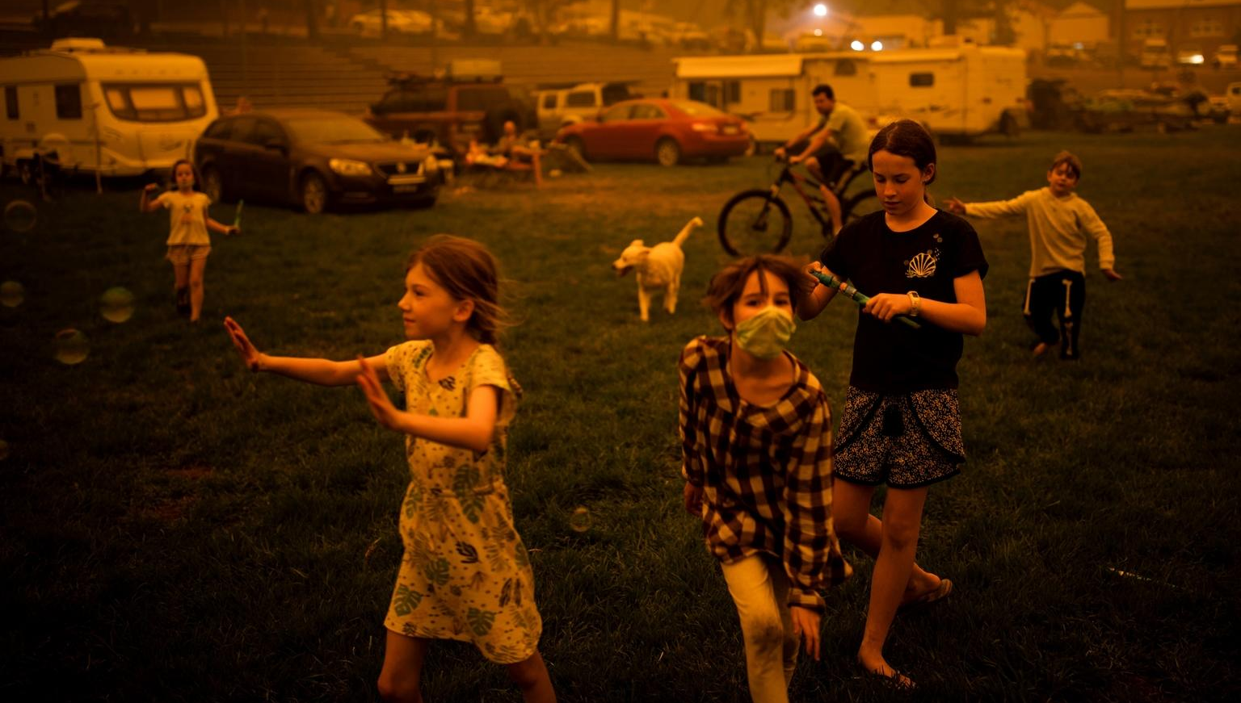
Wildfires are becoming more common in Australia. © Unicef/Davey
Notes:
Wildfires are large fires that burn vast amounts of forests and brush that can destroy children’s homes.
In Australia, climate change is causing the summer bushfire season to get worse every year, putting children at risk from air pollution and keeping children out of schools.
In the 2019-2020 bush fire season, fires destroyed more than 72,000 square miles of land in Australia. This is almost as much land that is in all of the UK (93,000 square miles).

Slide 9
Extreme weather events in the UK and elsewhere are becoming more common. Source: Pixabay

