Slide 1
Unicef/Gilbertson
Notes:
Ahmad, 16, works on his German homework at night in his bedroom at the youth residence in Germany.
Unicef/Gilbertson

Slide 2
Teacher slide
Contents
Slide 3 Guess the article - images as clues to identify the article
Slide 4 Introducing the article
Slide 5 What do you need for your right to privacy to be respected – the question
Slide 6 What do you need for your rights to privacy to be respected – some possible answers
Slide 7 & 8 Primary activities
Slide 9 & 10 Secondary activities
Slide 11 Reflection
Slide 12 Extension
Instructions
This flexible resource is intended to provide you with some easy to use, appropriate rights-related learning to share with your children, their families and your colleagues.
Please edit out non-relevant slides or tasks before sharing with students. Please check the content works for your learners and feel free to add any content that would make the material more relevant to your setting.

Slide 3
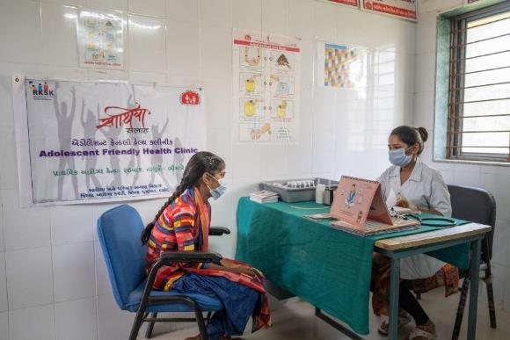
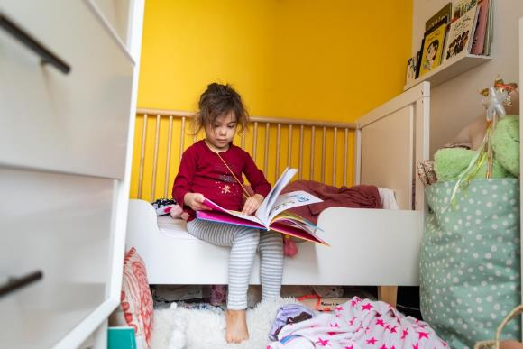
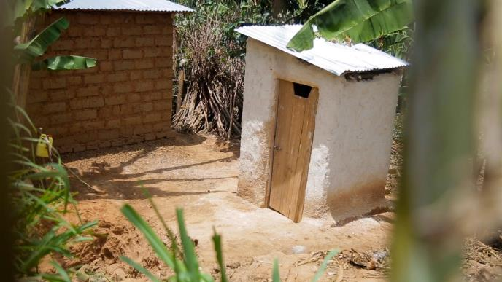
Guess the article
These pictures provide a clue to this week’s article.
Can you guess how they are linked together? Which article of the Convention do these pictures relate to?
Write down your thoughts or discuss with someone in your home.
Unicef/Paniwani
Unicef/Bajornas
Unicef/Kanobana
Notes:
From left to right:
Unicef/Paniwani – A consultation between a nurse and a 17 year-old girl at an adolescent clinic in India.
Unicef/Bajornas – A four-year-old girl reads in her bedroom in America.
Unicef/Kanobana – A new, safe and hygienic toilet at her home in Rawanda. This new toilet has a new roof, door and walls for privacy.

Slide 4
Introducing… Article 16
Jilly introduces Article 16 – The right to privacy
Article 16 – The right to privacy
Every child has the right to privacy. The law should protect the child’s private, family and home life, including protecting children from unlawful attacks that harm their reputation.
Watch Jilly on YouTube

Slide 5
Exploring article 16
What do you need so your right to privacy is respected?
Note your ideas down and then compare your thoughts with the next slide.

Slide 6
How many of these did you get?
For parents and carers to respect my private space and belongings.
For newspapers not to use my name or photo without my consent.
For my friends and family to understand that at times I need to be alone.
For the internet to be safer place.
For people to respect that some aspects of my life are private.
For parents not to use my photo on social media without my consent.
To have access to clear information about what it is safe to share online so that I feel informed and empowered to protect my personal data.
For the government to take the steps needed to ensure my right to privacy is respected.
What others did you think of?

Slide 7
Activity Time
Discuss different types of privacy (like internet safety or personal privacy). Create an acrostic poem using the letters
P R I V A C Y.
Children and young people have the right to privacy. Create a poster or sign to put on your bedroom door to show people that you want to have some time alone.
All these activities are related to…
Create a list of 5 of the most important rules to protect your right to privacy when you are online.
Watch this telling of the book 'Some Secrets Should Never be Kept' by Jayneen Sanders and use as class discussion. *Teachers - this story contains sensitive subjects so please watch it first before sharing with the class.
You don’t need to do every single activity
but if you have time you can do more than one.
Primary

Slide 8
Activity Time
Explore the concept of secrets. Are all secrets bad? Can you think of examples where keeping a secret would be a good thing? Discuss with an adult the types of secrets there are and what you should consider if someone tells you a secret. Is there a difference between secrets and surprises?
Look at the PANTS lessons from the NSPCC.
You have the right to privacy. Think about a 2 year old, a 10 year old and a 16 year old. Are there any differences in the types of privacy that should be respected at these ages? What are the similarities and differences?
Watch this video about privacy online. Use this as a starting point for class discussion.
Primary

Slide 9
Activity time
Children and young people have a right to privacy and yet it’s important that parents and carers monitor their use of the internet to help keep them safe and protected. What do you think is the best way for parents and young people to balance a child’s right to privacy with an adult’s responsibility for keeping them safe? Try and find time to have this conversation with the adults in your family.
Discuss with your friend if It’s OK if a celebrity includes her child in a ‘reality’ television show. What impact might this have on the child?
These activities will help you
understand how...
…can relate to your life.
You don’t need to do every activity, just do as many as you can.
Not everyone has a bedroom of their own or a space that is private. What advice would you give someone about how they can still enjoy a sense of privacy in other ways – walking outdoors for example?
Design a ’friendly’ poster that you could put on your bedroom door to show your family that you would like some time on your own.
Secondary

Slide 10
Activity time
One way that children are empowered to protect their privacy online is to be given the option to request that their personal data is deleted should they no longer wish to use a website, platform, product or service. Imagine you are an investigative journalist and find out if a company you use provides children with an option to close their accounts and deletes all personal data when that account is closed
Write a page for a parenting manual about how to respect a child’s right to privacy as that child grows into an adolescent.
“I have the right to keep my phone calls and emails private.” Create a drama scenario in which a teenage boy is talking with his father about his right to privacy. How might the father respond? Try to see the debate from both sides.
Do you feel the government is doing enough to ensure companies respect young people’s privacy in the media and online? If not write a letter to your MP outlining your concerns and what you expect from the government.
Create a short presentation about how the right to privacy is respected in school – this presentation could be shared in PSHE.
Secondary

Slide 11
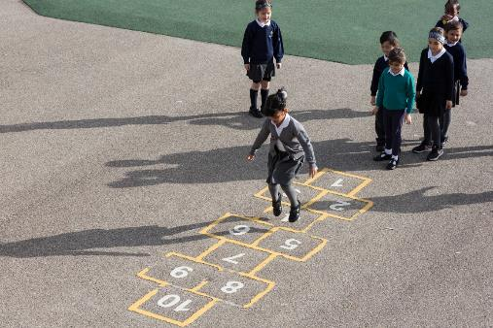
Reflection
Try to find somewhere peaceful and spend a few minutes being quiet and still … then think about these questions…
How can you show that you respect the right of privacy of your friends or members of your family?
What role does trust and respect play between children, young people and adults when discussing the right to privacy?
Do you think the right to privacy will become more or less important in the future? Why is this?
Uncief/Dawe

Slide 12
Extension
The right to an identity and the right to privacy are closely linked. How can we protect both these rights?
You can find a summary of the whole Convention here.
UNICEF/Dawe

Slide 13
Thank you

