Slide 1
Unicef/Noorani
Notes:
While collecting water, children stand holding their donkeys near a water point outside their village about 20 km West of El-Fasher, the capital of the state of North Darfur, Sudan.
Unicef/Noorani

Slide 2
Teacher slide
Contents
Slide 3 Guess the article - images as clues to identify the article
Slide 4 Introducing the article
Slide 5 Exploring articles 32 and 35 – the question
Slide 6 Exploring articles 32 and 35 – the answers
Slide 7 & 8 Primary activities
Slide 9 & 10 Secondary activities
Slide 11 Reflection
Slide 12 Extension
Instructions
This flexible resource is intended to provide you with some easy to use, appropriate rights-related learning to share with your children, their families and your colleagues.
Please edit out non-relevant slides or tasks before sharing with students. Please check the content works for your learners and feel free to add any content that would make the material more relevant to your setting.

Slide 3
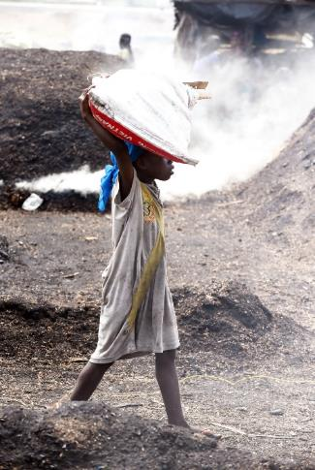
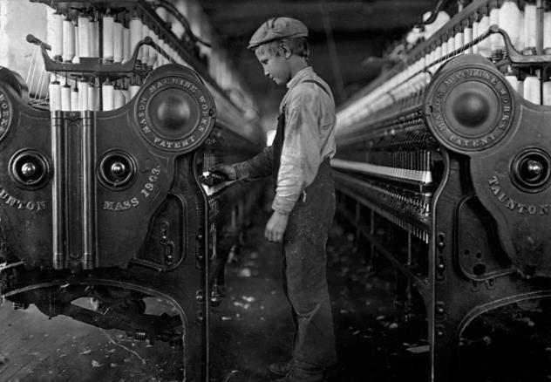
Guess the article
These pictures provide a clue to this week’s article.
Can you guess how they are linked together? Which article of the Convention do these pictures relate to?
Write down your thoughts or discuss with someone in your home.
Unicef/Dejongh
Wikicommons
Wikicommons
Notes:
From left to right:
Unicef/Dejongh – Child working in a charcoal production field in the town of San Pedro, in the South West of Côte d'Ivoire, in an atmosphere filled with heat, dust and smoke.
Wikicommons – currency
Wikicommons - A young mill worker, unknown city in the United States, 1918.

Slide 4
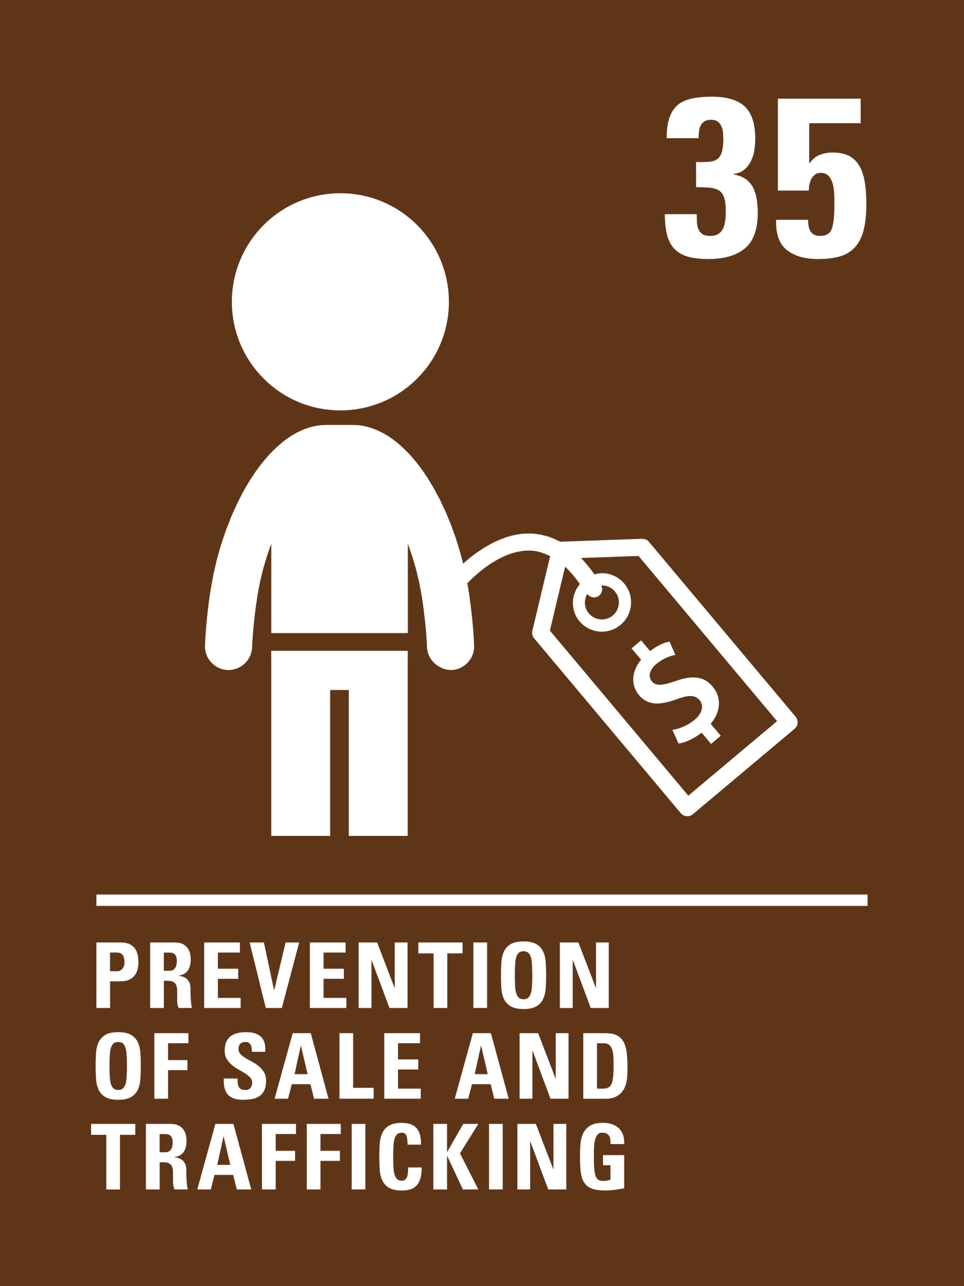
Introducing… Article 32 & 35
Hilary introduces Article 32 – Protection from Harmful Work & 35 – Prevention of Sale and Trafficking
Article 32
Governments must protect children from economic exploitation and work that is dangerous or might harm their health, development or education. Governments must set a minimum age for children to work and ensure that work conditions are safe and appropriate.
Article 35
Governments must protect children from being abducted, sold or moved illegally to a different place in or outside their country for the purpose of exploitation.
Watch Hilary on YouTube

Slide 5
Exploring article 32 & 35
What does the word ‘work’ make you think of?
Note your ideas down and then compare your thoughts with the next slide.

Slide 6
How many of these did you get?
We work hard at school.
Some children help out with work at home or have a part time job.
People work to earn money.
Covid-19 has changed work for lots of people.
Some people aren't able to work.
Children or adults should not be taken away from home and forced to work.
There are laws about how much work people should do and how much money they should get paid.
What others did you think of?

Slide 7
Activity Time
Draw a large clock on a piece of paper and divide it up into 12 equal segments. In each segment write or draw what you are doing on a normal day. Are you at school, sleeping, playing or watching TV? Now imagine you have to fit a job into your day too. What would you have to stop doing to be able to work?
All these activities are related to…
As a class, listen to a short retelling of Cinderella. In circle time discuss how she was treated by her stepsisters. How should her life have been different?
Draw or list work that you think children of different ages are allowed to do outside of their home. What is the difference between helping out at home, working for someone else, and child labour.
How does the government protect children in the UK who work? Use this website to help you.
You don’t need to do every single activity
but if you have time you can do more than one.
Primary

Slide 8
Activity Time
Find out about and discuss Fairtrade and how it helps to protect children’s rights, particularly Article 32. Use this information to get started.
Sometimes children are taken away from their families by force (abducted) and are made to do dangerous or illegal activities. Write a speech or a letter to set out the reasons why abducting children is wrong.
Draw, list or discuss reasons why children might be involved in harmful work. How does this affect their rights?
Watch this video on child trafficking. Act out or write the boy’s story.
Watch this video with your teacher or another adult. Discuss why the boy does not choose to join the football club abroad. Look up the words ABDUCTION and TRAFFICKING and explain the meaning to your class.
Primary

Slide 9
Activity time
Do you have a job or know of friends who do? Find out how the law protects children in the UK. Is there anything that surprises you? What is the difference between 'child work' and ‘child labour'? Make up a quiz for your family and friends about what you found out.
These activities will help you
understand how...
…can relate to your life.
You don’t need to do every activity, just do as many as you can.
Millions of children around the world are involved in child labour. Explore why this is. Which articles of the Convention relate to protection and are being denied?
Explore if children are involved in making your favourite clothing or cosmetic brands. How does this make you feel? Use these articles to start your research: Child labour in fashion and Child labour in the beauty industry. Take action to raise awareness of child labour and global brands.
Secondary

Slide 10
Activity time
Find out about and discuss Fairtrade and how it helps to protect children’s rights, particularly Article 32. Use this information to get you started.
Listen to the podcast ‘What is wrong with child labour?’ and read Child labour is exploitation. Share your views on child labour and the issues discussed. Use the Convention to strengthen your debate: rights to protection vs right to participate.
Listen to this TED Talk about items we purchase that make us complicit in child labour. How can Fairtrade protect children?
Watch this short video related to Article 35. Look up the words exploitation and abduction and use the definitions in a short presentation (PowerPoint or spoken) about Article 35.
In 2013 over 360 children were trafficked into the UK. Research more recent figures and where these children have come from, why they are trafficked and what the main dangers are for these children. Explore county lines and child trafficking. Take action to raise awareness of these issues.
Secondary

Slide 11
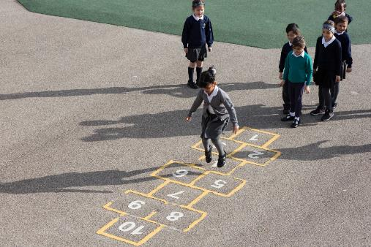
Reflection
Try to find somewhere peaceful and spend a few minutes being quiet and still … then think about these questions…
What should adults do to make sure any work children do is safe?
Do you think there should be more opportunities for children and young people to engage in paid work?
Who would you talk to or contact if you were worried about yourself or someone you know in connection with child labour or trafficking?
Uncief/Dawe

Slide 12
Extension
Rights are indivisible and all equally important. Imagine you were engaged in child labour, how might your other rights be affected?
How might Covid-19 impact upon child labour and trafficking?
You can find a summary of the whole Convention here.
UNICEF/Dawe

Slide 13
Thank you

