Slide 1
Unicef/Merino
Notes:
Dante Vergara and his father in Chili. Dante’s father first introduced him to the hills and national parks near his home when he was very young, sparking his interest in environmental activism.
Unicef/Merino

Slide 2
Teacher slide
Contents
Slide 3 Guess the article - images as clues to identify the article
Slide 4 Introducing the article
Slide 5 Exploring articles 9, 10 and 11 – the question
Slide 6 Exploring articles 9, 10 and 11 – the answers
Slide 7 & 8 Primary activities
Slide 9 & 10 Secondary activities
Slide 11 Reflection
Slide 12 Extension
Instructions
This flexible resource is intended to provide you with some easy to use, appropriate rights-related learning to share with your children, their families and your colleagues.
Please edit out non-relevant slides or tasks before sharing with students. Please check the content works for your learners and feel free to add any content that would make the material more relevant to your setting.

Slide 3
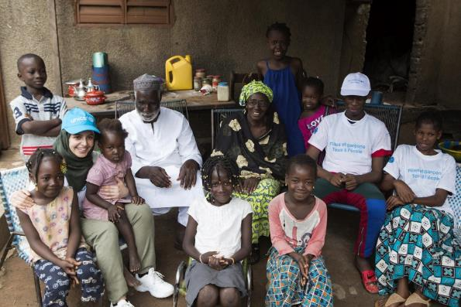
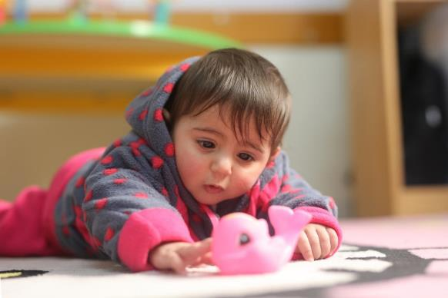
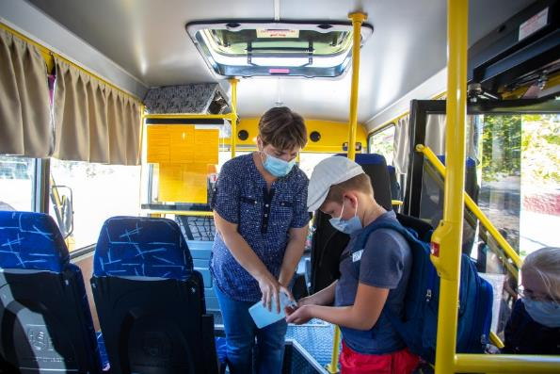
Guess the article
These pictures provide a clue to this week’s article.
Can you guess how they are linked together? Which article of the Convention do these pictures relate to?
Write down your thoughts or discuss with someone in your home.
Unicef/Keïta
Unicef/Albaba
Unicef/Filippov
Notes:
From left to right:
Unicef/Keïta – UNICEF Goodwill Ambassador Muzoon Almellehan at the home of Adama Keita, 55, and his extended family in the Cite BMS neighbourhood of Bamako, Mali.
Unicef/Albaba - Reeam, age 18 weeks, attempts crawling in one of UNICEF's Early Childhood Development (ECD) centres in Gaza City, State of Palestine.
Unicef/Filippov - Children on the school bus to school in eastern Ukraine.

Slide 4
Introducing… Articles 9, 10 & 11
Steven introduces Articles 9, 10, 11 – Staying in contact with your family
Article 9 (separation from parents)
Children must not be separated from their parents against their will unless it is in their best interests (for example, if a parent is hurting or neglecting a child). Children whose parents have separated have the right to stay in contact with both parents, unless this could cause them harm.
Article 10 (family reunification)
Governments must respond quickly and sympathetically if a child or their parents apply to live together in the same country. If a child’s parents live apart in different countries, the child has the right to visit and keep in contact with both of them.
Article 11 (abduction and non-return of children)
Governments must do everything they can to stop children being taken out of their own country illegally by their parents or other relatives, or being prevented from returning home.
Watch Steven on YouTube

Slide 5
Exploring articles 9, 10 & 11
When it is safe to do so, why is it important for children to stay in contact with their families?
When considering your answers remember that there are many different kinds of families and some children are not looked after by their families. And remember every child has the right to be safe.
Note your ideas down and then compare your thoughts with the next slide.

Slide 6
How many of these did you get?
So you can be loved and cared for.
Because, for most people, your family can help you to enjoy many of your rights.
Being in a family helps you to learn what sort of things matter to you and this can be important when you are an adult and if have a family of your own in the future.
To help you have a link to your identity and understand who you are.
For security and protection.
Families often provide for your needs with support and guidance, as well as providing practical things like food and shelter.
It is important to be brought up in line with your family’s religion, culture and traditions.
So you have relationships with your siblings, grandparents and other family members.
What others did you think of?

Slide 7
Activity Time
Not all children live in the same kinds of families – there are families of many different types. Draw yourself with the people who look after you. Add details about who they are if you like. Share your drawing with a classmate and discuss.
All these activities are related to…
Draw around your hand. On each finger write one thing you have learned from or love about your parent or carer.
Think about the reasons why a child might need to be cared for by someone other than their parents. Share your ideas with a teacher or with your class.
You don’t need to do every single activity
but if you have time you can do more than one.
Primary

Slide 8
Activity Time
Have you ever been away from your parents, carers and family – perhaps on a school trip? What did you miss the most? How did you keep in touch? Write about some top tips for keeping in touch when people can’t be together. Our experiences in 2020 might give you some ideas!
Read Luna Loves Library Day by Joseph Coelho or watch this video of the author reading the book on YouTube. Why does Luna love visiting the library with her dad so much? Write your own version of the Troll King and the Mermaid Queen but with different main characters.
Have you ever been abroad? What things happen on a journey abroad that help to protect children from being taken out of the country illegally?
Read the Refugee Council’s Facts about unaccompanied refugees.* Does anything surprise you?
Can you draw a map of all the different places your family and friends live? It could be of your town, your country, or the whole world!
Primary
Notes:
*We’ve put this in primary but might not be entirely appropriate for younger ones - towards the end of this document, it says “Children are also regularly trafficked into the UK to be forced into domestic servitude, sexual exploitation and other forms of forced labour including cannabis cultivation. We are there for them.” Please tailor this content for your learners if you need to before sharing.

Slide 9
Activity time
Watch this video of a family reunited in South Sudan. share with your friends or class some of the feelings a person may have in this situation..
Imagine you are soon to see a parent who you have been separated from for a long time. Write a diary entry to express how you might be feeling.
These activities will help you
understand how...
…can relate to your life.
You don’t need to do every activity, just do as many as you can.
Find out about the work of the charity ‘Safe Passage’ and read about some of the children they have helped to be reunited with their families.
Research the ‘Dubs Amendment’. Brexit means our laws will be changing on 31 December. How will this impact on the realisation of Article 10 for children? Newsround provides a good starting point – read to the end of the article.
Secondary

Slide 10
Activity time
Give groups of students a piece of paper with the simplified wording of Article 9, 10 and 11. Explain to them that Article 3 says decisions must be taken in the best interests of the child and this is also a general principle of the Convention which applies to all the rights. How does Article 3 link to Articles 9, 10 and 11? Discuss in groups and then come together as a class to share answers.
Read and watch the film clip from 2018 on BBC Newsround. The report refers to the situation in the USA where 545 children are still not reunited with their parents. How does this make you feel? What could you do about this? Discuss as a class.
Discuss reasons why children might not be able to live with their parents. Watch this video about children who are separated from their parents. Why do you think it is important for young people to speak out about their experiences? Why do you think this is important?
Think about the restrictions which have been introduced as a result of the Covid-19 pandemic. How might they have affected enjoyment of Articles 9, 10 and 11? Do you think the right balance has been struck or not? Organise a class debate with teams for and against.
Secondary

Slide 11
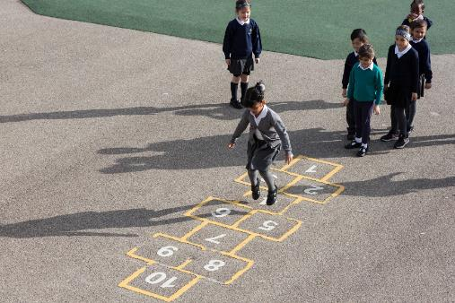
Reflection
Try to find somewhere peaceful and spend a few minutes being quiet and still…
Article 10 says that if children live in a different country to their parents, they have the right to stay in contact, visit and to apply to be reunited with them.
Why might children live in different countries from their parents or families?
How might you feel if you were unable to see your family for a long time? What would you miss most?
Imagine your family was looking after a child because they were separated from their parents. How would you make them feel welcome?
Why do you think this right is important?
Uncief/Dawe

Slide 12
Extension
Watch this film.
Article 11 says children should not be taken out of the country illegally. One reason children, especially girls, are taken abroad is for child marriage. Across the world 12 million girls under the age of 18 are married each year. You might think this is just a problem in far off parts of the world, but concerns have been raised about the UK, too. More information here.
If it was not safe for a child to live with or see their parents, what support should they get?
Look at the Convention and try to identify how many other rights might be affected when a child is married before the age of 18.
You can find a summary of the whole Convention here.
UNICEF/Dawe

Slide 13
Thank you

