Slide 1
UnicefPancici
Notes:
A girl plays with toys in an inclusive kindergarten in Belgrade, Serbia.
Unicef/Pancic

Slide 2
Teacher slide
Contents
Slide 3 Guess the article - images as clues to identify the article
Slide 4 Introducing Article 31
Slide 5 Exploring Article 31 - the question
Slide 6 Exploring Article 31 - answers
Slide 7 & 8 Primary activities
Slide 9 & 10 Secondary activities
Slide 11 Reflection
Instructions
This flexible resource is intended to provide you with some easy to use, appropriate rights-related learning to share with your children, their families and your colleagues.
Please edit out non-relevant slides or tasks before sharing with students. Please check the content works for your learners and feel free to add any content that would make the material more relevant to your setting.

Slide 3
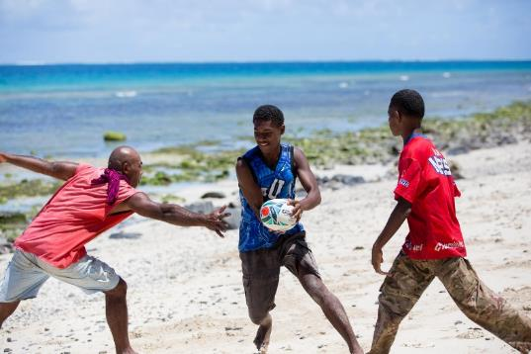
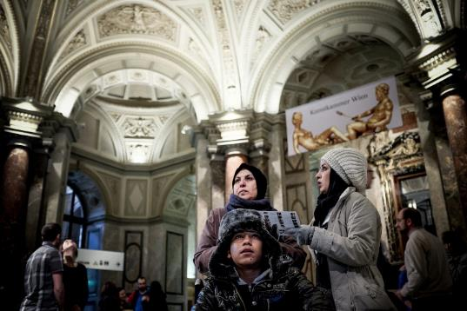
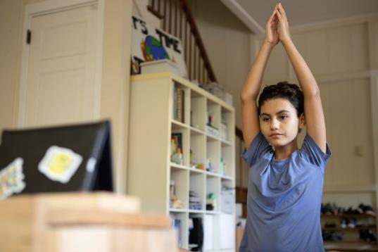
Guess the article
These pictures provide a clue to this week’s article.
Can you guess which article of the Convention do these pictures relate to?
Write down your thoughts or discuss with someone in your home.
Unicef/Infinity
Unicef/Gilbertson
Unicef/Schverdfinger
Notes:
From left to right:
1. Children play at a child-friendly space in Daku Village, Kia Island. Unicef/Infinity
2. Fatima and her son, Sajad, and her daughter, Houda, visit the Museum of Art History in Vienna, their new home city. Unicef/Gilbertson
3. Mila, 11, does an online yoga class at home in Colon Province, Panama. Unicef/Schverdfinger

Slide 4
Introducing article 31
Maia and Priya introduce Article 31
Article 31 – Rest, Play, Culture, Arts
Every child has the right to relax, play and take part in a wide range of cultural and artistic activities.
This applies to all children regardless of background or abilities.
Watch Maia and Priya on YouTube

Slide 5
Exploring Article 31
What kinds of activities might be included within Article 31?
Note down your thoughts and compare with the next slide.

Slide 6
How many of these did you get?
Spending time with friends.
Choosing what to do – not being directed by a grown up.
Drawing or craft activities.
Going to museums and galleries.
Going to the theatre, to concerts or to the cinema.
Playing a wide range of sports.
Having a safe space to, relax, read, draw or listen to music.
Playing at the park.
Playing video games.
Doing yoga, meditation or mindfulness activities.
What else did you think of?

Slide 7
Activity Time
Can you draw a puffer fish? How about a robot or a pirate ship? Take part in an online art lesson – which will you choose?
Draw a picture of yourself playing your favourite game. Show your picture to a grown up and talk to them about what you have drawn.
All these activities are related to…
How do you like to spend your free time? Think about what your ideal weekend would be like. Where would you go? What would you do? What activities would you participate in? Create a comic strip showing your dream weekend and share it with your class.
Make a chill out den at home or in your classroom where you can relax. Use cushions, blankets and even fairy lights. Take a picture of yourself relaxing in your chill out den and share it with your class.
You don’t need to do every single activity
but if you have time you can do more than one.
Lower Primary

Slide 8
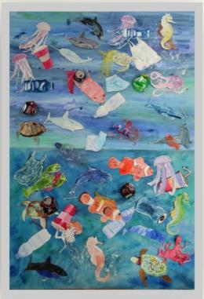
Activity Time
What can you do to relax, rest and play during this time of restrictions to keep everyone safe from Covid? What does your family do to relax? Write a list of things that you can do and share with your class. How many of them can you tick off?
Think about your local playgrounds. Are there activities for children of different ages? Are there activities for children with wheelchairs, or who are blind or partially sighted? Article 31 says that all children have the right to engage in play, regardless of their age and abilities. Design a playground that as many children as possible can enjoy. How can you make sure that there is something for everyone?
Lots of museums and galleries now have virtual tours so you can visit museums all over the world from your classroom or living room! Choose a museum and go on a virtual tour. Find out if your local museums or galleries have virtual tours. Why not create your own school virtual art exhibition like Christ Church School, Hampstead – a Gold Rights Respecting School.
Have you heard of the author Michael Rosen? He talks in this video by Norton Road Primary School about the right to play. Do you agree with what the children say? You might like to watch this with adults at home and discuss it with them.
Primary

Slide 9
Activity time
Think about your local parks and playgrounds. How accessible are they to all children? Are there activities for children with wheelchairs, or children with sight problems for example? Are there areas and equipment suitable for babies through to teenagers? Design a playground that as many children and young people as possible can enjoy. Draw a map of your playground and label the different areas. Try to explain why you have chosen your design.
Write a list of clubs that your dream school would have available for students. This could include sports, arts, IT and others. Which of these clubs would be possible at your school? Think about the time and resources you would need. Write a letter to your headteacher to ask whether you could set up a new club.
These activities will help you
understand how...
…can relate to your life.
You don’t need to do every activity, just do as many as you can.
Watch these short animations about the importance of play. Create a leaflet for new parents explaining why play is so important for their children.
You probably know of the famous children’s writer Michael Rosen. Listen to him talking about the power of play. How do some of your teachers use ‘fun’ activities to engage you in learning? Could you feed back to them how helpful this is?
Secondary

Slide 10
Activity time
The Little Angel theatre has created a special project to take theatre to children in hospitals. Can you think of any children or young people who might find it hard to access theatre or the arts? Discuss with your friends or teachers how your school community could do something about this.
Unicef supports children around the world to realise their rights, including the right to play. Watch 16 year old Tijan’s tour of a centre for young people in a refugee camp in Syria. How does this centre support children and young people to access their right to relax and play? What other rights are being supported in this film?
What do you think prevents children and young people accessing their right to relax, play and culture? A report commissioned by the Children’s Commissioner in Wales found that the top barriers were time, money, transport, confidence, lack of provision and accessibility, not enough information about what is happening and permission. Do you agree? Are any of these a problem for you and your friends in your area? How can duty bearers support children to overcome them? Write to your local council or MP to tell them about these barriers and what you think should be done about this.
.
Lots of museums and galleries now have virtual tours so you can visit museums all over the world from your classroom or living room! Choose a museum and go on a virtual tour. Find out if your local museums or galleries have virtual tours. Why not create your own school virtual art exhibition like Christ Church School, Hampstead – a Gold Rights Respecting School.
Secondary

Slide 11
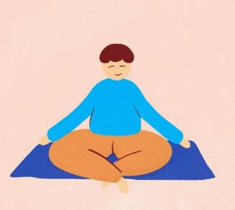
reflection
Find somewhere peaceful and quiet. Relax and let your mind be still. Focus on the sounds of your breath.
Inhale for 4 seconds, hold your breath for 7 seconds, and exhale forcefully making a WHOOSH sound for 8 seconds. Repeat 4 times or until your mind relaxes.
Now lets consider…
What does everyone need to relax, rest and play?
What is your favourite way to really relax?
Can you think of something you could do to help somebody you care about to feel a bit more relaxed?
Spend a couple of moments thinking about this and then write down your thoughts and if you want, share this back with your teacher, friends or family.
Take a moment to breath…
Press play below to do a breathing exercise and reflect on this week’s topic.
Uncief/UN0376033

