Slide 1
Unicef/Haque
Notes:
Two friends look at something on their phone outside a slum in Dhaka, Bangladesh.
Unicef/Haque

Slide 2
Teacher slide
Contents
Slide 3 - Introducing Safer Internet Day
Slide 4 - Articles for Safer Internet Day
Slide 5 - What does a safer internet have to do with rights? Question
Slide 6 - What does a safer internet have to do with rights? Answers
Slide 7 & 8 - Primary activities
Slide 9 & 10 - Secondary activities
Slide 11 - Reflection
Instructions
This flexible resource is intended to provide you with some easy to use, appropriate rights-related learning to share with your children, their families and your colleagues.
Please edit out non-relevant slides or tasks before sharing with students. Please check the content works for your learners and feel free to add any content that would make the material more relevant to your setting.

Slide 3
Introducing SAFER INTERNET DAY
Safer Internet Day is a global event to help everyone to think about being as safe as possible when we are online.
It is celebrated this year on 9th February.
The UN Convention on the Rights of the Child is all about ensuring the best possible childhood for every child and young person. All of the rights apply, all of the time, and this includes the time a child spends on the internet. This week’s activities will include some particular focus on Articles 16 and 17, the rights to privacy and to access reliable information.
The United Kingdom Committee for UNICEF (Unicef UK) is calling for a long-term approach to ensure digital inclusion. We're asking the Department for Education to undertake a comprehensive mapping exercise to understand exactly how many children aren't online at home and why that is, and use this information to close the digital divide for good.
Anja, Senior Policy Adviser, introduces
Safer Internet Day
Watch Anja on YouTube

Slide 4
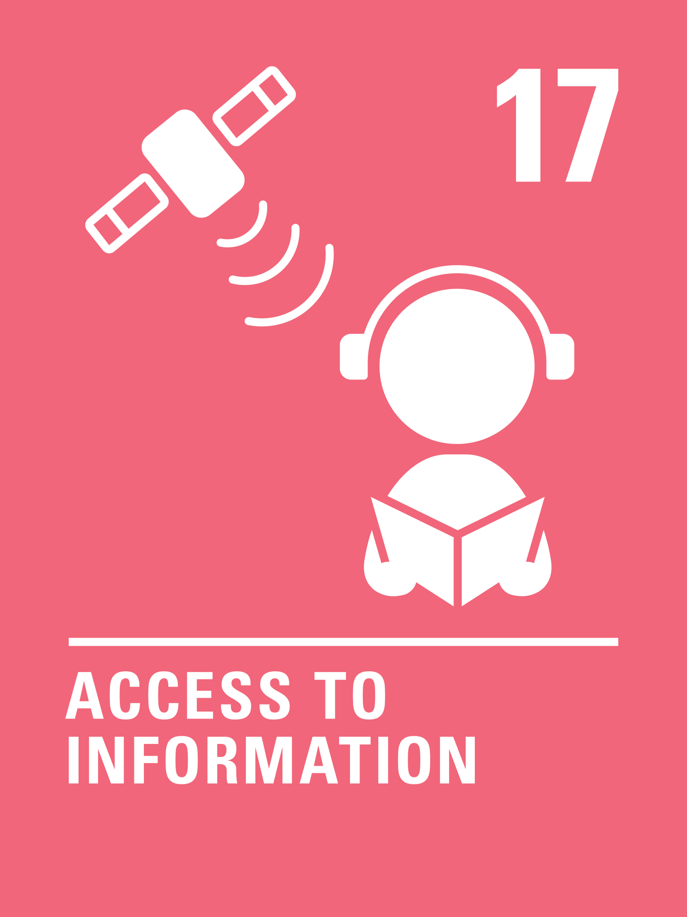
articles for Safer internet day
This week’s activities link to the following articles:
Article 16 - the right to privacy
Every child has the right to privacy. The law should protect the child’s private, family and home life, including protecting children from unlawful attacks that harm their reputation.
Article 17 - access to information from the media
Every child has the right to reliable information from a variety of sources, and governments should encourage the media to provide information that children can understand. Governments must help protect children from materials that could harm them.

Slide 5
What does a safer internet have to do with rights?
When you think of the internet and being online, how many different rights are connected with this?
Note your ideas down and then compare your thoughts with the next slide.

Slide 6
How many of these did you get?
Article 19 – the right to be protected from all forms of harm
Article 17 – the right to access reliable information
Articles 28 & 29 – the right to an education and to develop talents and abilities
Article 8 – the right to your identity being protected
Article 31 – the right to relax and play
Article 16 – the right to privacy
Article 15 – the right to meet with others and join groups
You probably thought of many other rights too!

Slide 7
Activity Time
Imagine there was no internet, computers, mobile phones and other devices! An older family member will be able to remember a time like this. If you can talk to them and then describe what life would be like for children, at school and at home. You can write this down or discuss it with somebody.
Many children will play games online, enjoying your right to play, but in school and at home you probably have a list of rules about when you can play and for how long. Why are these rules important? How do they protect some of your other rights? Discuss your ideas with an adult or safely online with your friends.
All these activities are related to…
Your right to be safe and protected is always important, including when you use the internet. Can you think of three top tips for staying safe online? Use thinkuknow.co.uk to help. Discuss this with adults in your house or share with your class.
.
Play a game of ‘Two Truths and a Lie’ in class or at home. Just like on the internet, it’s not always easy to tell when something is true, is it? Draw a poster to explain why truth is important.
You don’t need to do every single activity
but if you have time you can do more than one.
Primary

Slide 8
Activity Time
Make a list of positive and negative things about the internet, keeping in mind your rights. When you have done this write down your ideas for messages or ‘slogans’ that could be part of an online safety display when you are back in school. Share your ideas with a teacher.
.
.
Watch this video of the book Monkey Puzzle.
Why does the butterfly keep getting it wrong? Try describing something to a friend and ask them to draw it. Does it look like you imagined it would? Talk with an adult about why it’s important to ask the right questions when using the internet to find things out.
Some children don’t have a device they can easily use at home or may not have reliable internet access. How might this affect their right to an education?
What do you think the government should do to help children in this situation?
Unicef UK want to hear your ideas, so please share these with your teacher who can then share with them with us.
Watch this Newsround report about cyberbullying. What can you do to respect people's rights online? Write a short story, drama script or song to give positive messages about acting respectfully online.
.
.
Primary

Slide 9
Activity time
Have a look at the Safer Internet Day website. Read through the messages and identify two that you think are particularly important. Try to rewrite these two messages to include child rights. How does this affect the tone and importance of the message?
These activities will help you
understand how...
…can relate to Safer Internet Day.
You don’t need to do every activity, just do as many as you can.
”Access to the internet is essential to live a full and happy life”
Do you agree with this statement?
Here are some recent statistics about what is called the ‘Digital Divide’ – the Global situation and in the UK.
If you were in charge what would you do to close the Digital Divide?
Unicef UK want to hear your ideas, so please share these with your teacher who can then share with them with us.
Watch this video.
Try to make a list of all the different types of data you and your family share online in a typical day.
Have you ever thought about what happens to it all?
Have a discussion at home about the link between data and your right to privacy.
Secondary

Slide 10
Activity time
Watch this video where Tim Berners-Lee explains what is needed to make the internet more accessible. Using the video as a stimulus, write a story in which the internet either helps someone to access their rights or prevents them.
We’ve all heard people talk about fake news, but what exactly does it mean?
Try being a reporter and find out. What rights did you think of while doing this activity?
Do you use the internet to make new friends? If so, how do you know they are who they say they are? Watch the following video and then discuss in groups how the young person in the video can keep themselves safe online. What rights are being protected or denied in this video?
Recommended with young people aged 13 and up.
Imagine you were inventing a new internet, one which would help everyone to access their rights. Create an advertising campaign to encourage people to sign up – you could make posters, think up slogans, even
make a video advertisement.
Secondary
Notes:
Teacher guide for ‘Try being a reporter’ activity - https://www.bbc.co.uk/teach/young-reporter/ireporter-guidance-for-teachers/zbb3hcw

Slide 11
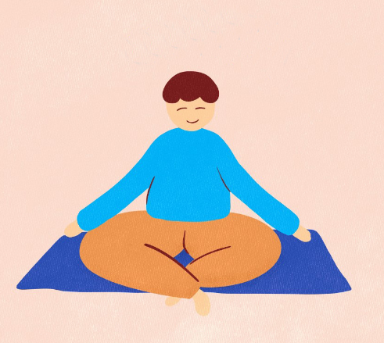
Reflection
Find somewhere peaceful and quiet. Relax and let your mind be still. Focus on the sounds of your breath.
Inhale for 4 seconds, hold your breath for 7 seconds, and exhale forcefully making a WHOOSH sound for 8 seconds. Repeat 4 times or until your mind relaxes.
Now lets consider…
What do you enjoy most about the internet and being online?
How can you help a friend or younger family member to become safer online?
Think of one way that you will use the internet today to do or say something positive to another person.
Take a moment to breath…
Press play below to do a breathing exercise and reflect on this week’s topic.
Uncief/UN0376033

