Slide 1
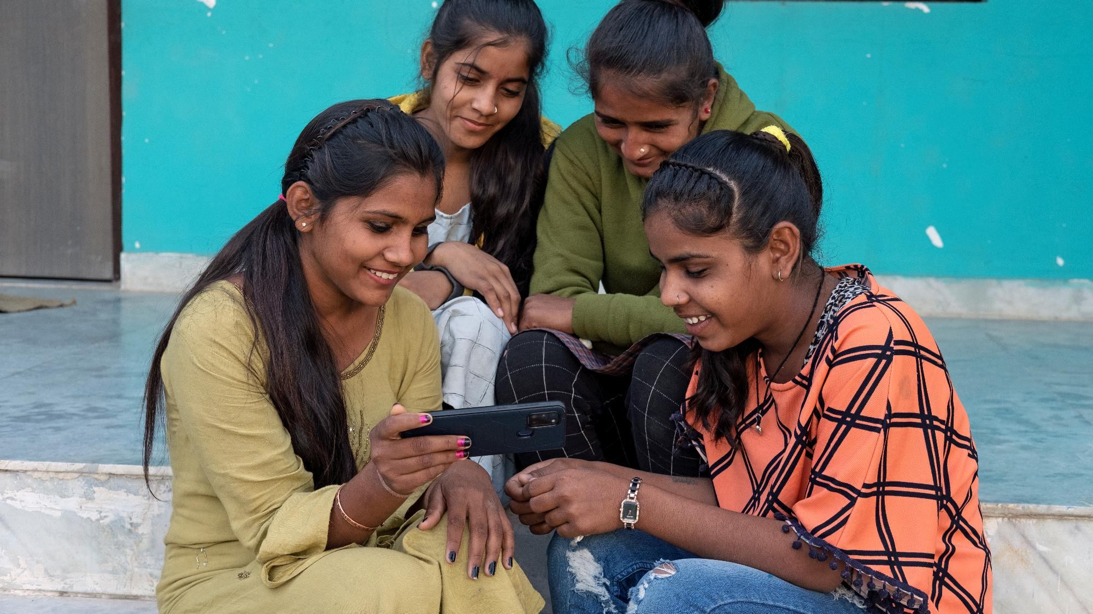
UNICEFUK/Brown
Notes:
Children read books in a village in Cambodia.
Unicef/Brown

Slide 2
Teacher slide
Contents
Slide 3 - Introducing World Book Day
Slide 4 - Articles for World Book Day
Slide 5 - Exploring World Book Day. Question
Slide 6 - Exploring World Book Day. Answers
Slide 7 & 8 - Primary activities
Slide 9 & 10 - Secondary activities
Slide 11 - Reflection
Instructions
This flexible resource is intended to provide you with some easy to use, appropriate rights-related learning to share with your children, their families and your colleagues.
Please edit out non-relevant slides or tasks before sharing with students.
Please check the content works for your learners and feel free to add any content that would make the material more relevant to your setting.

Slide 3
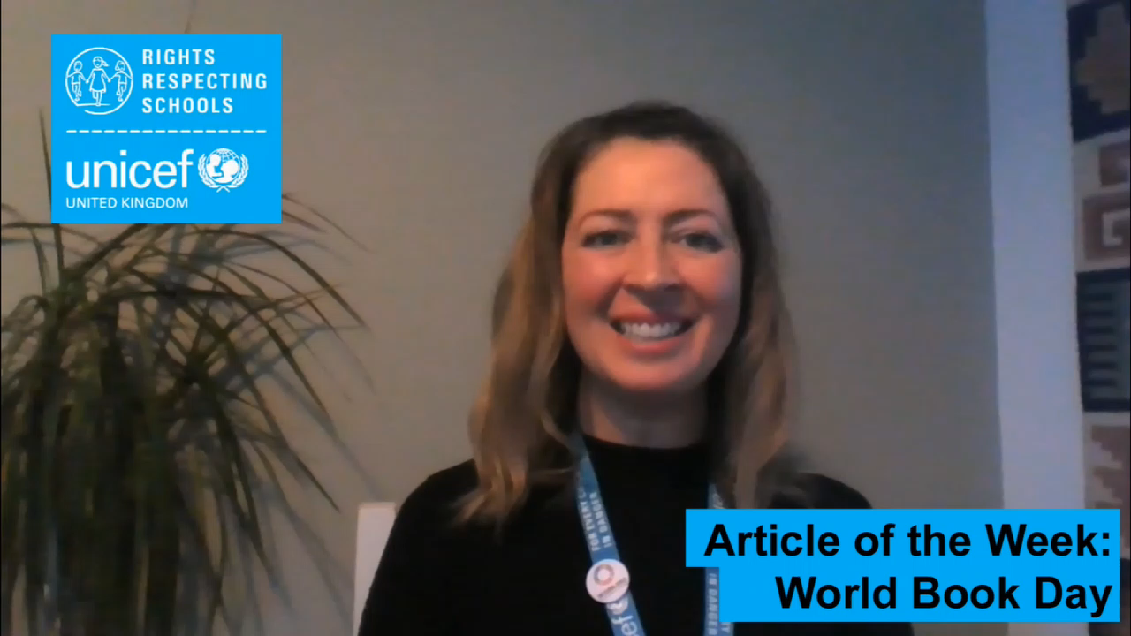
Introducing World book DAY
World Book Day was created by UNESCO on 23rd April 1995 as a worldwide celebration of books and reading.
It is marked in over 100 countries around the globe. The first World Book Day in the UK and Ireland took place in 1997 to encourage young people to discover the pleasure of reading.
World Book Day is also now a charity with a mission to help change children’s lives by promoting reading for pleasure, offering every child and young person the opportunity to have a book of their own.
This year (2021) marks the 24th year of WBD on 4th March and we hope you can find many different ways to enjoy reading.
There are lots of connections between World Book Day and your rights, especially your rights to access reliable information, the right to develop your talents and abilities and the right to relax and play.
Jenny, RRSA Professional Adviser, introduces
World Book Day
Watch Jenny on YouTube

Slide 4



articles for WORlD BOOK day
This week’s activities link to the following articles:
Article 17 - access to information from the media
Every child has the right to reliable information from a variety of sources, and governments should encourage the media to provide information that children can understand. Governments must help protect children from materials that could harm them.
Article 29 (goals of education)
Education must develop every child’s personality, talents and abilities to the full. It must encourage the child’s respect for human rights, as well as respect for their parents, their own and other cultures and the environment.
Article 31 (leisure, play and culture)
Every child has the right to relax, play and take part in a wide range of cultural and artistic activities.

Slide 5
EXPLORING WORLD BOOK DAY
How many different reasons can you think of why reading books is important?
Note your ideas down and then compare your thoughts with the next slide.

Slide 6
How many of these did you get?
To learn new things about the world
To enjoy a story that makes you laugh, cry or get excited
To use your imagination
To share with friends and family
To find out new things
To get ideas for your own writing and stories
To calm you down
To help get to sleep
To inspire you
Did you get any others?

Slide 7
Activity Time
World Book Day is all about enjoying brilliant books. Have you ever watched Dog Loves Books? Dog and Pug have lots of adventures as they jump into books – can you think of a favourite book you'd love to jump into?
Talk to someone about why it's your favourite, write a book review or even write yourself into the story!
Where’s the most unusual place you can go to read a book? Maybe you have a favourite spot in the garden? Or a special place in your house somewhere? Tell a family member or a friend why you enjoy reading in this place.
All these activities are related to…
Do you think books are a bigger or smaller part of our lives than they used to be decades ago? Talk to a parent, grandparent or another trusted adult about their experience of books and compare it to your own and to other children in your class.
Read a story aloud to a family member – remember to use expression to make the story exciting and fun. Show them the pictures and talk about what is happening in the pictures too.
You don’t need to do every single activity
but if you have time you can do more than one.
Primary

Slide 8
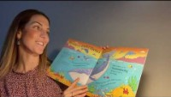
Activity Time
Harry Potter is one of the most famous children’s book characters. Even though he a wizard, Harry wasn’t always able to enjoy his rights. Talk with your class about some of the rights Harry wasn’t able to enjoy then make up a spell Harry and his friends could cast to make everyone respect rights.
.
.
Year 4 children at William Tyndale School worked with professionals to create this amazing animated version of a book: The Flamingo Who Didn’t Want To Be Pink. Could you make your own animation or comic strip version of a book you’ve read?
.
.
Books are a great way to find out new things, like this one about whales: Could a Whale Swim to the Moon?
Make a note of 3 interesting facts from the story.
Do you know any facts about a different subject that you can share with the class?
You have the right to develop your personality, talents, and abilities (Article 29), so what would you like to become great at? Imagine you’ve become famous for your talent. Design the cover of your autobiography. You’ll need a title, picture for the front and then a short blurb for the back. Share this with your teacher or your class.
.
Primary

Slide 9
Activity time
“We don’t need books anymore because we have the internet.”
Do you agree with the statement? What reasons do you see, for and against? Maybe you could have a debate in your class or with people at home?
World Book Day is about promoting reading for enjoyment. This ties in with your right to relax and play (Article 31), so what type of books do you enjoy most? What is your favourite book? Who is your favourite character? Talk to someone in your home about your answers or write a book review about your favourite book.
These activities will help you
understand how...
…can relate to World Book Day.
You don’t need to do every activity, just do as many as you can.
Children’s author Cressida Cowell suggests that reading for pleasure is vital to educational success. Why do you think that might be? Read this article by Cressida Cowell giving advice to parents – do you agree with her tips? Come up with your own ideas to encourage more reading for pleasure.
Create a list, collage or video titled Ten books that changed the world and why. You can ask other people for ideas and do your own research. Share your list with your class.
Secondary

Slide 10

Activity time
Watch this video of some amazing libraries. What would the world's best school library look like to you? Design your own, this could be drawing or a model of some sort, or talk to someone about it. What features could you include to make sure that everyone was able to access their rights in the library?
Survey the people in the your home or class about the books they’ve read and produce a report on your findings. You might focus on the number of books, the types of books or which authors are most popular, for example.
Do you know the character Scout from To Kill a Mockingbird, Auggie from Wonder, or even Cinderella? You can look at most characters in books from the point of view of whether or not they get to enjoy all their rights. Pick a character from a book who made an impression on you and create a word cloud about their rights.
Article 17 isn’t just about your right to information, it’s a right to reliable information. Which of these sources would you trust more: Facebook, Encyclopaedia Britannica, Wikipedia or a tabloid newspaper? Not all words and opinions are equal - play this fake news game to see how easy it is to make something look believable.
Secondary

Slide 11
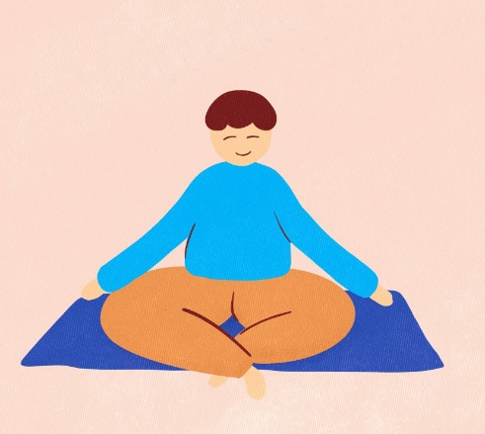

Reflection
Find somewhere peaceful and quiet. Relax and let your mind be still. Focus on the sounds of your breath.
Now lets consider…
Think about a favourite book, what makes it special to you?
How could you make more time for reading?
Would it be good to encourage others to read more too?
Spend a couple of moments thinking about this and then write down your thoughts and if you want, share this back with your teacher, friends or family.
Take a moment to breath…
Press play below to do a breathing exercise and reflect on this week’s topic.
Uncief/UN0376033

