Slide 1
UNICEF/Prinsloo
Notes:
Children hold hands in Rumonge Province, Burundi.
UNICEF/Prinsloo

Slide 2
Slide 3 – Resources for Teachers and Facilitators
Slide 4 – Introducing International Day for the Elimination of Racial Discrimination
Slide 5 – Introducing the articles
Slide 6 – Exploring International Day for the Elimination of Racial Discrimination - Question
Slide 7 – Exploring International Day for the Elimination of Racial Discrimination - Answer
Slides 8&9 – Primary Activities
Slides 10&11 – Secondary Activities
Slide 12 – Reflection

Slide 3
Resources for Teachers and Facilitators
Some of the activities in this week’s pack may be difficult for your pupils to discuss. The following links can help you explore this topic and prepare your approach to facilitating work on race and racism in your school:
Talking to your kids about racism | UNICEF
School Resources | The Anti-Racist Educator
How to talk to children about racism | NSPCC
Show Racism the Red Card | Guidance for Initial Teacher Training
How should I talk about race in my mostly white classroom? | ADL

Slide 4
INTRODUCING INTERNATIONAL DAY FOR THE
ELIMINATION OF RACIAL DISCRIMINATION
“Youth standing up against racism” is the 2021 theme of the International Day for the Elimination of Racial Discrimination on 21st March.
It engages the public through #FightRacism, which aims to foster a global culture of tolerance, equality and anti-discrimination and calls on each and every one of us to stand up against racial prejudice and intolerant attitudes.
The International Day for the Elimination of Racial Discrimination first started to recognise the day the police in Sharpeville, South Africa, opened fire and killed 69 people at a peaceful demonstration against apartheid in 1960.
Since then the apartheid system in South Africa has been dismantled. And while progress has been made in many countries to abolish racist laws and practices, too many people all over the world still experience discrimination based on their race.
Frances introduces International Day for the Elimination of Racial Discrimination
Click here to watch on YouTube

Slide 5
LINKED UNCRC ARTICLES
There are three articles that provide a particularly strong link this week:
Article 2 (non-discrimination)
The Convention applies to every child without discrimination, whatever their ethnicity, gender, religion, language, abilities or any other status whatever they think or say, whatever their family background.
Article 12 (respect for the views of the child)
Every child has the right to express their views, feelings and wishes in all matters affecting them, and to have their views considered and taken seriously.
Article 30 (children from minority or indigenous groups)
Every child has the right to learn and use the language, customs and religion of their family, whether or not these are shared by the majority of the people in the country where they live.

Slide 6
EXPLORING INERNATIONAL DAY FOR THE
ELIMINATION OF RACIAL DISCRIMINATION
Racism is unfair and unacceptable.
How should everyone be treated equally to eliminate racism?
UNICEF/Truong Viet Hung
Notes:
UNICEF/Truong Viet Hung

Slide 7
How many of these did you get?
Being treated with respect and dignity no matter who you are or where you come from.
Being given the same chance to do well and succeed in life as everyone else.
People stand up against racism if or when it occurs.
People are interested in you and what makes you the person you are.
You learn about different people’s experiences of the world.
To be allowed to join in and play with any other children you choose.
To know that you matter as a person no matter who you are.
In summary – to have all your rights met no matter who you are.
Did you get any of these? What other answers did you have?

Slide 8
We all have similarities and differences.
Draw a picture of yourself and a friend or family member.
Can you think of 5 things about you both that are the same and 5 things that are different? Think about both how you look and your personalities.
Do you know the book 'Shine' by Sarah Asuquo?
Discuss as a class what the story means to you and what lessons other children could learn from Kai.
Imagine that someone is being treated unfairly and is not allowed to go to school, to have friends and to play because of the colour of their skin or how their hair looks. *
How would this feel? What would you say and do to help them?
Discuss this with the people in your class.
21st March is the International Day for the Elimination of Racial Discrimination.
Look up the meaning of the words 'elimination', 'race' and 'discrimination'. Explain what the words mean to a member of your family or a teacher.
Look up Articles 2, 12 and 30 in the CRC. How do these rights help us to speak up against racism? Discuss this as a class.
Notes:
* When working on this exercise please recognise that some children and young people might find talking about their experiences upsetting.

Slide 9
Many celebrities have spoken about their own experiences of racism.
Research and write a short biography about someone famous who has overcome racism to succeed in their chosen career.
Some examples are: Michelle Obama, former First Lady of the US, Nadiya Hussain, Great British Bake Off winner, Marcus Rashford, England footballer.
Statues were removed from cities across the UK in response to the Black Lives Matter movement, such as the statue of Edward Colston in Bristol because he had links to the slave trade.
Research which statues of other historical figures have been removed and why. Then write a piece of persuasive text either for or against this action.
You can find out more about the removal of statues here.
Watch this film of a boy called Balraj experiencing racism.
What would you do if you were in the same football team as Balraj and you witnessed the racism?
Listen to Tiana reading her poem.
Write your own poem to express how you feel about racism.

Slide 10
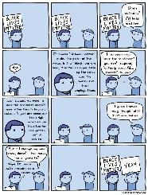
There are often examples of racism and other discrimination in the news. Racism isn’t always about colour.
Read this recent example where a holiday company was found to be "directly discriminating on the basis of race“ in their treatment of Gypsy and Traveller communities.
Discuss with friends, or as a class what it might feel like to experience direct discrimination because of your race.
At the inauguration of President Joe Biden, youth poet laureate Amanda Gorman read the poem she had created titled 'The Hill We Climb’. Read the following extract and discuss with your friends what you feel this means.
"...And yes, we are far from polished, far from pristine, but that doesn’t mean we are striving to form a union that is perfect. We are striving to forge our union with purpose. To compose a country committed to all cultures, colours, characters, and conditions of man. And so we lift our gazes not to what stands between us, but what stands before us. We close the divide because we know to put our future first, we must first put our differences aside.”
Discuss this cartoon about 'Black Lives Matter' with your teachers and/or family.
Why do you think there is a need to focus on the experiences of black people at the moment?
Watch this video about a young woman who started a 'black lives matter' protest in Manchester.
What could you do in your everyday life to challenge racism?

Slide 11
Watch this video of young people asking questions about racism.
The adults giving their answers suggest different ways to tackle racism – which of the suggestions do you think is most important and why?
They all have different views about whether we should continue to have 'black history month’. Explain how their views differ and which one do you agree with most?
Look at the resources on Racism and Discrimination on the Unicef Youth website.
Have a go at one of the activities. Could you lead a lesson or an assembly using some of these ideas?
How does your school community show that it values difference and diversity?
How well does it make everyone feel included? *
Have a open and honest discussion with your class.
Can you agree on two positives and one thing that can be improved and share these with the school’s leadership?
The Coronavirus pandemic has seen a rise in racist attacks on certain communities around the world.
Read this article about the experiences of some Asian communities in Britain and write a persuasive piece about how to tackle this so it does not become a long term problem. You may wish to think about issues of longstanding racism that have happened in the past to make links.
Notes:
* When working on this exercise please recognise that some children and young people might find talking about their experiences upsetting.

Slide 12
REFLECTION
Try to find somewhere to be quiet and still. Take a couple of minutes to think…
Every single human being is different.
Why is this a good thing for each of us and for the world?
How can we respect the differences we see in the people around us?
This video shows a class activity that demonstrates how different experiences in life can give some people a ‘head start’ while others are held back.
Lot’s of things, including a person’s race, can affect this. Watch the video and discuss what you think with your class.

Slide 13
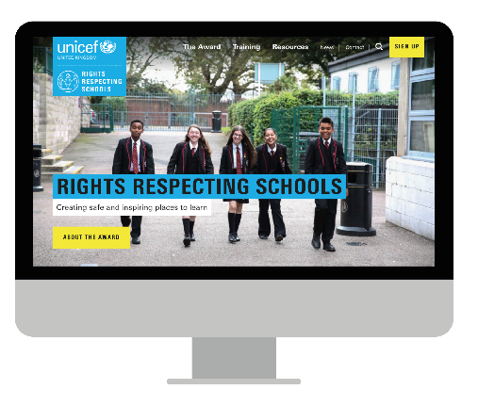
MORE INFO…
RRSA WEBSITE
For more information or to download previous Article of the Week packs please visit the RRSA website by clicking the link below
CLICK HERE

