Slide 1
UNICEF/Bukhari
Notes:
UNICEF/Bukhari
A four year old boy receives the polio vaccine in Lahore, Pakistan.

Slide 2
Slide 3 – Introducing World Immunisation Week
Slide 4 – Introducing the articles
Slide 5 – Exploring World Immunisation Week - question
Slide 6 – Exploring World Immunisation Week - answers
Slides 7&8 – Primary Activities
Slides 9&10 – Secondary Activities
Slide 11 – Reflection

Slide 3
INTRODUCING WORLD IMMUNISATION WEEK
World Immunisation Week is celebrated every year in the last week of April.
It aims to raise awareness of vaccines and their important role in protecting people of all ages against potentially life-threatening diseases.
Immunisation saves many millions of lives every year, yet there are millions of children in the world who are not getting the vaccines they need, and many people miss out on vaccines as they get older.
Covid-19 has made us all aware of the importance of vaccinations in protecting our lives, health and wellbeing. This year’s theme is ‘Vaccines bring us closer’ recognising how important it is that the world works together to improve the health of everyone.
UNICEF is playing a leading role in this.
Geri Introduces World Immunisation Week
Click here to watch on YouTube

Slide 4
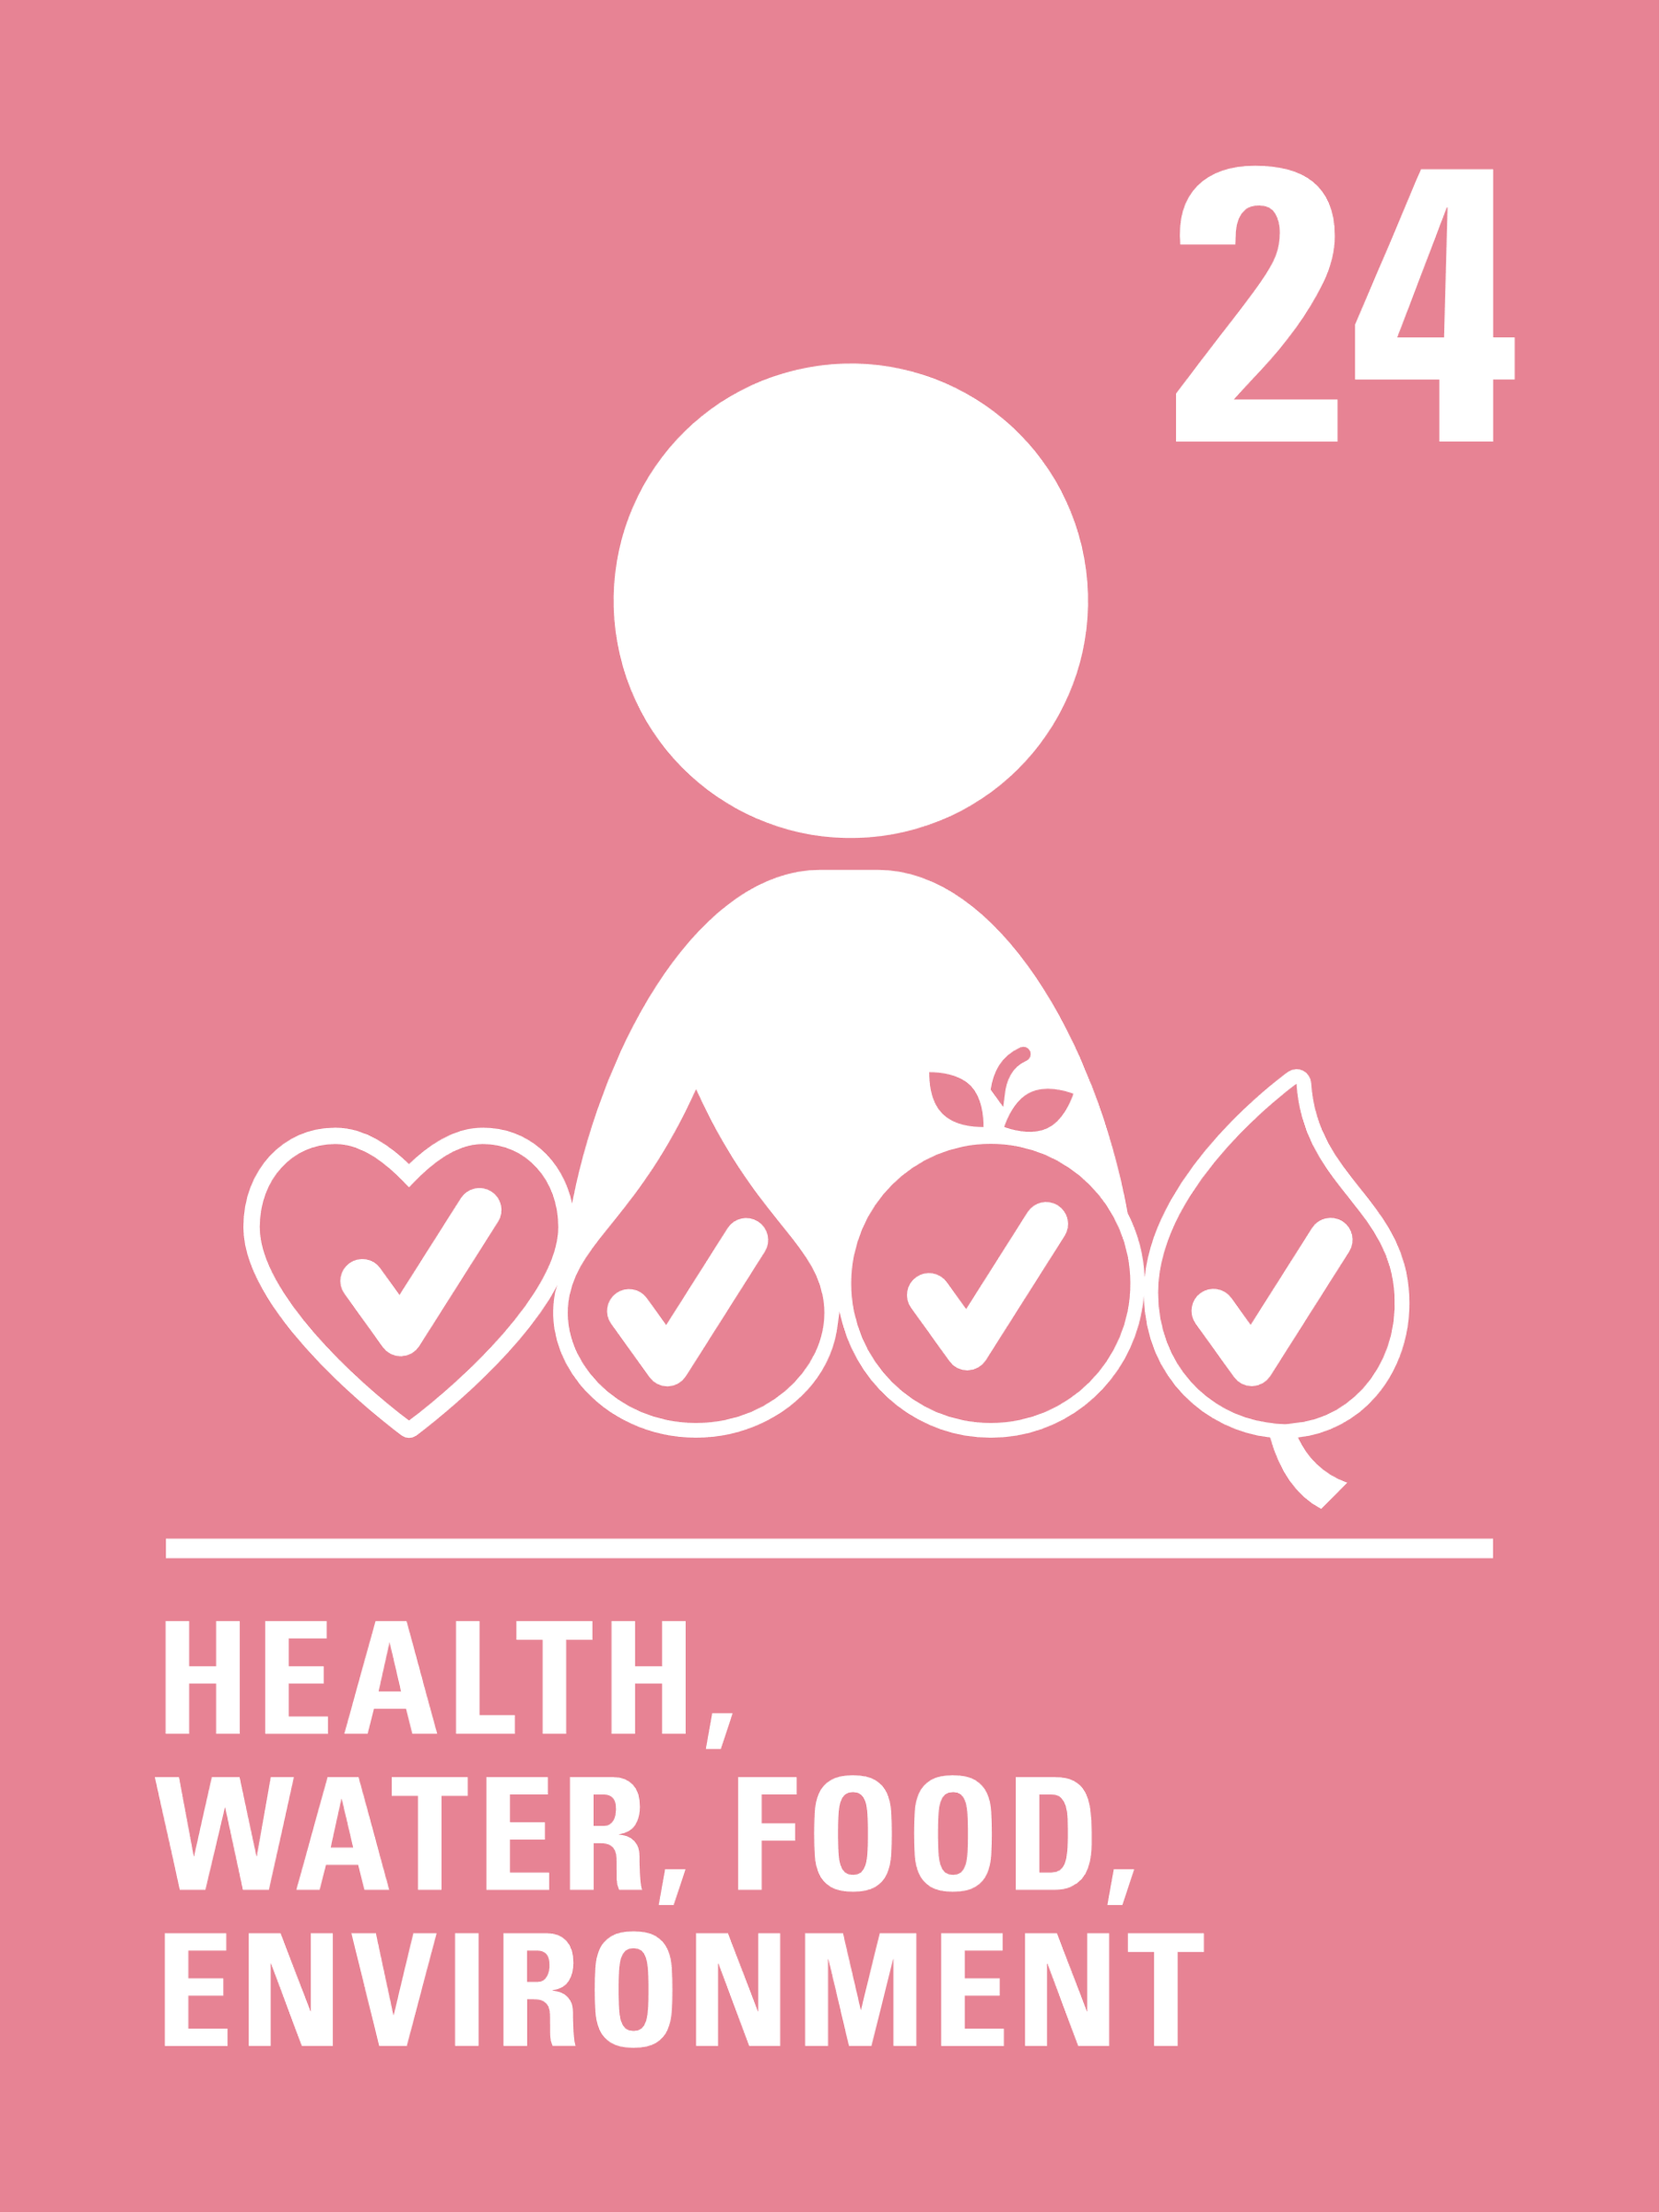
LINKED UNCRC ARTICLES
There are two articles that provide a particularly strong link this week:
Article 6: Every child has the right to life.
Governments must do all they can to ensure children survive and develop to their full potential.
Article 24: Every child has the right to the best possible health.
Governments must provide good quality health care, clean water, nutritious food, and a clean environment and education on health and wellbeing so that children can stay healthy. Richer countries must help poorer countries achieve this.
.

Slide 5
EXPLORING WORLD IMMUNISATION WEEK
How do you think vaccinations help children and young people enjoy their right to survive, be healthy and thrive?
UNICEF/Viet Hungi
Notes:
UNICEF/Viet Hung
Offloading first shipment of COVID-19 vaccines to Viet Nam. UNICEF Representative Rana Flowers is awaiting for the COVID-19 vaccines to be offloaded from the cargo plane.

Slide 6
How many of these did you get?
They help protect you against serious illnesses and even death.
They protect other people in your family and community against diseases.
They can help wipe out diseases completely like smallpox.
They can stop you missing out on your education through illness; this means you have more chance of doing well at school.
Children who are well are likely to have a happier childhood because they can see their friends and join in things.
They improve your life while you are growing up and as an adult.
Did you get any of these? What other answers did you have?

Slide 7
Doctors have a very important job in helping us have our vaccinations and stay healthy. Watch this video then talk about different ways that doctors help people. Draw pictures or make a shared collage of people who help us to stay healthy.
Vaccines stop us from catching some diseases and becoming very ill.
Draw pictures, make a poster or write a list of all the different things you can do to help to keep yourself healthy. .
Vaccines are one way to help us be healthy.
Write or draw an A to Z list of different ways that children can enjoy Article 24.
For example V is for Vaccinations, H is for hospitals. Compare your list with someone in your class.
Watch this video and then talk to someone about what you have found out or make a poster to show how vaccines work.

Slide 8
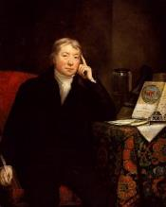
Talk with members of your family of different ages to try and find out which vaccinations were the same and which are different to those that children can get today and what the benefits of these vaccines are.
Produce a short report about what you find out and present to your class.
Make a poster that celebrates World Immunisation Week and how this links with Articles 6 and 24 of the CRC. You could also use this years’ theme ‘Vaccines bring us closer’ to help you create your poster.
Find out about Edward Jenner and how he discovered the idea of vaccinating people to prevent disease. This video may help you get you started.
Pretend that you are Jenner - write a letter to the scientists who have created Covid-19 vaccines to congratulate them.
Read these photo stories and watch the video at the end and then design and make a board game about the journey of a vaccine, perhaps like Snakes and Ladders.
WikiCommons

Slide 9
For many people getting a vaccine can be very difficult because they live in remote places. Read this article and watch ‘The Last Child’ video about the vaccine Cold Chain (a chain of precisely coordinated events in temperature-controlled environments to store, manage and transport vaccines) and UNICEF’s role in getting vaccines to people. Then write a job description for a health worker involved. What qualities would that person need?
Research a childhood disease like measles.
How is it caused? What are the side effects? How does vaccination help? You could interview parents, carers or grandparents and discover their experiences as part of your research. with a teacher.
This article shows the positive impact vaccines have had on the world.
After reading it, write down three key messages that you will remember and share with a friend.
Edward Jenner developed the first vaccinations in the 18th century. This is a drama about his life and work to find a cure for smallpox. After watching it, think about other life-saving discoveries that enable children to enjoy Articles 6 and 24. Share your thoughts with a friend.
WikiCommons

Slide 10
Scientists and researchers play a hugely important role in vaccine development.
They study and develop vaccines, monitor and modify existing vaccines, and study the overall safety of vaccines.
Do your own research and see if this is a career you might be interested in. What would you need to study? Then talk to your teacher or a friend about it.
This video ‘A Tale of Two Mothers’ tell different stories of vaccination experiences in South Africa. Watch the video and talk with a friend about how it made you feel. Is there anything you can do to raise awareness of the unequal access to vaccines and healthcare? UNICEF is part of a campaign to ensure fair access to Covid – 19 vaccinations around the world, find out more here and see if you can publicise this in your community.
People have vaccinations at different times and stages in their lives, beginning when they are babies. Some parents are worried about vaccinating their children.
Have a look at this video from the NHS that explains why vaccinations are important.
Organise a debate that explores the arguments for and against routine vaccinations for children and adults. Link your arguments to Articles 6 and 24 of the CRC.
Look at the picture story and watch the video at the end and then design a board game about the journey of a vaccine showing the difficult nature of the journey, perhaps like Snakes and Ladders.

Slide 11
REFLECTION
Take some time and find a space where you can be still and think about the following questions:
For over a year stories of life and death have been in the news every single day.
How do we show that we value and appreciate our rights to life and our health?
How could we help others to see the power of science and medicine to make life safer and better for us all?
How do you feel about the amazing protection we get from vaccines and other medicines?
UNICEF/Cho Mayak
Notes:
UNICEF/Cho Mayak
The South Sudan Minster of Health, Elizabeth Chuei, is receiving the COVID-19 vaccine at Juba Teaching Hospital where the launch of COVID-19 vaccination drive took place.

Slide 12
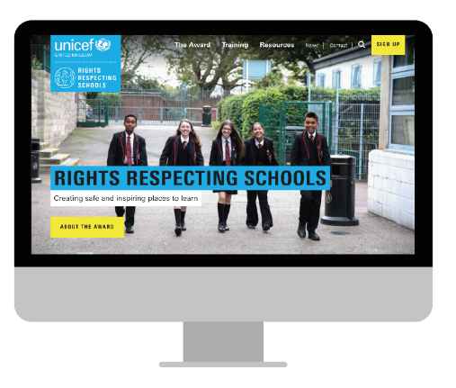
MORE INFO…
RRSA WEBSITE
For more information or to download previous Article of the Week packs please visit the RRSA website by clicking the link below
CLICK HERE

Slide 13
Thank you
UNICEF UK/Dawe

