Slide 1
UNICEF/Dejongh
Notes:
UNICEF/Dejongh
A boy returns to his UNICEF supported public inclusive school in Maroua, in the Far North of Cameroon, after it was closed for a few months due to the pandemic. He says: “I was bored when the school was closed, and I missed my friends. I realize how much I like school and studying at home is not my thing. I love mathematic. My dream is to become a police officer.”

Slide 2
Slide 3 – Guess the article
Slide 4 – Introducing Article 29
Slide 5 – Exploring Article 29 - Question
Slide 6 – Exploring Article 29 –
Answers
Slides 7&8 – Primary Activities
Slides 9&10 – Secondary Activities
Slide 11 – Reflection

Slide 3
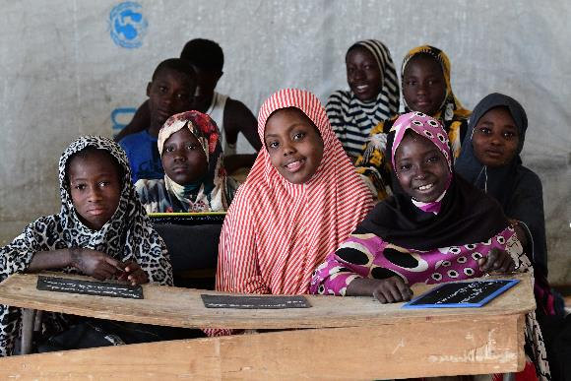
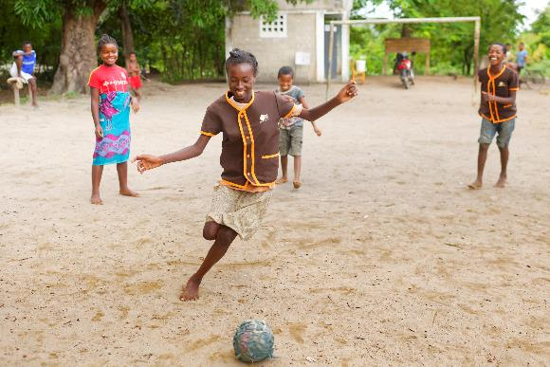
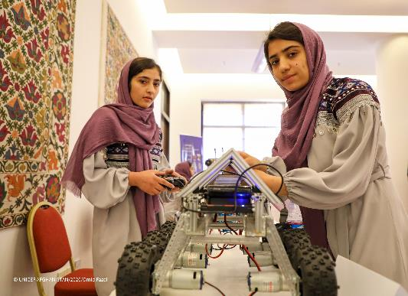
Guess the Article
These pictures provide a clue to this week’s article.
How do these pictures help you? Can you guess how they are linked together?
Write down your thoughts or discuss with someone in your class.
UNICEF/Dejongh
UNICEF/Ramasomanana
UNICEF/Fazel
Notes:
1. UNICEF/Dejongh - Young girls attend a UNICEF constructed school in a camp, in Niamey, the capital of Niger.
2. UNICEF/Ramasomanana – School children in Madagascar play football during their break
3. UNICEF/Fazel – Members of the Afghanistan’s Girls’ Robotics Club exhibit their work

Slide 4
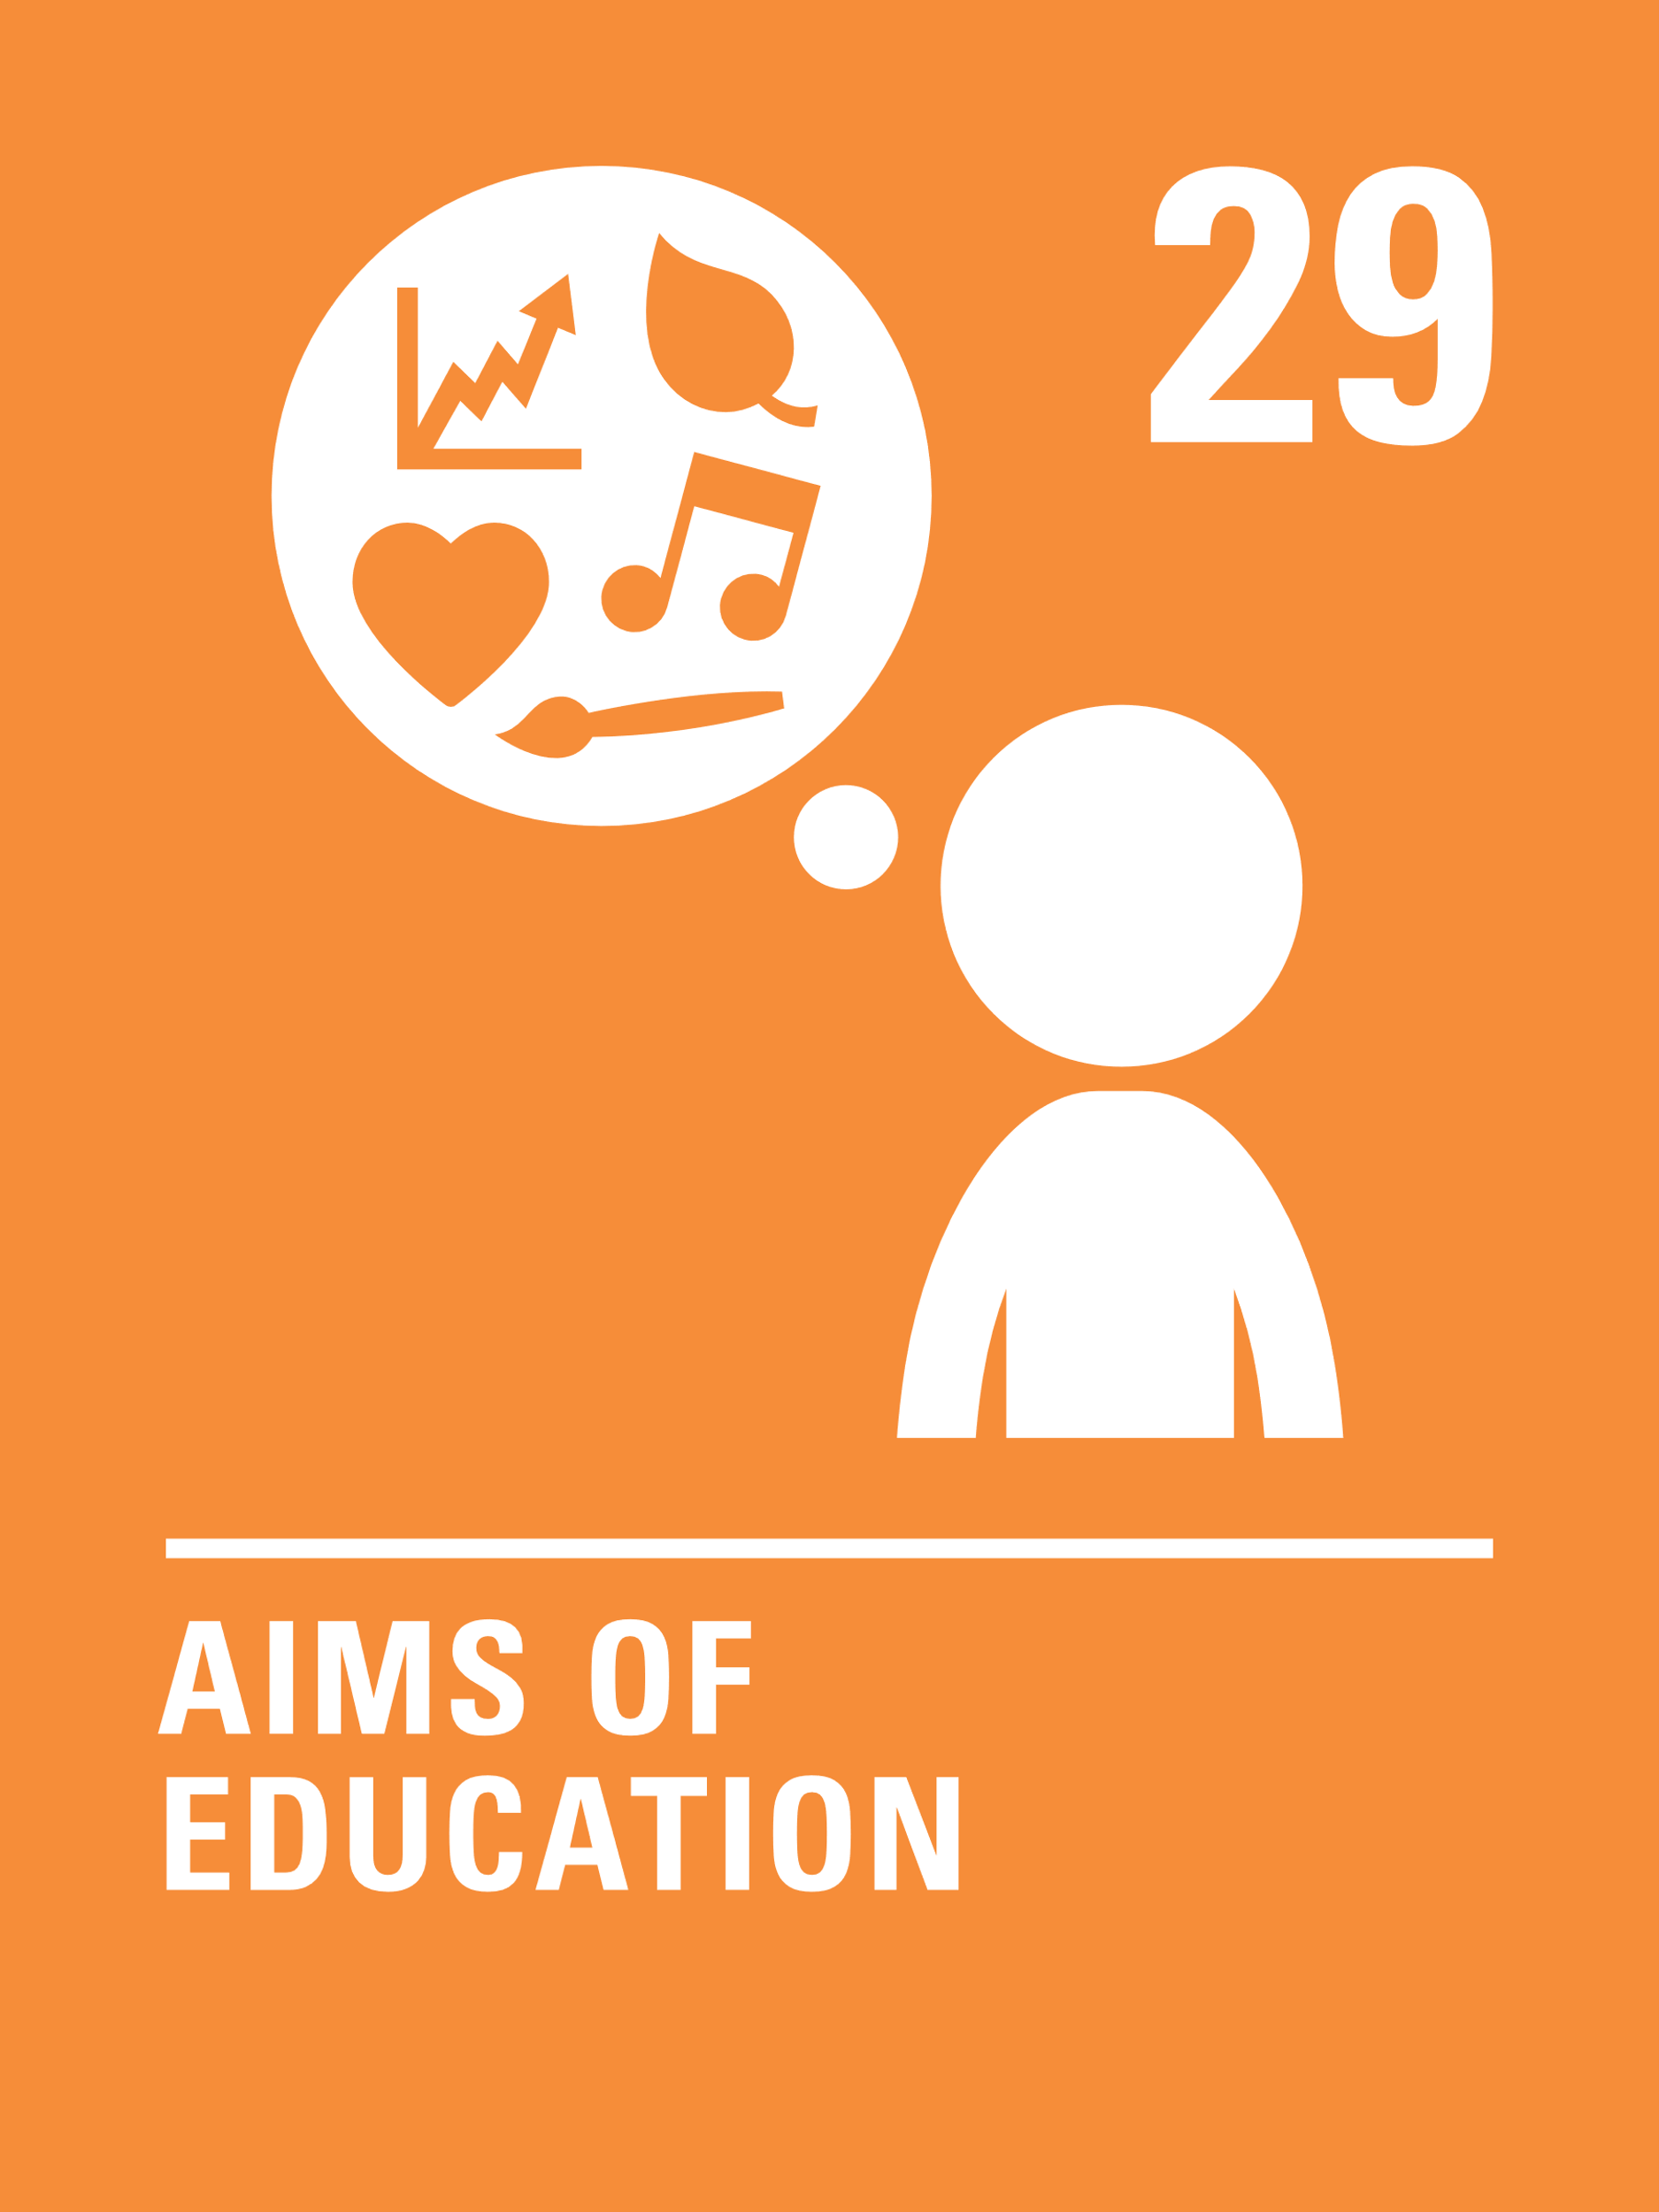
INTRODUCING ARTICLE 29
Kathy introduces Article 29
Article 29 – goals of education
Education must develop every child’s
personality, talents and abilities to the
full. It must encourage the child’s respect for human rights, as well as respect for their parents, their own and other cultures, and the environment.
Click here to watch on YouTube

Slide 5
EXPLORING ARTICLE 29
What are your hopes for your future?
How does education help you reach these goals?
UNICEF/Houser
Notes:
UNICEF/Houser
A child learns through painting at a UNICEF supported early childhood development and care centre in Rwanda.

Slide 6
How many of these did you get?
To be the best I can be
To spend time with friends
To travel the world
To take part in sport or activities that I enjoy
To be healthy, happy, safe
To feel included and have a voice
To be part of a community
To protect the environment
To keep learning new skills
To get a job I enjoy
To grow in confidence
To find out more about different cultures and traditions.
To learn how to work as part of a team
What others did you think of?

Slide 7
Your education should help you develop all of your skills and help you to shine.
Draw a picture showing how you love spending your time.
Watch this short video and write a list or discuss the importance of being in a school that respects your rights.
Lots of clubs and activities that help develop your talents have been closed or been online during the pandemic.
What are you most looking forward to doing again?
Create a poster to share with your class about what you enjoy doing the most.
Think about who has supported your learning or been a role model for you.
Why have they been so
important to you?
Write a thank you letter or card and send to them if you wish.

Slide 8
The Big Ask is a survey for children and young people aged 4-17 in England.
It gives you a chance to have a say on the things that matter to you in your life, now and in the future.
Complete The Big Ask here.
Article 29 says that education must encourage respect for the environment. Watch this video about schools built from recycled plastic in the Ivory Coast.
Discuss how you think these new classrooms will help children enjoy their right to an education and help the environment. Which other rights do you think are supported through this project?
In June, a group of world leaders will come together to discuss issues, such as education, health and the environment. This meeting is called the G7 (Group of 7). A focus this year is promoting the importance of every girl around the world to access their right to a quality education.
In your class, look at this Declaration and discuss why education is important, and what you will do about it. Please send your completed Declaration back to us and we will make sure your voice is heard.
A growth mindset helps you develop resilience and explores how
we all develop and learn through our experiences.
Watch this video then write a poem or a story about a character who overcomes their fears or a challenge.

Slide 9
Think about who has supported your learning or been a role model for you.
Why have they been so important to you?
Write a thank you letter or card and send to them if you wish.
Watch this short video and write a list or discuss the importance of being in a school that respects your rights.
Lots of clubs and activities that help develop your talents have been closed or been online during the pandemic.
What are you most looking forward to doing again?
Create a poster to share with your class about what you enjoy doing the most.
During the pandemic we have taken part in online learning and activities.
This has not suited everyone.
Create a list of the positives and negatives of doing things online and discuss this with your class.

Slide 10
The Big Ask is a survey for children and young people aged 4-17 in England.
It gives you a chance to have a say on the things that matter to you in your life, now and in the future.
Complete The Big Ask here.
In the workplace many employers use a 70:20:10 model based on the thinking that 70% of learning comes from your experience of doing things, 20% from watching and observing others, and 10% from formal classes and courses.
Reflecting on your own experience draw a diagram to show how you have developed your skills and talents. Do they fit with this model? Share your findings with your class.
In June, a group of world leaders will come together to discuss issues, such as education, health and the environment. This meeting is called the G7 (Group of 7). A focus this year is promoting the importance of every girl around the world to access their right to a quality education.
In your class, look at this Declaration and discuss why education is important, and what you will do about it. Please send your completed Declaration back to us and we will make sure your voice is heard.
Read this information about Global Goal 4: Quality Education.
Discuss the positives and the challenges ahead.
In a small group or as a class take action to raise awareness of the need for a quality education.

Slide 11
REFLECTION
How do you feel about being back at school? What is different in school because of the pandemic? Are there things you miss about learning at home?
How can we ensure that all children access their right to an education that encourages them to respect:
Human rights
Their parents and their own cultures
The environment
Each other
UNICEF/Abdul
Notes:
UNICEF/Abdul
A post that acts as a 'talking compound' at a Primary School in Uganda, encouraging parents to value the education of their daughters more than the bride price they get from marrying them off.

Slide 12
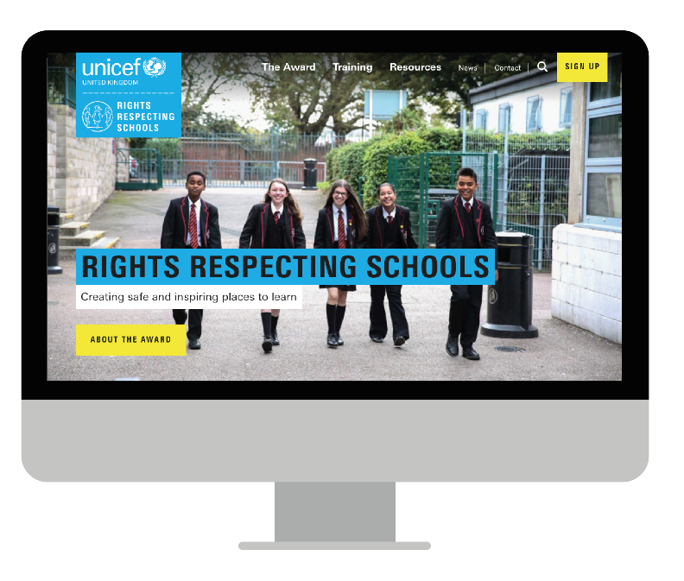
MORE INFO…
RRSA WEBSITE
For more information or to download previous Article of the Week packs please visit the RRSA website by clicking the link below
CLICK HERE

