Slide 1
UNICEF UK/Dawe
Notes:
UNICEF UK/Dawe
Students at a Gold Rights Respecting School.

Slide 2
Teachers Introduction to this week’s Pack
This Article of the Week pack (published 13.05.21) combines Article 19 – protection from violence, neglect and abuse, and 34 – sexual exploitation. We chose to combine these articles to help facilitate discussion and activities around consent, sexual abuse, harassment and exploitation in school.
As part of your work as a Rights Respecting School you will understand that all the rights in the UNCRC are there for every child and that rights are indivisible from one another. It is important not to ignore some of the articles that may be more challenging to explore in the context of learning.
Please use your professional judgement about the choice of activities from this pack, based on your existing provision of ‘relationship, health and sex education’ and your knowledge of your pupils, their context and their capacities for understanding.
Secondary activities refer to recent media coverage of both longstanding and current issues of sexual exploitation and abuse among and between young people. We hope your school will help students navigate this conversation and that language based on children’s rights will provide a useful framework for discussion.
In the context of these articles, we would encourage you to review, with pupils, the breadth and accessibility of information and signposting about how your pupils can access the support services or help they need, both in and out of school, with regards to all aspects of their safety and wellbeing.
Best wishes,
The Rights Respecting Team, UK Committee for UNICEF

Slide 3
Slide 4 – Guess the articles
This flexible resource is intended to provide you with some easy to use, appropriate rights-related learning to share with your children, their families and your colleagues.
Please edit out non-relevant slides or tasks before sharing with students. Please check the content works for your learners and feel free to add any content that would make the material more relevant to your setting.
This pack also provides links to learning resources from third parties and from the UK Committee for Unicef (UNICEF UK) that you can access for free.
Slide 5 – Introducing the articles
Slide 6 – Question around the articles
Slide 7 – Some possible answers
Slides 8&9 – Primary Activities
Slides 10&11 – Secondary Activities
Slide 12 – Reflection

Slide 4

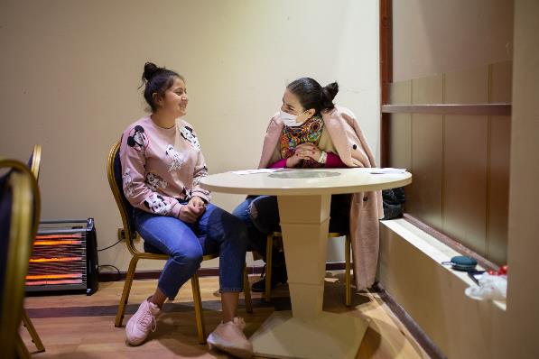
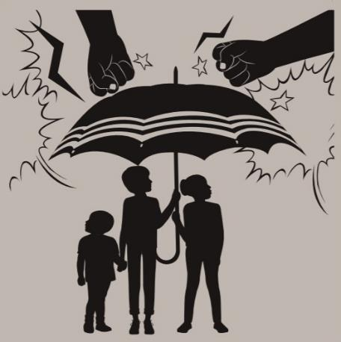
Guess the Article
These pictures provide a clue to this week’s article.
How do these pictures help you? Can you guess how they are linked together?
Write down your thoughts or discuss with someone in your house.
NSPCC/ChildLine
Unicef/Mahari
Notes:
From left to right:
The ChildLine logo
Psychologist Lusine Aghabekyan is talking with a girl from Nagorno Karabakh, temporarily residing in a shelter in Armenia. Image credit Unicef/Mahari
The image to represent 'protection' from the UNICEF UK Rights Respecting Schools 'Wants and Needs' activity pack.

Slide 5


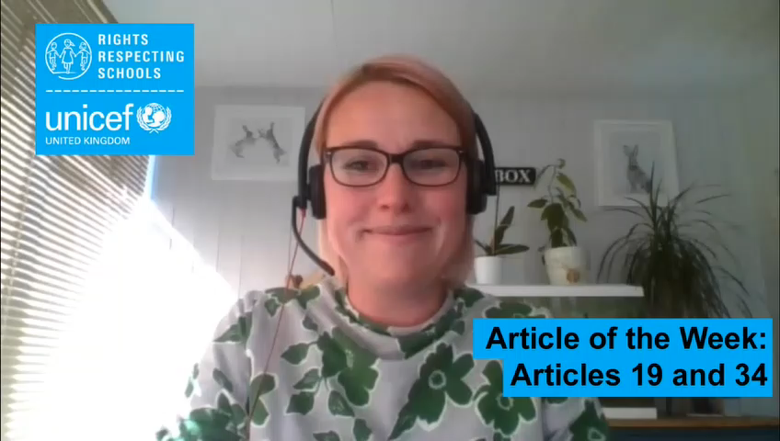

INTRODUCING ARTICLES 19 AND 34
Sarah, Head of Safeguarding at UNICEF UK introduces this pack
Article 19 – protection from violence,
abuse and neglect
Governments must do all they can to ensure that children are protected from all forms of violence, abuse, neglect and bad treatment by their parents or anyone else who looks after them.
Article 34 – protection from sexual abuse
Governments must protect children from all forms of abuse and sexual exploitation.
Click here to watch on YouTube

Slide 6
EXPLORING ARTICLES 19 AND 34
What do you need to feel safe and protected?

Slide 7
How many of these did you get?
To be confident that adults take your safety seriously and do all that they can to keep you safe.
Having a home that you feel safe and secure in.
To be able to talk honestly about where, when and why you might not feel safe and know that adults will work to put this right.
For everyone to consider what behaviours need to change so that all children and young people feel safe.
To know that the government prioritises children's safety and wellbeing when making decisions.
What others did you think of?
Being able to talk about your emotions and feelings
Having the information to know how to keep safe, including online.
To know who to talk or what to do if you don’t feel safe.
Having people around you who listen to your worries or concerns.
Feeling you can trust adults who care for you.

Slide 8
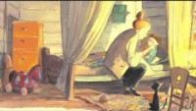
Who are all the people in your life who help you to get your right to be safe and protected - at home, at school and in your community? Draw a picture with you in the middle and all these people around you.
Have a look at this story: ‘Some Secrets Should Never Be Kept' by Jayneen Sandersand. In class, discuss the different people you could tell if there is something you need to talk about.*
You probably talk about ‘trusted adults’ in school. Write a list of words or phrases about what trust feels like and looks like to you.
Use some of your ideas to make a piece of art or write a poem about trust. You could mention Article 19.
When you are in school there are lots of adults to talk to if you are not feeling safe or something is wrong in your life. You have heard of Childline but do you know much about their work? Find out more on their website. Share some new facts you've learnt with your teacher or the class.
Notes:
* Review this video before sharing with your class.

Slide 9
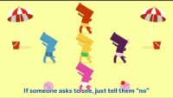
Article 19 is about protection from all sorts of harm and Article 34 is about protection from sexual exploitation. When your school teaches you about healthy, relationships, saying ‘no’, having respect for each other and being safe online, they are helping to protect you from many types of harm including sexual exploitation.
As a class, discuss why this is so important to know as you grow up.
Sometimes children don’t treat each other with respect. Have a class discussion about how this might make a person feel. Which rights might be affected?
Make a poster or make up an acrostic poem for the word RESPECT to highlight the importance of everyone using respectful language with each other and what a child should do if they think someone is making inappropriate comments to them or about them.
You might have watched this ‘PANTS’ video in school. Watch it with your class and have a look together at the NSPCC information here. The letter N in PANTS is for ‘No means No’ How would you explain this to a younger child? Discuss your ideas in class.
Hopefully your school feels like a safe place with lots of trusted adults. Many children go to clubs, classes or groups that are nothing to do with school. How many can you think of? Have a discussion in class about how children can be safe in these different settings and what they should do if something is bothering them.

Slide 10
Some governments empower schools to take measures to protect their students – this can include searching and screening pupils for dangerous or inappropriate items like drugs, alcohol, or weapons. How do you feel about this? Could this be a topic for discussion between adults and young people that forms the basis of a policy that respects students’ privacy but also keeps students safe. If so, have a go at drafting such a policy or expressing your thoughts through poetry.
What are the five most important things your school does to protect your rights to be safe from all kinds of harm and exploitation? Write a list and compare your list with others in your class.
In January 2019, UNICEF presented the #ENDviolence Youth Manifesto to ministers at the Education World Forum to help keep children safe in school. Have a look at the manifesto. Are there things in the manifesto that are relevant for your school or local community? Have a go at writing a manifesto to help keep young people safe at your school or in your local community.
All the learning you do around personal, health, relationships and sex education helps you to be safe and protected from many harms including sexual exploitation. Discuss how the knowledge and skills you gain in these areas help to empower and protect you. Think about other skills and qualities you develop in school too such as confidence and self-esteem.

Slide 11
The idea of consent and the importance of being able to say ‘no’ may be something you have learnt about. Think about all your rights – which of them relate to your understanding of consent? Work on this with a partner and then share ideas in a form or class discussion.
‘Mental health is as important to a child's safety and wellbeing as their physical health’ (NSPCC).
It’s not always easy for young people to speak about things that are worrying them. Consider starting a Student Wellbeing group in your school where young people can share ideas about what helps them to improve their mental health and to share sources of information, such as Young Minds and CAMHS, that aim to help with mental health problems such as depression, anxiety, self-harm and eating disorders.
A growing number of children and young people have revealed they have been sexually abused or harassed at school.
Schools should be safe places where people treat each with dignity and respect. Abuse should never be dismissed as ‘boys being boys’ or ‘banter’ but seriously tackled. What systems are in place in your school for discussing and addressing this issue? What changes, if any, need to take place? Think of three key recommendations you could take to your School Council or Headteacher to ensure people are treated with dignity and respect.
Article 34 refers to protection from sexual exploitation. Sadly, this affects some children and young people all around the world including in the UK. Look up the word ‘exploitation’. Discuss as a class what it means and consider how different types of sexual exploitation cause harm to a child and might affect many of their other rights.

Slide 12
REFLECTION
Try to find somewhere peaceful and spend a few minutes being quiet and still … then think about these questions…
The International Director of UNICEF, Henrietta Fore, said recently:
“Let us make 2021 the year we start to build a fairer, safer, healthier world for children.”
Thinking about children in different situations across the world, think about one thing that
Governments, schools, local organisations could do to help the world be a safer place for children.
What could you do?
UNICEF UK/Dawe

Slide 13
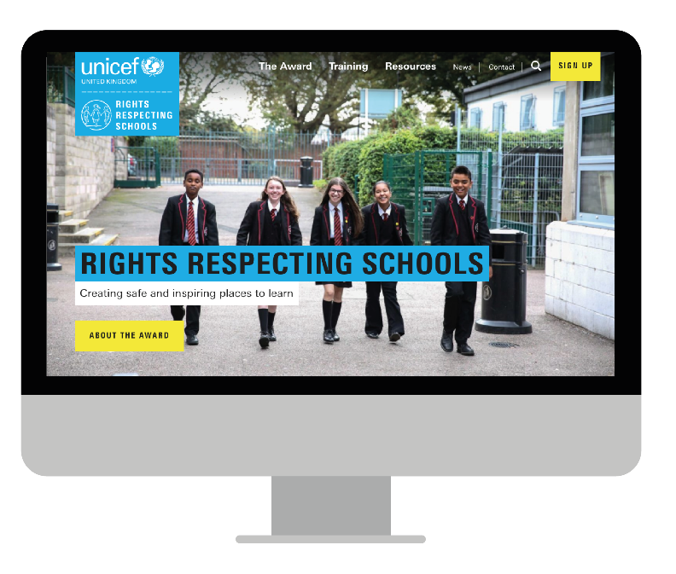
MORE INFO…
RRSA WEBSITE
For more information or to download previous Article of the Week packs please visit the RRSA website by clicking the link below
CLICK HERE

Slide 14
THANKYOU
UNICEF UK/Dawe

