Slide 1
UNICEF/De Luigi
Notes:
UNICEF/De Luigi
Mohamed “Momo” (18), centre, with his foster parents Stefano and Giovanna at their home in northern Italy. Momo is the very first migrant in Italy to be transferred to a foster family, as part of a pilot programme supported by UNICEF.

Slide 2
Slide 3 – Introducing Foster Care Fortnight
Slide 4 – Introducing the articles
Slide 5 – Exploring Foster Care Fortnight - question
Slide 6 – Exploring Foster Care Fortnight - answers
Slides 7&8 – Primary Activities
Slides 9&10 – Secondary Activities
Slide 11 – Reflection

Slide 3
INTRODUCING FOSTER CARE FORTNIGHT
Foster Care Fortnight is the 10 to 23 May this year.
And 15 May is the International Day of Families
Foster Care Fortnight is the Fostering Network’s annual campaign to raise the profile of fostering and to show how foster care can transform lives. Established for almost 20 years, the fortnight is a chance to highlight the need for more foster carers.
The International Day of Families is a UN day to remember the importance of families to people all over the world.
Isobel introduces Foster Care Fortnight
Click here to watch on YouTube

Slide 4
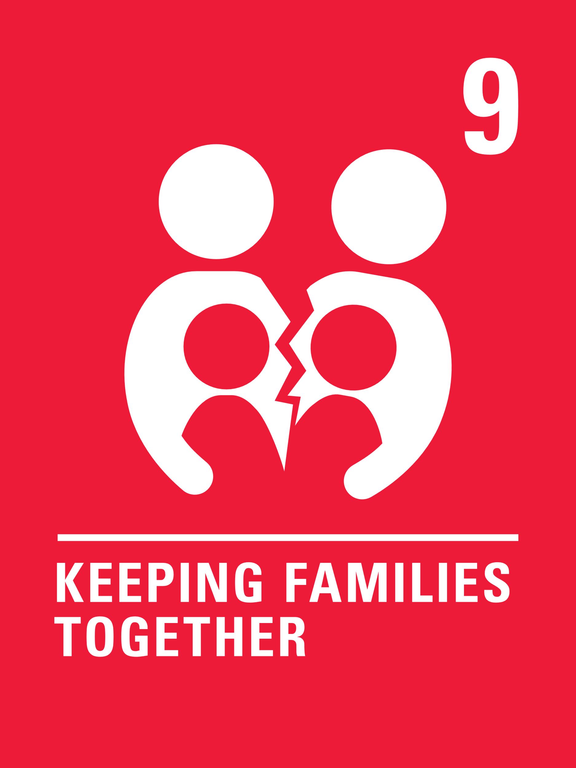
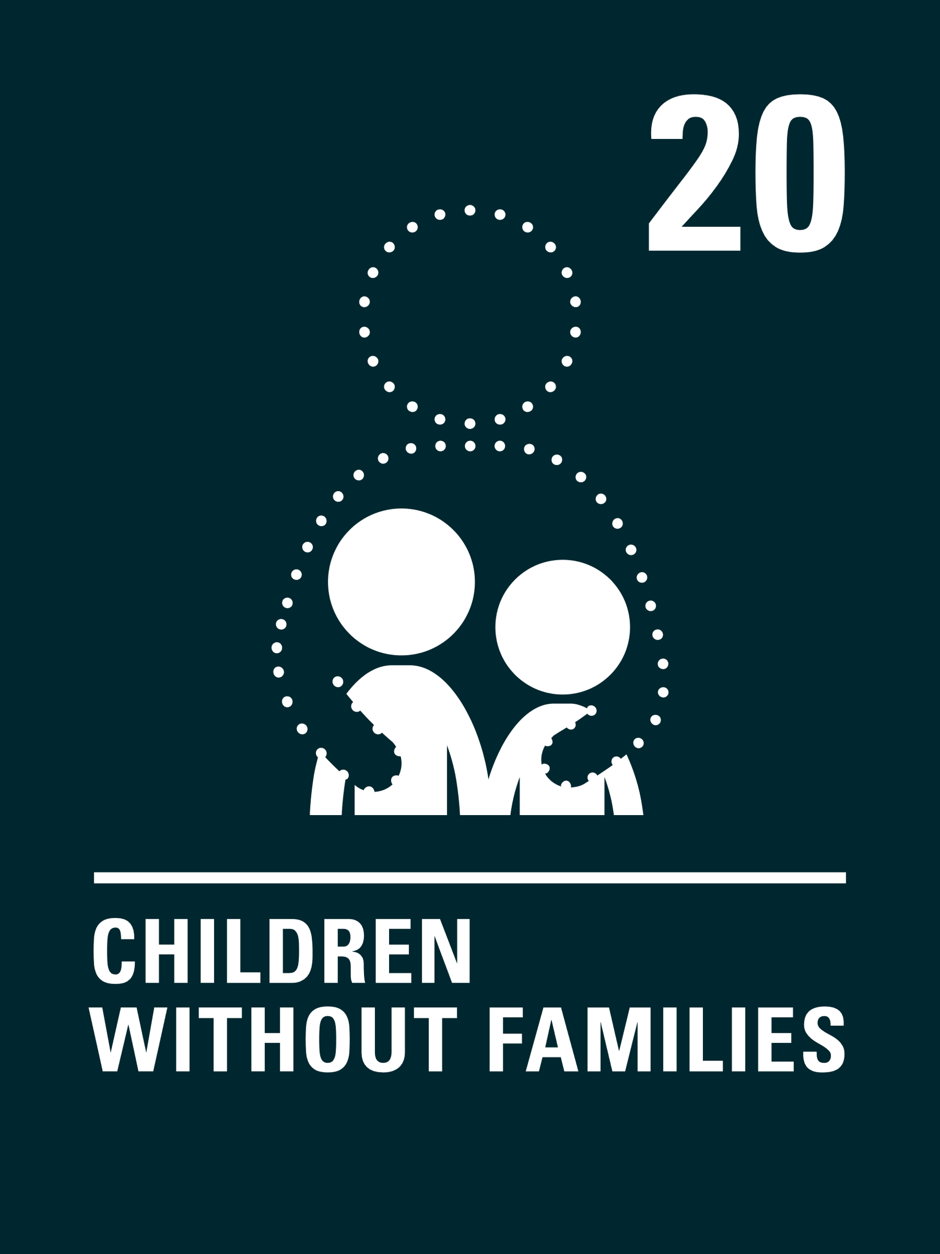
LINKED UNCRC ARTICLES
There are two articles that provide a particularly strong link this week:
Article 9: Separation from parents
All children have the right to live with a family who cares for them. A child or young person must not be separated from their parents unless it is in their best interests (for example if a parent is hurting or neglecting a child). Children whose parents have separated have the right to stay in contact with both parents unless this could cause them harm.
Article 20: Children unable to live with their family
If a child or young person cannot be looked after by their immediate family the government must give them special protection and assistance. This includes making sure the child is provided with alternative care that is continuous and respects the child’s culture, language and religion.
.

Slide 5
EXPLORING FOSTER CARE FORTNIGHT
Why are families and carers so important?
UNICEF/Babajanyan
Notes:
UNICEF/Babajanyan
Alea, 16, her siblings, foster mother and sister sit in the backyard of her foster home in Gjakova, Kosovo on 29 May 2018. Alea and her siblings were removed from their biological parents and home by social workers due to severe psychological abuse, physical abuse and neglect. After the children were placed with a foster care family and in a local school, they started thriving. The local Centre for Social Work, with UNICEF's backing, oversees the children's case.

Slide 6
How many of these did you get?
They look after us and keep us safe.
They encourage us and guide us through life.
We learn from them.
They love us.
They help us feel confident and happy.
We can be helped to feel that we belong.
Did you get any of these?
What other answers did you have?
They provide for our needs, like food, clothes and shelter.
They speak up for us if we can’t use our voice.
We look after and support each other.
They help us to be the best we can be.

Slide 7
Watch ‘The Family Book’ by Todd Parr or ‘All Kinds of Families’ by Suzanne Lang.
Talk to your friend about the different families that you know.
Draw around your hand.
On each finger write one thing you have learned from or love about your parent or carer.
Watch this short film about families.
Discuss what is the best thing about living with your family or carers? Make a card or write a letter to thank them for all that they are to you.
Draw a picture of yourself with the people who look after you.
You might like to add details about who they are. Share your drawing and talk about it with a classmate.
Lower primary
Notes:
Lower primary

Slide 8
What is a family?
It means different things to different people. It is YOUR story.
Watch this video and write a story or draw a comic book about what makes you, YOU, and who helps you in your life.
The Covid-19 pandemic meant we weren’t able to see our family and friends.
How did this make you feel? What ways did you use to keep in touch?
What would happen if you couldn’t access digital technology – not every child or family can. Talk about this with your class.
All children have the right to be cared for and kept safe. Some children can’t stay at home and need to go somewhere safe to be cared for. This could be with another family member, or in foster care. Foster carers are trained in offering support and care to children in need. Have you ever heard of Foster Care? Talk about it in your class, and then watch this video and listen to James’ story. How did this story make you feel? Talk about it in your class. How would you support James if he moved to your school?
Have you ever been away from your parents, carers and family – perhaps on a school trip?
Write about some top tips for keeping in touch when people can’t be together. Our experiences in 2020 might give you some ideas!
Upper primary
Notes:
Upper primary

Slide 9
Every family is different and unique. What is your family like? Draw a picture of a tree and add the names of the people in your family. This doesn’t need to just be who lives with you, this can be people who are special to you, even if you don’t see them much. Don’t forget to include yourself. This is your Family Tree. or with a teacher.
Over 65 thousand children are living in foster care around the UK. Foster carers provide children who are unable to stay at home with a stable, safe home. This may be for a few days, weeks or even years. Children and carers need support and acceptance. In May, the theme for Foster Care Fortnight is #WhyWeCare. Why do you think it is important to raise awareness of foster care? Talk about this in your class. Watch this video.
Why do you think some children need to live in foster care?
There are lots of misconceptions about this. Write a list and discuss this with your class. Be open and honest and ask questions. You may want to do some research on local fostering services where you live.
The Covid-19 pandemic meant we weren’t able to see our family and friends for some time. Write down how this made you feel? What ways did you use to keep in touch? Did you need to use technology? Imagine if you weren’t able to see your family because of safety reasons. Share your thoughts with your class.

Slide 10
All children have the right to be cared for and kept safe. Some children need alternative care arrangements. Watch this film and listen to Abi’s diary as she explains how she felt moving into a new foster care home. How did this story make you feel? Talk about it in your class. How would you support Abi if she moved to your school?
Discuss reasons why children might not be able to live with their parents. Watch this video about children who are separated from their parents. Why do you think it is important for young people to speak out about their experiences? How would you support a friend who experienced some of these issues?
Give groups of students a piece of paper with the simplified wording of Article 9 and 20. Explain to them that Article 3 says decisions must be taken in the best interests of the child and this is also a general principle of the Convention which applies to all the rights.
How does Article 3 link to Articles 9 and 20? Discuss in groups and then come together as a class to share answers.
Imagine you are soon to see a parent who you have been separated from for a long time.
Write a diary entry to express how you might be feeling.

Slide 11
REFLECTION
15th May is International Day of Families. The theme this year is Families and New Technologies.
During the pandemic many of us could only contact our family using technology, though not every child around the world was able to do this.
Why is contact so important?
Apart from technology, how else can we keep connect with those we care about most?
Foster care can give families a chance to sort things out, but more importantly, provide a child with a safe, secure, nurturing home where they can be supported to be the best they can be and have all of their needs met.
Why is such care so important?
What qualities does it take to be a great foster carer or parent?
UNICEF/Babajanyan
Notes:
UNICEF/Babajanyan
Klejdi, age 3, with his foster mother in their home in Kosovo. Klejdi's foster parents began to take care of him when he was 2 months old.

Slide 12
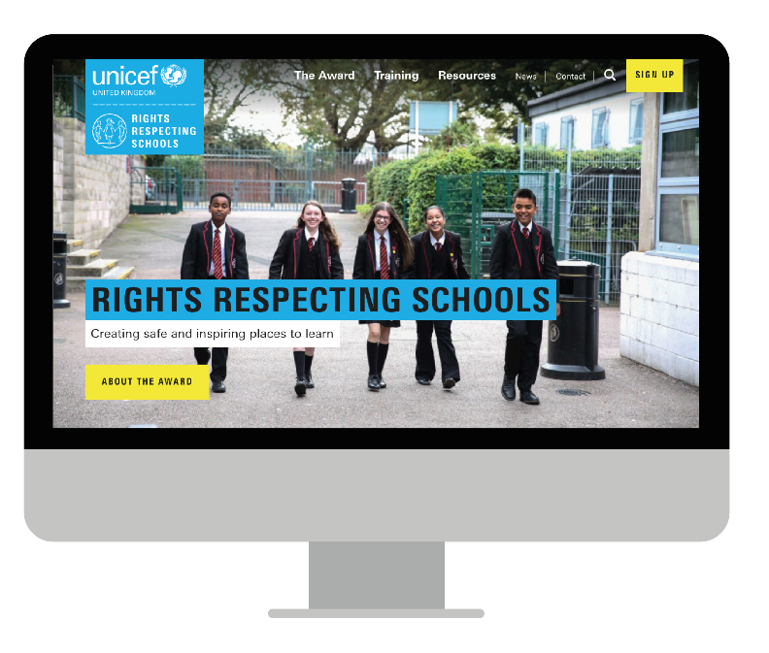
MORE INFO…
RRSA WEBSITE
For more information or to download previous Article of the Week packs please visit the RRSA website by clicking the link below
CLICK HERE

