Slide 1
UNICEF/Holt
Notes:
UNICEF/Holt
A boy weeds his family’s poppy crop in the Lakari Bazaar, a major trading centre in Helmand Province. There are only four schools in the region, and attacks on schools and girl students have deterred many families from sending their children to official schools. Thousands of children do not attend school at all, and many work in family businesses instead.

Slide 2
Slide 3 – Introducing World Day Against Drug Abuse and Illicit Trafficking
Slide 4 – Introducing the Article 33
Slide 5 – Exploring Article 33 - question
Slide 6 – Exploring Article 33 - answers
Slides 7&8 – Primary Activities
Slides 9&10 – Secondary Activities
Slide 11 – Reflection

Slide 3
INTRODUCING WORLD DAY AGAINST DRUG ABUSE
AND ILLICIT TRAFFICKING
This day is held each year on 26th June.
The day aims to highlight efforts across the world to achieve the goal of a world free from drug abuse and raise awareness of the major problem that illegal drugs represent to society. The theme for 2021 is ‘Share Facts on Drugs, Save Lives’ and aims to combat misinformation and promotes sharing the facts on drugs — from health risks and solutions to tackle the world drug problem, to evidence-based prevention, treatment, and care.
World Drug Report — 2020
Around 269 million people used drugs worldwide in 2018, which is 30 per cent more than in 2009, while over 35 million people suffer from drug use disorders, according to the latest World Drug Report.
Helen introduces the topic
Click here to watch on YouTube

Slide 4
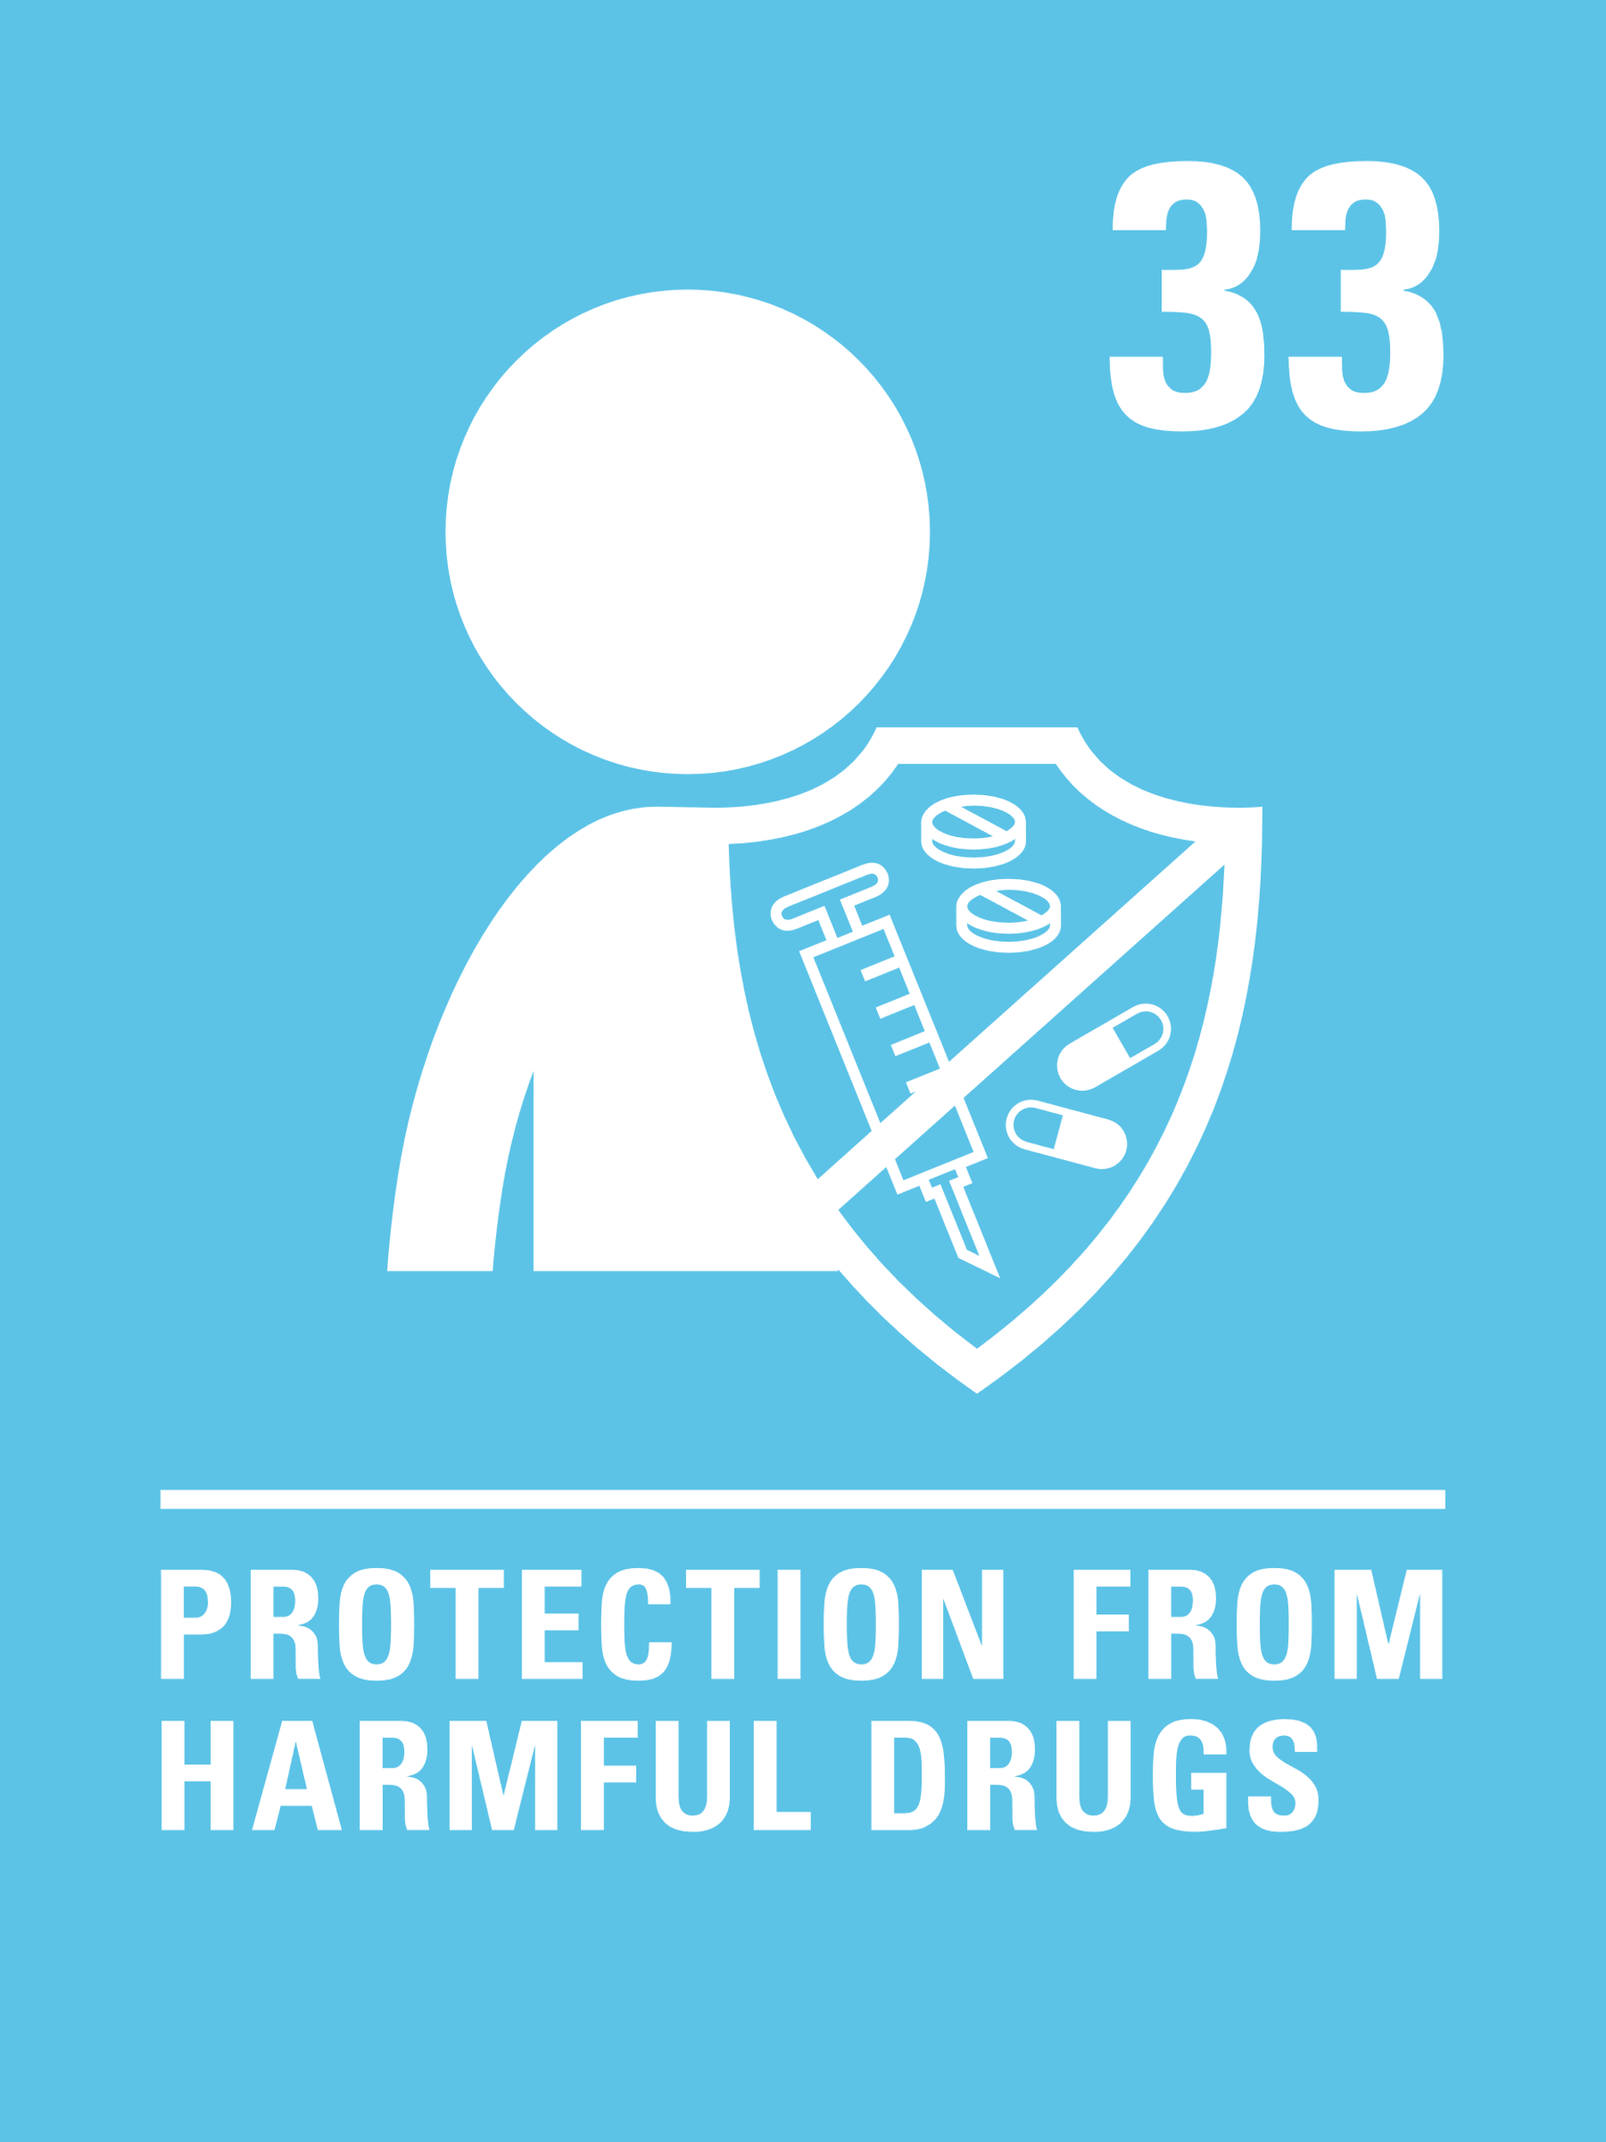
LINKED UNCRC ARTICLES
One article provides a particularly strong link this week:
Article 33 – Governments must protect children from the illegal use of drugs and from being involved in the production or distribution of drugs
States Parties shall take all appropriate measures, including legislative, administrative, social and educational measures, to protect children from the illicit use of narcotic drugs and psychotropic substances as defined in the relevant international treaties, and to prevent the use of children in the illicit production and trafficking of such substances.

Slide 5
EXPLORING ARTICLE 33
Why is it important that all children and young people know the facts about harmful drugs?
Notes:
UNICEF/Pirozzi
On 10 June 2013 in Kosovo, a social worker (facing camera), using posters as a visual aid, discusses the effects and consequences of drugs with a young woman at a drop-in centre for substance abusers, in Pristina, the capital. The centre is run by Labyrinth, a UNICEF-supported NGO.

Slide 6
How many of these did you get?
Drugs are substances that can negatively affect your body and mind.
Harmful drugs are illegal and you could get into trouble with the police, school, parents/carers.
We need to know about the difference between legal drugs, from a shop or doctor, and harmful drugs that people sell to children and young people.
You need to know about the laws in our country.
You need to know it’s OK to ask for help if you have a worry about yourself or someone you know using harmful drugs.
Knowing about how harmful drugs are, will help you know that it’s important to say no if you are ever offered any.
Education is so important, the more you know about harmful drugs, the more support you know you are entitled to.
You might see lots of stories about harmful drugs, alcohol or tobacco on TV or in films. If you know what they are, it helps to know what is legal and what is not.
You will know what to do if you have a worry about yourself or someone else.
You know who to report a concern to.
Using illegal drugs can make you act and behave in a different ways and can have a long term impact on your life.
Did you get any of these? What other answers did you have?

Slide 7
In circle time or as a class talk about being safe and healthy. Discuss medicines and why taking some substances can be dangerous. Have a look with your class at this information from BBC Bitesize. ..
What is a drug? Are they always illegal? Write down a list of legal and illegal drugs you know about. Then watch this video and add to your lists. Talk about the difference between legal and illegal drugs.
Why do you think you must only take your own medicine? Discuss what might happen if you took someone else’s by mistake. Draw a picture to show how to keep medicines out of reach of babies and young children.
In pairs think of five reasons why children might be tempted to use tobacco, alcohol or illegal drugs.
Share your ideas within the class.
Act out how you might persuade someone not to smoke or drink alcohol.

Slide 8
Drugs, alcohol and smoking are all illegal under the age of 18. They are all harmful to children as they grown up. Do you know why they can harm you? In a group, read the guidance from Childline and learn some facts about this. Write a story together about what you would do if someone you knew was drinking, smoking or taking drugs.
Make posters to #sharethefactsondrugs highlighting the dangers of legal and illegal drugs and make links with relevant rights from the CRC. Present these to other children at your school so that they know how to keep themselves and others safe from harmful drugs, particularly over the summer holidays.
Smoking is illegal if you are under 18.
There are many reasons for this. Smoking has also been banned in enclosed public spaces and in cars with children. Do you know the laws?
Check out this website for further information and talk about the pros and cons of this approach.
Although we are talking about Article 33, where Governments must protect children from the illegal use of drugs, there are many other articles of the UNCRC. Have a look at the articles and work with your friends to see which other rights can help protect children from the effects of drugs, smoking and alcohol. Share your ideas with the class.

Slide 9
What would you do if you were worried about a friend who you thought might be taking illegal drugs? Talk about it in your class. This website might help you think about steps you could take to support a friend.
What is a drug? Are they always illegal? Write down a list of legal and illegal drugs you know about. Then watch this video and add to your lists. Talk about the difference between legal and illegal drugs.
No one should every pressure you to take drugs. Remember it is your life, your body, your decision.
What would you do if a friend or an adult tried to pressure you into taking drugs? Remember you can always talk to a trusted adult and report your concerns.
Read these 10 useful ways to deal with peer pressure.
Drinking alcohol is illegal in the UK if you are under the age of 18. Do you know the risks associated with underage drinking? This website will provide you with lots of reasons why underage drinking can put you at an increased risk of harm.

Slide 10
Criminal gangs work across the UK, transporting and selling illegal drugs. They move drugs around the country and often use children or vulnerable people to help them do this. Criminal gangs often use mobile phones to organise these illegal deals. This is called County Lines. Do some research and write a short paragraph about what it means. This website will help. a teacher.
Now you know about County Lines, watch this video. How could you spot the signs that someone you know is involved in this sort of activity? What could you do to help?
People with drug use disorders may have a weakened immune system and have less access to basic necessities. The impact of Covid-19 has added another layer of concern. Watch this video and discuss your concerns. What supports are available in the area you live in? Carry out some research and list services and agencies people can go to for help.
Although we are talking specifically about Article 33, where Governments must protect children from the illegal use of drugs, there are many other articles of the CRC. Have a look at the articles and highlight what other rights protect children and young people from the effects of drugs, smoking and alcohol.

Slide 11
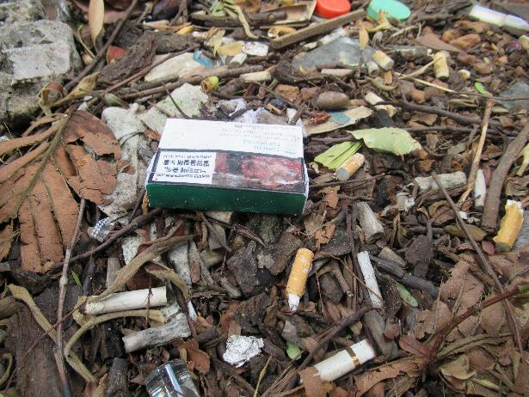
REFLECTION
Why do young people under the age of 18 smoke, drink alcohol or take illegal drugs? Sometimes film and tv can glamourise the use of them.
Sometimes, people think they look grown up and cool if they smoke or drink alcohol. Sometimes people are pressured by others and feel they need to fit in.
Have a think about these issues – why do so many young people get involved in smoking, drinking alcohol or taking drugs? What can be done to prevent this or raise awareness in your school? Could you think about a campaign and speak to your Pupil Voice groups?
Click here to watch on YouTube
Notes:
UNICEF/UNI220097
Cigarette packs, plastic bags and styrofoam boxes scattered on the road shows the alarms on people's awareness of environmental protection

Slide 12
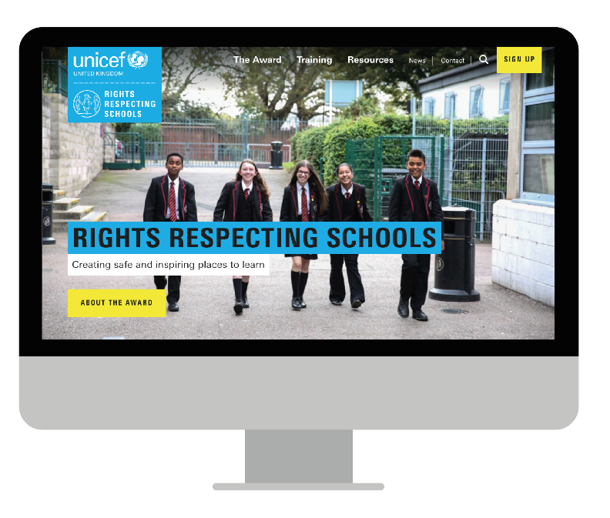
MORE INFO…
RRSA WEBSITE
For more information or to download previous Article of the Week packs please visit the RRSA website by clicking the link below
CLICK HERE
And for more support on any of the issues raised in this week’s pack please contact
ChildLine – 0800 11 11
Frank – 0300 1236600

