Slide 1
UNICEF/Ryeng
Notes:
UNICEF/Ryeng
The entrance gate to the high court in Aweil, South Sudan. The judge working there suggests two immediate actions to be taken: train all judges in the country on the importance of juvenile justice and then create a special court for these cases. The court will be important for a child friendly approach, but also to expedite these cases as fast as possible.

Slide 2
Slide 3 – Guess the article
Slide 4 – Introducing Article 40
Slide 5 – Exploring Article 40 - Question
Slide 6 – Exploring Article 40 –
Answers
Slides 7&8 – Primary Activities
Slides 9&10 – Secondary Activities
Slide 11 – Reflection

Slide 3
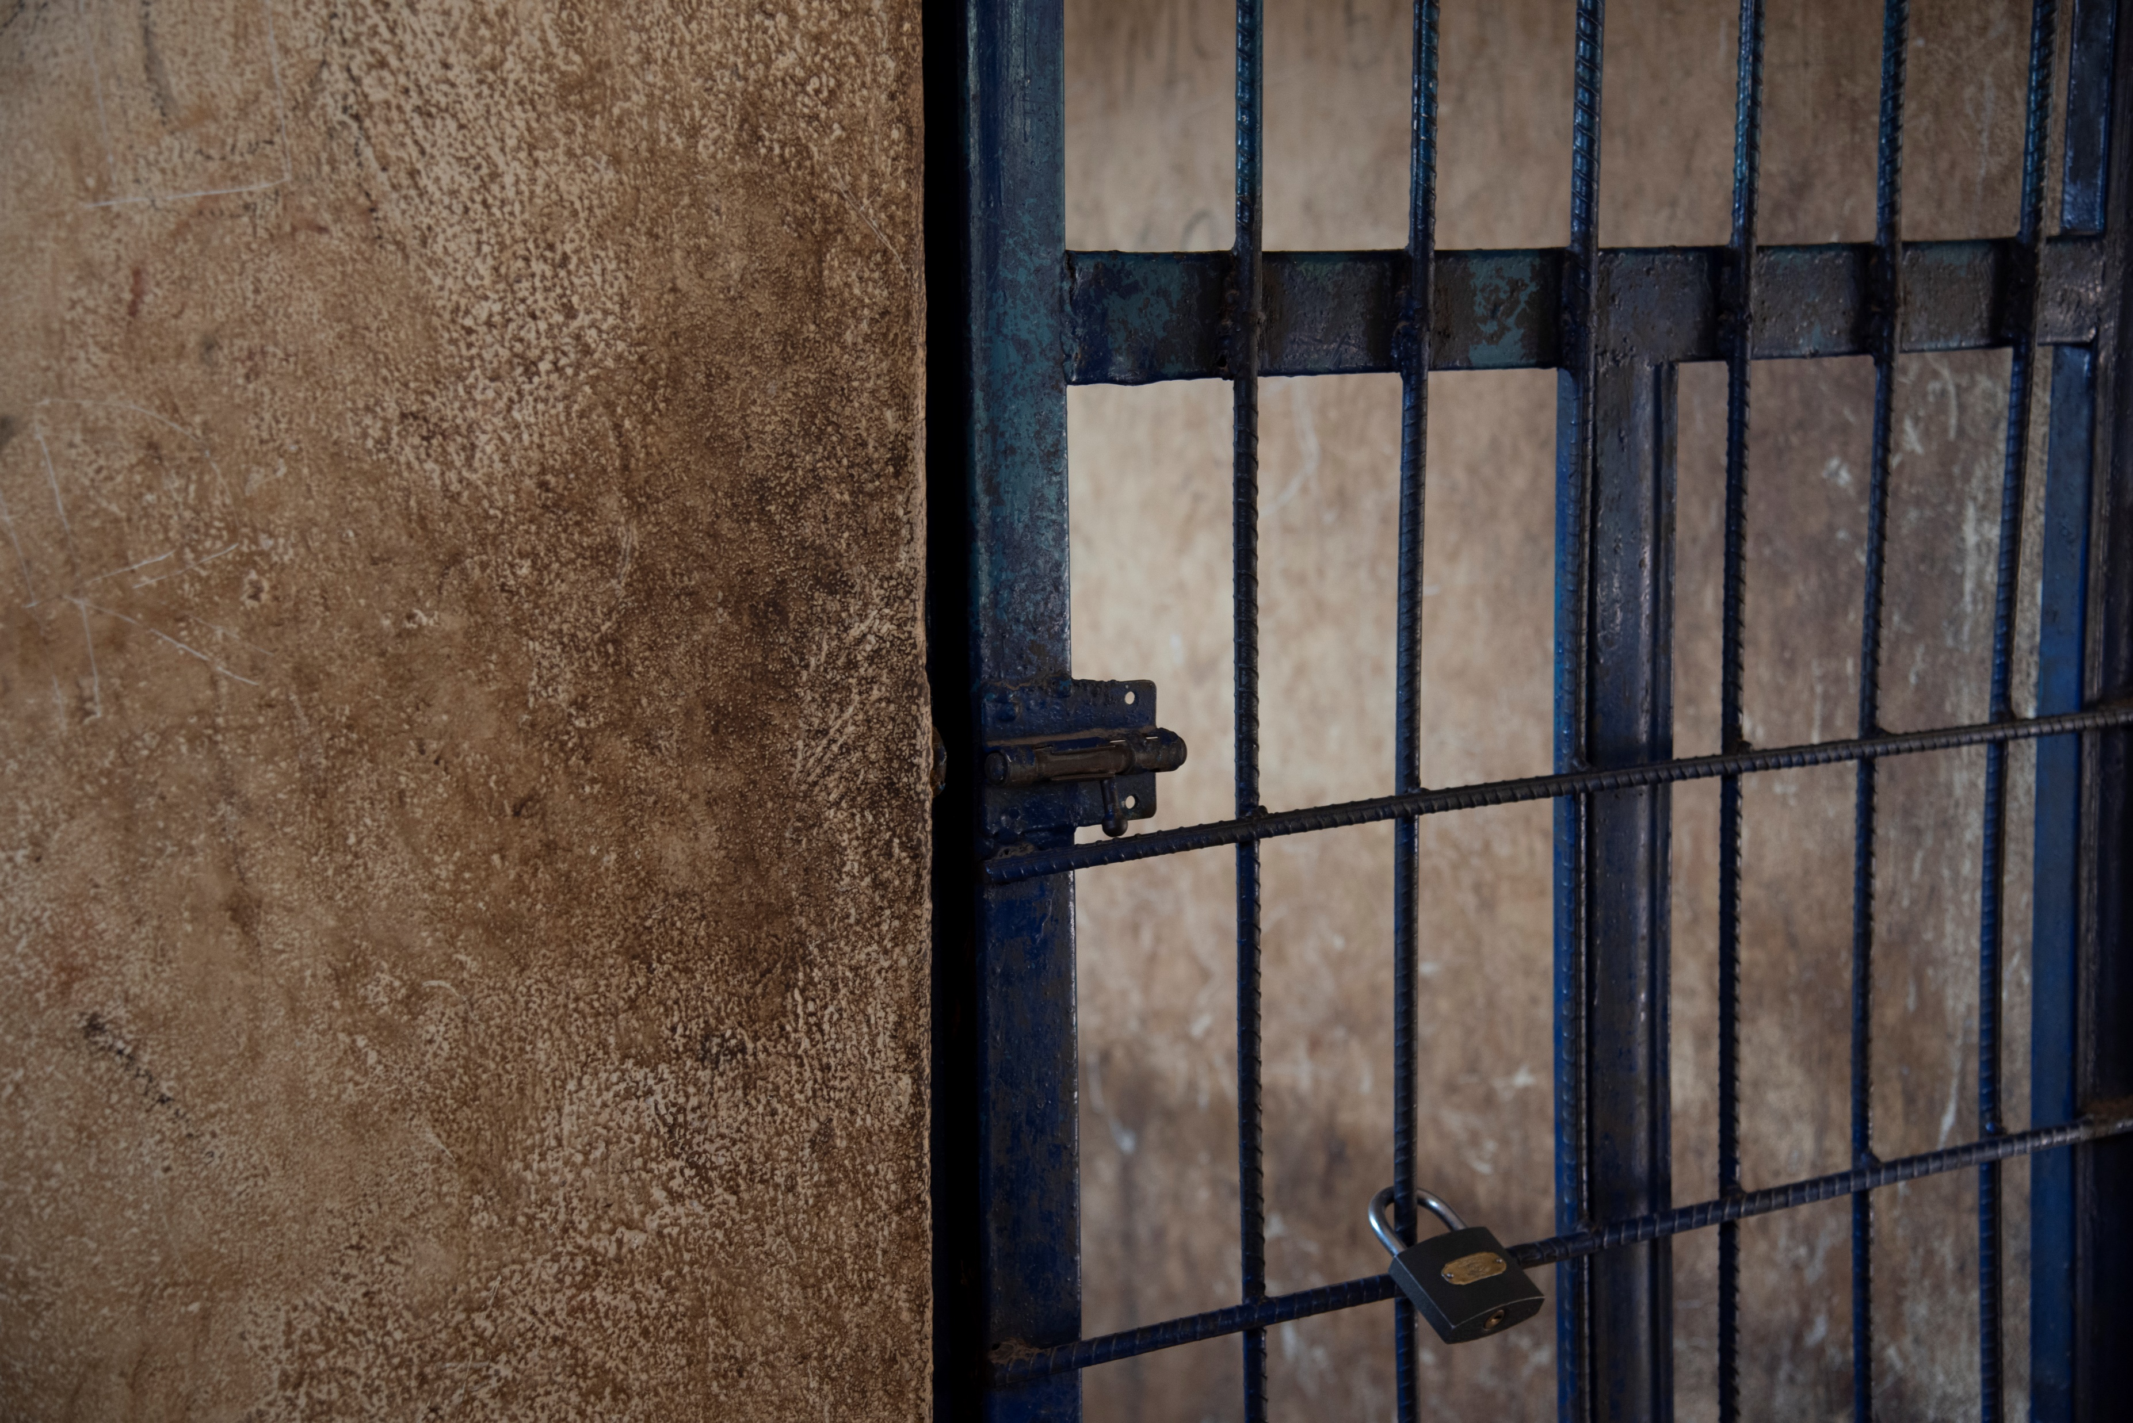
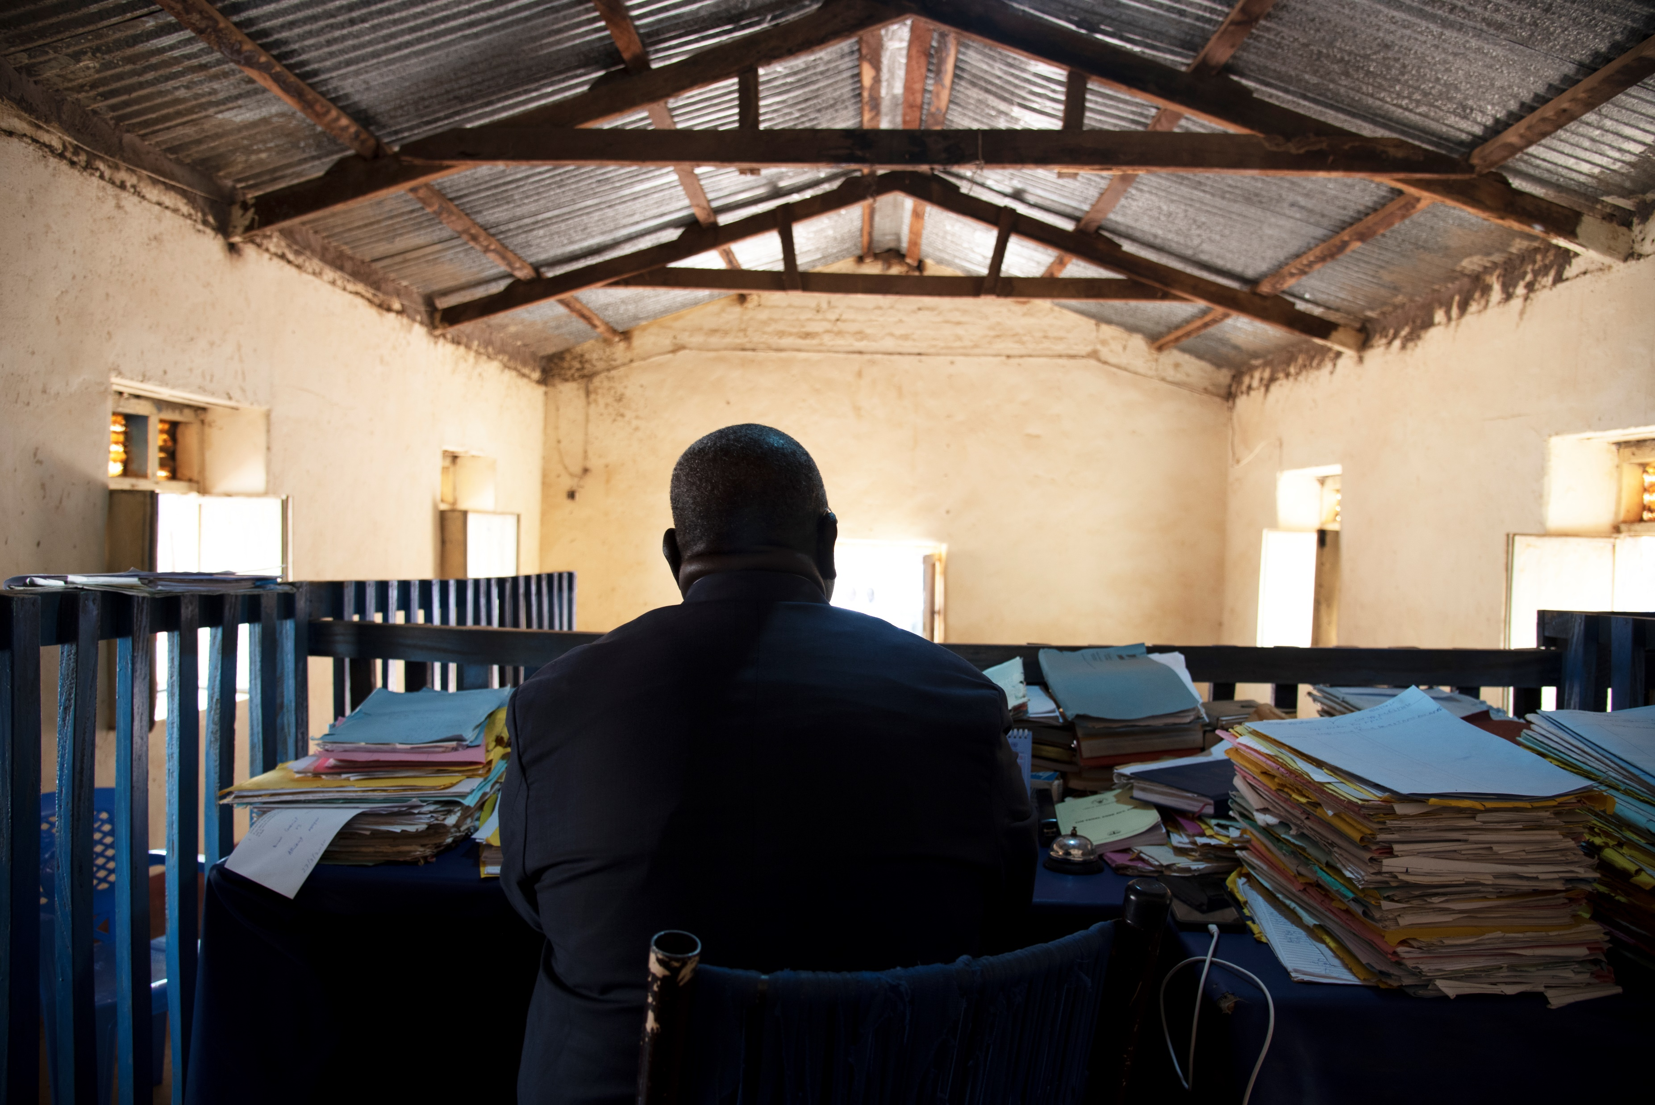
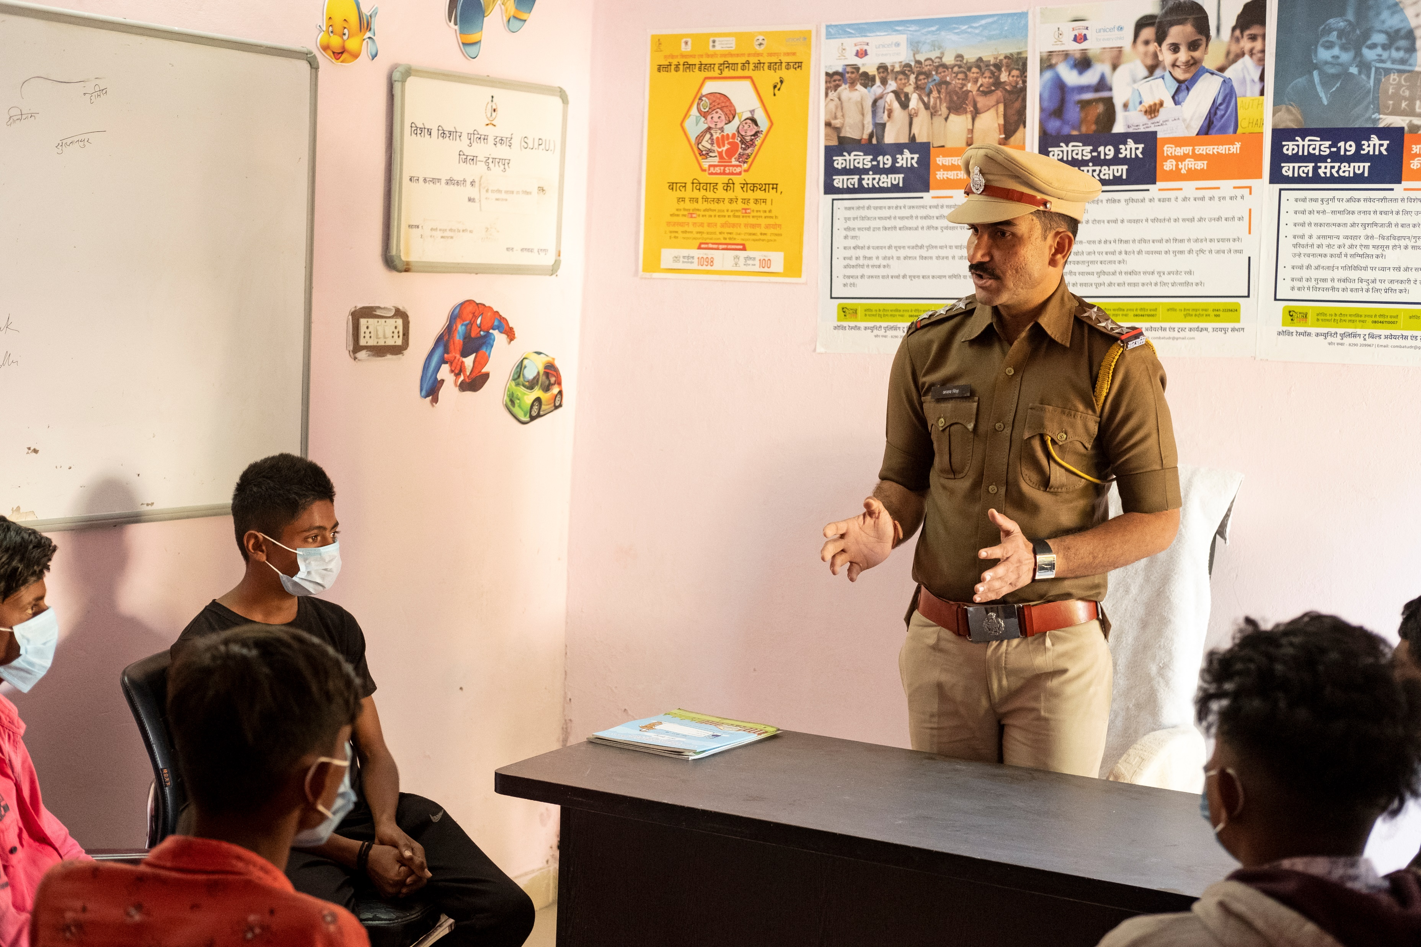
Guess the Article
These pictures provide a clue to this week’s article.
How do these pictures help you? Can you guess how they are linked together?
Write down your thoughts or discuss with someone in your class.
UNICEF/Ryeng
UNICEF/Ryeng
UNICEF/Kolari
Notes:
UNICEF/Ryeng – Outside a cell in the special protection unit in Aweil, South Sudan, a holding centre for women and children while waiting for their cases to come up for court.
UNICEF/Ryeng – A judge is sitting on the bench in the high court in Aweil, South Sudan. The Judge is one of the more progressive judges in South Sudan, with a special interest in justice for children.
UNICEF/Kolari – A police inspector talks to adolescent boys about cyber crime. In 2012 UNICEF Rajasthan designed a state-wide intervention to work closely with the police department for evolving and strengthening a child friendly police system in the state.

Slide 4
INTRODUCING ARTICLE 40
Martin introduces Article 40
Article 40 (juvenile justice)
A child accused or guilty of breaking
the law must be treated with dignity
and respect. They have the right to legal assistance and a fair trial that takes account of their age. Governments must set a minimum age for children to be tried in a criminal court and manage a justice system that enables children who have been in conflict with the law to reintegrate into society.
Click here to watch on YouTube

Slide 5
EXPLORING ARTICLE 40
If a child does something seriously wrong and against the law how should they be treated?
UNICEF/Ryeng
Notes:
UNICEF/Ryeng
A 13-year-old boy sits by the window in a special protection unit in Aweil, South Sudan, a holding centre for women and children while waiting for their cases to come up for court.

Slide 6
How many of these did you get?
They should be treated with fairness
They have the right to be listened to
Their views need to be respected
They should be kept safe
They should be treated with dignity even if they need to be punished
They still have their rights
They need a chance to learn and change their lives
What others did you think of?

Slide 7
Read or watch the video ‘This is not my hat’ by Jon Klassen.
Explore the story and characters as a class.
Why did the little fish steal the hat?
Use the opportunity to discuss right and wrong and resolving wrongdoing.
Being sorry is not just saying sorry.
Use circle time or something similar to discuss with children what happens in your school setting when a child does something wrong such as hurting another child or taking something that doesn’t belong to them. Take the opportunity to explain the school’s response and how children are supported to apologise, learn and move on.
Watch this video about the Rule of Law.
As a class, discuss what you need to agree in school so that everyone’s rights are respected and there isn’t ‘chaos’.
Why do we need laws?
Did the Judge answer the question about Rosa Parks?
What would you do if you thought a law was unfair?
Read this Newsround article to see how laws are made.
Design a flow diagram to explain the process to your class or write a story about a country with no laws.

Slide 8
Think about the duty bearers who help you.
If a child has done something seriously wrong and is in trouble with the police what support do you think they would need?
Who could help them and provide advice?
Article 40 states that a child accused of breaking the law must be treated with dignity and respect.
In your school you will have a behaviour policy that provides guidance around how you should act, how you are rewarded and what happens if you do something wrong. School rules are not ‘laws’ but discuss your school’s behaviour policy to see how it makes sure that all children are treated with dignity and respect. If you have any questions or concerns you could share them with your School Council or arrange to meet your Head teacher to discuss them?
Imagine a child aged about 11 or 12* had committed a very serious crime and a court decided that they should be placed in special secure care away from family and friends for a year or two.
Look at the CRC and discuss in a group how things could be organised to make sure that child could still access their rights.
* The age of criminal responsibility is different across the UK.
Look at some of these activities from the National Archive about children being imprisoned in the Victorian period.
The CRC did not exist then but imagine it did and discuss the experiences of those children from a rights point of view.

Slide 9
Article 40 states that a child accused of breaking the law must be treated with dignity and respect.
In your school you will have a behaviour policy that provides guidance around how you should act, how you are rewarded and what happens if you do something wrong. School rules are not ‘laws’ but take a look at your school’s behaviour policy to see how it makes sure that all children are treated with dignity and respect. Could it be improved to link more directly to rights or made more child friendly? If you have any questions or concerns you could share them with your School Council or arrange to meet your Head teacher to discuss them.
There is lots of advice and guidance so support young people in understanding the law and their rights. Have you discussed this in PSHE?
Have a look at this website from a charity and this one from the Crown Prosecution Service and then share five facts with your class which you did not previously know.
The minimum age at which a child can be convicted of a crime is sometimes called the age of criminal responsibility. This varies around the world and within the UK.
Do some research about what the minimum age is in different countries.
Have a class debate for and against raising the age of criminal responsibility to 16. Here’s an article and some information from the NSPCC and the UK government to begin your research.
Have you heard of restorative approaches? Does your school use them?
Find out more here and then discuss as a class how such approaches could be used alongside children’s and young people rights.

Slide 10
When anyone is found guilty of serious offenses most people agree that there should be consequences, even prison or secure care.
Apart from this being a ‘punishment’ why else should it happen? This article may help your discussion.
Just like many other areas of life there is evidence of racial discrimination in the Criminal Justice System.
Read this report from the campaign organisation Justice.
Can you see how many articles of the Convention you can link to their recommendations?
Read the Executive Summary of A Rights-Based Analysis of Youth Justice in the UK that was recently produced by the UK Committee for UNICEF (UNICEF UK).
Look at the recommendations for your part of the UK.
If you agree with the recommendations write a letter to a local politician to ask for change.
Article 40 says that children who have been through the criminal justice system should be helped to ‘reintegrate into society’.
Imagine a friend or relative of yours had been in a youth offenders centre or secure care. How would you and your school community help them to reintegrate?

Slide 11
Talking about crime and how offenders are treated might be upsetting. Make sure you have a trusted adult to speak with if anything in this week’s activities worries you.
Article 40 says that even when children have done wrong, they must be treated with DIGNITY and RESPECT.
Take some time and find a space to be quiet for a while and to think.
What does it feel like to be respected?
Why does your dignity matter to you?
What do you do to show respect to others and treat them with dignity?
REFLECTION
UNICEF/Noorani
Notes:
UNICEF/Noorani
A metal workshop in a rehabilitation school in Malaysia. UNICEF is supporting the Government of Malaysia to develop a more holistic solution in addressing matters relating to children in conflict with the law. These include diversion (directing children away from judicial proceedings and towards community solutions), restorative justice (promoting reconciliation, restitution and responsibility through the involvement of the child, family members, victims and communities), and alternatives to custodial sentencing (counselling, probation and community service).

Slide 12
MORE INFO…
RRSA WEBSITE
For more information or to download previous Article of the Week packs please visit the RRSA website by clicking the link below
CLICK HERE

