Slide 1
UNICEF/Canaj/Magnum Photos
Notes:
UNICEF/Canaj/Magnum Photos
A young girl at a new temporary accommodation facility on the Greek island of Lesvos. She lived in Moria camp with her mother for ten months before it burned down on 9 September 2020. They then lived on the street for five days before being relocated to the new camp.
They are travelling from Afghanistan to Switzerland, where they will join her father who is an asylum seeker.

Slide 2
Slide 3 – Introducing World Refugee Day
Slide 4 – Introducing the articles
Slide 5 – Exploring World Refugee Day - Question
Slide 6 – Exploring World Refugee Day - Answers
Slides 7&8 – Primary Activities
Slides 9&10 – Secondary Activities
Slide 11 – Reflection

Slide 3
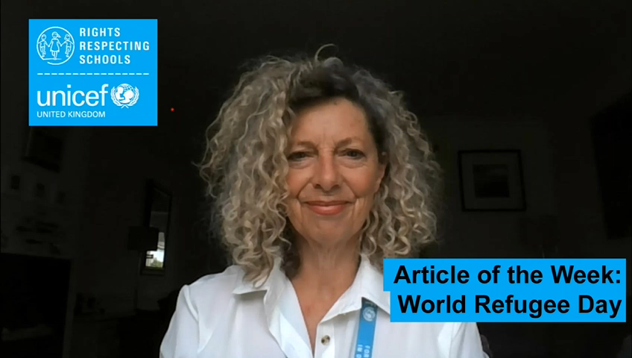
INTRODUCING WORLD REFUGEE DAY
World Refugee Day has been recognised by the United Nations since 2001.
A refugee is someone who has had to flee their home because their lives were in danger in their home country. There are many different reasons for this and we will explore some of them in the activities coming up. World Refugee Day is on 20th June 2021 and helps to raise awareness of the lives and experiences of refugees.
This year’s theme is ‘Together we heal, learn and shine.’
Jilly introduces World Refugee Day
Click here to watch on YouTube

Slide 4


LINKED UNCRC ARTICLES
On World Refugee Day Article 22 and Article 10 are particularly important:
Article 22 (refugee children)
If a child is seeking refugee or has refugee status, governments must provide them with appropriate protection and assistance to help them enjoy all the rights in the Convention. Governments must help refugee children who are separated from their parents to be reunited with them.
Article 10 (family reunification)
Governments must respond quickly and sympathetically if a child or their parents apply to live together in the same country. If a child’s parents live apart in different countries, the child has a right to visit and keep in contact with both of them.

Slide 5
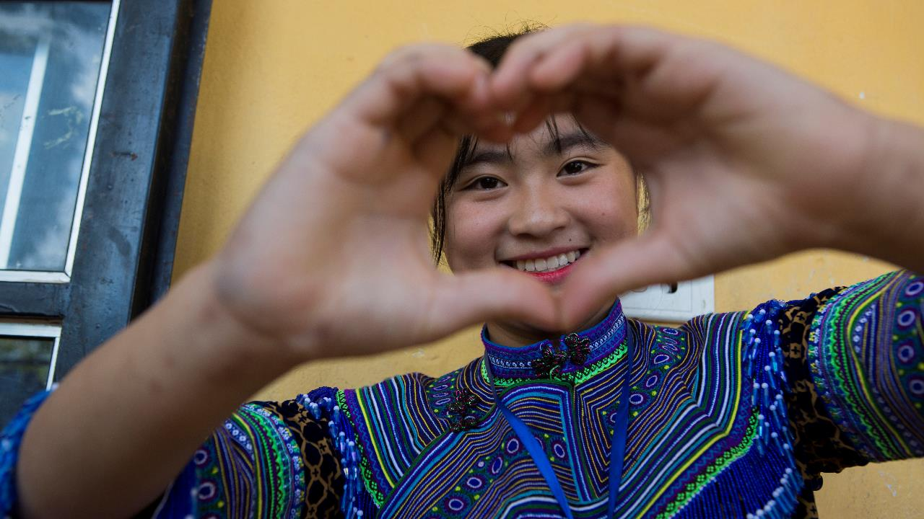
EXPLORING WORLD REFUGEE DAY
Why might some children have to leave their homes and their country to try and find safety in another country?
UNICEF/Mohsin
Notes:
UNICEF/Mohsin
On Tuesday 23 March 2021 in Bangladesh, Rohingya children stand in the remains of their Multi-Purpose Adolescent Centre devasted in yesterday's fire in Cox's Bazar. Thousands of homes have been destroyed upending the lives of Rohingya families and children living in the refugee camps.

Slide 6
How many of these did you get?
There may be war and conflict in the country they used to live in
There may be a lack of food and/or clean water
There could have been a natural disaster such as a flood or an earthquake
Climate change could have impacted their home and family’s livelihood
They may have been treated unfairly because of their religious beliefs
They could have faced persecution because of their race or ethnicity
They could have faced persecution because of their family’s political beliefs
Did you get any of these? What other answers did you have?

Slide 7
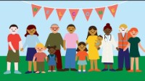
You have the right to be safe.
Which people keep us safe? Which people help you?
Can you draw some pictures of people who help you in your community?
What sort of things might happen if you are not kept safe? What kind of dangers might some children face? Discuss with your class how some people are not safe in their countries and have to move somewhere where they can be safe.
Think about your home.
What makes it special to you? What makes a home safe? Who keeps you safe at home?
Can you draw a picture of your home? Include all the people who live with you.
There may be lots of families within your community who have lived in different countries or have moved to the UK from somewhere else in the world.
Have a look at a world map and see if you can identify these countries. You could also create a display in your classroom showing where your friends have travelled from.
This video from Save the Children explains what a refugee is.
Watch the video and discuss what you learnt with your class.

Slide 8
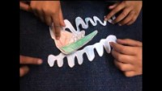
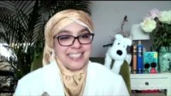
Imagine a new child has arrived in your school from another country.
Create a pack to welcome them to your school and include information you think they would need to know, such as school timings, uniform and dinner choices.
Watch this animation created by Mount Stewart Infant School (a Rights Respecting School) about a family who has had to flee the war in Syria.
Can you create a similar animation using an ICT application of your choice?
As an idea for a class novel, read the book ‘The Boy at the back of the class’ by Onajali Q Rauf for a child's perspective on the refugee crisis.
As a class discuss the tasks the author has set at the end of the video (8:52).
Play this interactive game from the BBC to understand the difficult choices Syrian refugees have to make to try and get to safety.
Decide as a class which decisions you will make at each step of the journey.

Slide 9
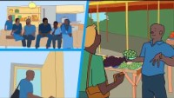
It’s easy to get confused about the terminology used to describe people who are forced to leave their homes. Watch these animations that explain some of the words used to describe displaced people.
After watching, you might like to write a poem called ‘Words Matter’ to show what you have learnt or create a handy guide to help people understand the difference between words such as refugee, asylum seeker, internally displaced person and migrant.
In 2020 there were 26 million refugees across the world. 68% of them came from just 5 countries – Syria, Venezuela, Afghanistan, South Sudan and Myanmar. To find out where refugees go watch this video. Share what you find out with your class.
Article 10 says that governments must help children separated from their parents be reunited. Watch this video about the work UNICEF is doing in South Sudan to reunite children separated from their parents because of the conflict there. Before you watch it, think about a time when you were temporarily lost as a child, perhaps lost in a shop, or on the beach. Now imagine what it must be like to be separated in a time of war.
You can find out more about UNICEF’S work to reunite children here: https://www.unicef.org/protection/family-separation-during-crisis
Find out what the UK government is doing to help refugee children be reunited with their parents.
There are different views about government policy, in light of Articles 10 and 22, what do you think about the UK government’s stance on refugees? You could even write to your local MP to express your views.

Slide 10
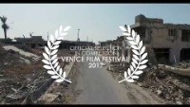
The war in Syria has been ongoing for ten years.
Watch this video about Mustafa who escaped the war and now lives in Germany.
Imagine an entry in his diary, what might his thoughts be?
You might be interested in finding out about an extraordinary art project called Little Amal. Little Amal is a giant puppet – a 3.5 metre-tall living artwork character that represents child refugees, especially those who have been separated from their families. In 2021 the puppet will walk 8,000 km across Turkey, Greece, Italy, France, Switzerland, Germany, Belgium and the UK to focus attention on the urgent needs of young refugees.
Can you think how you could use puppets or another type of artform to raise awareness of the lives of children forced to be refugees?
This is the trailer to the film Human Flow made in 2017 by the Chinese artist and filmmaker Ai Weiwei in which he wants to help people understand what being a migrant is like. Watch the trailer and talk with a partner about which part you found most memorable or moving.
Refugee children are 5 times more likely to be out of school than other children.
Watch this video and read about the work UNICEF is doing to help refugee children access their right to education.
How can you support refugee children to access quality education in your school?

Slide 11
REFLECTION
This year’s World Refugee Day theme is ‘Together we heal, learn and shine.’
Spend a few minutes thinking about what that actually means.
What words or actions can help to heal a bad situation?
How can we learn more about the lives of other people whose experiences may be very different to ours?
How can all children, including refugees ‘shine’?
We are all different but why is doing things ‘together’ really important?
UNICEF/Kabuye
Notes:
UNICEF/Kabuye
Children play at the ECD centre in Busheka, Isingiro District, Uganda. The centre is run by Right to Play, which works to improve learning outcomes and develop critical life skills in disadvantaged children and youth in refugee settlements and host communities using play-based approaches. It has partnered with UNICEF under the framework of the National Integrated Early Childhood Development (NiECD) program to include integration of play-based approaches into early childhood development.

Slide 12
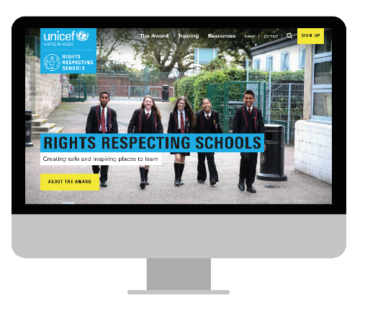
MORE INFO…
RRSA WEBSITE
For more information or to download previous Article of the Week packs please visit the RRSA website by clicking the link below
CLICK HERE

