Slide 1
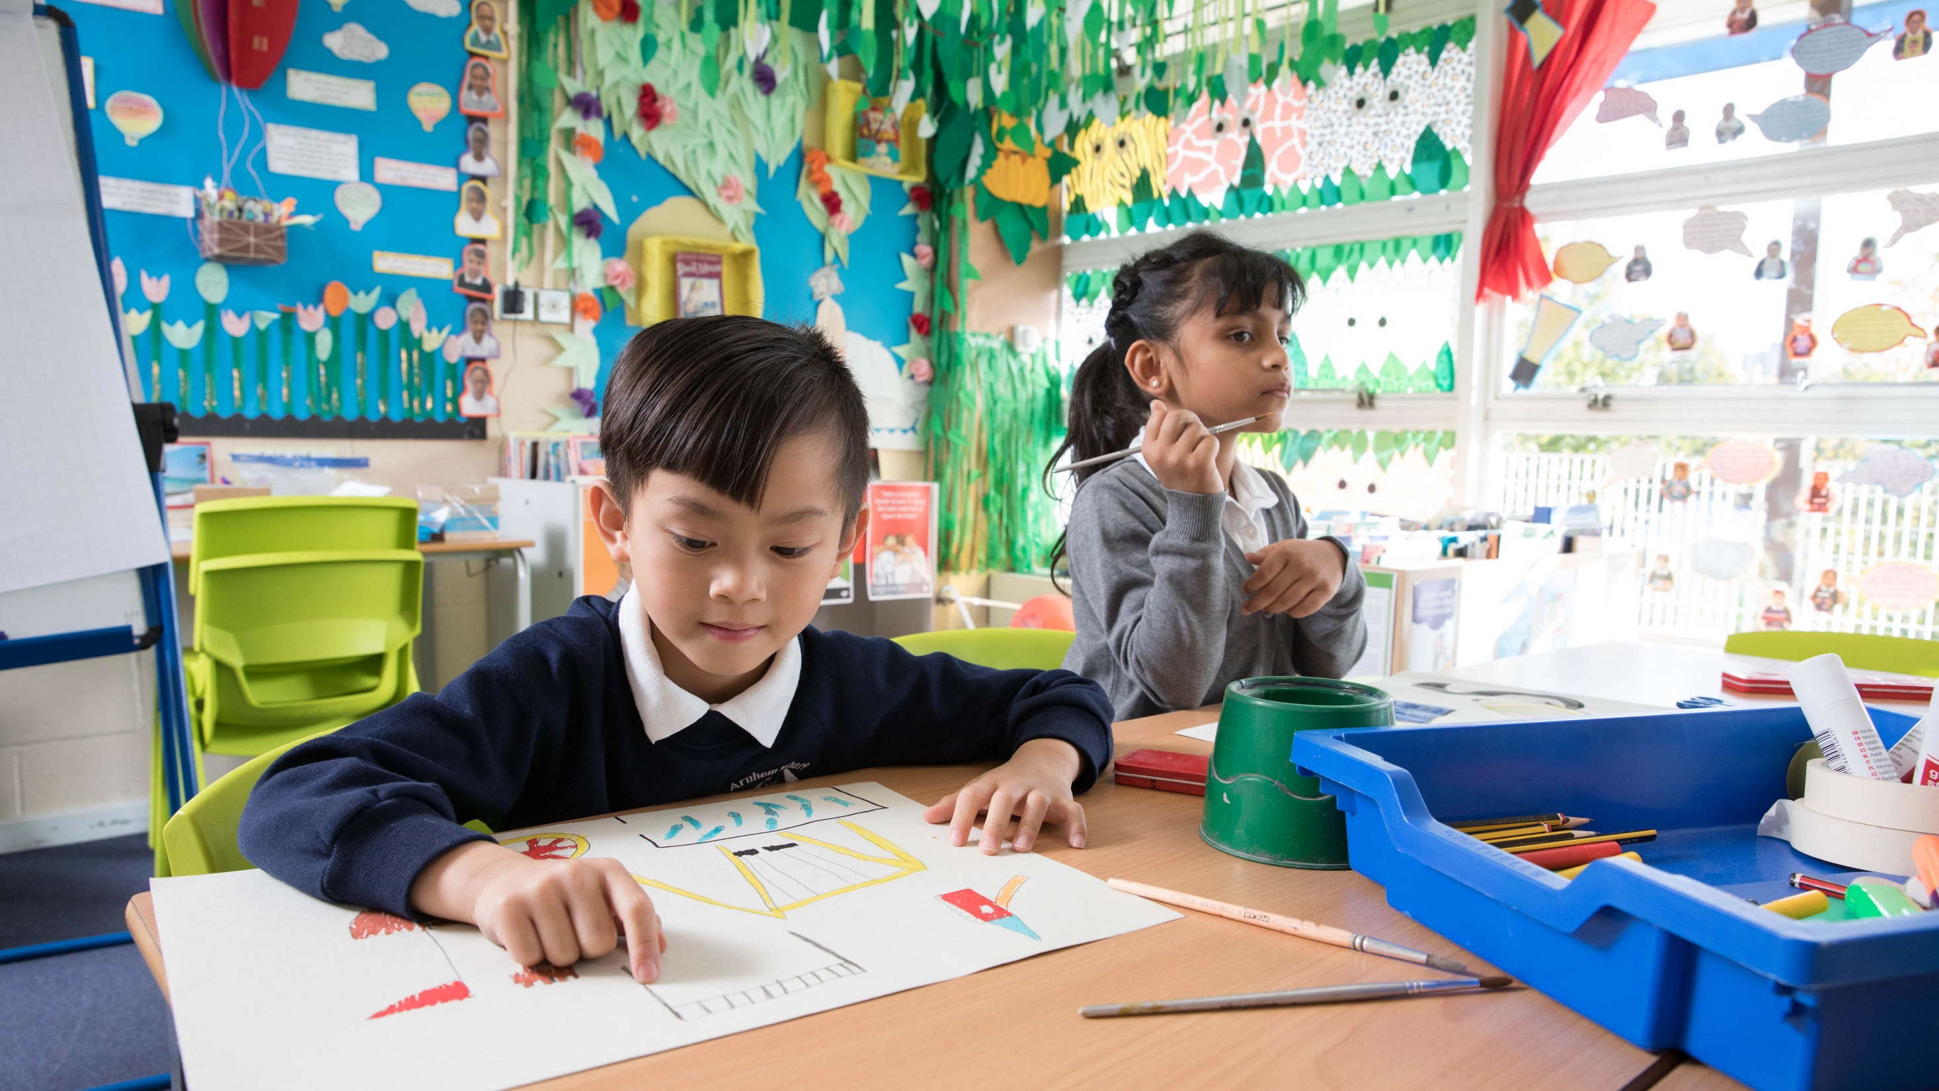


  WELCOME
  TO OUTRIGHT
© UNICEF/Dawe
United Kingdom Committee for UNICEF (UNICEF UK), Registered Charity No. 1072612 (England & Wales), SC043677 (Scotland).

Slide 2
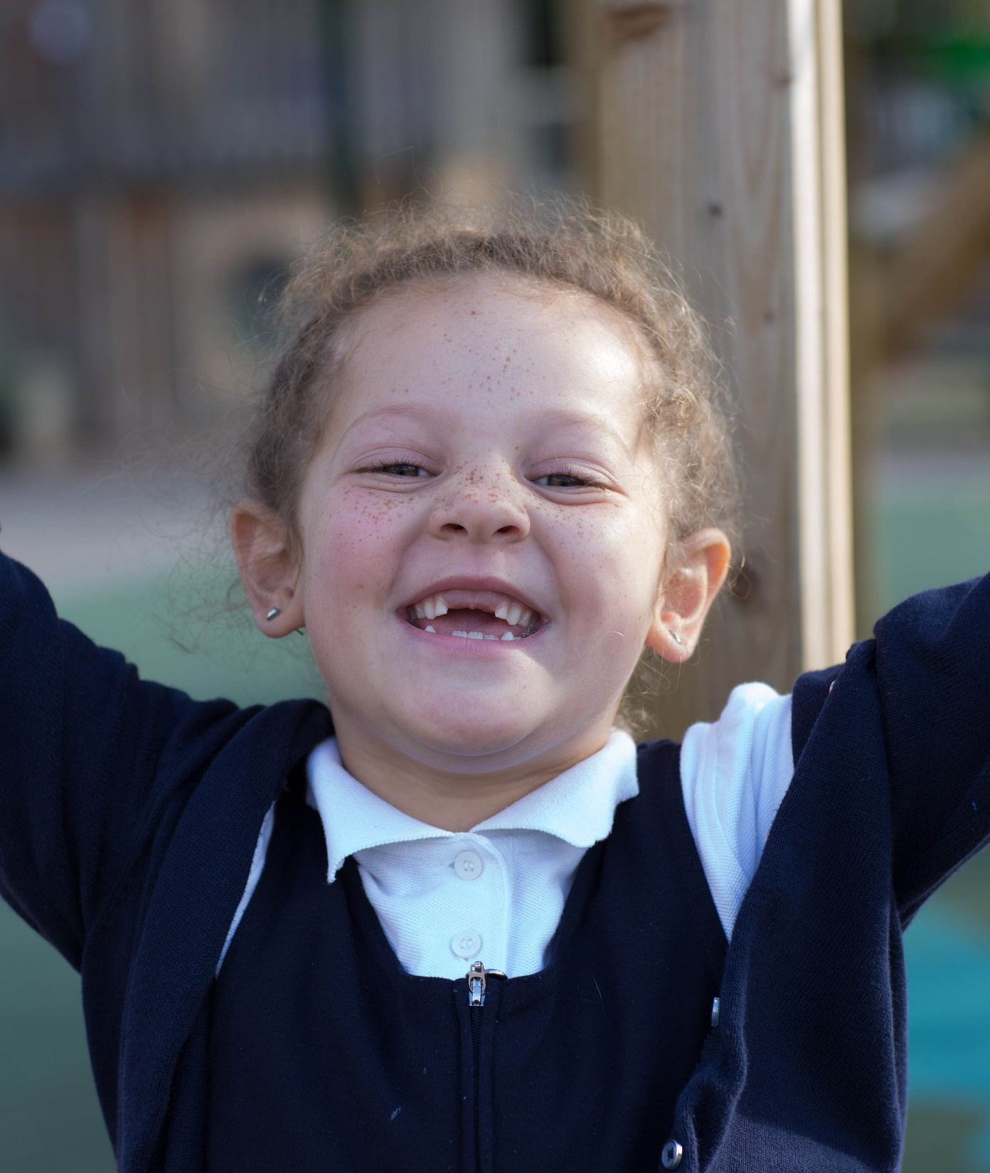
WHAT IS OUTRIGHT?
OutRight is a youth campaign run by UNICEF UK that helps children and young people to speak out about children’s rights in the UK and abroad.
It’s a campaign by children, for children.
© UNICEF/Dawe

Slide 3
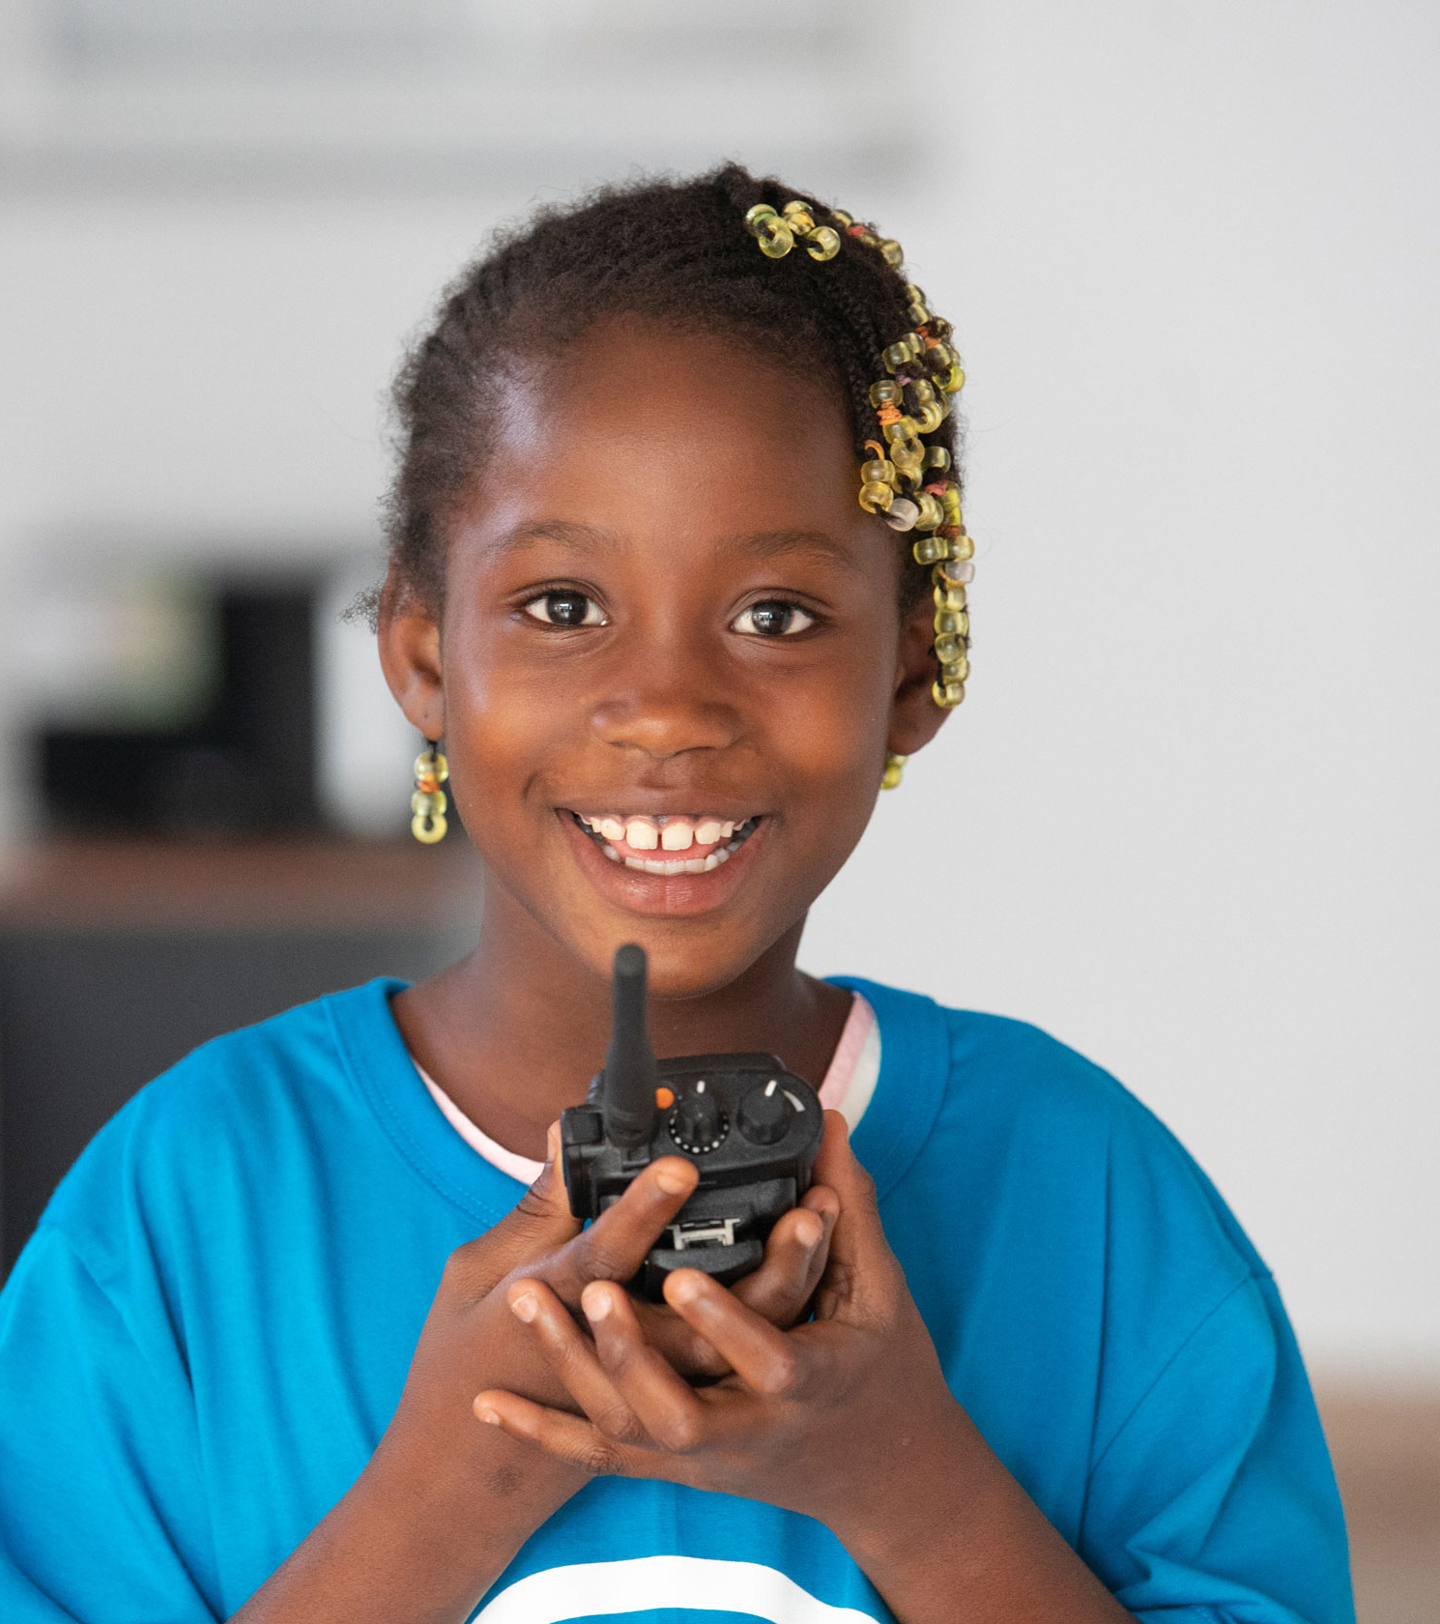
MAKE YOUR VOICE
HEARD!
OutRight will help children like you to stand up for the rights of children in the UK and around the world, with the support of our campaign champion, Paddington Bear.
This year, OutRight is all about mental health and children’s rights.
© UNICEF/Diarassouba

Slide 4
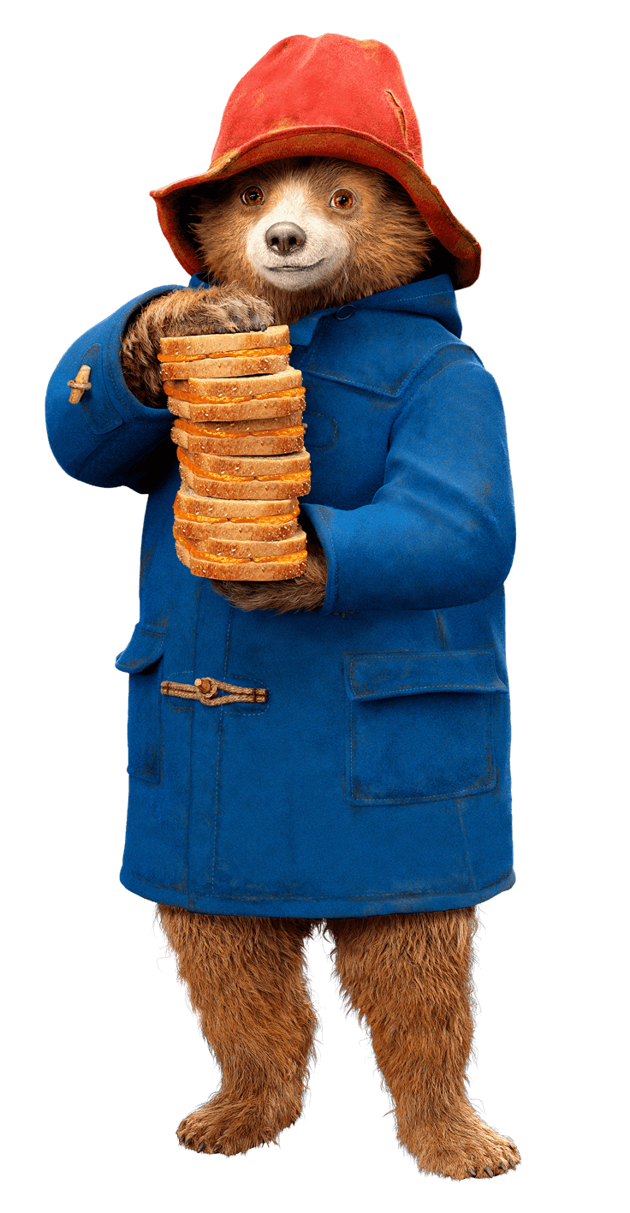


Notes:
Paddington is a champion for children and, like UNICEF UK, wants you to use your voices to make the world a better place.
Just like all of us, Paddington has mental health. Sometimes he feels happy and excited. Sometimes he feels scared or worried. He finds different ways to cope with his feelings. Through OutRight, hand in hand with Paddington we will learn about different ways to express our emotions and talk about how we are feeling.
You and the children you work with can learn more about Paddington's story in the 'Meet Paddington' resource.

Slide 5
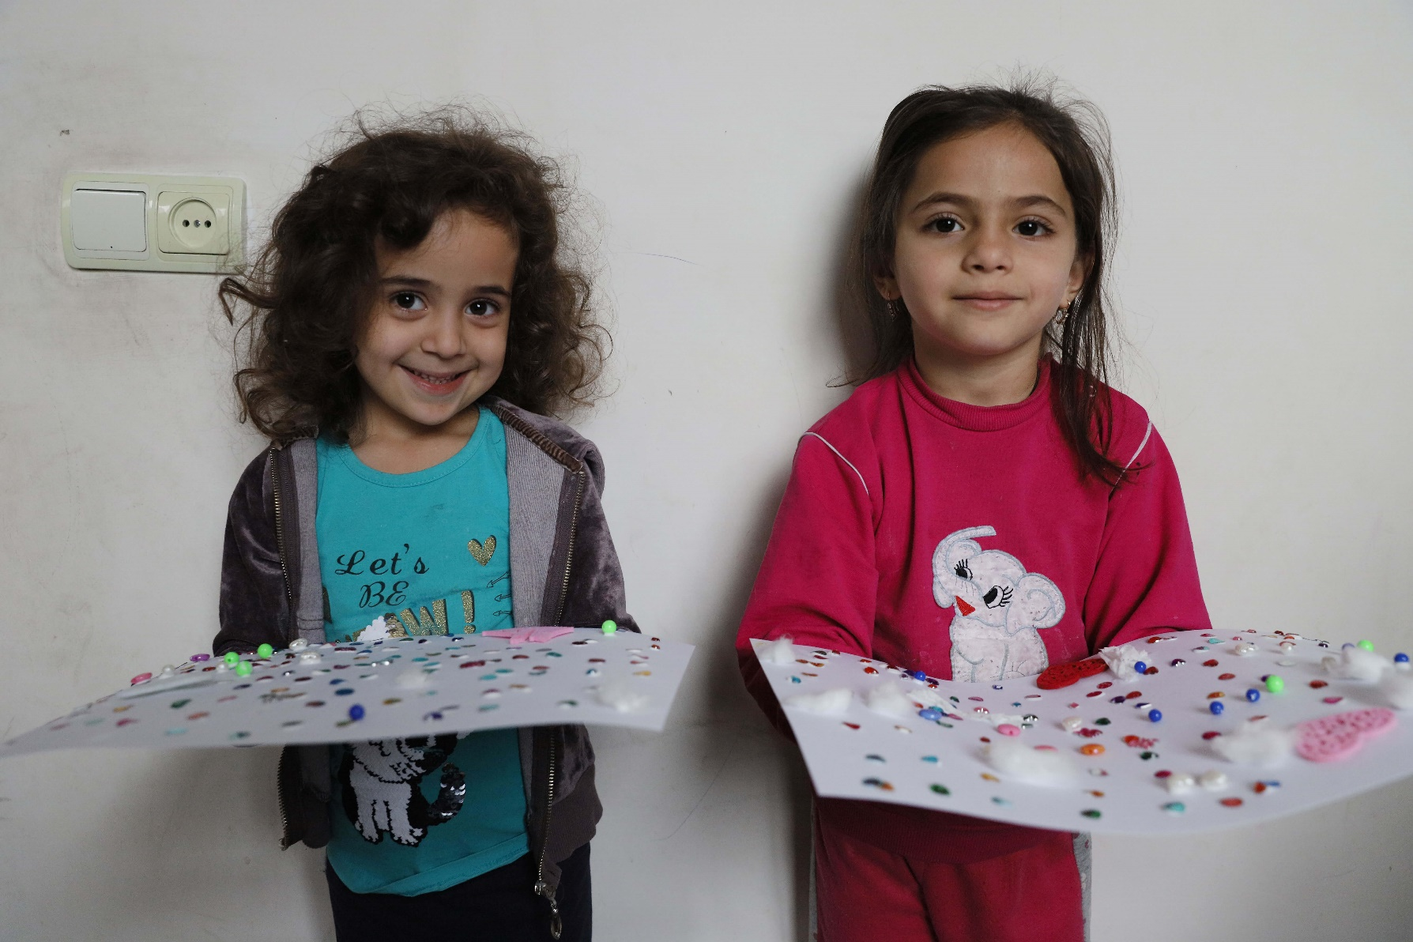

What is mental health?
Mental health
is something
that everyone
has – just like
physical health.
Sometimes we feel well, and sometimes we don’t.
Mental health refers to how we think, feel and behave.
© UNICEF/Grigoryan
Notes:
When our mental health is good, we might enjoy being around other people and feel able to take on challenges and new experiences.
But when our mental health is not so good, we can find it much harder to cope.

Slide 6
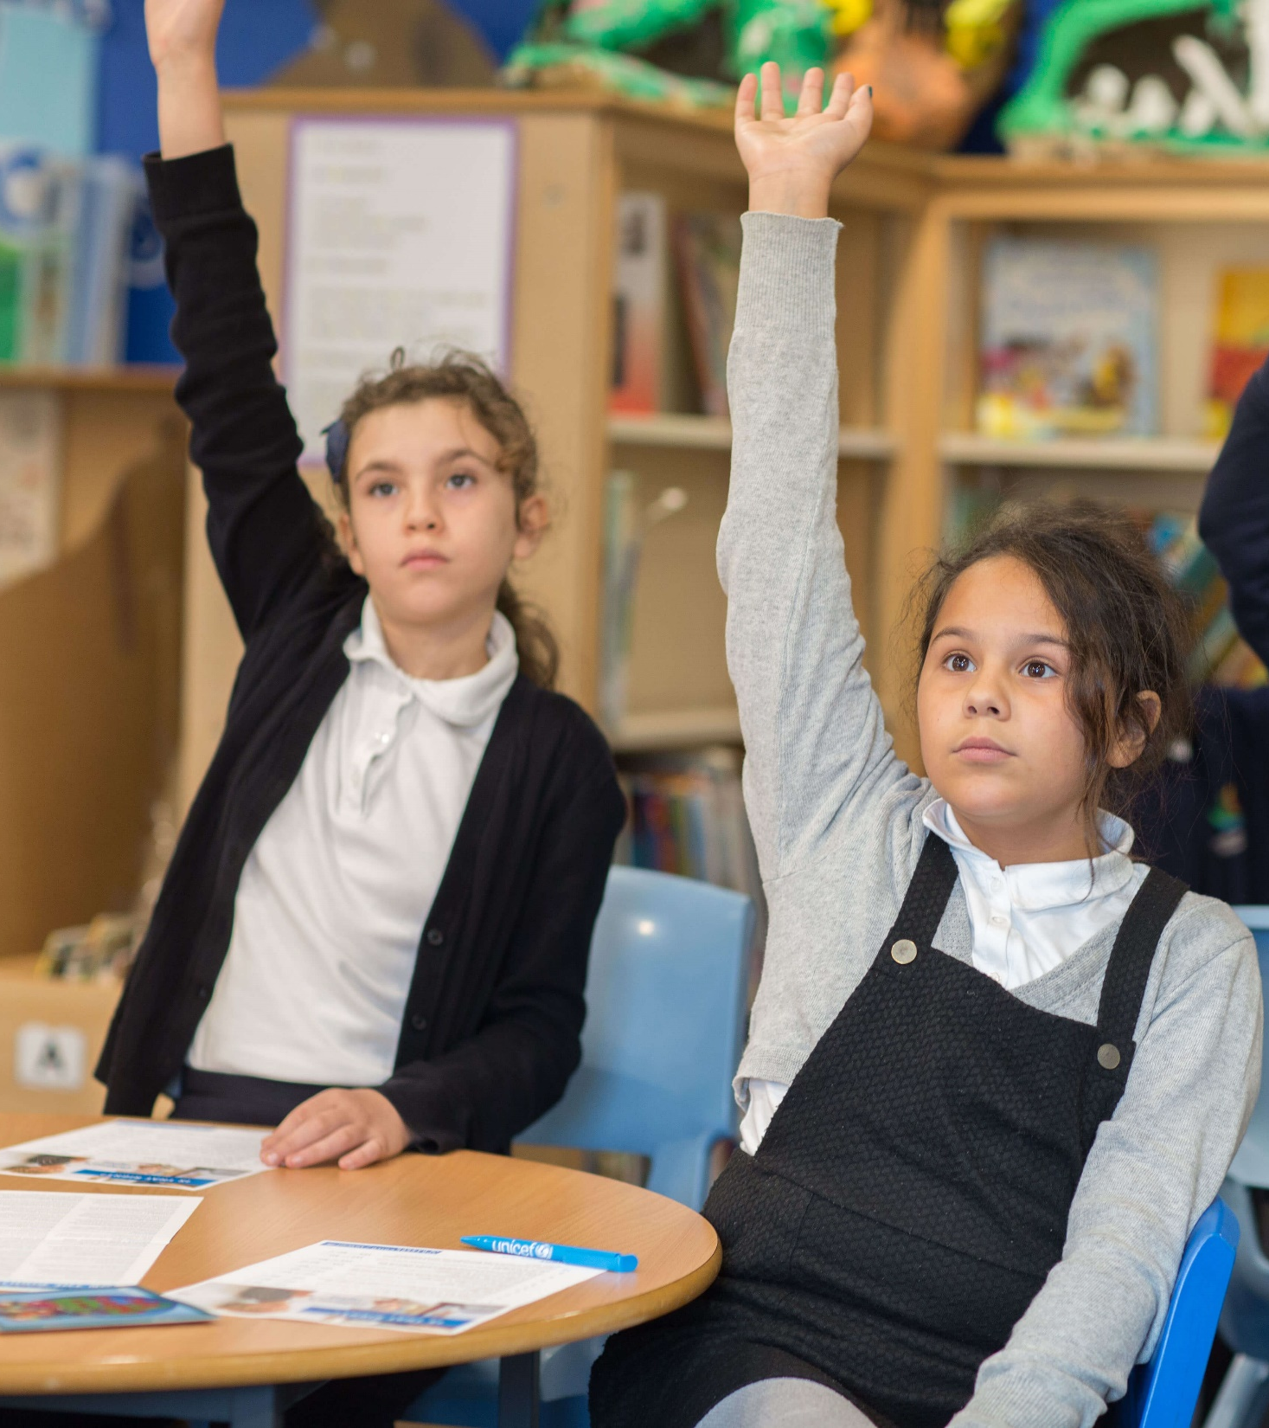

TAKING PART IN OUTRIGHT
We will:
Learn about mental health
and how it’s connected
to rights
Learn how some people are
treated unfairly because of their mental health
Think about how we can talk about how
we're feeling
Find out what to do if we're worried about someone we know
Speak out and take action on mental health, and hear about other children and young people who are doing the same
© UNICEF/Dawe
Notes:
All children have the right to the best health care possible. All adults and children should have information about how to stay safe and healthy. This is not just about children’s physical health, it’s about their mental health too.
Your mental health can impact how you feel and how you act. For example, for some children, if they're feeling happy it may encourage them to play and be active, and if they were feeling sad, that feeling could make someone want to spend time alone. It's important to understand that everyone is unique when it comes to how they feel and act.

Slide 7
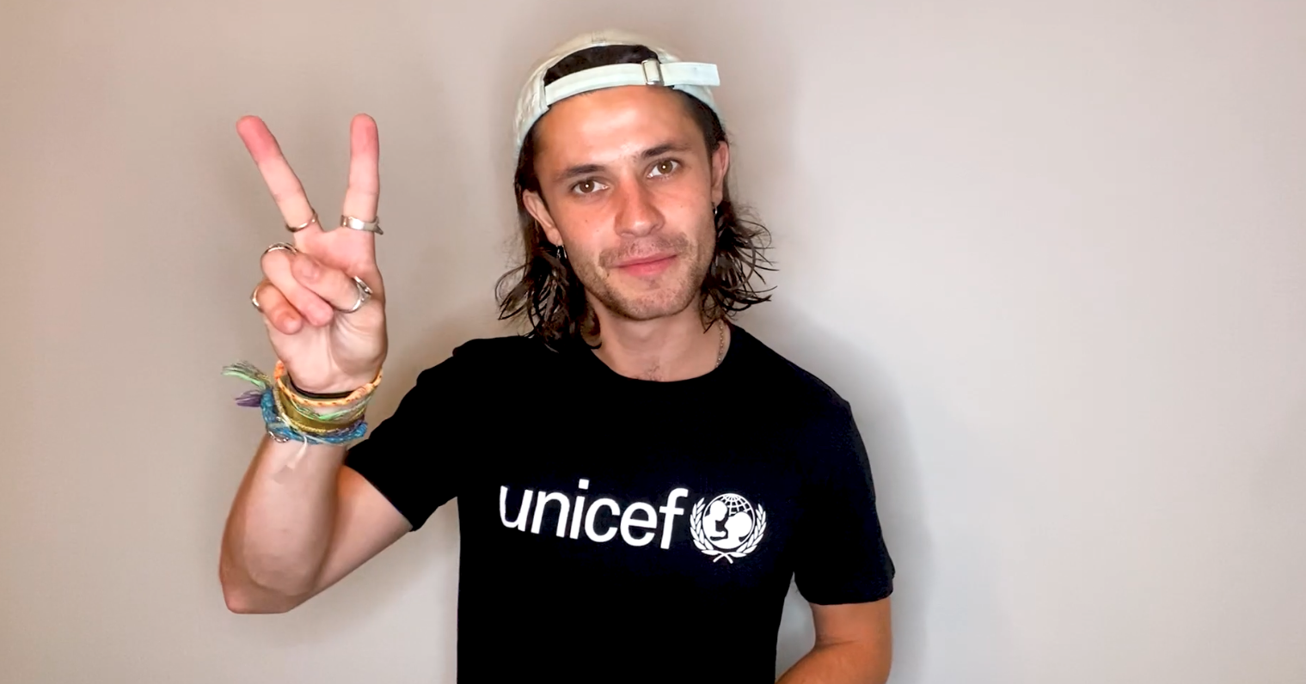
A MESSAGE FROM CEL SPELLMAN
Actor and UNICEF UK
High Profile Supporter
Cel Spellman has this message for you about
taking part in OutRight…
Click to play video
Cel video link
Notes:
Cel is a champion for youth voice and, like UNICEF UK, wants you to use your voices to make the world a better place.
The welcome message from Cel Spellman is available here: https://www.youtube.com/watch?v=TQF6DOSQbkA

Slide 8
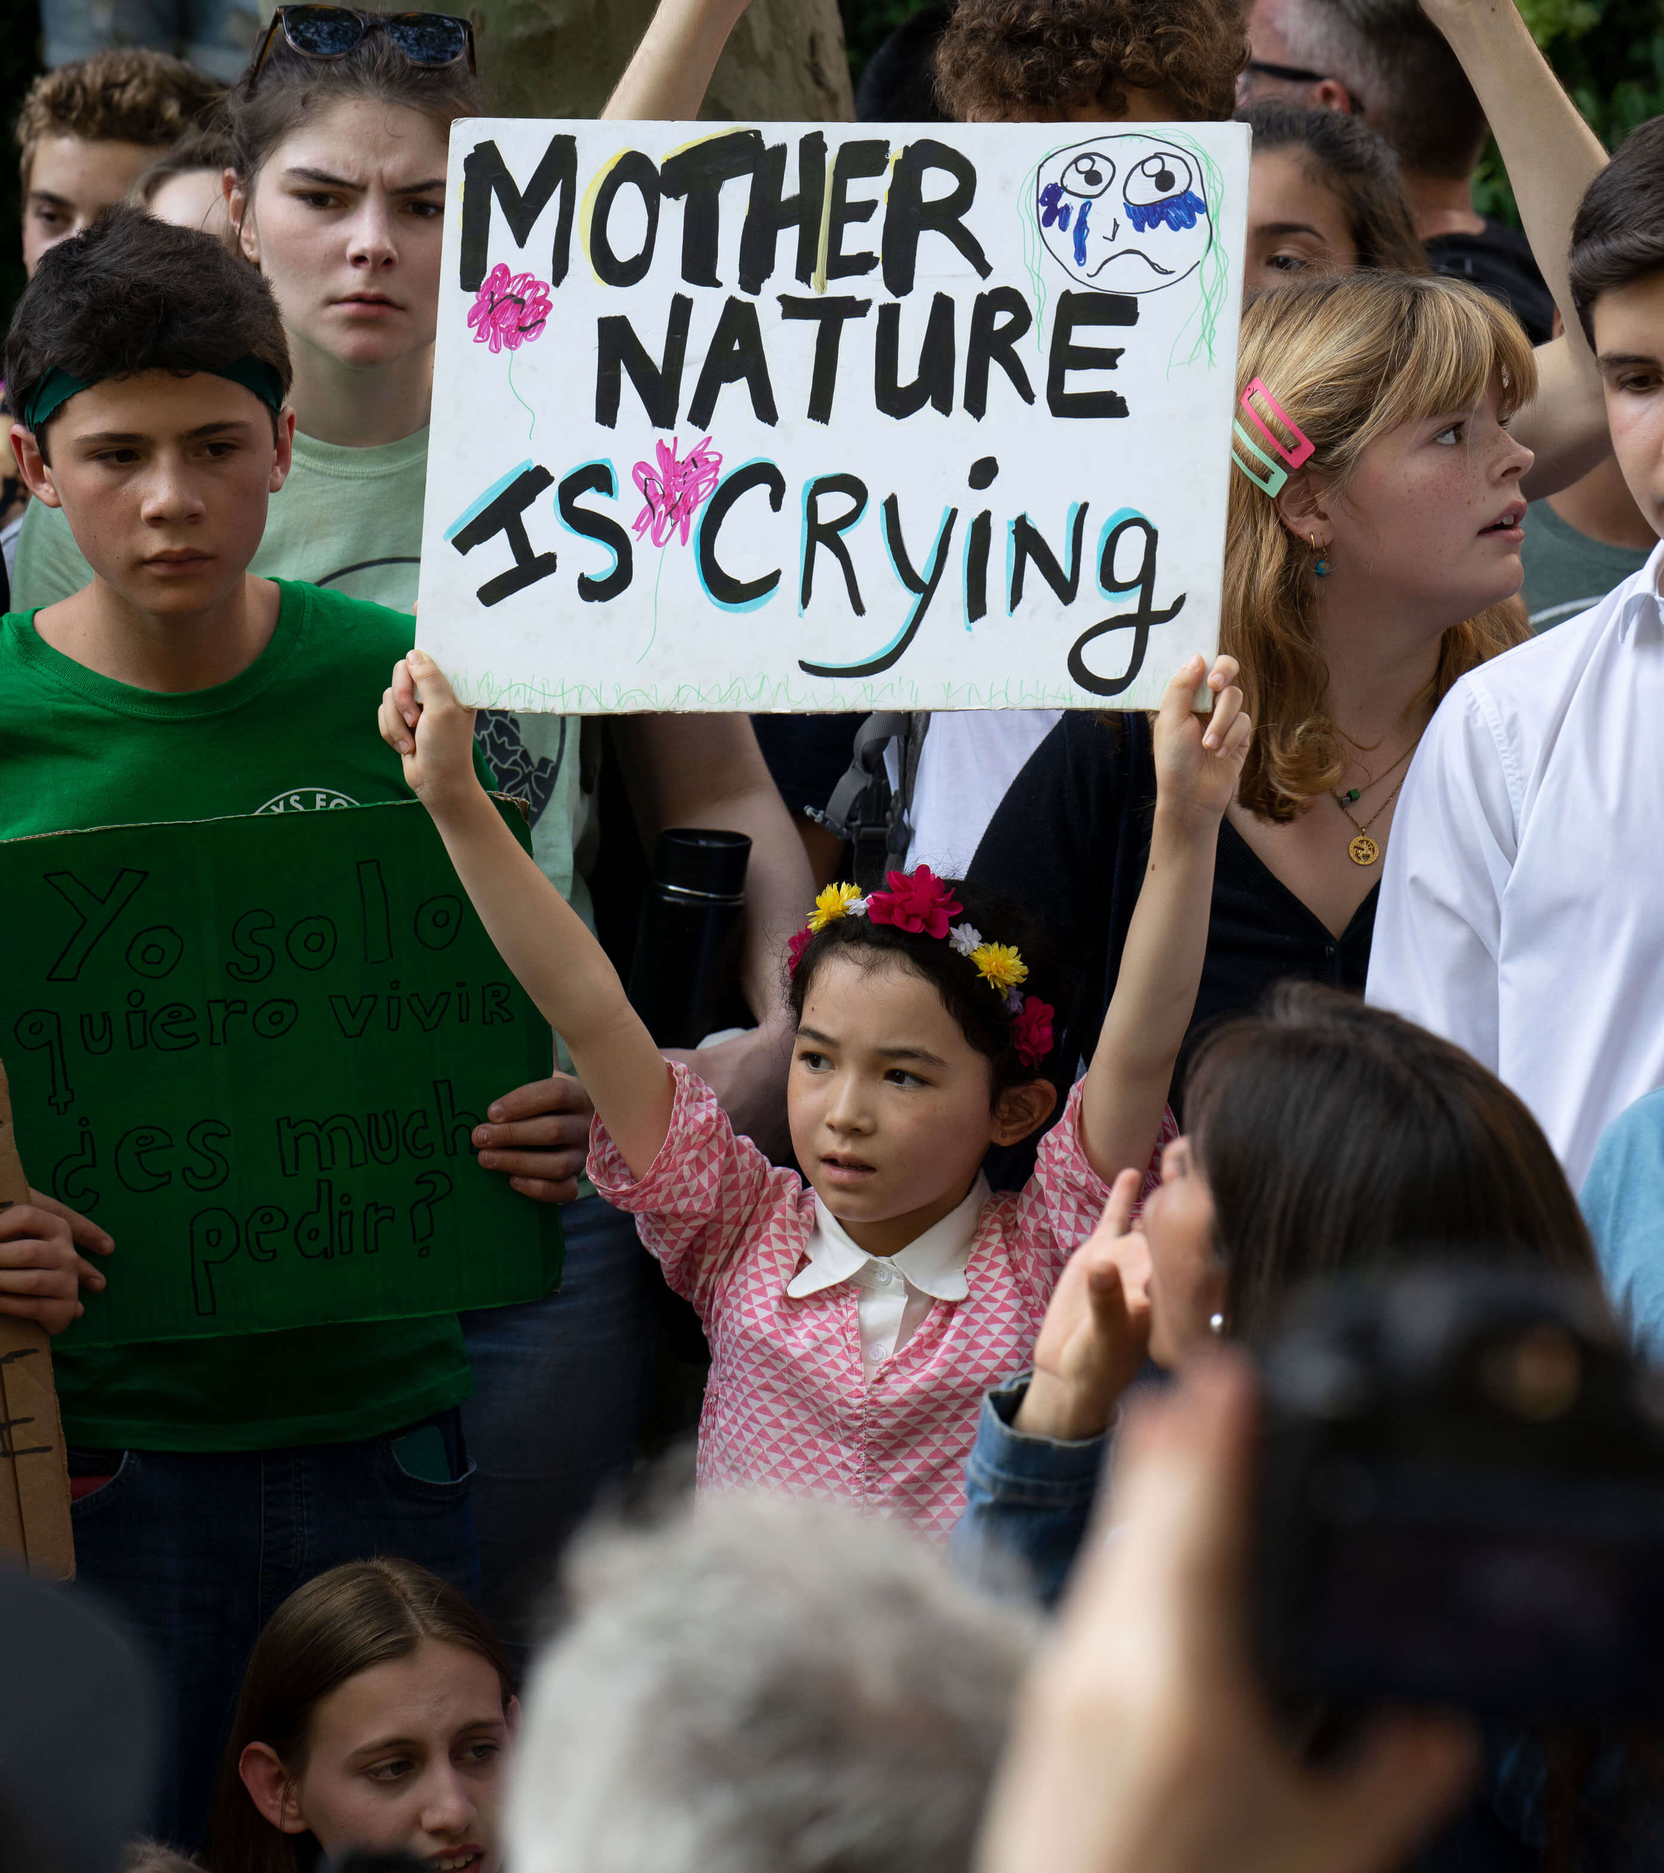
WHY
CAMPAIGN?
Children like you have an important role to play in campaigning to create change.
Your voices matter and can make a difference!
UN Convention on the Rights of the Child: Article 12
Every child has the right to say what they think in all matters affecting them, and to have their views taken seriously.
© UNICEF/Nesbitt
Notes:
Article 12 is a very important part of the UN Convention on the Rights of the Child because it's all about respecting children's views: every child has the right to express their views, feelings and wishes in all matters affecting them, and to have their views considered and taken seriously. This right applies at all times, for example during immigration proceedings, housing decisions or the child’s day-to-day home life.
Different situations and experiences can affect children's mental health so it's really important they know they have the right to talk about that. By getting involved in this campaign, children and young people can show those in power just how much they know and care about mental health and children’s rights.
Campaigning is one way children can use their voices and make sure their views are respected. Campaigning on issues that affect children can make a real difference to children and young people in the UK and around the world.

Slide 9



  JOIN PADDINGTON AND
  MAKE YOUR VOICE HEARD
For World Mental Health Day on 10 October, share what
you’ve learned and created during the campaign so far.
#WorldMentalHealthDay2021
On World Children's Day we will be amplifying children's voices. Tell us why you think mental health is important and we will share and repost your messages and quotes.
#WCD2021
After that, as a class or group you can create a Mental Health and Wellbeing Declaration
Don't forget to tag us on Twitter:
@UNICEFUK_Action
Notes:
As you work through the learning activities, children should have a better understanding of mental health, appreciating its importance in their lives and the lives of other children around the world.
We hope they feel inspired to use their voices.
There are lots of ways children can speak out and advocate for the importance of mental health and children’s rights throughout this campaign. We’ve shared a few of our ideas here but know that you’re going to come up with more!
For more information on how to share the work your class or group has been doing see the 'Campaign actions' resources that will be released over the next few months.
The Mental Health and Wellbeing Declaration will outline how and why mental health should be a focus in your school, group or organisation. Your group can also contact a local decision-maker and media outlets to raise awareness of the important of children's mental health.

Slide 10
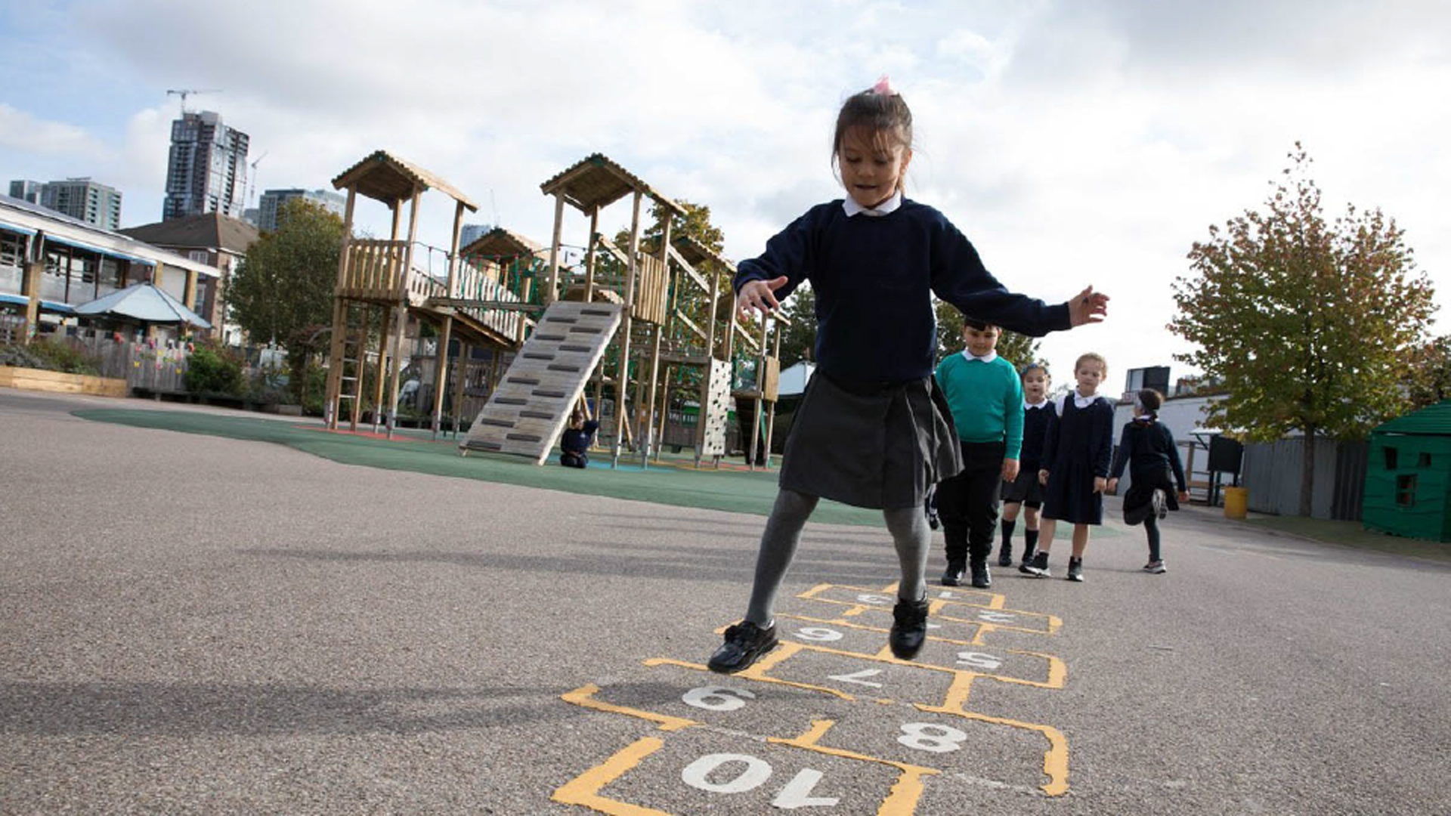

  THANK YOU
Thank you so much for taking part in OutRight this year and for making your voice heard.
We look forward to hearing what you get up to!
© UNICEF/Dawe

