Slide 1


Activity 1
DO YOU KNOW
YOUR RIGHTS?
UNICEF UK, registered charity England & Wales (1072612) Scotland (SC043677).
Notes:
Explain to the children that we are going to play a game to remind us of what we already know about children’s rights and to help us become familiar with the five rights we will be learning about this year.
Go through the questions one by one. Give children one minute to read and record their fill-in-the-blank answer for each question. More, or less, time may be given depending on how much time you have available, reading skills and the group’s existing level of knowledge of the CRC.
Allow children unfamiliar with child rights to use the child friendly summary or the Pocket Book of Rights as a reference for completing the activity.
Child friendly summary: https://www.unicef.org.uk/rights-respecting-schools/wp-content/uploads/sites/4/2019/11/UN0332751.pdf
Pocket book of rights: www.unicef.org.uk/rights-respecting-schools/resources/teaching-resources/pocket-book-of-rights/
Review the answers with the group using the answer slides. Ask the children to keep track of how many answers they got right.

Slide 2
Everyone under the age of ____ has the rights in the Convention.
18
Notes:
The answer is: 18
The answer will appear when you click through.

Slide 3
best
The _____ interests of the child must be a top priority in all things that affect children.
Notes:
The answer is: best.

Slide 4
Every child has the right to have a ____ in all matters affecting them, and to have their views taken seriously.
say
Notes:
The answer is: say.

Slide 5
The Convention applies to everyone: whatever their _____, religion or abilities, whatever they think or say, whatever type of family they come from.
race
Notes:
The answer is: race.

Slide 6
Every child has the right to the best possible health. ____________ must work to provide good quality health care, clean water, nutritious food and a clean environment and education on health and wellbeing so that children can stay healthy.
Governments
Notes:
The answer is: Governments.

Slide 7
Every child must be free to say what they ______ and to seek and receive all kinds of information, as long as it is within the law.
think
Notes:
The answer is: think.

Slide 8
Education must develop every child’s personality, talents and _________
to the full. It must encourage the child’s respect for human rights, as well as respect for their parents, their own and other cultures, and the environment.
.
abilities
Notes:
The answer is: abilities.

Slide 9
Every child has the right to reliable _____________ from the media. This should be information that children can understand. Governments must help protect children from materials that could harm them.
information
Notes:
The answer is: information.

Slide 10
disability
A child with a ___________ has the right to live a full and decent life with dignity and independence, and to play an active part in the community. Governments must do all they can to provide support.
Notes:
The answer is: disability.

Slide 11
© UNICEF/Mahari

Slide 12
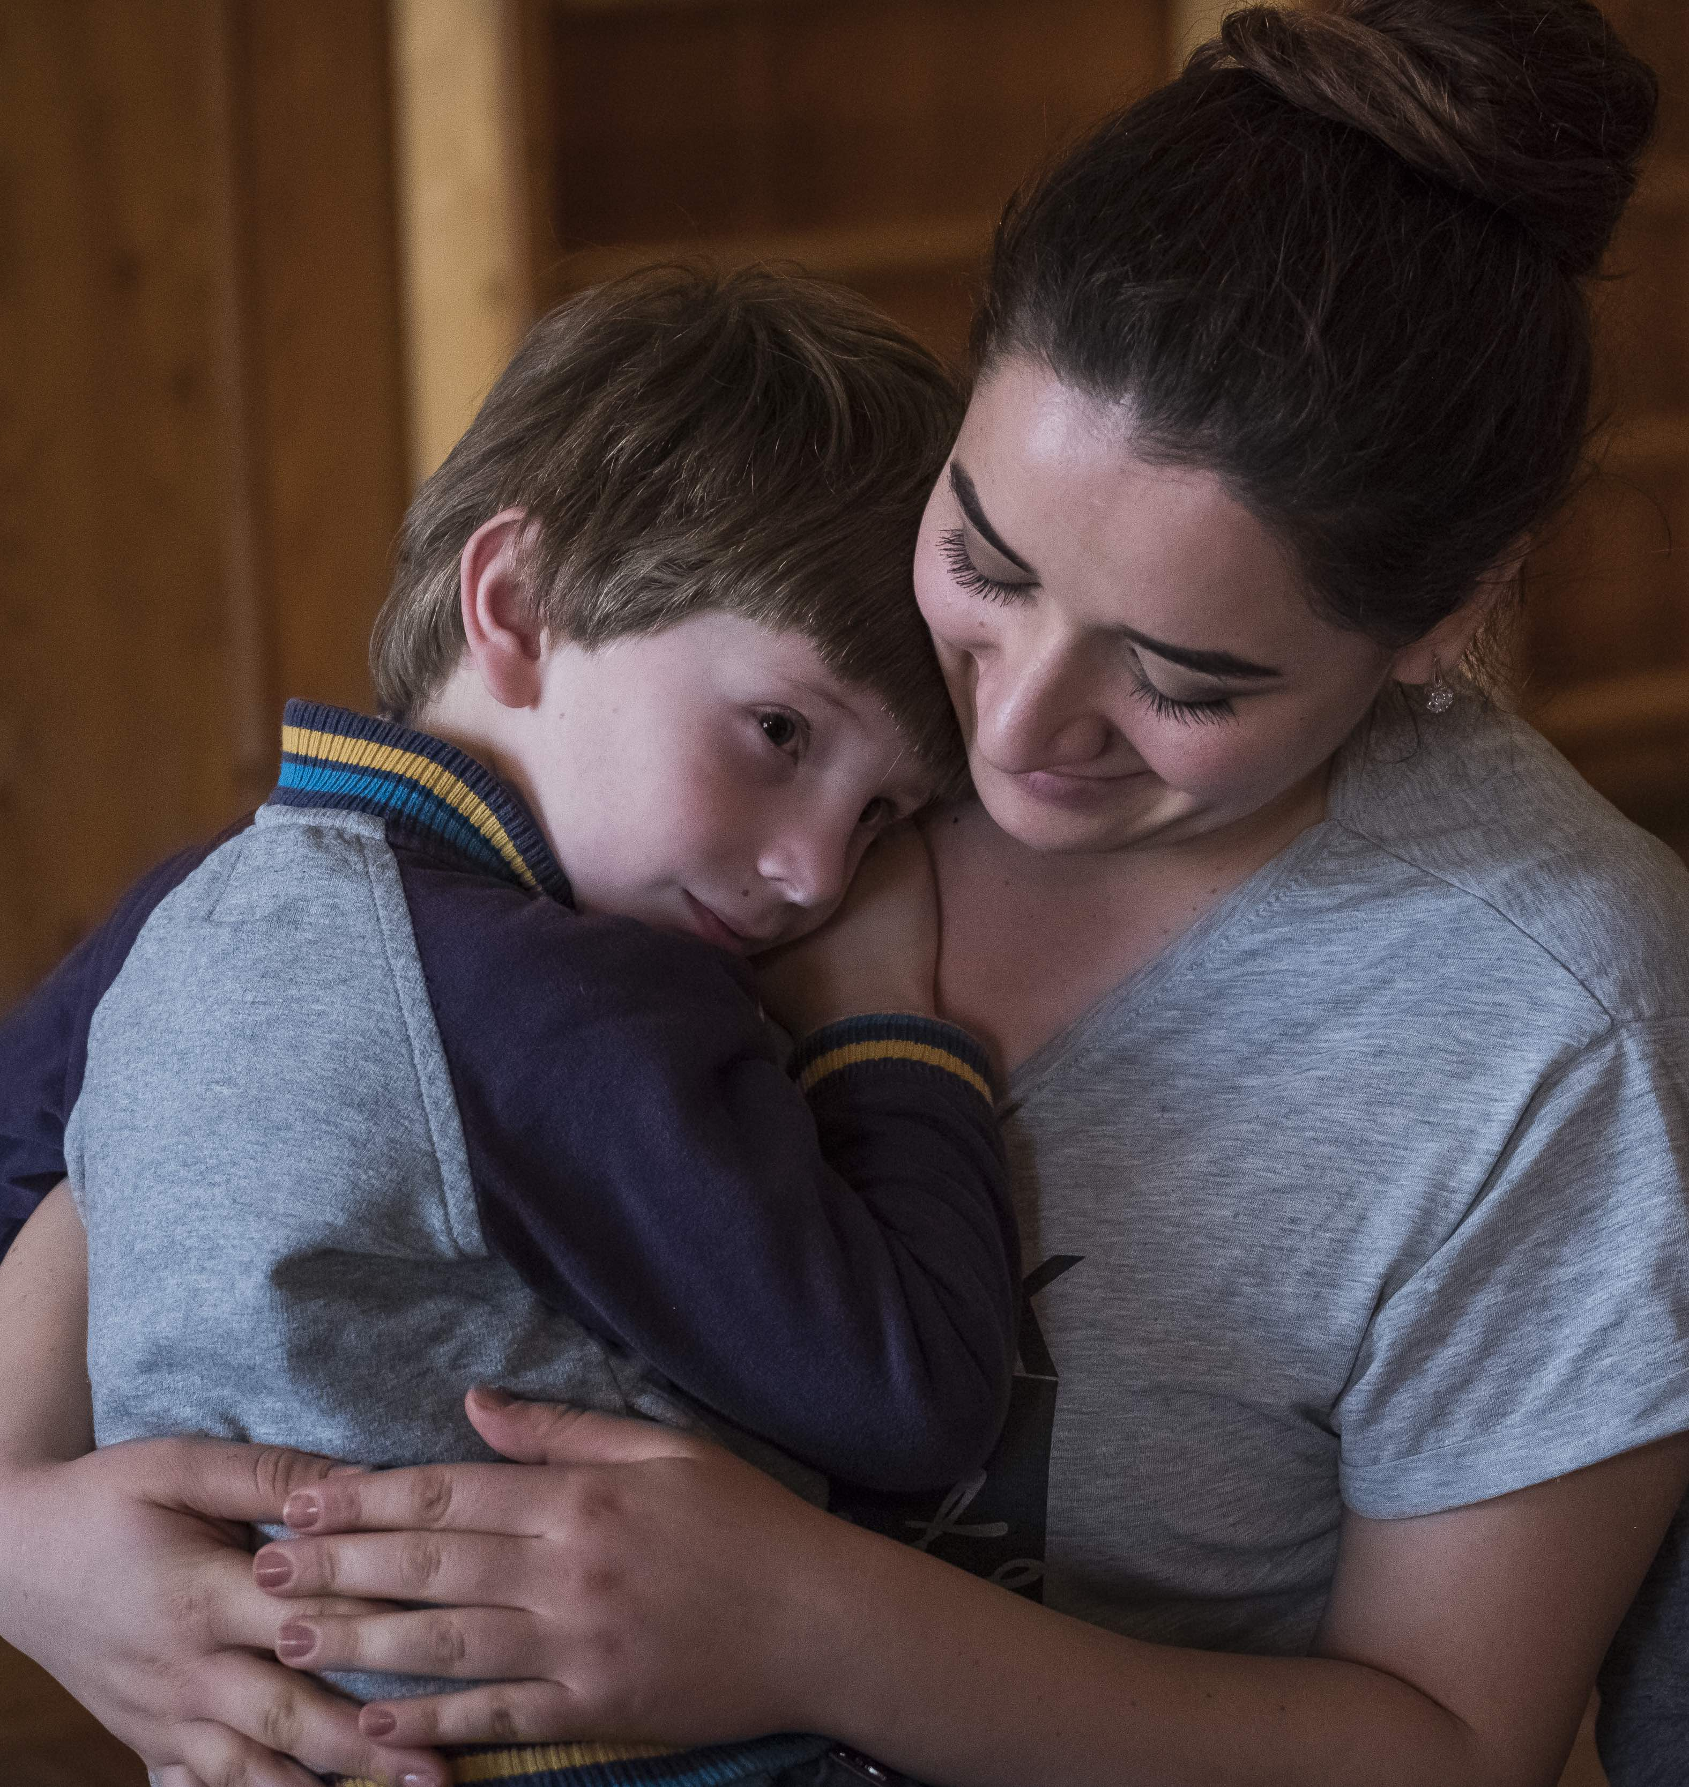

RIGHTS AND MENTAL HEALTH
© UNICEF/Sokhin
Mental health is something that everyone has – just like physical health. Sometimes we feel well, and sometimes we don’t. Mental health refers to how we think, feel and behave, and this changes. When our mental health is good, we might enjoy being around other people and feel able to take on challenges and new experiences.
© Unicef
Notes:
Part 2
Ask children to take turns reading each of the Articles on the following slides out loud.
Ask children to think about how the topic of mental health and wellbeing might connect to each of the six key rights (Articles 2, 3, 12, 13, 24 and 29) that we will highlight for OutRight this year.

Slide 13
ARTICLE 2 (no discrimination)
The Convention applies to
everyone: whatever their race,
religion or abilities, whatever they think
or say, whatever type of family they come from.
How is this Article linked to mental health?
Notes:
The rights we’ll talk about today apply to every child. Article 2 explains that these rights apply to all children everywhere, no matter who they, where they come from and what they look like.
Many of the Articles link to mental health and this Article explains how all those Articles apply to every child.

Slide 14
ARTICLE 3 (best interests of
the child)
The best interests of the child must
be a top priority in all things that
affect children.
How is this Article linked to mental health?
Notes:
Article 3 is important for every child’s mental health as it means adults should consider how the decisions they make will affect children’s mental health and that they should do what’s best for the child.
The role of governments is included in this Article too – it means they must make sure that people and places responsible for looking after children, like schools and children’s homes, are doing a good job of looking after children’s mental health.

Slide 15
ARTICLE 12 (respect for the
views of the child)
Every child has the right to have
a say in all matters affecting them,
and to have their views taken seriously.
How is this Article linked to mental health?
Notes:
Article 12 is really important because it means every child’s opinion matters when it comes to talking about their mental health and choices relating to it, including how they take care of their mental health and what kind of support or treatment they may receive.

Slide 16
ARTICLE 13 (freedom of
expression)
Every child must be free to say
what they think and to seek and
receive all kinds of information, as
long as it is within the law.
How is this Article linked to mental health?
Notes:
In relation to mental health, Article 13 means that every child must be free to express their thoughts and opinions about mental health. It also means they should have access to a range of information about mental health and the support available to them, as long as it's within the law.

Slide 17
ARTICLE 24 (health and health
services)
Every child has the right to the best
possible health. Governments must
work to provide good quality health care, clean water, nutritious food and a clean environment
so that children can stay healthy. Richer countries must help poorer countries achieve this.
How is this Article linked to mental health?
Notes:
Article 24 states that every child has the right to the best possible health care. This covers their mental and physical health, and governments must provide this. Other things they must provide that are included in this Article include clean water, nutritious food, a clean environment and education on health and wellbeing. These are all very important for children’s mental health.

Slide 18
ARTICLE 29 (education)
Education must develop every
child’s personality, talents and abilities
to the full. It must encourage the child’s
respect for human rights, as well as
respect for their parents, their own and
other cultures, and the environment.
How is this Article linked to mental health?
Notes:
Every child has the right to education. In respect to mental health, every child’s right to education includes developing their talents, personality, and abilities to the full. Understanding and being aware of our minds and mental health is important to ensure children develop to their full potential.

