Slide 1


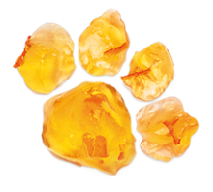

UNICEF UK, registered charity England & Wales (1072612) Scotland (SC043677).

Slide 2
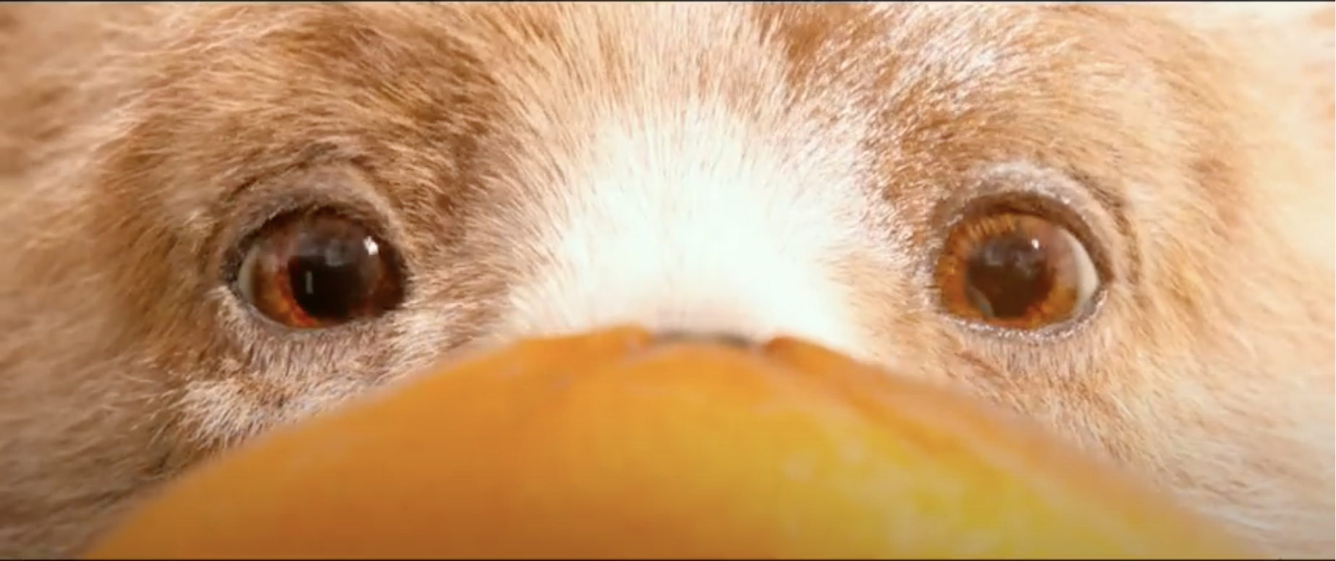
Click to play video
Notes:
Share Paddington’s story

Slide 3
Notes:
What are emotions?
Emotions are also called feelings like being happy or anger or scared.

Slide 4

He lost his uncle Pastuzo in the earthquake in Peru?
Notes:
How do you think Paddington felt?
Why do you think he felt that way?
Can you think of anything else?
Prompts: Sad, worried

Slide 5
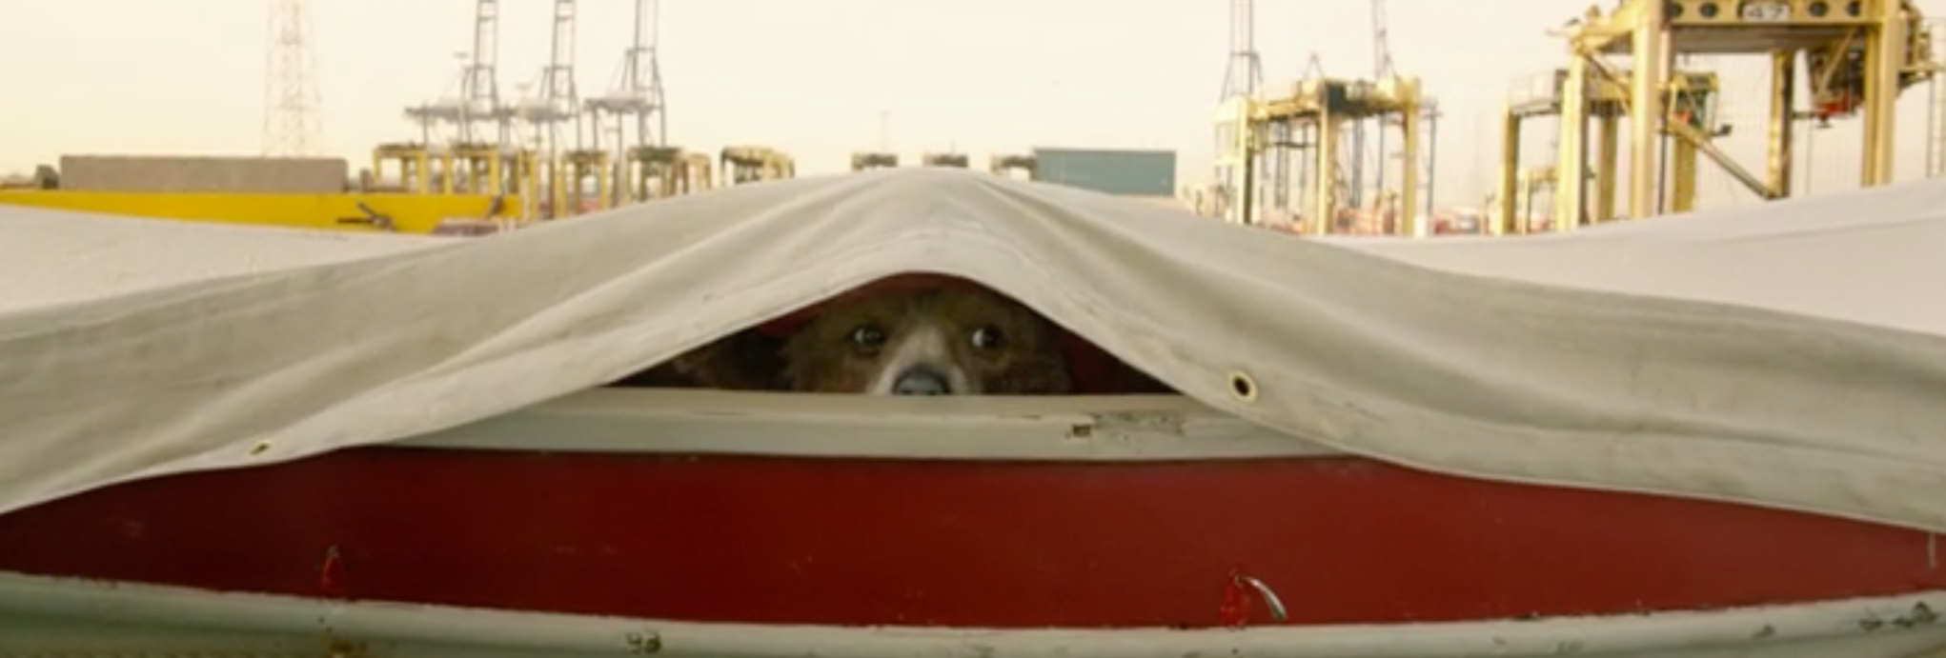
He was hiding in the lifeboat?
Notes:
How do you think Paddington felt?
Why do you think he felt that way?
Can you think of anything else?
Prompts: Scared, lonely, afraid he might be found, worried, anxious

Slide 6
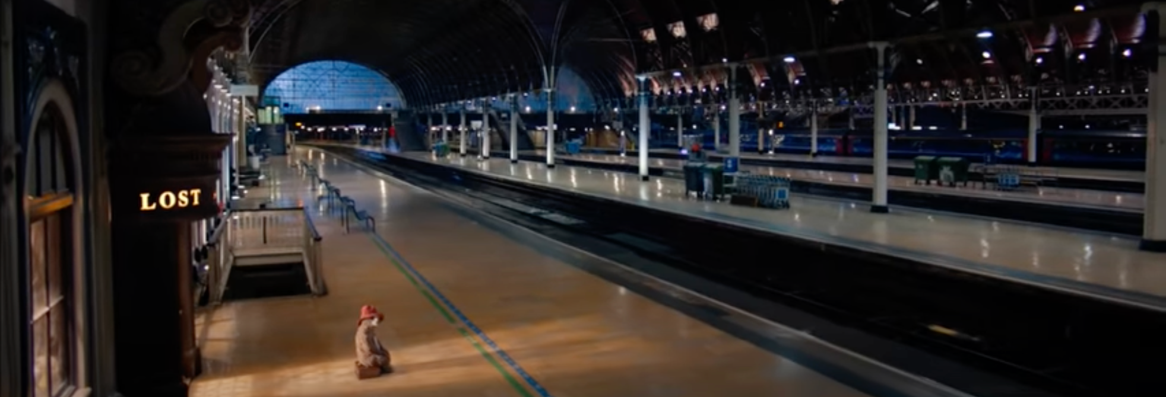
He was sitting alone at the railway station, wondering what to do next?
Notes:
How do you think Paddington felt?
Why do you think he felt that way?
Can you think of anything else?
Prompts: Lonely, scared, excited, nervous, confused, afraid

Slide 7
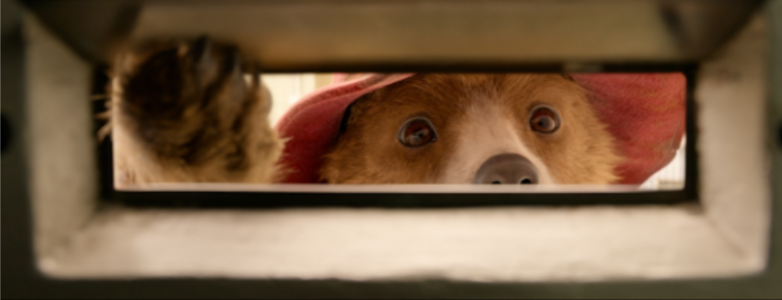
The Brown family offered him a place to stay?
Notes:
How do you think Paddington felt?
Why do you think he felt that way?
Can you think of anything else?
Prompts: Happy, relieved, nervous, confused

Slide 8
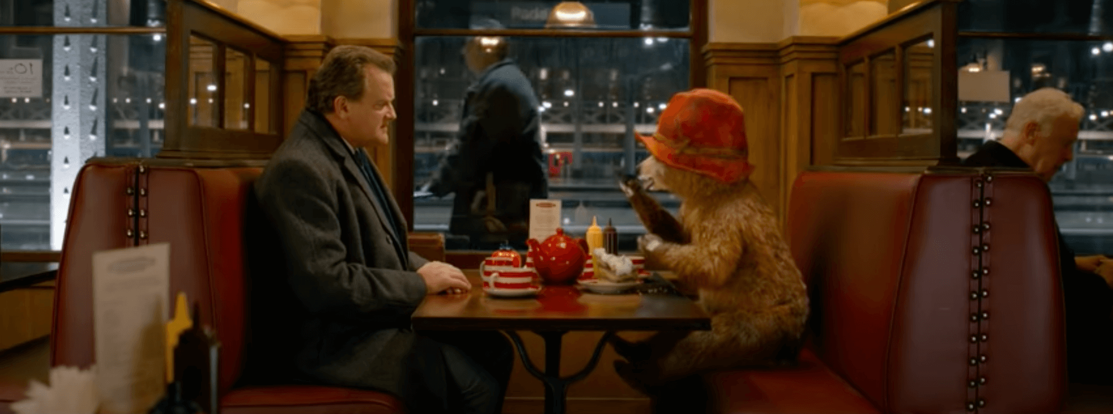
No one could pronounce his bear name?
Notes:
How do you think Paddington felt?
Why do you think he felt that way?
Can you think of anything else?
Prompts: Sad, misunderstood, confused, lonely

Slide 9
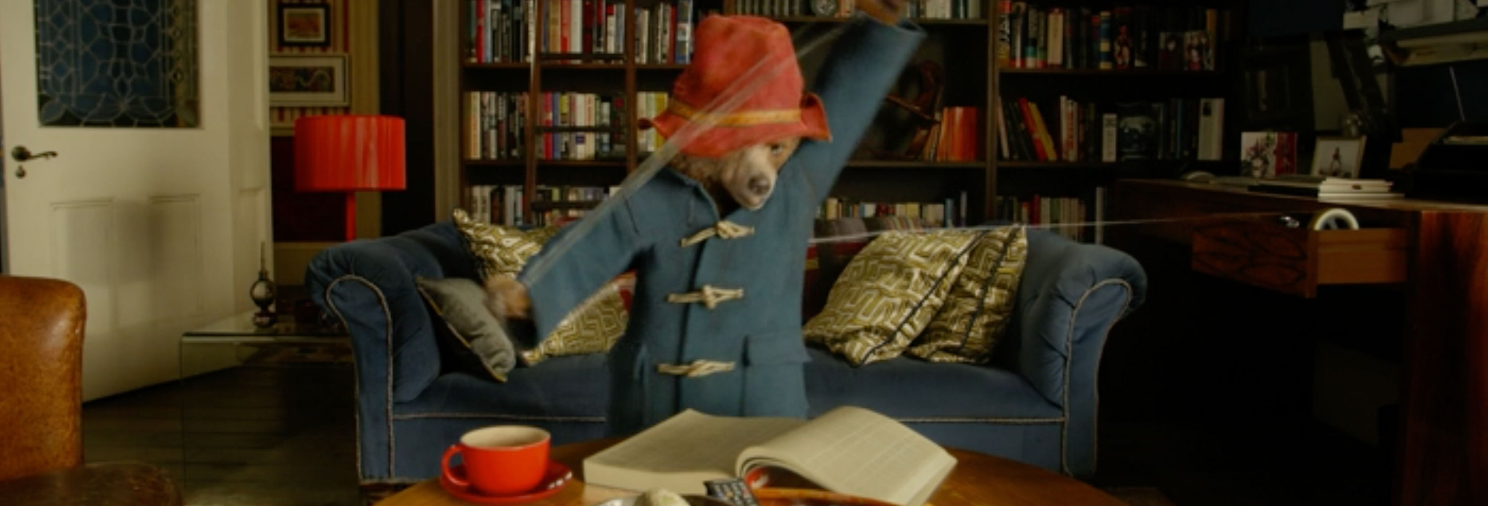
He had to learn to do new things that humans normally did, but not bears?
Notes:
How do you think Paddington felt?
Why do you think he felt that way?
Can you think of anything else?
Prompts: Excited, confused, happy

Slide 10
Notes:
Part 2

Slide 11

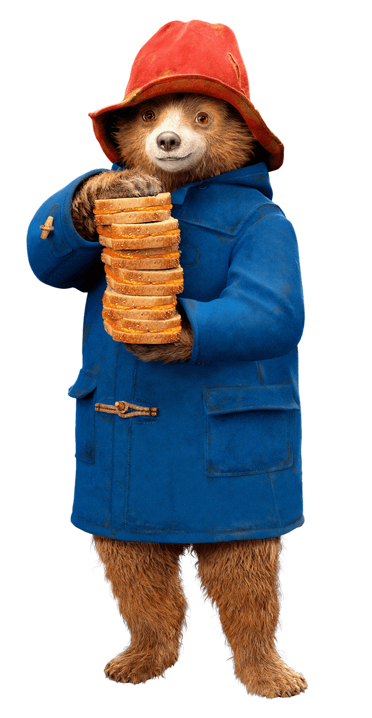


Mental health is something that everyone has – just like physical health. Sometimes we feel well, and sometimes we don’t.
Mental health refers to how we think, feel and behave, and this changes.
When our mental health is good, we might enjoy being around other people and feel able to take on challenges and new experiences.
But when our mental health is not so good, we can find it much harder to cope.
Source: adapted from Young Minds
Notes:
Mental health is something that everyone has – just like physical health. Sometimes we feel well, and sometimes we don’t. Mental health refers to how we think, feel and behave, and this changes. When our mental health is good, we might enjoy being around other people and feel able to take on challenges and new experiences. But when our mental health is not so good, we can find it much harder to cope.
Source: adapted from Young Minds

Slide 12
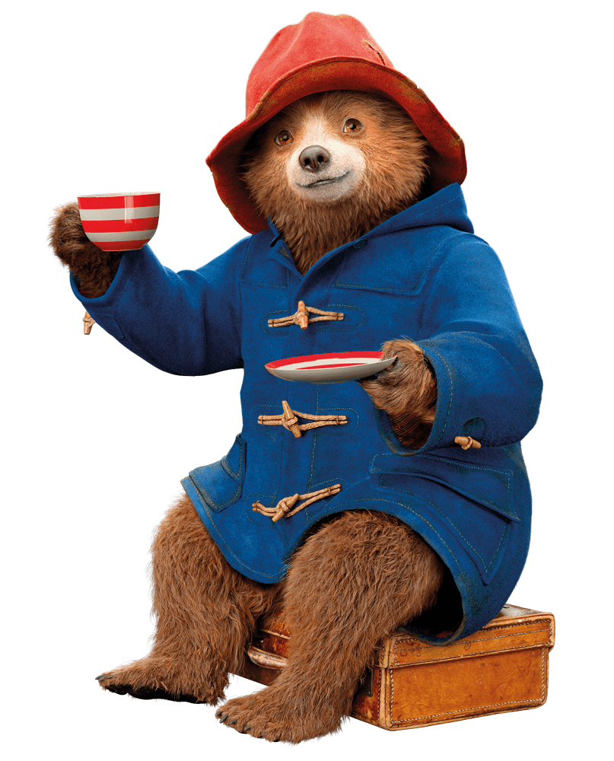
Mental health conditions are health problems that can change a person’s thinking, behaviour and ability to cope
with emotions.
They can affect daily life and stop someone doing the things they usually enjoy, or the ability to feel ok.
Source: adapted from Young Minds
Notes:
Mental health is something that everyone has – just like physical health. Sometimes we feel well, and sometimes we don’t. Mental health refers to how we think, feel and behave, and this changes. When our mental health is good, we might enjoy being around other people and feel able to take on challenges and new experiences. But when our mental health is not so good, we can find it much harder to cope.
Source: adapted from Young Minds

Slide 13
THE MENTAL HEALTH CONTINUUM
Being active and enjoying hobbies Comfortable with others and/or yourself | Feeling cross Not feeling like yourself | Feeling tearful and sad a lot of the time Not sleeping well | More anger, anxiety Feeling tearful and sad a lot of the time Thinking about hurting yourself (on purpose)
Notes:
Introduce the mental health green-yellow-amber-red continuum diagram, noting that the difference between mental health and mental health problems. Explain that just like our physical health, our mental health can change over different times. Sometimes we may be very healthy, but anyone’s situation can shift if or as their as their situation improves or deteriorates.
Share examples from along the continuum as they are introduced in the slide progression. Give additional examples as needed for understanding.
Green
- Changing moods and emotions
- Sleeping well
- Being active and enjoying hobbies
- Comfortable with others and/or yourself
Yellow
- Increased nervousness, sadness, worrying
- Feeling cross, forgetful, impatient
- Not sleeping well
- Not feeling like yourself
- Not wanting to see the people you like
Amber
- Increased anger, anxiety
- Feeling tearful and sad a lot of the time
- Not sleeping well
- Not wanting to see anyone at all
- Finding it hard to concentrate and doing less well at school
Red
- Trouble controlling emotions
- Feeling very anxious
- Panic attacks
- Depressed mood, feeling overwhelmed
- Constant tiredness, very poor sleep
- Feeling confused about what is real
- Choosing not to see anyone
- Thinking about hurting yourself (on purpose)
- Thinking about ending your life

Slide 14
WHERE DO THESE EXAMPLES GO?
If you get a bump or bruise?
If you feel sad after an argument with a friend?
If you feel sad for many days in a row and can’t sleep?
If you are very ill and have to go to the hospital and stay overnight?
Notes:
Ask the children to think about the examples shown of physical and mental health. Which category might they go in? For younger children, give additional examples from the list below. For older children, ask them to think of examples for each category – including both physical and mental health examples. Prompt as needed and highlight what the solutions for each of these examples might be.
Examples:
Getting a bump or a bruise (physically healthy – may need a little care, will heal quickly)
Having a cold or not feeling well but still being able to play (physically reacting – may need some medicine, but you’ll go back to healthy soon by taking care of yourself)
Having a broken arm or leg (physically Injured - you’ll need medical help to be healed)
Being ill with a virus like COVID-19 (physically ill – you may need medicine and regular medical help until you get better)
Feeling sad because you don’t like what’s for dinner (mentally healthy – being happy or sad for short periods are all normal emotions)
Worried about not going to school because of lockdown (mentally reacting – you can talk to someone or need some self-care, but can usually go back to being healthy by taking care of yourself)
Not caring about completing schoolwork any more after many months of lockdown (mentally injured –you need help to process what you’re feeling to get back to full health)
Feeling depressed for a long time and wanting to hurt yourself (mentally ill –you need medicine and regular medical help until you get better)
Prompt children to make the connections that:
• Every place on the continuum is a completely normal place to be
• It is normal to move back and forth on the scale
• When we are healthy or reacting we can usually treat ourselves through self-care or the support of friends, family or carers; but when we are injured or ill, we usually need help from medical professionals to become healthy again.

Slide 15
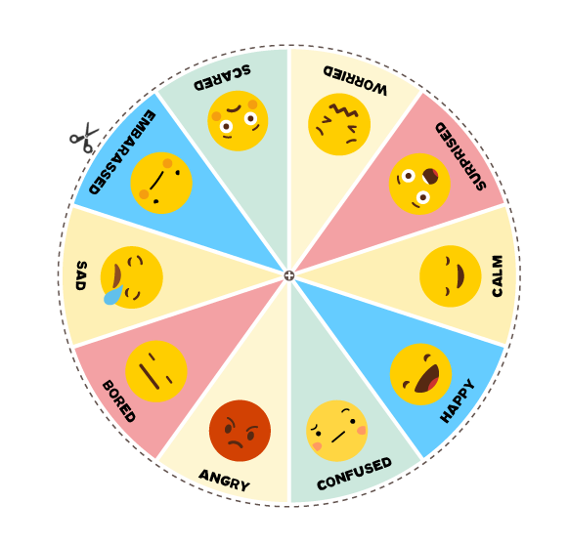
LET'S MAKE A WHEEL
OF WELLBEING
Use your own wheel of wellbeing to track how you're feeling
Source: Adapted from Mentally Healthy Schools / Anna Freud National Centre for Children and Families
Notes:
Invite children to make a list of six to eight emotions that they are most likely to feel day to day. Be sure to include a range of different emotions. For example: happy, angry, stressed, surprised, calm, scared, nervous.
Using white paper or card and markers, instruct children to draw a large circle on the paper, then divide the circle into the number of wedges of emotions that they have included in their list.
Ask children to write one of the emotions from their list in each of the wedges of the circle, then decorate each wedge to demonstrate that specific feeling. For example, they might draw emoji faces for each emotion, or draw and colour the wedge how that emotion makes them feel.
Ask children to cut out the circle to complete the emotion wheel, then use a clothes peg or paper clip to mark how they might be feeling in the moment.
Explain that we can use our emotion wheel to help us identify at any time how we might be feeling. This is important because when we can identify how we are feeling, it helps us talk about it and it helps us know what actions we might take if we want to change our feelings or behaviour.
Having good mental health, doesn't mean feeling happy all day, every day: most people feel sad or worried at least sometimes. However, if someone is feeling very sad or worried, for long periods of time, it's important not to ignore that, and talk to somebody.

Slide 16



ARTICLE 13 (FREEDOM OF EXPRESSION)
Children have the right to share freely with others what they learn, think and feel, by talking, drawing, writing or in other ways, unless it harms people.
Notes:
Complete the lesson by reminding children of the connection to Article 13 of the CRC. Children have the right to share freely with others what they learn, think and feel, by talking, drawing, writing or in other ways, unless it harms people.

