Slide 1

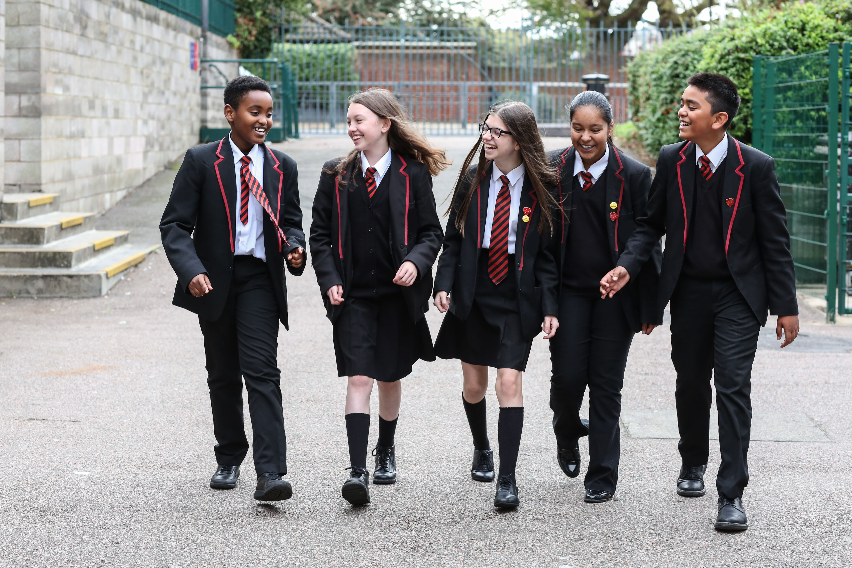

Activity 1
Is mental health and wellbeing a child’s right?
UNICEF UK, registered charity England & Wales
(1072612) Scotland (SC043677).​
©UNICEF/Dawe

Slide 2
ARTICLE 2
(no discrimination)
All children have all these rights, no matter who they are, where they live, what language they speak, what their religion is, what they think, what they look like, regardless of gender or wealth, if they have a disability, and no matter who their parents or families are or what their parents or families believe or do. No child should be treated unfairly for any reason.
Notes:
Article 2 explains that these rights apply to all children everywhere, no matter who they, where they come from and what they look like.
For example, a school should not discriminate against a child who is suffering from anxiety, just like one would expect a school to make reasonable adjustments not to discriminate against a child with a broken leg.

Slide 3
ARTICLE 3
(best interests of the child)
When adults make decisions, they should think about how their decisions will affect children. All adults should do what is best for children. Governments should make sure children are protected and looked after by their parents, or by other people when this is needed. Governments should make sure that people and places responsible for looking after children are doing a good job.
Notes:
Article 3 is important for every child’s mental health because it means adults should consider how the decisions they make will affect children’s mental health and that they should do what’s best for the child.
The role of governments is included in this Article too – it means they must make sure that people and places responsible for looking after children, like schools and children’s homes, are doing a good job of looking after children’s mental health.

Slide 4
ARTICLE 12
(respect for the views of the child)
Children have the right to give their opinions freely on issues that affect them. Adults should listen and take children seriously.
Notes:
Article 12 is really important because it means every child’s opinion matters when it comes to talking about their mental health and choices relating to it; including how they take care of it and what kind of support or treatment they may receive.

Slide 5
ARTICLE 13
(freedom of expression)
Children have the right to share freely with others what they learn, think and feel, by talking, drawing, writing or in any other way unless it harms other people.
Notes:
In relation to mental health, Article 13 means that every child must be free to express their thoughts and opinions about mental health. It also means they should have access to a range of information about mental health and the support available to them,,as long as it's within the law.

Slide 6
ARTICLE 24
(health and health services)
Children have the right to the best health care possible, clean water to drink, healthy food and a clean and safe environment to live in. All adults and children should have information about how to stay safe and healthy.
Notes:
Article 24 states that every child has the right to the best possible health care. This covers their mental and physical health, and governments must provide this. Other things they must provide that are included in this Article include clean water, nutritious food, a clean environment and education on health and wellbeing. These are all very important for children’s mental health.

Slide 7
ARTICLE 29
(goals of education)
Children’s education should help them fully develop their personalities, talents and abilities. It should teach them to understand their own rights, and to respect other people’s rights, cultures and differences.
It should help them to live peacefully and protect the environment.
Notes:
Article 29 tells us that every child has the right to education. In respect to mental health, every child’s right to education includes developing their talents, personality, and abilities to the full. Understanding and being aware of our minds and mental health is important to ensure children develop to their full potential. Children with a mental health condition have the same right to education as children who are in good mental health.

Slide 8
IS MENTAL HEALTH AND WELLBEING
A CHILD’S RIGHT?
© Unicef
Notes:
Complete the activity by returning to the opening question. How did this activity and discussion change your thinking?

