Slide 1

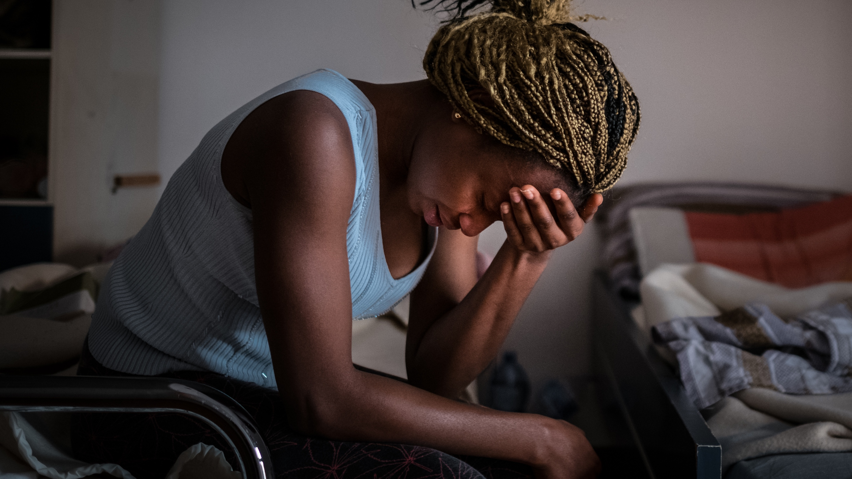

Activity 3
What is mental health
and wellbeing?
© UNICEF/Gilbertson VII Photo

Slide 2


EMOTION CHARADES
© UNICEF/Al-Safadi
Two minutes per turn
Don’t use words
Guess as fast as you can!
Notes:
Part 1
Invite young people to play emotion charades. Write different emotions on slips of paper and put them in a bag or hat. This can be prepared in advance, or young people can create the emotion slips before the activity (leave time to review slips and remove duplicates and any words submitted that do not belong).
Ask young people to take turns to pick an emotion out of the bag or hat, then act out that feeling, without speaking, in front of the group. The rest of the group must guess which emotion is being portrayed. (If playing virtually, let each young person think of an emotion to act out.) Using a timer, give each team two minutes per turn. If you want to keep score, time the groups while guessing. The time elapsed is the score and the team with the lowest score wins!
In wrapping up the activity, ask young people to point out how often the ‘actors’ portrayed a physical feeling or expression to demonstrate the emotion. What does this say about that emotion?

Slide 3

WHAT’S THE WORD?
© UNICEF/Dawe
Expanding your mental health vocabulary.
Notes:
Part 2
Introduce young people to the vocabulary game. Explain that it is important when we talk about mental health that we learn how to use the proper language. Using the right terminology when we talk about mental health can remove some of the stigma and discrimination caused by outdated language. Knowing the right language also helps normalise talking about mental health.
Split the group into smaller groups of three or four. Each group will need pen and paper. (For virtual facilitation this can be completed as an individual challenge.)
Explain that on each slide the young people will see a word that relates in some way to mental health and wellbeing. For each slide they will have two minutes for each group to discuss and write a definition for the word that they see. You may give more time for each word for younger groups or groups less familiar with the subject matter.
After the time is finished, ask a representative from each group to share their definition.
Display the actual definition for the word by clicking through the slide.
Work through the vocabulary slides one by one, discussing each word and giving young people an opportunity to talk about why each word is important, and how it might hurt someone or cause stigma or shame if used incorrectly.

Slide 4
MENTAL HEALTH
Mental health refers to how we think, feel and behave.
Mental Health is something that everyone has – just like physical health.
Our mental health changes. Sometimes we feel well, and sometimes we don’t. When our mental health is good, we might enjoy being around other people and feel able to take on challenges and new experiences.
But when our mental health is not so good, we can find it much harder
to cope.
Notes:
Mental health refers to how we think, feel and behave.
Mental Health is something that everyone has – just like physical health.
Our mental health changes. Sometimes we feel well, and sometimes we don’t. When our mental health is good, we might enjoy being around other people and feel able to take on challenges and new experiences.
But when our mental health is not so good, we can find it much harder to cope.
Source: adapted from Young Minds - https://youngminds.org.uk/find-help/what-is-mental-health/

Slide 5
MENTAL HEALTH
Mental health refers to how we think, feel and behave.
Mental Health is something that everyone has – just like physical health.
Our mental health changes. Sometimes we feel well, and sometimes we don’t. When our mental health is good, we might enjoy being around other people and feel able to take on challenges and new experiences.
But when our mental health is not so good, we can find it much harder
to cope.
Notes:
Mental health refers to how we think, feel and behave.
Mental Health is something that everyone has – just like physical health.
Our mental health changes. Sometimes we feel well, and sometimes we don’t. When our mental health is good, we might enjoy being around other people and feel able to take on challenges and new experiences.
But when our mental health is not so good, we can find it much harder to cope.
Source: adapted from Young Minds - https://youngminds.org.uk/find-help/what-is-mental-health/

Slide 6
MENTAL HEALTH
Mental health refers to how we think, feel and behave.
Mental Health is something that everyone has – just like physical health.
Our mental health changes. Sometimes we feel well, and sometimes we don’t. When our mental health is good, we might enjoy being around other people and feel able to take on challenges and new experiences.
But when our mental health is not so good, we can find it much harder
to cope.
Notes:
Mental health refers to how we think, feel and behave.
Mental Health is something that everyone has – just like physical health.
Our mental health changes. Sometimes we feel well, and sometimes we don’t. When our mental health is good, we might enjoy being around other people and feel able to take on challenges and new experiences.
But when our mental health is not so good, we can find it much harder to cope.
Source: adapted from Young Minds - https://youngminds.org.uk/find-help/what-is-mental-health/

Slide 7
MENTAL HEALTH CONDITION
Mental health problems that change a person’s thinking, behaviour and ability to cope with emotions.
Without support, they can affect daily life and stop someone doing the things they usually enjoy, or the ability to feel OK.
Notes:
Mental health problems that change a person’s thinking, behaviour and ability to cope with emotions. Without support, they can affect daily life and stop someone doing the things they usually enjoy, or the ability to feel OK.
Source: adapted from Young Minds - https://youngminds.org.uk/find-help/what-is-mental-health/

Slide 8
NEURODIVERSITY
The idea that brain differences are normal, rather than deficits or disabilities.
Neurodiversity is not a mental health condition.
Notes:
Neurodiversity is the term that is applied to all those with neurological differences such as dyslexia, dyspraxia, ADHD, or the autistic spectrum.
Neurodiversity is not a mental health condition and should not be classified as such.
The idea of neurodiversity can help reduce stigma and celebrate difference.
Source: adapted from bdadyslexia.org.uk

Slide 9
MINDFULNESS
The practice of paying full attention to something and focusing on being intensely aware of what you're sensing and feeling in the moment in order to relax the body and mind and help reduce stress.
Notes:
Mindfulness is the practice of paying full attention to something and focusing on being intensely aware of what you're sensing and feeling in the moment in order to relax the body and mind and help reduce stress.
Source: adapted from kidshealth.org

Slide 10
STRESS
A physical and emotional response to pressure or threat that may make you feel tense, nervous, or on edge.
Stress triggers the physical release of adrenaline, which may give you a feeling of energy, an increased heartbeat or sweaty palms.
Notes:
Stress
A physical and emotional response to pressure or threat that may make you feel tense, nervous, or on edge. Stress triggers the physical release of adrenaline, which may give you a feeling of energy, an increased heartbeat or sweaty palms.
Source: adapted from kidshealth.org

Slide 11
DEPRESSION
A low mood involving sadness, discouragement, despair, or hopelessness that lasts for weeks, months, or even longer.
A condition that affects thinking and interferes with the ability to notice or enjoy the good things in life.
Notes:
Depression is a low mood involving sadness, discouragement, despair, or hopelessness that can last for weeks, months, or even longer. Depression can affect thinking and interferes with the ability to notice or enjoy the good things in life.
Source: adapted from kidshealth.org

Slide 12
ANXIETY
A sense of uneasiness, nervousness, worry, fear, or dread of what's about to happen or what might happen. A sense of anticipated danger, trouble, or threat.
Anxiety disorders are mental health conditions that involve excessive amounts of anxiety, fear, nervousness, worry, or dread. Anxiety that is too constant or too intense can cause a person to feel preoccupied, distracted, tense, and always on alert.
Notes:
Anxiety
A sense of uneasiness, nervousness, worry, fear, or dread of what's about to happen or what might happen. A sense of anticipated danger, trouble, or threat. Anxiety disorders are mental health conditions that involve excessive amounts of anxiety, fear, nervousness, worry, or dread. Anxiety that is too constant or too intense can cause a person to feel preoccupied, distracted, tense, and always on alert.
Source: adapted from kidshealth.org
Note for facilitators: encourage young people to recognise the difference between short term feelings of depression or anxiety and longer term diagnoses of these conditions. They will develop a further understanding of this during the next exercise.

Slide 13
RESILIENCE
The ability to adapt in the face of hard times and recover from difficulties.
Notes:
Resilience
The ability to adapt in the face of hard times and recover from difficulties.
Source: adapted from APA

Slide 14
SUICIDE
When a person takes their own life, or does something to make themself die.
Most often, people who choose suicide are severely depressed and believe it is the only way to stop their pain.
Notes:
Suicide
When a person takes their own life, or does something to make themself die. It is a preventable death. Most often, people who choose suicide are severely depressed and believe it is the only way to stop their pain.
Source: adapted from kidshealth.org
See also: https://youngminds.org.uk/find-help/for-parents/parents-guide-to-support-a-z/parents-guide-to-support-suicidal-thoughts/

Slide 15

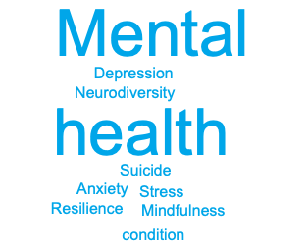
HOW DOES THIS CONNECT TO ARTICLE 13?
Notes:
Tie the discussion into Article 13 –we all have the right to share our opinion, but we should not use language that harms others.

Slide 16
THE MENTAL HEALTH CONTINUUM
Being active and enjoying hobbies Comfortable with others and/or yourself | Feeling cross Not feeling like yourself | Feeling tearful and sad a lot of the time Not sleeping well | Increased anger, anxiety Feeling tearful and sad a lot of the time Thinking about hurting yourself (on purpose)
Adapted from the following sources: Delphis and Safehouse
Notes:
Part 3
Introduce the mental health green-yellow-amber-red continuum diagram, noting that the difference between mental health and mental health conditions. Explain that just like our physical health, our mental health can change over different times. Sometimes we may be very healthy, but anyone’s situation can change.
Share examples from along the continuum as they are introduced in the slide progression. Give additional examples as needed for understanding.
Green
- Changing moods and emotions
- Sleeping well
- Being active and enjoying hobbies-Comfortable with others and/or yourself
Yellow
-Increased nervousness, sadness, worrying
-Feeling cross, forgetful, impatient-Not sleeping well
-Not feeling like yourself
-Not wanting to see the people you like
Amber
- Increased anger, anxiety
- Feeling tearful and sad a lot of the time
- Not sleeping well
- Not wanting to see anyone at all
- Finding it hard to concentrate and doing less well at school
Red
- Trouble controlling emotions
- Feeling very anxious
- Panic attacks (https://www.childline.org.uk/info-advice/your-feelings/anxiety-stress-panic/coping-panic-attacks/)
- Depressed mood, feeling overwhelmed
- Constant tiredness, very poor sleep
- Feeling confused about what is real
- Choosing not to see anyone

Slide 17
WHERE DO THESE EXAMPLES GO?
If you get a bump or bruise?
If you feel sad after an argument with a friend?
If you feel sad for many days in a row and can’t sleep?
If you are very ill and have to go to the hospital and stay overnight?
Adapted from the following sources: Delphis and Safehouse
Notes:
Ask the young people to think about the examples shown of physical and mental health. Which category might they go in?
Ask them to think of their own examples for each category – including both physical and mental health examples. Prompt as needed and highlight what the solutions for each of these examples might be.
Examples
Getting a bump or a bruise (physically healthy – may need a little care, will heal quickly)
Having a cold or not feeling well but still being able to play (physically reacting –may need some medicine, but you’ll go back to healthy soon by taking care of yourself)
Having a broken arm or leg (physically Injured – you’ll need medical help to be healed)
Being ill with a virus like COVID-19 (physically ill – you may need medicine and regular medical help until you get better)
Feeling sad because you don’t like what’s for dinner (mentally healthy – being happy or sad for short periods are all normal emotions)
Worried about not going to school because of lockdown (mentally reacting – you can talk to someone or need some self-care, but can usually go back to being healthy by taking care of yourself)
Not caring about completing school work any more after many months of lockdown (mentally injured – you need help to process what you’re feeling to get back to full health)
Feeling depressed for a long time and wanting to hurt yourself (mentally ill –you need medicine and regular medical help until you get better)
Prompt young people to make the connections that:
Every place on the continuum is a completely normal place to be
It is normal to move back and forth on the scale
When we are in the green or yellow areas of the continuum we can usually treat ourselves through self-care or the support of friends, family or carers; but when we are in amber or red, we usually need help from medical professionals to become healthy again.

