Slide 1
Unicef Voices of Youth/@sara.nzt
Notes:
Sara Naseh from Iran entered this image in the Unicef Voices of Youth World Children’s Day Illustration Challnage. She said: “I illustrated children of different backgrounds that are all working together as a family, to help our planet become a safer place for everyone. Let this day be a reminder that we are responsible for the children of today and owe them a better and safer life for tomorrow.“

Slide 2
Slide 3 – Guess the article
Slide 4 – Introducing articles 1 & 42
Slide 5 – Exploring articles 1 & 42
Slide 6 – Some possible answers
Slides 7&8 – Primary Activities
Slides 9&10 – Secondary Activities
Slide 11 – Reflection

Slide 3
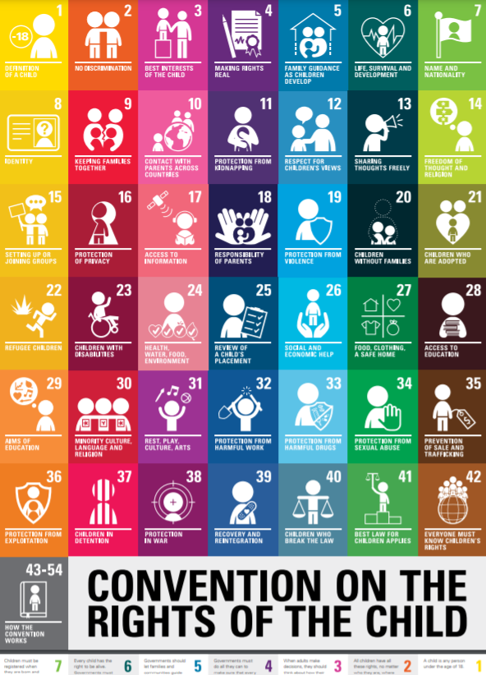
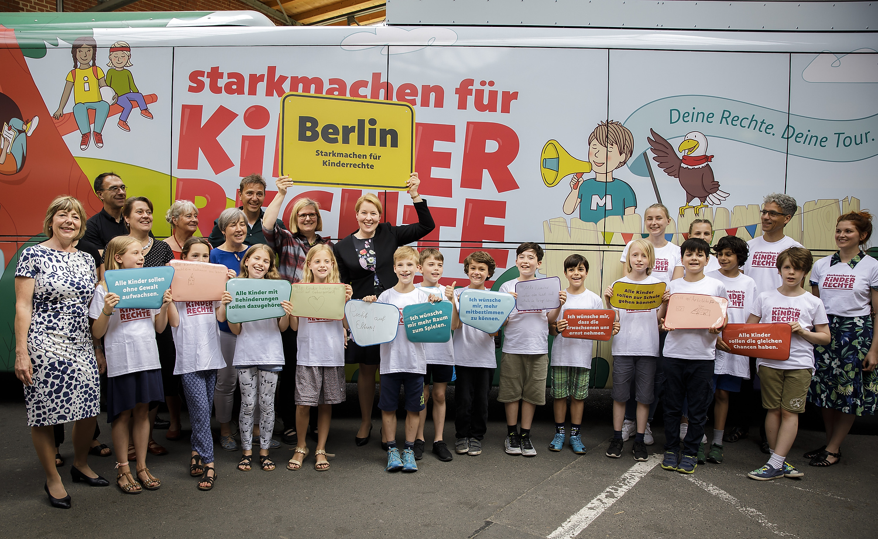
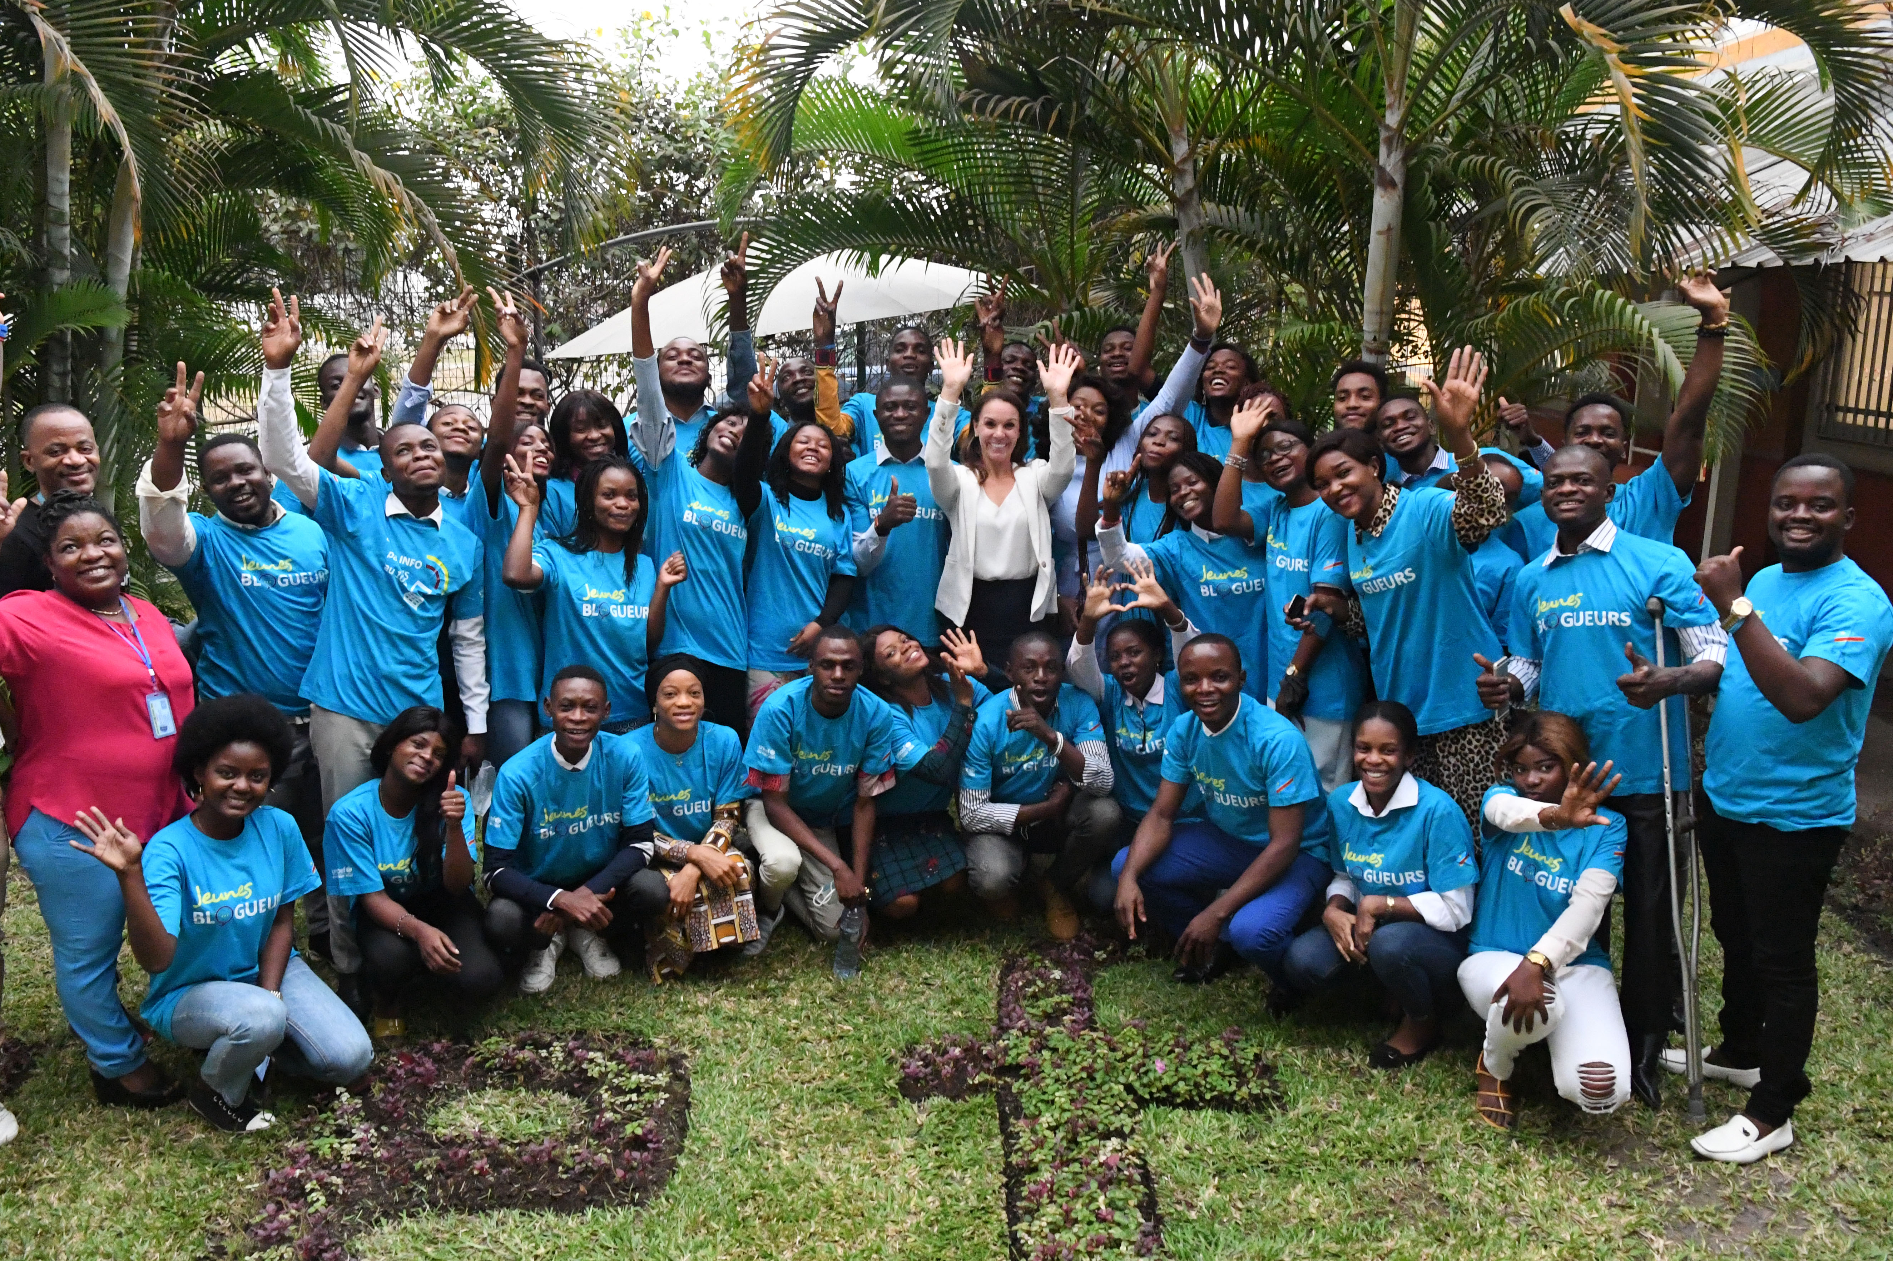
Guess the Article
These pictures provide a clue to this week’s article.
How do these pictures help you? Can you guess how they are linked together?
Write down your thoughts or discuss with someone in your house.
UNICEF UK/Zahn
Unicef/Zahn
Unicef/Dejongh
UNICEF
Notes:
From left to right
The Child Friendly CRC icons, available to download here - www.unicef.org.uk/rights-respecting-schools/resources/teaching-resources/guidance-assemblies-lessons/child-friendly-crc-text-and-icons/
Berlin, 20 June 2019 – The Minister for Family Affairs Dr. Franziska Giffey (in the centre) sends off the Children’s Rights Bus from Berlin. The United Nations Convention on the Rights of the Child was signed 30 years ago. To spread knowledge about children’s rights even more, a so-called Children’s Rights Bus (Kinderrechte-Bus) of Germany’s Federal Ministry for Family Affairs tours through more than 20 cities under the motto „Campaign for children’s rights“ („Starkmachen für Kinderrechte“).
UNICEF Democratic Republic of Congo trains the first 150 out of 500 young Congolese on Blogging: how to identify and debunk false information, defend children’s rights, produce positive content.

Slide 4
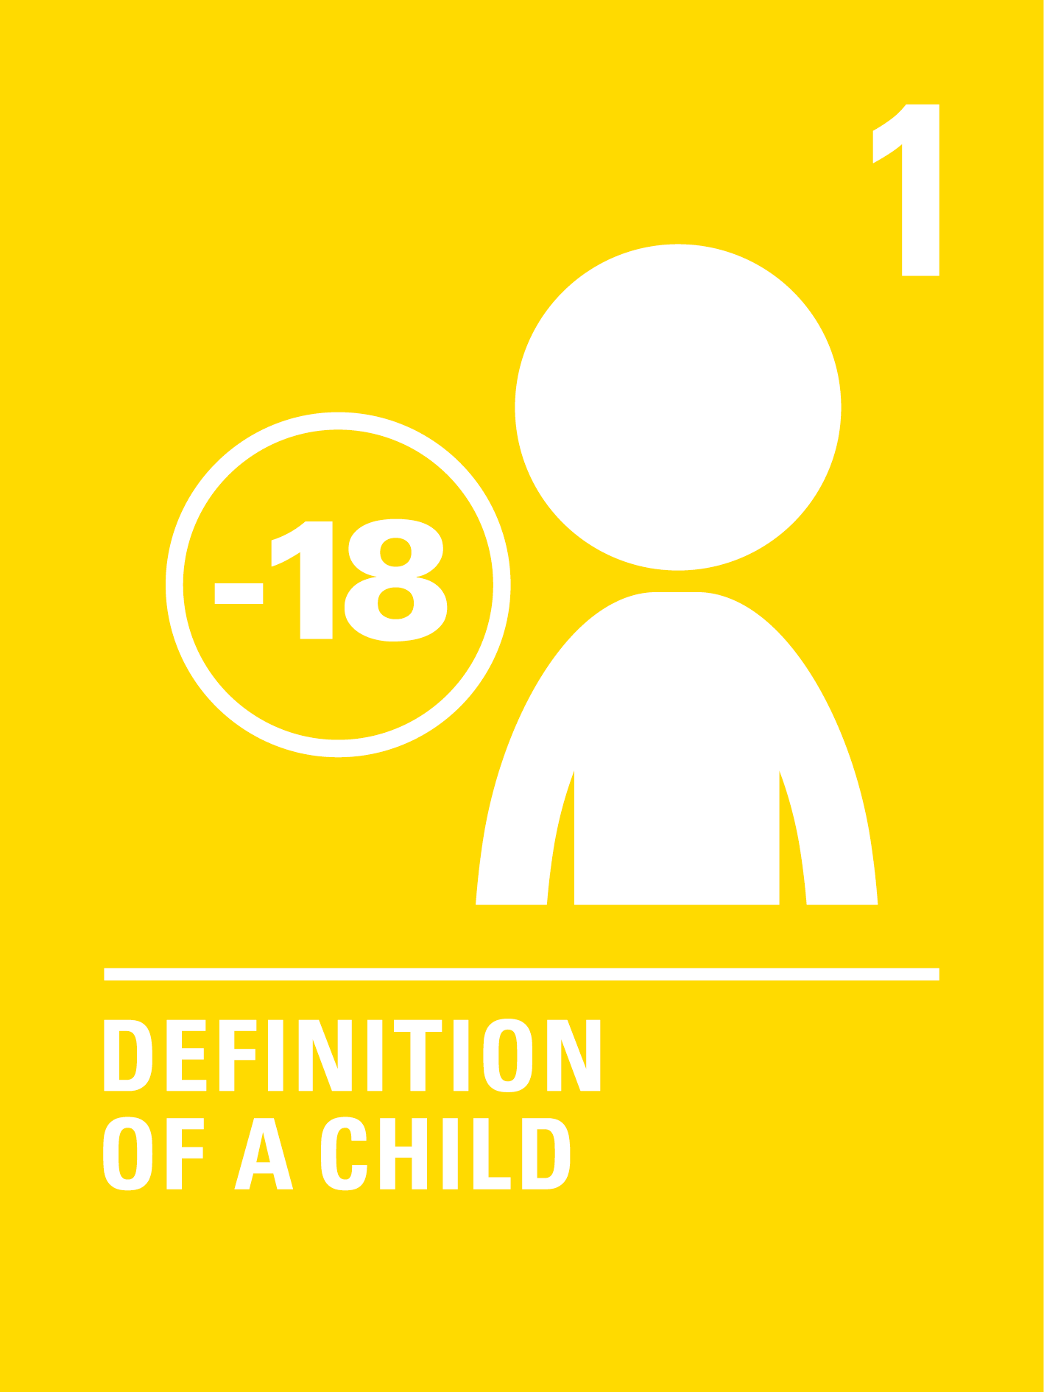
INTRODUCING ARTICLE 1 & 42
Jenny introduces Article 1 & 42
Article 1– Definition of a child
Everyone under the age of 18 has all the
rights in the Convention.
Article 42 – Everyone must know children’s rights
Governments must actively work to
make sure children and adults know
about the Convention.
Click here to watch on YouTube

Slide 5
EXPLORING ARTICLE 1 & 42
Teachers have a duty to make sure that children know about their rights and experience their rights in school. Can you list all the opportunities you have of learning about rights and experiencing them in school?

Slide 6
How many of these did you get?
In assemblies
In lessons and topic work
Rights are on displays
By learning about rights issues locally and globally
Through the school council, pupil council and rights respecting steering group
By learning to respect others’ opinions and differences
Through class charters or agreements
By listening to us
By treating us fairly
Through campaigning
Through our Eco and Fair Trade work
What others did you think of?

Slide 7
As soon as we are born, we have human rights because we are human beings. Which rights are particularly important for babies and young children and who do they depend on to help them enjoy those rights? You might like to make a poster that could be displayed in a doctor’s surgery showing key rights from the CRC for babies.
Have a look at this video from Australia that helps children to understand their rights and describes children’s rights as superpowers!
Choose a right and design a Rights Superpower Shield or Cloak for that right.
Create a poster, song or poem
to show that rights are for all children around the world. Perhaps you could display your artwork or perform your song or poem.
Create an obstacle course outside or a simple board game (like snakes and ladders) to show how things (like natural disasters, conflict and, poverty) can act as obstacles that hinder children’s access to their rights and need to be removed or overcome by positive actions.

Slide 8
Make yourself a set of cards to represent articles of the CRC than make up some games to play with the people in your home to help everyone learn about rights.
There are ideas for games and a template for the cards here.
This video ‘What are Children’s Rights’ explains what children’s rights are and where they came from. Watch the video and think about who might benefit from watching it? Could you create a workshop for parents and carers using it and some practical activities to go with it so they understand how they can promote and protect rights too.
What can YOU do in school and outside to help others access their rights?
Make a pledge and a plan for how you will help others every day, month and year - make sure it is realistic.
Small actions can be very important! What can the government do to help?
Create a quiz to share with friends and family about rights and the Convention.
Choose whether you will provide multiple choice answers or not. Don’t forget to write a list of answers too.

Slide 9
What can YOU do in school and outside to help others access their rights? Make a pledge and a plan for how you will help others every day, month and year - make sure it is realistic. Small actions can be very important! What can the government do to help?
This video ‘What are Children’s Rights’ explains what children’s rights are and where they came from. Watch the video and think about who might benefit from watching it? Could you create a workshop for parents and carers using it and some practical activities to go with it so they understand how they can promote and protect rights too.
Make yourself a set of cards to represent the articles of the CRC then make up some games to play with the people in your home to help everyone learn about rights. There are ideas for games and a template for the cards here.
The Commissioners for Children and Young People are required by law to protect and promote your rights. Find out who they are in your country and what they do. Perhaps you could plan an assembly to let others know about them and their important job.

Slide 10
Everyone has Human Rights, and everyone under 18 is considered a child or young person and has children’s rights from the CRC. In small groups think about why children need these additional rights in the CRC. Are there other groups of people who might also need additional rights and are there Conventions for them too?
Iceland has recently been ranked by the KidsRights Index as the top country where children’s rights are best guaranteed. Why do you think this might be? The Index ranks countries on how good they are at realising children’s rights taking into consideration the resources they have available to invest in children’s rights. Where do you think the UK comes? Investigate the position of some other countries. Are you surprised by any of your findings?
In 2021, Scotland was the first devolved nation to incorporate the CRC into domestic law. Read more about it here. This is one way to make sure that children and adults know about the CRC (Article 42) What does the government do in England, Wales and Northern Ireland to ensure children and adults know about the Convention? What else could governments do to make sure everyone knows about the CRC. Write a letter or create a video with your suggestions to send to your local MP.
Research a news event that is happening right now and affecting children’s rights – this can be either in your local area or globally. What barriers are stopping children and young people from accessing rights? What is their government doing (or not doing) to ensure they are able to enjoy their rights?

Slide 11
REFLECTION
Try to find somewhere peaceful and spend a few minutes being quiet and still … then think about these questions…
"Where after all do universal human rights begin? In small places close to home – so close and so small that they cannot be seen on any maps of the world … unless these rights have meaning there, they have little meaning anywhere.”
This was said by Eleanor Roosevelt, a champion for human rights. In 1948 she helped draw up the list of rights that everyone in the world should enjoy.
Spend a few moments thinking about ‘those small places’ like home, school, places of work. How can we make sure that rights are known and respected by everyone around us?
UNICEF UK/Dawe

Slide 12
MORE INFO…
RRSA WEBSITE
For more information or to download previous Article of the Week packs please visit the RRSA website by clicking the link below
CLICK HERE

