Slide 1
Notes:
Children in primary school in Dantweada, Chattisgarh, India.

Slide 2
Slide 3 – Guess the article
Slide 4 – Introducing the articles
Slide 5 – Question around the articles
Slide 6 – Some possible answers
Slides 7&8 – Primary Activities
Slides 9&10 – Secondary Activities
Slide 11 – Reflection

Slide 3
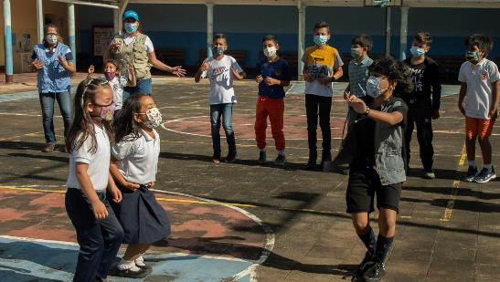
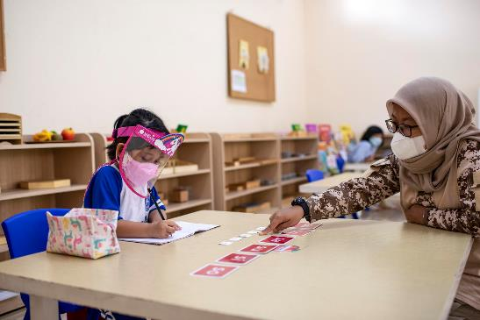
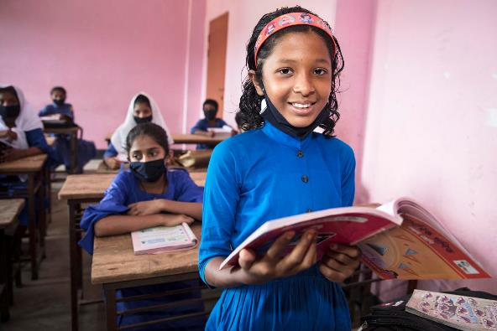
Guess the Articles
We are looking at two articles this week. These pictures should give you a clue.
How do these pictures help you? Can you guess how they are linked together?
Write down your thoughts or discuss with someone in your class.
Unicef/Pocaterra
Unicef/Wilander
Unicef/Mawa
Notes:
From left to right:
1. Children play during a visit to UNICEF staff to a UNICEF-supported school located in Táchira state, in July 2021. UNICEF/Pocaterra
2. Aurora, 5, learns to write with help from her teacher in East Jakarta, Indonesia, in September 2021. This was Aurora’s first month back at school after almost a year and a half of learning from home. UNICEF/Wilander
3. Jamiatul is very happy to be back in school following lockdown in Bangladesh. UNICEF/Mawa

Slide 4
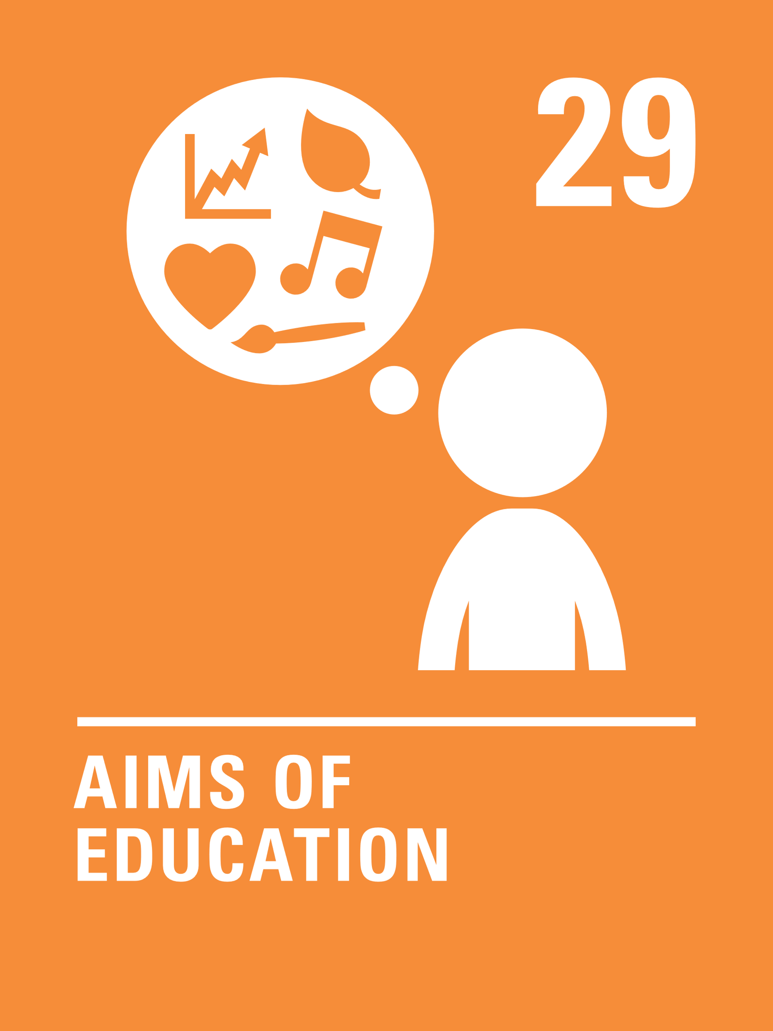
INTRODUCING ARTICLE 28 & 29
Isobel introduces Articles 28 and 29
Article 28 – The Right to Education
Every child has the right to an education. Primary education must be free and
different forms of secondary education
must be available to every child.
Article 29 – Goals of Education
Education must develop every child’s
personality, talents and abilities to the full.
Click here to watch on YouTube

Slide 5
EXPLORING ARTICLES 28 & 29
What do you think are the most important things children should learn in school?
Think about the way things have changed over the past year, does this affect your answer?

Slide 6
How many of these did you get?
Ways to develop your personality in interesting ways
Learning how to develop your talents and abilities
Resilience and independence
Learn about the world we live in
Learning about our rights
Learning about school subjects like English, Maths and Science
What other ideas did you have?
Learning how to be safe and healthy.
How to cope with change
Learning new ways to learn, like on-line learning
Learning ways to support each other through hard times
Wellbeing and mental health

Slide 7
Draw a picture of yourself completing your favourite school activity. Make a display in your classroom showing what you enjoy doing in school.
Education should develop your ‘personality, abilities and talents’. Look up these words in a dictionary and discuss as a class. Draw a silhouette of yourself and write words or draw pictures to describe your personality, your abilities and your talents. Share your work with a friend.
Watch this short Global Goals film which shows how many children and young people around the world are using their talents to make the world a better place. What are you good at? How could you use your talents to make the world a better place?
Imagine you have a magic wand which can change one thing about your school for the better. What would you use your one wish on? Discuss in class and listen to different ideas?
Lower Primary

Slide 8
Does your school encourage young people to respect: themselves, others, rights, their parents and the environment.
Rate each category out of 5, with 0 as no encouragement and 5 for lots of encouragement.
Share your results with a friend from your school or even different schools. What could your school do to improve its rating?
Article 28 says all children should get free primary education. School closures have stopped education for over 1.57 billion students globally. Watch this film of a 10-year-old girl from Chile as she returns to school. Most children in the UK are back in school but in many countries children have not yet been able to return. Why do you think this might be? List your ideas, are they the same or different to others in your class?
This is 12-year-old Cornell from the Democratic Republic of Congo in West Africa. He is talking about his life during the school closures because of the Coronavirus pandemic. How does Cornell’s experience compare to yours? What is the same and what is different?
Article 29 and Global Goal 4.7 say young people should learn about human impact on the environment, how to celebrate different cultures and live peacefully. How do you learn about these issues at your school?
Upper Primary

Slide 9
Article 29 and Global Goal 4.7 state that young people should be learning about human impact on the environment and how to celebrate different cultures and live peacefully with each other. How do you learn about these issues at your school? How could you learn more?
This is 12-year-old Cornell from the Democratic Republic of Congo in West Africa. He is talking about his life during the school closures because of the Coronavirus pandemic. How does Cornell’s experience compare to yours? What is the same and what is different?
What makes a good teacher? Watch this video – what does it tell us about the importance of the relationship between a teacher and a learner? How did you feel after watching the video? Is there something you feel you could be (or are!) really good at? Write a job description for the ‘ideal teacher of the future’.
Think about how well your school encourages young people to respect: themselves, others, human rights, their parents and the environment. Rate each category out of 5, with 0 as no encouragement and 5 for lots of encouragement. Share your results with a friend from your school or even different schools.
What could your school do to improve its rating?

Slide 10
Article 28 says children around the world should have access to free primary education. The pandemic school closures disrupted the education of more than 1.57 billion students. Watch this film about 15-year-old, Christine in Uganda. UNICEF is calling on governments around the world to prioritise children’s education. Write to a newspaper or influential person telling them why every child’s right to education is important and asking people to encourage governments around the world to prioritise education.
The pandemic has meant education has been interrupted for all children across the world. If you were the Minister of Education, what guidance would you give to headteachers to ensure all the goals of education are achieved? Think about the ways that school has changed recently, what things will you put in place to ensure all children can reach their full potential?
Watch this short film which asks many questions to get us thinking about what kind of education we all need. Choose two or three of the questions asked and write your own answers to them or discuss with your class.
Design or describe an ideal school of the future based on articles 28, 29 and Global Goal 4.7.
Imagine the world in 2040 and what the school will need to make sure all young people reach their full potential while developing their personalities, talents and abilities. Think about subjects taught and the budlings, resources and facilities needed. Be as creative as you like!
Present your ideas to your class and ask your teacher to share them with UNICEF UK.

Slide 11
REFLECTION
Give yourself some time and space to think
about this week’s articles.
Use these questions to guide your thoughts:
Why are school and learning important in your life?
What do you value or enjoy most about your education?
What could you do to show greater respect for your right to learn?
What could be done to strengthen every child’s right to an education around the world?
UNICEF UK/Dawe

Slide 12
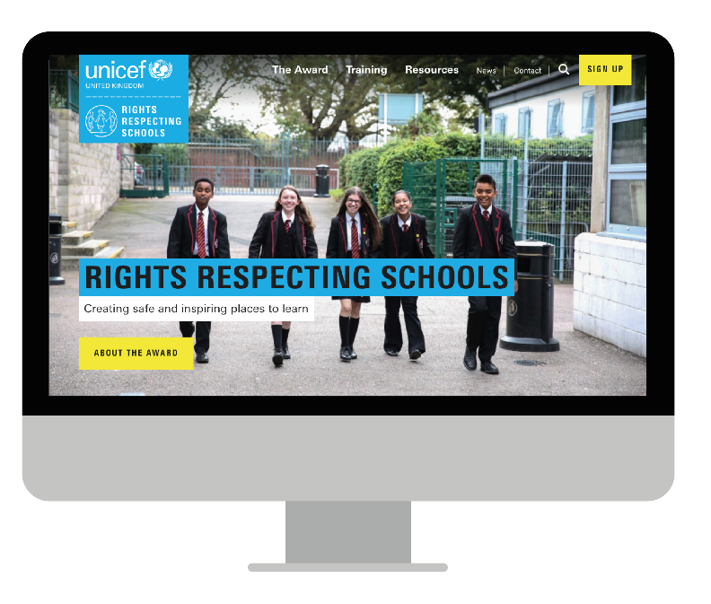
MORE INFO…
RRSA WEBSITE
For more information or to download previous Article of the Week packs please visit the RRSA website by clicking the link below
CLICK HERE

